Slide 1
Appalachian Compact 2014 LLRW Disposal Data
Tom Wolf, Governor John Quigley , Secretary

Slide 2
Appalachian Compact 2014 Disposed LLRW Volume by State and Facility Type
Facility Type/State | WV | DE | MD | PA | Total
Academic | 21.1 | 5.9 | 3.6 | 10.6 | 41.2
Government | 3.7 | 0 | 60,458.2 | 137.8 | 60,599.7
Industry | 0 | 36.7 | 174.5 | 7,970.3 | 8,181.5
Medical | 0 | 0 | 52.2 | 13.0 | 65.2
Utility | 0 | 0 | 11,645.9 | 47,908.7 | 59,554.7
Total | 24.8 | 42.7 | 72,334.3 | 56,040.4 | 128,442.2
Volume is in cubic feet. This data is for LLRW disposal at sites at Energy Solutions in Clive, Utah and Waste Control Specialists in Andrews, Texas for the calendar year 2014.

Slide 3
Appalachian Compact 2014 Disposed LLRW Volume by State and Facility Type

Slide 4
Appalachian Compact 2014 Disposed LLRW Activity by State and Facility Type
Facility Type/State | WV | DE | MD | PA | Total
Academic | 0.001 | 0.004 | 0.0001 | 0.07 | 0.07
Government | 0.001 | 0 | 1.40 | 0.22 | 1.62
Industry | 0 | 0.001 | 0.72 | 49.58 | 50.30
Medical | 0 | 0 | 0.08 | 0.07 | 0.14
Utility | 0 | 0 | 258.46 | 1,162.86 | 1,421.32
Total | 0.002 | 0.01 | 260.65 | 1,212.80 | 1,473.46
Activity is in curies. This data is for LLRW disposal at sites at Energy Solutions in Clive, Utah and Waste Control Specialists in Andrews, Texas for the calendar year 2014.

Slide 5
Appalachian Compact 2014 Disposed LLRW Activity by State and Facility Type

Slide 6
Appalachian Compact Disposed LLRW Volume from 1995 to 2014
Year | WV | DE | MD | PA | Total
1995 | 4.2 | 57.8 | 4,428.7 | 35,199.6 | 39,690.3
1996 | 34.8 | 127.2 | 3,391.1 | 24,203.1 | 27,756.2
1997 | 1.8 | 23.9 | 3,096.5 | 14,486.2 | 17,608.4
1998 | 48.0 | 173.8 | 7,604.6 | 42,686.0 | 50,512.4
1999 | 158.7 | 80.6 | 8,406.8 | 143,043.7 | 151,689.8
2000 | 53.4 | 27.6 | 9,766.8 | 421,398.1 | 431,245.9
2001 | 44.1 | 76.2 | 10,759.9 | 534,429.4 | 545,309.6
2002 | 183.3 | 366.4 | 6,752.8 | 55,371.4 | 62,673.9
2003 | 151.8 | 73.5 | 3,703.1 | 74,901.0 | 78,829.4
2004 | 34.8 | 48.8 | 13,177.8 | 55,136.0 | 68,397.4
2005 | 2.4 | 74.2 | 107,956.4 | 91,292.6 | 199,325.6
2006 | 38.0 | 59.2 | 48,131.8 | 57,627.7 | 105,856.7
2007 | 48.7 | 42.7 | 21,015.6 | 78,454.5 | 99,561.5
2008 | 132.2 | 414.8 | 6,702.5 | 113,483.2 | 120,732.7
2009 * | 134.1 | 431.2 | 21,451.3 | 103,666.9 | 125,683.5
2010 * | 11.3 | 29.4 | 22,957.6 | 76,519.4 | 99,517.7
2011 * | 19.1 | 1,061.0 | 10,568.7 | 155,508.5 | 167,157.3
2012 * | 21.0 | 75.2 | 12,364.3 | 122,380.2 | 134,840.7
2013 * | 44.8 | 339.5 | 23,597.2 | 72,066.9 | 96,048.4
2014* * | 24.8 | 42.7 | 72,334.3 | 56,040.4 | 128,442.2
Total 1995 | 1,191.2 | 3,625.6 | 418,167.8 | 2,327,894.8 | grand total
to 2014 |  |  |  |  | 2,750,879.5
Volume is in cubic feet. * 2009 to 2013 LLRW activity only includes disposal at Energy Solutions in Clive, Utah. ** 2014 activity includes disposal at Energy Solutions in Clive, Utah and Waste Control Specialists in Andrews, Texas. Years 1995 -2008 include disposal at Barnwell, South Carolina and Energy Solutions, Clive, Utah.

Slide 7
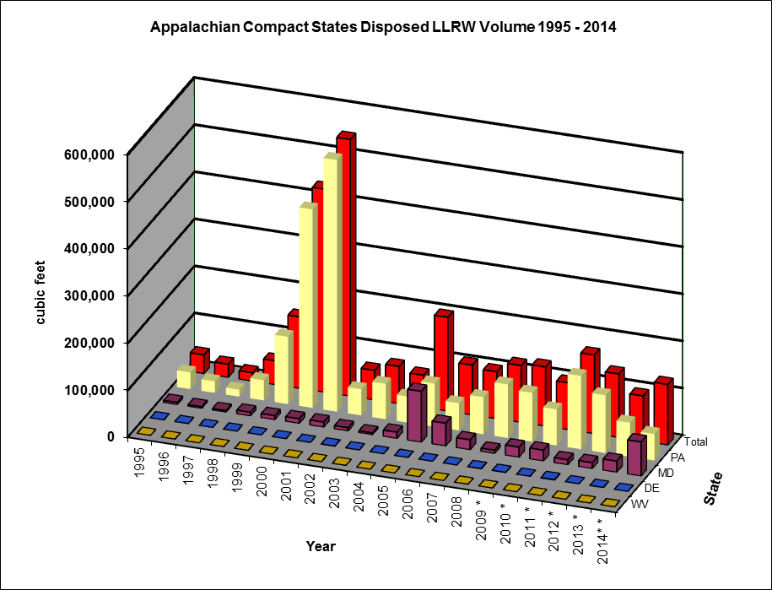
Appalachian Compact Disposed LLRW Volume from 1995 to 2014

Slide 8
Appalachian Compact Disposed LLRW Activity from 1995 to 2014
Year | WV | DE | MD | PA | Total
1995 | 4.6 | 0.01 | 346.2 | 5,691.9 | 6,042.7
1996 | 0.1 | 5.6 | 349.1 | 71,900.5 | 72,255.4
1997 | 0.03 | 1.3 | 198.5 | 8,017.9 | 8,217.7
1998 | 37.3 | 0.1 | 531.5 | 43,691.0 | 44,259.9
1999 | 0.5 | 0.1 | 1,335.7 | 86,618.0 | 87,954.3
2000 | 2.2 | 0.02 | 484.0 | 357,624.4 | 358,110.7
2001 | 0.03 | 0.03 | 903.3 | 168,919.6 | 169,822.9
2002 | 0.1 | 0.5 | 244.5 | 6,777.4 | 7,022.5
2003 | 0.2 | 24.7 | 166.3 | 241,649.8 | 241,840.9
2004 | 0.8 | 0.2 | 11,830.7 | 18,890.3 | 30,722.0
2005 | 0.7 | 31.3 | 156.8 | 58,786.2 | 58,974.9
2006 | 0.03 | 11.9 | 60.1 | 91,719.1 | 91,791.1
2007 | 0.2 | 12.9 | 25,304.7 | 492,579.3 | 517,897.0
2008 | 0.1 | 12.2 | 2,181.5 | 283,328.8 | 285,522.6
2009 * | 0.02 | 0.5 | 4.7 | 1,001.4 | 1,006.6
2010 * | 0.01 | 0.03 | 1.4 | 656.8 | 658.2
2011 * | 0.02 | 1.0 | 1.8 | 492.6 | 495.5
2012 * | 0.003 | 0.01 | 2.1 | 449.3 | 451.4
2013 * | 0.01 | 45.3 | 15.7 | 458.5 | 519.5
2014 ** | 0.002 | 0.01 | 260.7 | 1,212.8 | 1,473.5
Total 1995 | 47.0 | 147.7 | 44379.3 | 1940465.6 | grand total
to 2014 |  |  |  |  | 1,985,039.3
Activity is in curies. * 2009 to 2013 LLRW activity only includes disposal at Energy Solutions in Clive, Utah. ** 2014 activity includes disposal at Energy Solutions in Clive, Utah and Waste Control Specialists in Andrews, Texas. Years 1995 -2008 include disposal at Barnwell, South Carolina and Energy Solutions, Clive, Utah.

Slide 9
Appalachian Compact Disposed LLRW Activity from 1995 to 2014

Slide 10
Appalachian Compact 2014 Percent Disposed LLRW Volume and Activity by Disposal Site

