Slide 1
Status of Low-Level Radioactive
Waste (LLRW) Compacts and Update
on Commercial LLRW Disposal
Facilities
Low-Level Waste Advisory Committee Meeting
October 10, 2017
Tom Wolf, Governor Patrick McDonnell, Secretary

Slide 2
Background - Federal Legislation
States Responsible
Compacts Encouraged
Exclusion of Out-of-Compact Waste
Federal
Low-Level
Radioactive Waste
Policy Act

Slide 3
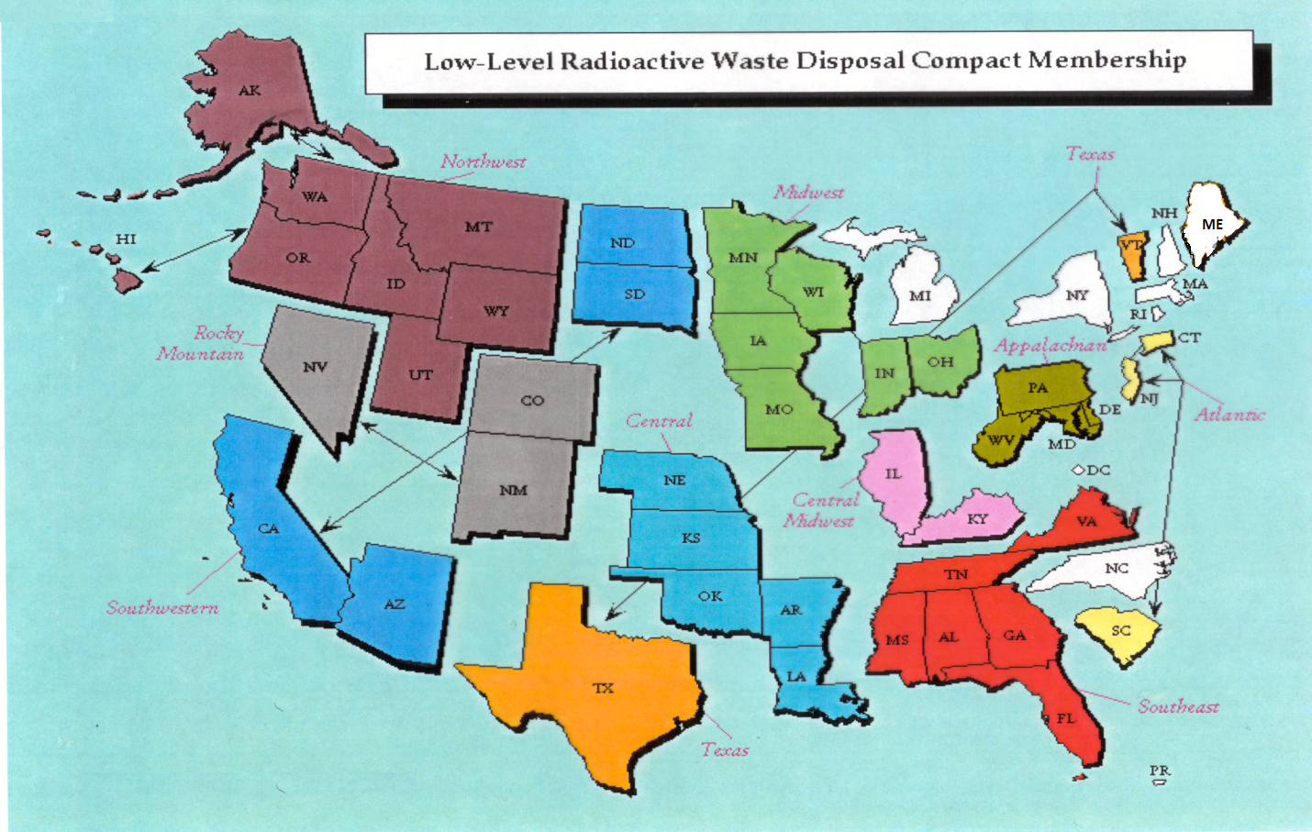
Status of LLRW Compacts

Slide 4
Status of Commercial LLRW Disposal Facilities
Barnwell Disposal Facility in South Carolina (Regional Facility)
Accepts Class A, B and C wastes from the Atlantic Compact (CT, NJ, SC)
Closed to generators outside the Atlantic Compact as of July 1, 2008
Current projected closure date is 2038
Richland Facility in Washington (Regional Facility)
Accepts Class A, B and C wastes from the Northwest and Rocky Mountain Compacts (11 states in 2 compacts)
Current projected closure date is 2056
EnergySolutions Facility in Utah (not a Regional Facility)
Accepts Class A waste from the entire nation except the Northwest and Rocky Mountain Compacts
Provides for disposal of bulk waste, containerized waste, large components, and mixed waste
Transports large components such as steam generators for disposal

Slide 5
Status of Commercial LLRW Disposal Facilities
EnergySolutions (Cont.)
Regulatory review for disposal of large quantities of depleted
uranium (DU) underway
Utah granted license variance for disposal of sealed sources
Received and managed 41,192 sealed sources between 2013
and 2016 under the CRCPD Source Collection and Threat
Reduction (SCATR) Program
Approval for disposal of Class A sealed sources has been
requested and is part of the permanent license amendment
Current projected closure date is 2050

Slide 6
Status of Commercial LLRW Disposal Facilities
WCS Disposal Facility in Texas (Regional Facility)
Two facilities: one license
Compact facility (initially licensed for 2.3 Mft³ and 3.9 MCi)
Federal facility for DOE waste (26 Mft³ and 5.6 MCi)
Accepts commercial LLRW (Class A, B and C) and federal LLRW and mixed waste
Annual limit on radioactivity of out-of-compact waste is 275,000 Ci
No annual limit on volume of out-of-compact waste
Volume expansion from 2.3 Mft³ to 9 Mft³ granted by the Texas Commission on Environmental Quality (TCEQ)
Disposal of Depleted Uranium (DU) and Greater-Than-Class C (GTCC) waste is being considered
Current projected closure date is 2045

Slide 7
Recent Developments
U.S. District Court prohibits proposed acquisition of Waste Control Specialists by EnergySolutions
NRC released a rulemaking plan on financial assurance for disposition of Category 1 and 2 byproduct material radioactive sealed sources (SECY-16-0115)
Commission issued the 10 CFR Part 61 Staff Requirements Memorandum (SECY-16-016)

Slide 8
Thank you. Questions?
Rich Janati
Chief, Division of Nuclear Safety
Administrator, Appalachian Compact Comm.
Phone: 717-787-2163
rjanati@pa.gov

