Slide 1
Status of Commercial Low-Level Radioactive Waste Disposal Facilities
Low-Level Waste Advisory Committee Meeting
October 4, 2019
Tom Wolf, Governor Patrick McDonnell, Secretary

Slide 2
Background - Federal Legislation
States Responsible
Compacts Encouraged
Exclusion of Out-of-Compact Waste
Federal
Low-Level
Radioactive Waste
Policy Act

Slide 3
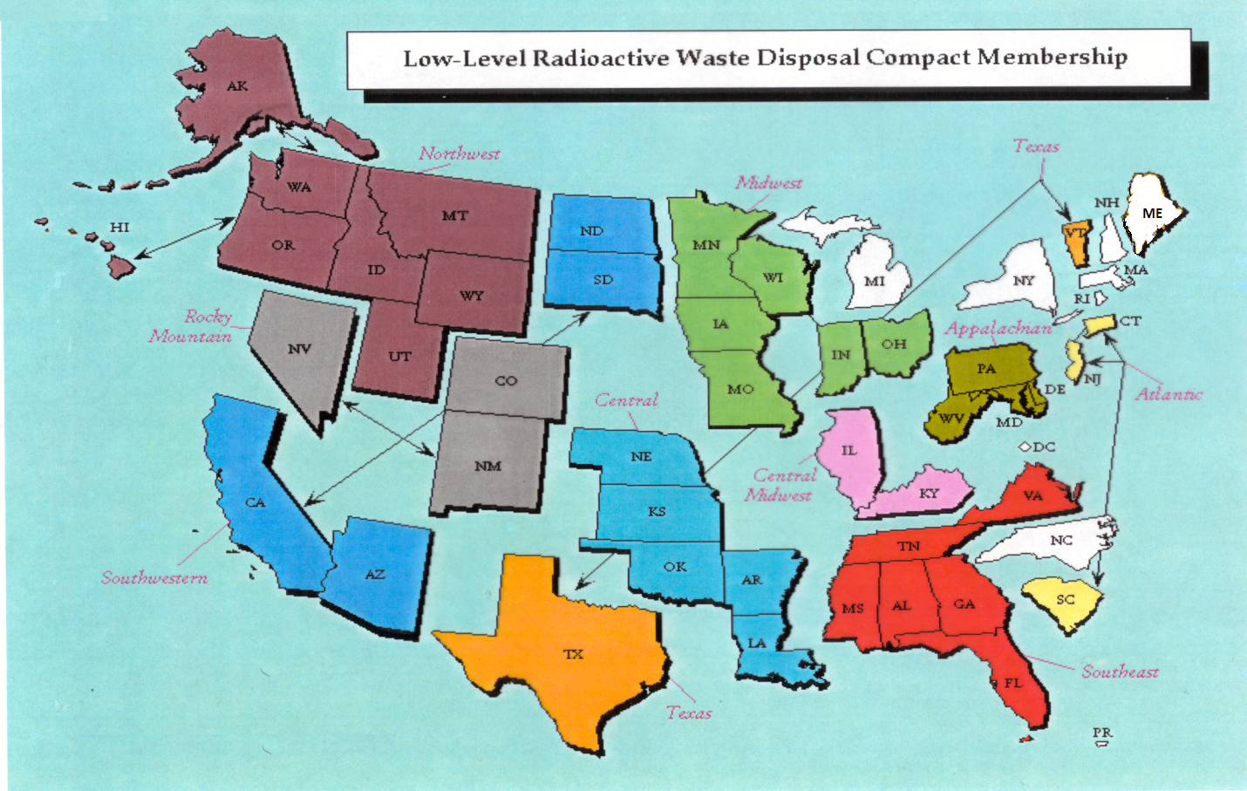
Status of LLRW Compacts

Slide 4
Status of Commercial LLRW Disposal Facilities
Barnwell Disposal Facility in South Carolina (Regional Facility)
Accepts Class A, B and C wastes from the Atlantic Compact (CT, NJ, SC)
Closed to generators outside the Atlantic Compact as of July 1, 2008
Richland Facility in Washington (Regional Facility)
Accepts Class A, B and C wastes from the Northwest and Rocky Mountain Compacts (11 states in 2 compacts)
EnergySolutions Facility in Utah (not a Regional Facility)
Accepts Class A waste (soil, resin, filters, operational waste, large components) from the entire nation except the Northwest and Rocky Mountain Compacts
Processes radioactive liquids
Provides for disposal of bulk waste, containerized waste, large components, and mixed waste
Transports large components for disposal

Slide 5
Status of Commercial LLRW Disposal Facilities
EnergySolutions (Cont.)
May not receive or dispose of significant quantities of DU (one metric ton) until Utah approves DU performance assessment
Approval for disposal of Class A sealed sources has been requested and is part of the permanent license amendment
In May 2019, Utah legislature enacted House Bill 220 (HB-220) re disposal of radioactive waste in Utah

Slide 6
Status of Commercial LLRW Disposal Facilities
WCS Disposal Facility in Texas (Regional Facility)
Accepts commercial LLRW (Class A, B and C) and federal LLRW and mixed waste
Annual limit on radioactivity of out-of-compact waste is 275,000 Ci
No annual limit on volume of out-of-compact waste
Disposal of Depleted Uranium (DU) and Greater-Than-Class C (GTCC)
waste is being considered
Texas legislature introduced proposed Bills HB-2269 and SB-1021 relating to operations of the facility and SB-1753 relating to regulation of radioactive waste

Slide 7
Recent National Developments
Interpretation of Definition of High-Level Radioactive Waste
Very Low-Level Waste (VLLW) Scoping Study
Status of 10 CFR Part 61 Rulemaking
Greater-Than-Class C (GTCC) Waste Regulatory Basis

Slide 8
Questions?
Rich Janati, M.S.
Chief, Division of Nuclear Safety
Administrator, Appalachian Compact Commission
Phone: 717-787-2163
rjanati@pa.gov

