Slide 1
ESTABLISHMENT OF A CORRECTION FACTOR FOR MONITORING THE EXTREMITIES OF INTERVENTIONAL FLUOROSCOPISTS Karen Colucci, Steve King, Mike Sheetz, Joe Och

Slide 2
REGULATIONS
The NRC and DEP have established occupational dose limits for the extremities, specifically a shallow-dose equivalent of 50 rem (500 mSv) to the skin of any extremity.
Furthermore it is required to monitor occupational exposure to radiation from radiation sources and to supply and require the use of individual monitoring devices by adults likely to receive, in 1 year from sources external to the body, a dose in excess of 10 percent of the limits, (50 mSv in the case of the extremities).

Slide 3
INFECTION CONTROL
Wearing dosimetry devices can be a source of infection.

Slide 4
The Association of Operating Room Nurses, (AORN),
recommends that personnel remove jewelry
if working in the operating room setting.

Slide 5
The World Health Organization consensus recommendation is to strongly discourage
the wearing of rings during health care.

Slide 6
Pennsylvania’s Institute for Health Care Improvement mandates the removal of rings, bracelets, and watches before beginning surgical hand scrubbing.

Slide 7
yearly mortality in excess of
100,000 due to hospital- acquired infections

Slide 8
NCRP
NCRP 168 makes clear recommendations for the use of personnel dosimetry and urges monitoring the dose to the eye, the only language pertaining to extremity monitoring is that it is “recommended if high hand exposure is expected.”
This document makes 31 recommendations regarding interventional fluoroscopy, 4 pertaining to dosimetry, but none focusing on wearing extremity monitors.

Slide 9
CONVERSION FACTOR
Use of a conversion factor for estimating dose
is not uncommon in interventional Fluoroscopy.
The Webster calculation is widely accepted
for use in determining dose to the body,
and lens dose values are often calculated
from other readings.

Slide 10
Several papers have been published regarding the
development of a conversion factor for fluoroscopy.
In 2010, Miller et al used historical data to establish
a conversion value of 2.8.
In 2011, Martin et al found a range of values from 0.8 to 3.4,
with a mean of 2.1.
Also in 2011, Schueler et al, using phantom
scatter measurements found a range of 1.3 to 2.7,
with a mean of 1.7.

Slide 11
OUR DATA
.
TABLE 1: Extremity/collar Conversion Factors
based on review of historic dosimetry data
Facility | Range | mean
GEISINGER | 1.4 – 2.9 | 1.8
UPMC | 2.5 | 2.5
HERSHEY | 1.9-2.0 | 2.0
LEHIGH | 1.9-2.1 | 2.0

Slide 12
These were supplemented with direct measurements.

Slide 13
Methods
A number of interventional fluoroscopy procedures were observed in order to familiarize ourselves with the processes involved
Observations included fluoroscopist positions, c-arm positions, fluoroscopy settings, shield placement, etc

Slide 14
Observations
PA-DEP inspectors visited catheterization lab for observations
Detailed notes taken:
Physician location in relation to patient and table
Physician’s hands in relation to the patient and table
Fluoroscopy machine details (technique, FOV, SID, time, crane angles, etc)
Shielding use and location

Slide 15
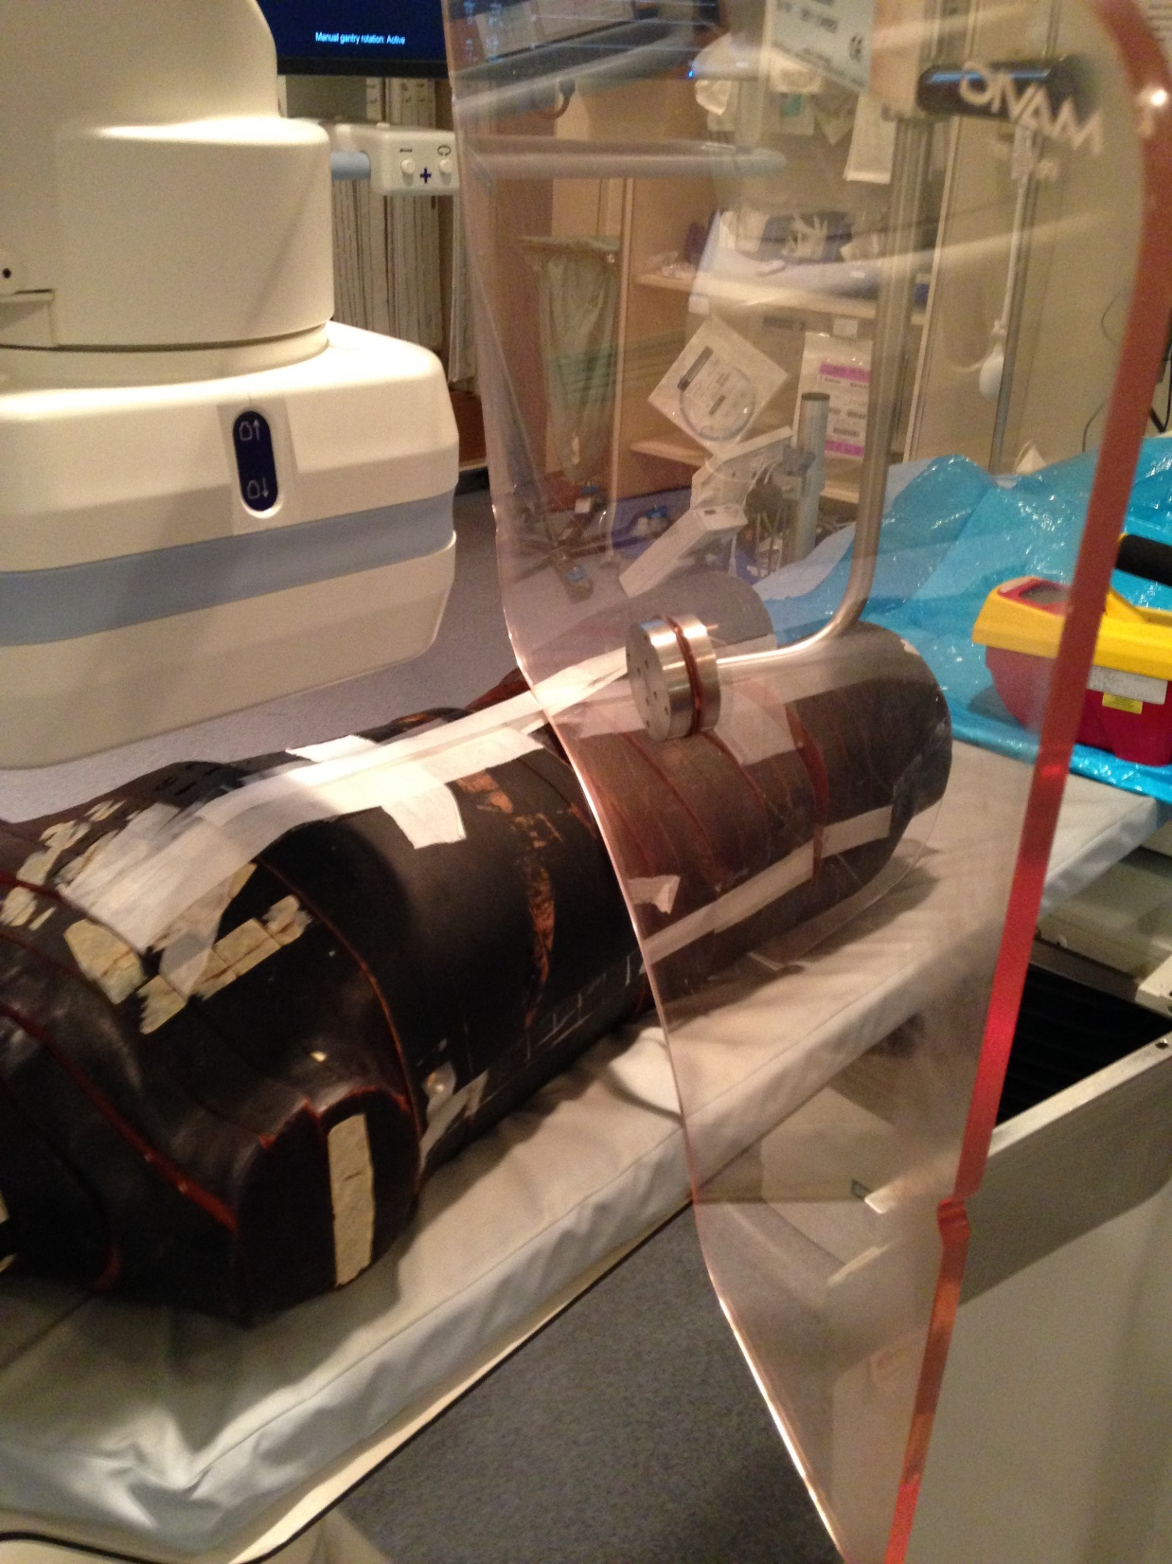

Slide 16
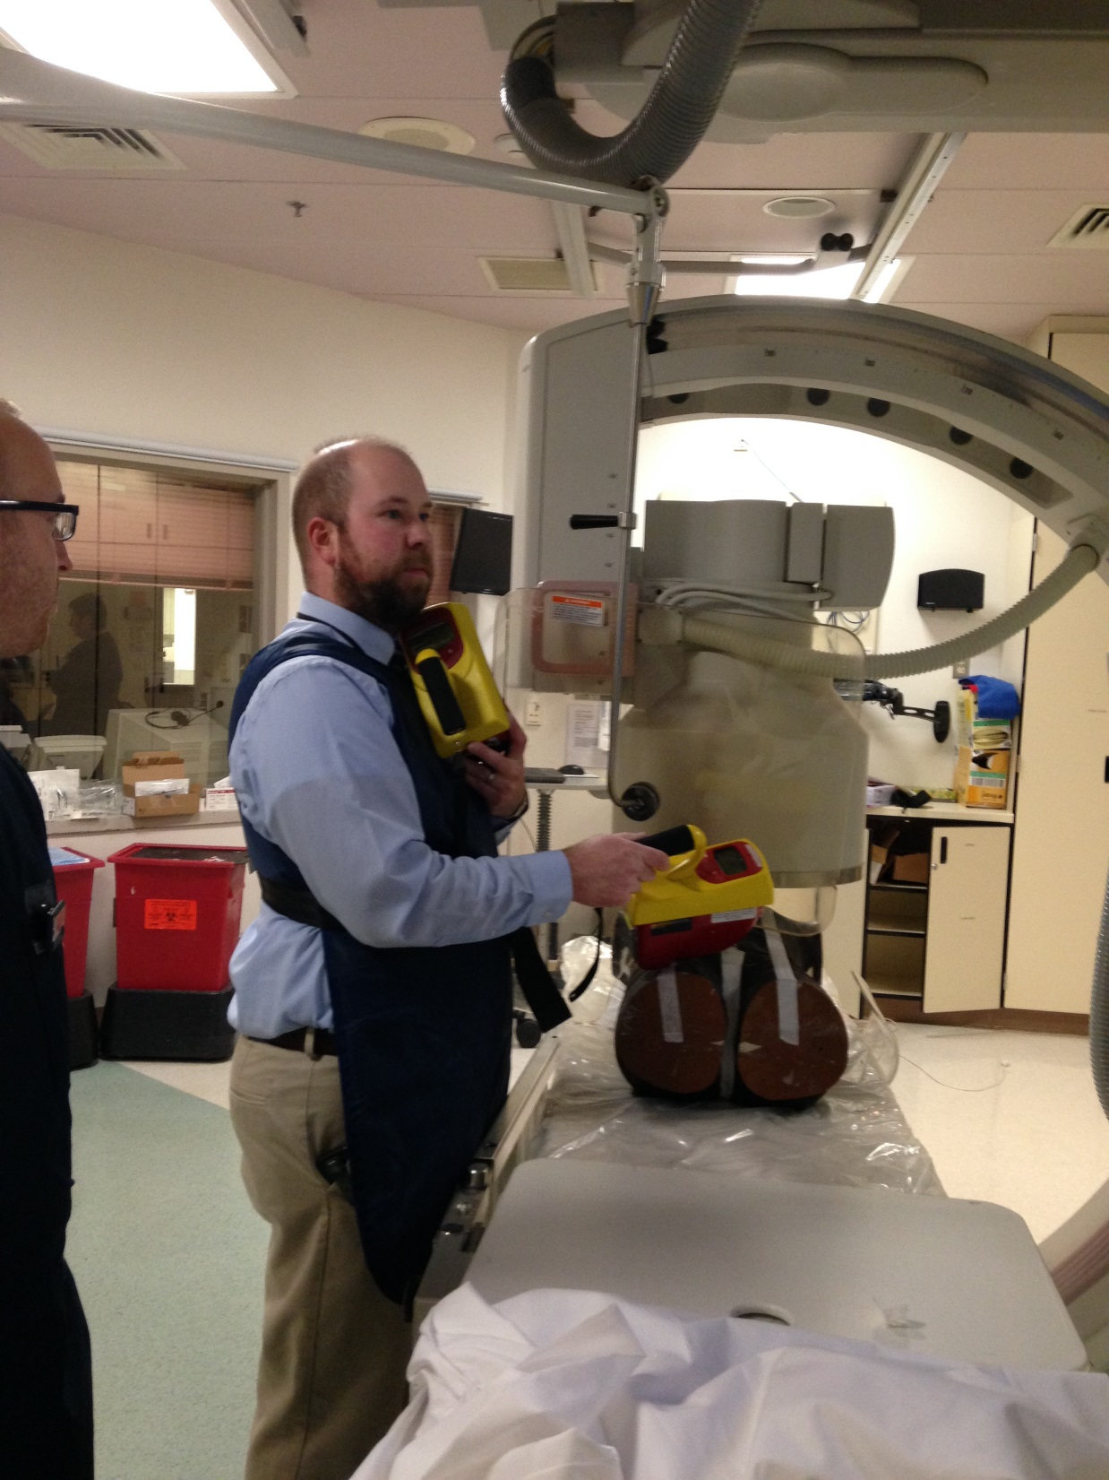

Slide 17
RESULTS
TABLE 2: Extremity/collar Conversion Factors
based on phantom measurement
Facility | Range | mean
GHS | 1.0 – 3.5 | 2.3

Slide 18
CONCLUSION
Based on the above findings,
a conversion factor of 2.5 is indicated.
We request that the PA DEP accept a conversion factor
of 2.5 for estimating the dose to the hands
when ring badges cannot or will not be used
for individuals performing interventional
fluoroscopic procedures

