Slide 1
Orphan Well Grant Program (OWPG)
Information / Training
August 2024
Josh Shapiro, Governor
Jessica Shirley, Acting Secretary

Slide 2
Orphan Well Plugging Grant
Title 1V Non-Discrimination Notice
Federal and State law prohibit discrimination on the basis of age, color, creed, mental and/or physical disability, gender identity, national origin, pregnancy, race, religion, sex, or sexual orientation. If you believe you have been discriminated against in any program, activity or facility as described above, or if you desire further information, please contact DEP’s Non-Discrimination Coordinator at ra-epnondiscrim@pa.gov.
For more information, please visit DEP’s web page on Non-Discrimination

Slide 3
Orphan Well Plugging Grant
Infrastructure Investment and Jobs Act (IIJA)
Acts 96/136 (Orphan Well Plugging Grant)
Chapter 28 of the Oil & Gas Act (58 PA.C.S. §§ 2801 et. seq.)

Slide 4
Orphan Well Plugging Grant
Optional Checklist
Pre-application
Pre-plugging
Plugging
Post-plugging

Slide 5
Pre-application
Eligible Well
Abandoned_Orphan_Web - Report Viewer (pa.gov)
Exclude IIJA Wells
PA Oil and Gas Mapping
Well Type (select all), Well Status (DEP Orphan)

Slide 6
Pre-application
Eligible Applicant
Qualified Well Plugger
Oil and Gas Compliance - Report Extracts (pa.gov)
Obtain UEI Number
Go to SAM.gov to register

Slide 7
Pre-application
Well Plugging and Restoration Agreement
Landowner Consent Form
Visit Well
Confirm location (take photo)
Methane screening (required)
Check for soil contamination

Slide 8
Conditional Application Approval
Complete Grant Application
15 days for approval/denial
letter 3 days after
Conditional per EID requirements
Submit Environmental Information Documentation (EID) for ESA/NHPA Clearances

Slide 9
Conditonal Application Approval
DOI Terms and Conditions
Environmental Information Documentation
Project Scope and Description
ESA Clearances
NHPA Clearances
Package must be approved by DOI before NTP Issued

Slide 10
Application Approval
Grant Agreement
45 days awardee to sign
DEP sign (executed)
Notice to Proceed (NTP) issued

Slide 11
Pre-plugging
Methane Measurement
Methane Measurement Service Provider form
Submitted pre-measurement
Methane Measurement Report form
All readings, submitted at end of project
SAP Vendor #

Slide 12
Pre-plugging
Notice of Intent to Plug (NOI)
Submit to Oil and Gas Inspector
District office
Copy ra-eporphangrant@pa.gov

Slide 13
Plugging
Daily Log of Activities
Submitted Weekly
Daily Electronic Briefing
Brief e-mail, submitted daily

Slide 14
Plugging
Davis Bacon Act Compliance
Wage Determinations
Sent to grantee with grant agreement
Weekly Certified Payroll
Submitted weekly to ra-eporphangrant@pa.gov

Slide 15
Plugging
Tech Specs
Expectations
Oversight

Slide 16
Post-Plugging
Certificate of Well Plugging
Methane Measurement Report
Orphan Well Completion Worksheet
Itemized Expenses for Reimbursement form

Slide 17
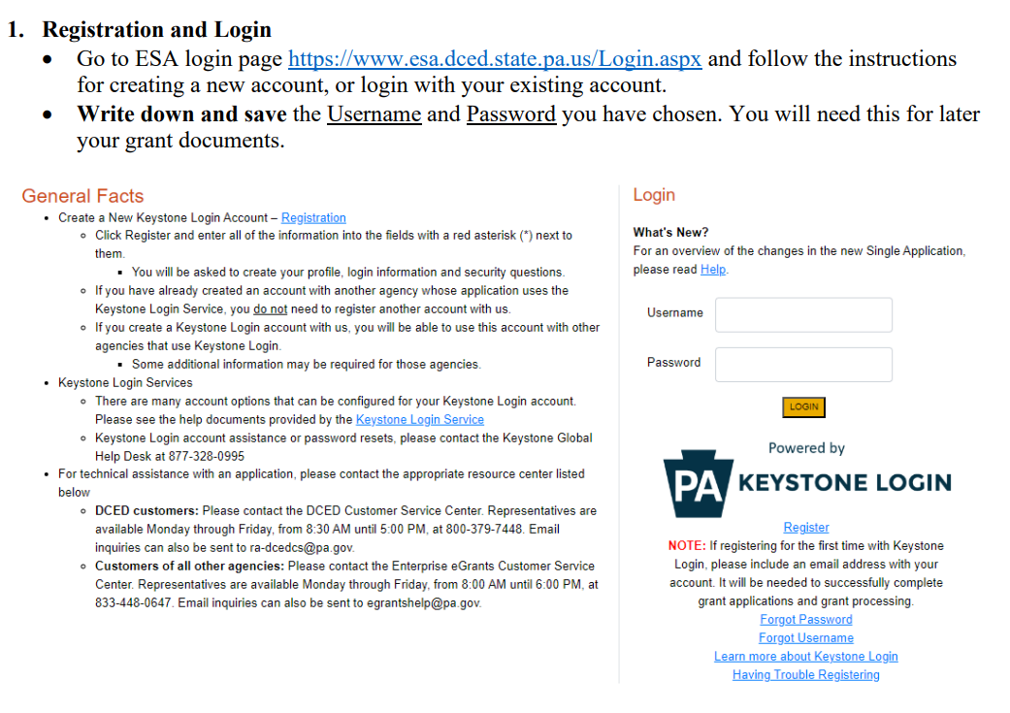
Application

Slide 18
Application

Slide 19
Application

Slide 20
Application

Slide 21
Application

Slide 22
Application

Slide 23
Application

Slide 24
Application

Slide 25
Application

Slide 26
Application

Slide 27
Application

Slide 28
Application

Slide 29
Application

Slide 30
Application

Slide 31
Application

Slide 32
Application

Slide 33
Application

Slide 34
Application

Slide 35
Application

Slide 36
Environmental Considerations
Chapter 102 Requirements (earth disturbance)
< 5 acres total earth disturbance = E&S Plan
Minimize disturbance, use BMPs, seed and mulch
Site remediation: achieve ≥ 70% perennial vegetative cover

Slide 37
Environmental Considerations
Chapter 105 Requirements (water obstructions and encroachments to streams, wetlands, etc.)
Permitting (typically GP-8, sometimes Environmental Assessment for waived activities)
Avoid and minimize, steel plates over culverts, temporary bridges, fiberglass or wood timber matting to reduce soil compaction

Slide 38
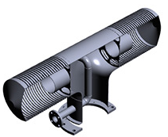
Environmental Considerations
Example intake screen
Image credit: Federal Screen Products, Inc.
Water Withdrawals
Prevent impingement & entrainment
Prevent spread of aquatic invasive species
Resources: PFBC and StopAquaticHitchHikers.Org
Backflow preventer + Clean, Drain, Dry and/or Disinfect
Through-screen velocity ≤ $\frac{1}{2}$ft/sec
Mesh size ≤ $\frac{3}{16}in.$ (floating) ≤ $\frac{1}{10} in.$ (submerged)
Recommend place inside coarse “trash rack” for debris
Clear leaves and debris regularly
Flex Hose
Pumping
Pump Off
Intake side
Pump/Tank side
Ball check valve example (one-way flow)
Image credit: Tameson.com

Slide 39
Environmental Considerations
Control and disposal
Fluids: brine, chemicals, drilling mud, water
Reuse water when possible
Contaminated soils - dispose at a certified facility
Trash, well remnants, tanks, pipes, etc.
Recycle when possible
Historic properties – DEP will consult PHMC

Slide 40
Environmental Considerations
PNDI Conservation Explorer Tool
Federal law: Endangered Species Act (ESA)
PA Law: Wild Resource Conservation Act, Fish & Boat Code, Game & Wildlife Code
Resource agencies: USFWS, PFBC, PGC, DCNR
Free account, submit projects free, $40 fee for final receipt

Slide 41
Environmental Considerations
PA-SHARE Tool
Federal law: Section 106 of National Historic Preservation Act (NHPA)
PA Law: State History Code
Resource agencies: PHMC's SHPO Office (state), ACHP (federal)
Free account, submit projects free, receive receipt
Notes:
Pennsylvania Historic and Museum Commission – State Historic Preservation Office (SHPO) or "The SHPO" as in "Officer" = the Executive Director of PHMC
ACHP = Advisory Council on Historic Preservation
Other consulting parties may include:
Tribal Historic Preservation Officers of federally recognized Indian Tribes (18 with historic presence in Pennsylvania), local historical societies, and other organizations with interests in cultural resource preservation.

Slide 42
Additional Opportunities
IIJA Plugging Contracts
Invitation to Bid (Low bid)
Request for Proposal (Technically Qualified Well Plugging Contractor)
Methane Emissions Reduction Program (MERP)

Slide 43
Additional Opportunities
Methane Emissions Reduction Program (MERP)
Marginal Conventional Well (MCW)
$420,000 for any single applicant within each application period
$20,000 for each eligible well <or= 3,000 feet
$35,000 for each eligible well > than 3,000 feet
Applicants: Operator of wells, Qualified Well Plugger, Third Party
MERP Small Operator Assistance: Operator of 10 or less wells
MERP General Assistance: Operator of 11 or more wells

Slide 44
Joe Gaboff jgaboff@pa.gov Any further questions can be sent to ra-epoilandgas@pa.gov

