Slide 1
Status of Commercial Low-Level Radioactive Waste Disposal Facilities
and Recent Developments
Low-Level Waste Advisory Committee Meeting
September 28, 2018
Tom Wolf, Governor Patrick McDonnell, Secretary

Slide 2
Background - Federal Legislation
States Responsible
Compacts Encouraged
Exclusion of Out-of-Compact Waste
Federal
Low-Level
Radioactive Waste
Policy Act

Slide 3
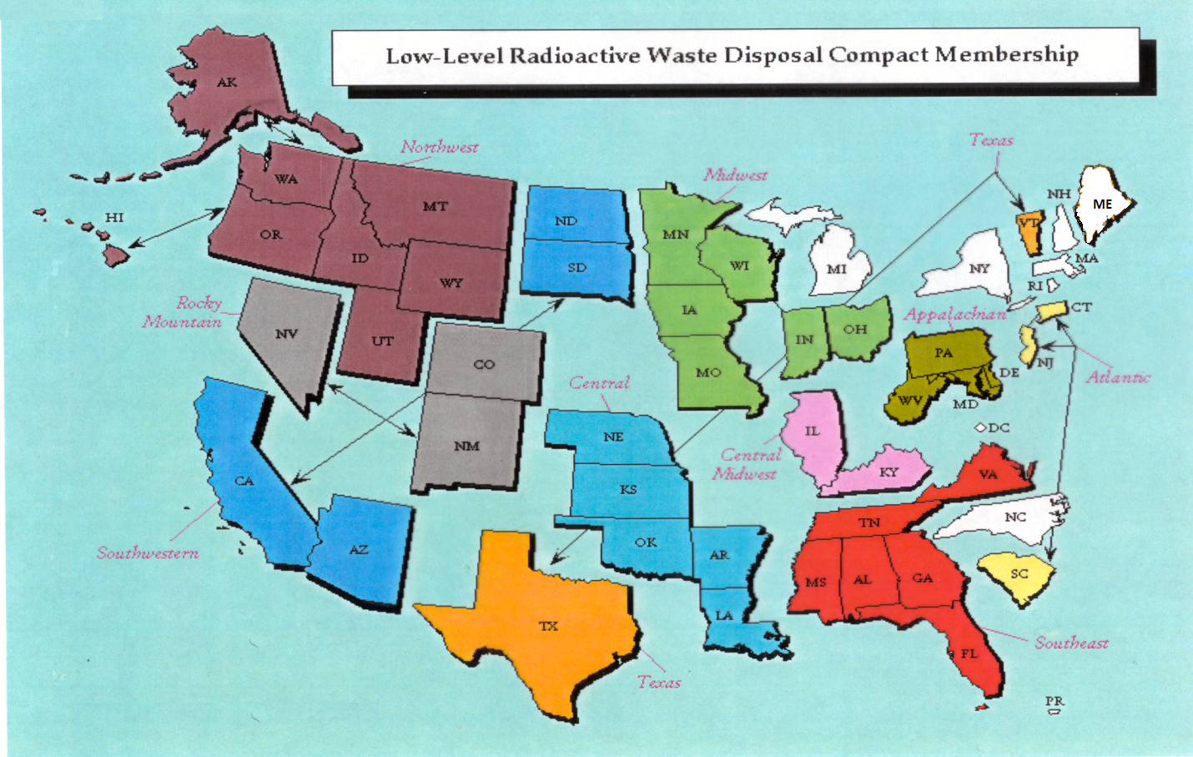
Status of LLRW Compacts

Slide 4
Status of Commercial LLRW Disposal Facilities
Barnwell Disposal Facility in South Carolina (Regional Facility)
Accepts Class A, B and C wastes from the Atlantic Compact (CT, NJ, SC)
Closed to generators outside the Atlantic Compact as of July 1, 2008
Current projected closure date is 2038
Richland Facility in Washington (Regional Facility)
Accepts Class A, B and C wastes from the Northwest and Rocky Mountain Compacts (11 states in 2 compacts)
Current projected closure date is 2056
EnergySolutions Facility in Utah (not a Regional Facility)
Accepts Class A waste from the entire nation except the Northwest and Rocky Mountain Compacts
Provides for disposal of bulk waste, containerized waste, large components, and mixed waste
Transports large components such as steam generators for disposal

Slide 5
Status of Commercial LLRW Disposal Facilities
EnergySolutions (Cont.)
Regulatory review for disposal of large quantities of depleted
uranium (DU) underway
May not receive or dispose of significant quantities of DU until Utah approves DU performance assessment
Approval for disposal of Class A sealed sources has been requested and is part of the permanent license amendment
Current projected closure date is 2050

Slide 6
Status of Commercial LLRW Disposal Facilities
WCS Disposal Facility in Texas (Regional Facility)
Two facilities: one license
Compact facility (9 Mft³ and 3.9 MCi)
Federal facility for DOE waste (26 Mft³ and 5.6 MCi)
Accepts commercial LLRW (Class A, B and C) and federal LLRW and mixed waste
Annual limit on radioactivity of out-of-compact waste is 275,000 Ci
No annual limit on volume of out-of-compact waste
Texas legislation reducing state fees on disposal became effective in
June 2017 and additional disposal rate changes are expected
Disposal of Depleted Uranium (DU) and Greater-Than-Class C (GTCC)
waste is being considered
Current projected closure date is 2045

Slide 7
Recent Developments
J.F. Lehman & Company Acquires WCS
NRC Issues Federal Register Notice re GTCC Waste Disposal Regulatory Basis Development
NRC Issues Federal Register Notice re Very Low-Level Waste (VLLW) Scoping Study
NRC Publishes Revised 10 CFR Part 61 Rule and Guidance

Slide 8
Questions?
Questions?
Rich Janati, M.S.
Chief, Division of Nuclear Safety
Administrator, Appalachian Compact Commission
Phone: 717.787.2163
rjanati@pa.gov

