Slide 1
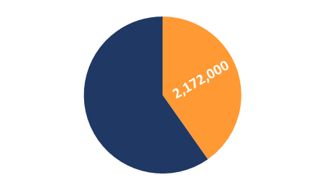
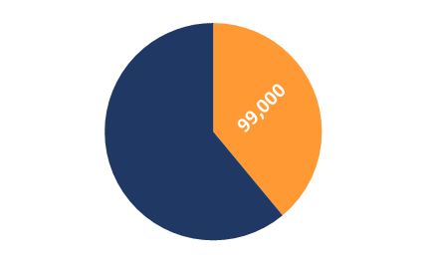
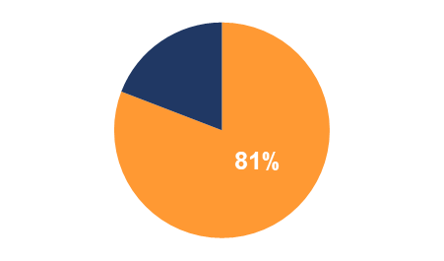
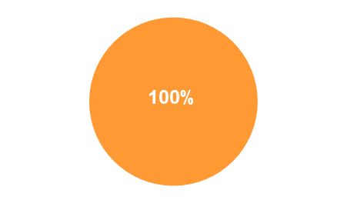
PHASE 3 WIP COUNTY SNAPSHOTS
www.dep.pa.gov
Countywide Action Plan Snapshot
Lebanon County, Pennsylvania
Current Conditions
Lebanon County is one of 34 counties in Pennsylvania's Chesapeake Bay Watershed that have developed Countywide Action Plans. Current loading rates are 5.4M lbs of nitrogen and 255K lbs of phosphorus annually. By 2025 Lebanon County needs to reduce 2.17M lbs of nitrogen and 99K lbs of phosphorus.
Nitrogen (N)
Current Load (lbs):
5,395,000
Phosphorus (P)
Current Load (lbs):
255,000
Planning
Target (lbs)
Reduction
Goal (lbs)
Planning Target (lbs): 3,223,000
Reduction Goal (lbs): 2,172,000
Planning Target (lbs): 155,000
Reduction Goal (lbs): 99,000
Pollutant Reduction Progress
By 2025, Lebanon County needs to reduce 2.17M lbs of nitrogen and 99K lbs of phosphorus. Lebanon County has developed a plan to reduce 1.76M lbs of nitrogen, which is 81% of the goal and 107K lbs of phosphorus, which is over 100% of the goal.
Nitrogen (N)
Reduction Goal (lbs):
2,172,000
Phosphorus (P)
Reduction Goal (lbs):
99,000
Remaining
Reduction
Nutrient
Reduction
Progress
Reduction Progress: 1,756,000 lbs
Reduction Progress: 107,000 lbs
Sector Reductions
Lebanon County has identified reductions within four sectors within their planning template: agriculture, developed, natural and wastewater. Projected land use changes and population changes results in increases within the septic sector. Lebanon County has identified practices that result in total reductions of 1.76M lbs of nitrogen and 107K lbs of phosphorus.
Sector | Nitrogen (lbs.) | Phosphorus (lbs.)
Agriculture | -1,679,000 | -90,000
Developed | -7,000 | -200
Natural | -23,000 | -15,000
Septic | +2,000 | -
Wastewater | -50,000 | -2,000
Total Reductions | -1,756,000 | -107,000
Data is from CAST19 and progress year 2019

Slide 2
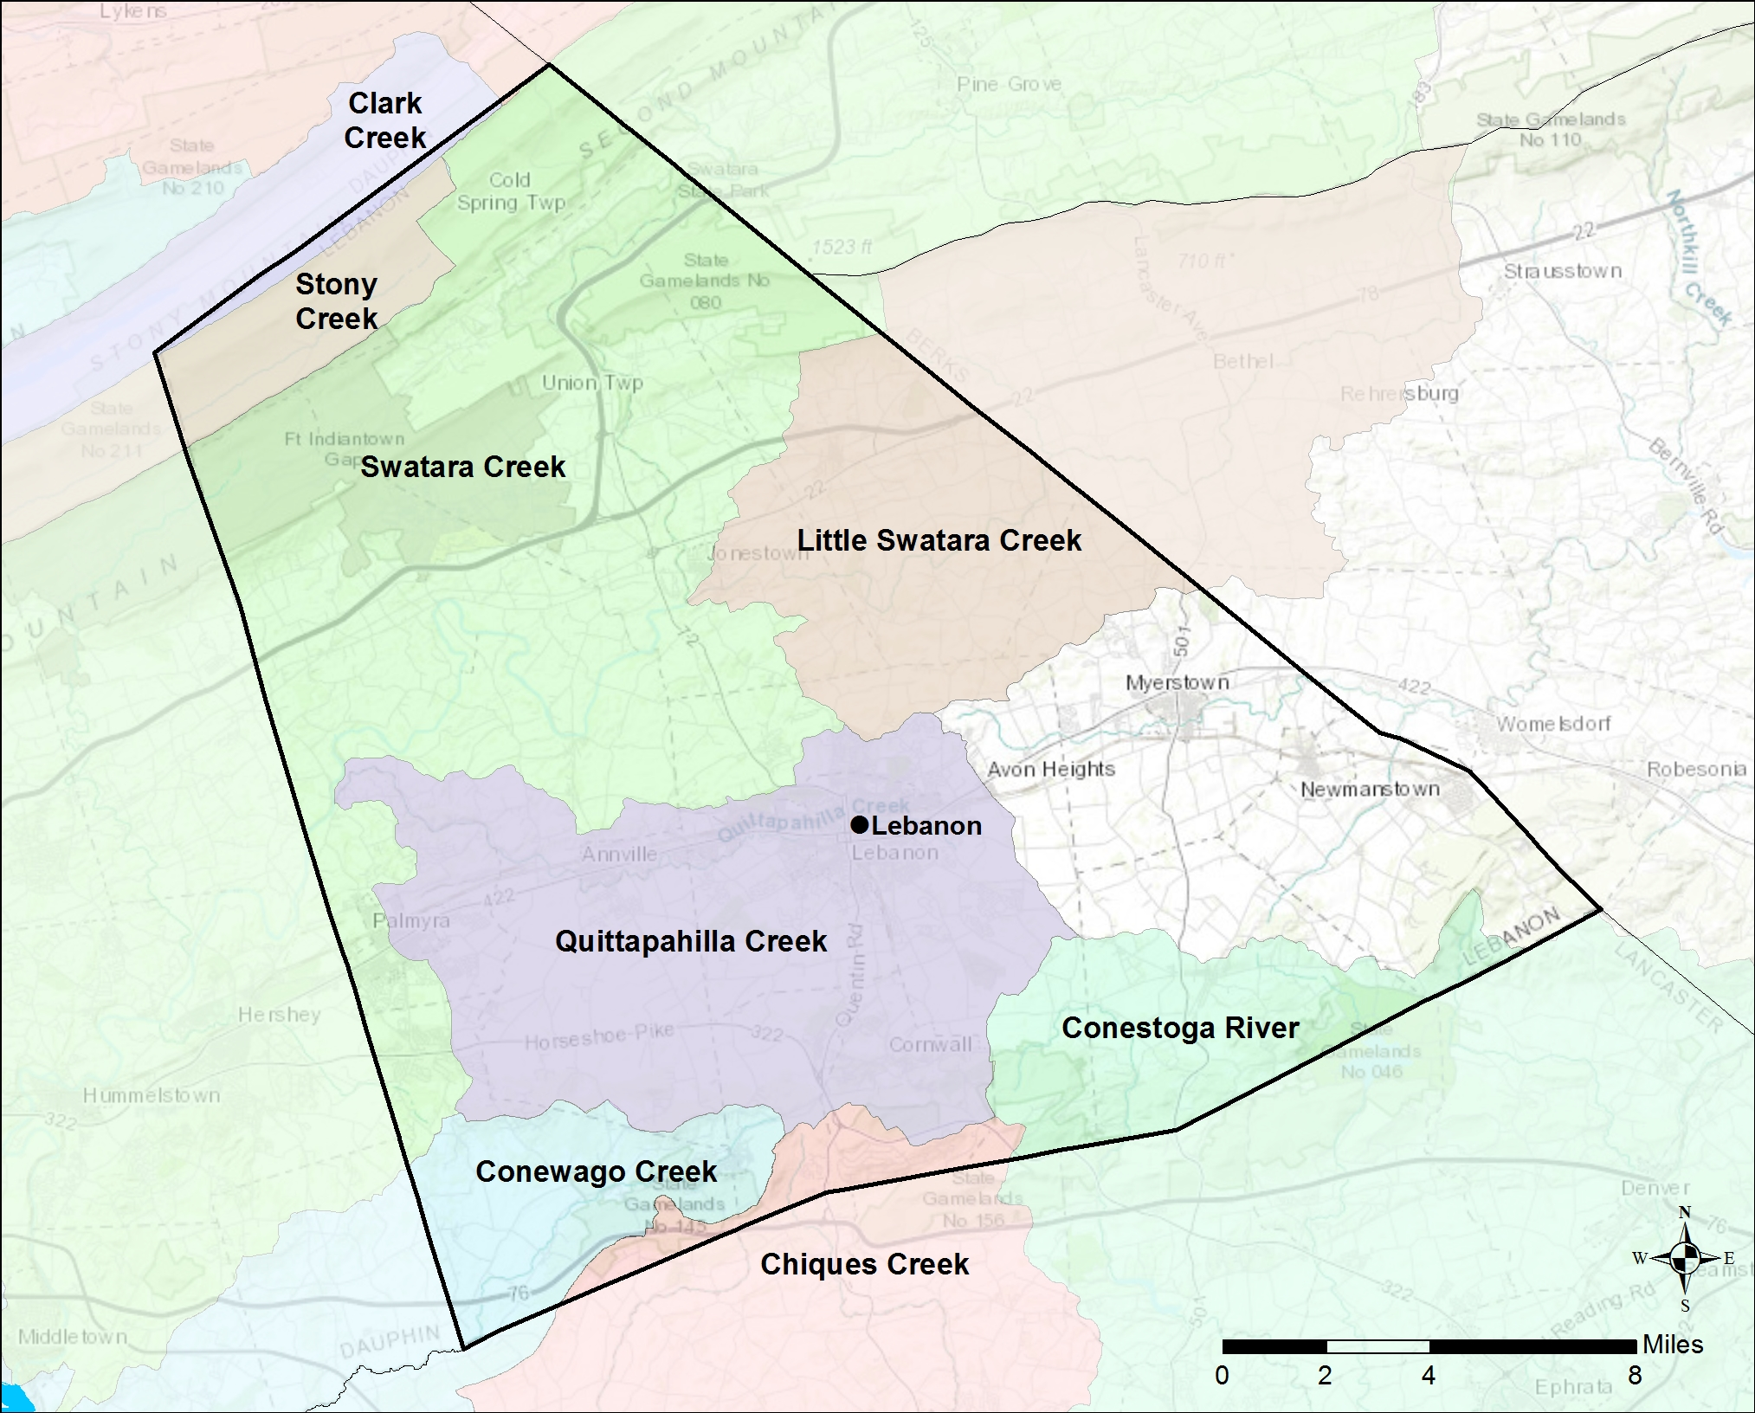
PHASE 3 WIP COUNTY SNAPSHOTS
www.dep.pa.gov
Lebanon County Watershed Map
Information About the Watersheds
Lebanon County contains 8 major watersheds: Clark Creek, Stony Creek, Swatara Creek, Little Swatara Creek, Quitapahilla Creek, Conewago Creek, Chiques Creek and Conestoga Creek . Watersheds in Lebanon County have elevated levels of Nitrogen, Phosphorous, and Sediment. Of the 572 total stream miles in Lebanon County, approximately 55% are impaired.
County Land Use:
Lebanon County has a total acreage of
197,310 acres in the Bay watershed. Agricultural land represents 38% of the total land with 75,442 total acres. Developed land represents another 22% of the total land
in Lebanon County. Natural land, which is made up of forests, stream, and wetlands, represents the remaining 40% of the land
in Lebanon County. Cropland makes up a majority of the Agriculture sector with 47,380 acres. The developed sector is mostly Non- Municipal Separate Storm Sewer Systems (MS4s) (60%) 25,459 acres and a smaller portion of MS4 (40%) 16,843 acres.
Lebanon County:
Total Acres: 197,310
Agriculture:
Total Acres: 75,442
Developed:
Total Acres: 42,302
Local Benefits:
Storm events are the number one way for nutrients and sediment to enter waterways. Increased runoff impacts: flooding, water quality, habitat, etc. Pollutants enter the waterways by two methods: overland runoff or leaching into groundwater.
Flooding affects safety, property, infrastructure, and economics.
Lebanon County relies on local water sources to supply drinking water to its residents.
Just like humans, Lebanon County’s livestock depend on clean water.
Learn more and Get Involved
To learn more about the Countywide Action Plans, visit DEPs Countywide Action Plans website: dep.pa.gov/cap

