Slide 1
Bureau of Laboratories
Air Chemistry & Gravimetrics Section

Slide 2
What does GRAVIMETRIC mean anyway ??????????
According to the Webster’s dictionary, the noun GRAVIMETRY is the measurement of weight or density.
According to Wikipedia, GRAVIMETRIC ANALYSIS describes a set of methods in analytical chemistry for the quantitative determination of an analyte based on the mass of a solid. An example is the measurement of suspended solids in a water sample - a known volume of water is filtered, and the collected solids are weighed.

Slide 3
Overview
The Air Chemistry & Gravimetrics Section performs various analyses of fuels including coals, waste liquids and virgin oils, paints and coatings, filters, dustfalls and microscopic analyses in samples for the DEP Bureau of Air Quality and analysis of water and soil samples for various analyses including TOX, HEM & SGT-HEM, total solids, total suspended solids, and total dissolved solids for DEP, DCNR and other state and federal agencies.

Slide 4
FUEL ANALYSIS

Slide 5
Coal Flowchart
Coal Analysis
SAC 302
% Air Dry Loss
R MOISTURE AIR
% Sulfur
RSVARIO
% Moisture
RMOIST RESIDUAL
BTU Analysis
RBTU
% Ash
RASH SOLID

Slide 6
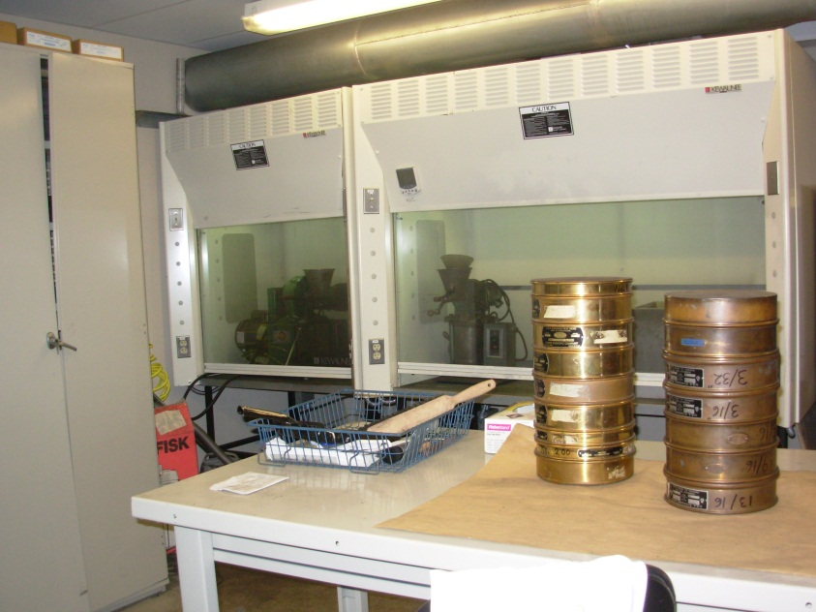
COAL ANALYSIS
Coal samples that have not been ground when received in the Lab are weighed, spread out in a shallow pan and are air dried for twenty-four hours. The samples are reweighed and the % Air Dry Loss is calculated.
The samples are then ground and pulverized to a minus 60 mesh size.
Laboratory analysis includes BTU, % Sulfur, % Moisture and % Ash.

Slide 7
Coal Analysis Continued
BTU Analysis is performed using a Parr 6400 Bomb Calorimeter.
BTU is the heat content of the coal sample. The BTU is determined by burning a weighed sample of coal under controlled conditions, in an atmosphere of oxygen, in a calibrated microprocessor controlled isoperibol calorimeter. Isoperibol refers to a constant temperature environment.
Heat correction factors include:
the ignition thread consumed during combustion,
the amount of Na₂CO₃ used to titrate the sample
the Sulfur result and
the % Air Dry Loss is entered as the Moisture factor to calculate results on an as received basis (analytical data calculated to the moisture condition of the sample as it arrived at the laboratory and before any processing or conditioning).

Slide 8
Coal Analysis Continued
Reference method for the BTU analysis is ASTM D 1989.
%Sulfur - analysis is performed on the elementar VarioMax Sulfur Analyzer and measured using a Thermal Conductivity Detector (TCD).
The VarioMax automated instrument, operated in Carbon, Nitrogen and Sulfur Mode (CNS Mode), determines the sulfur content of coal samples. Samples are oxidized via catalytic tube combustion at 1140 ºC. The nitrogen, carbon and sulfur in the combustion gas are separated by specific absorption columns in a purge and trap system. The nitrogen, carbon and sulfur are then successively released and pass through a Thermal Conductivity Detector (TCD) for measurement. The sample’s TCD signal is compared to the TCD signals of Certified Coal Standards to determine the %S.

Slide 9
Coal Analysis Continued
Reference method for Sulfur Analysis in Coal and Coke is ASTM D 4239-97. Sulfur result is reported as % S.
The % Ash and % Moisture analysis is performed using a TGA701 Thermogravimetric Analyzer. Empty crucibles are loaded into the furnace carousel, the tare weight is determined, coal sample is loaded and the initial sample weight is determined. The weight loss is monitored and the furnace temperature is controlled according to the selected analysis method for determination of the moisture or ash content.
% Ash - % Air Dry Loss is required to calculate results on an as received basis.
% Moisture -% Air Dry Loss is required to calculate results on an as received basis.

Slide 10
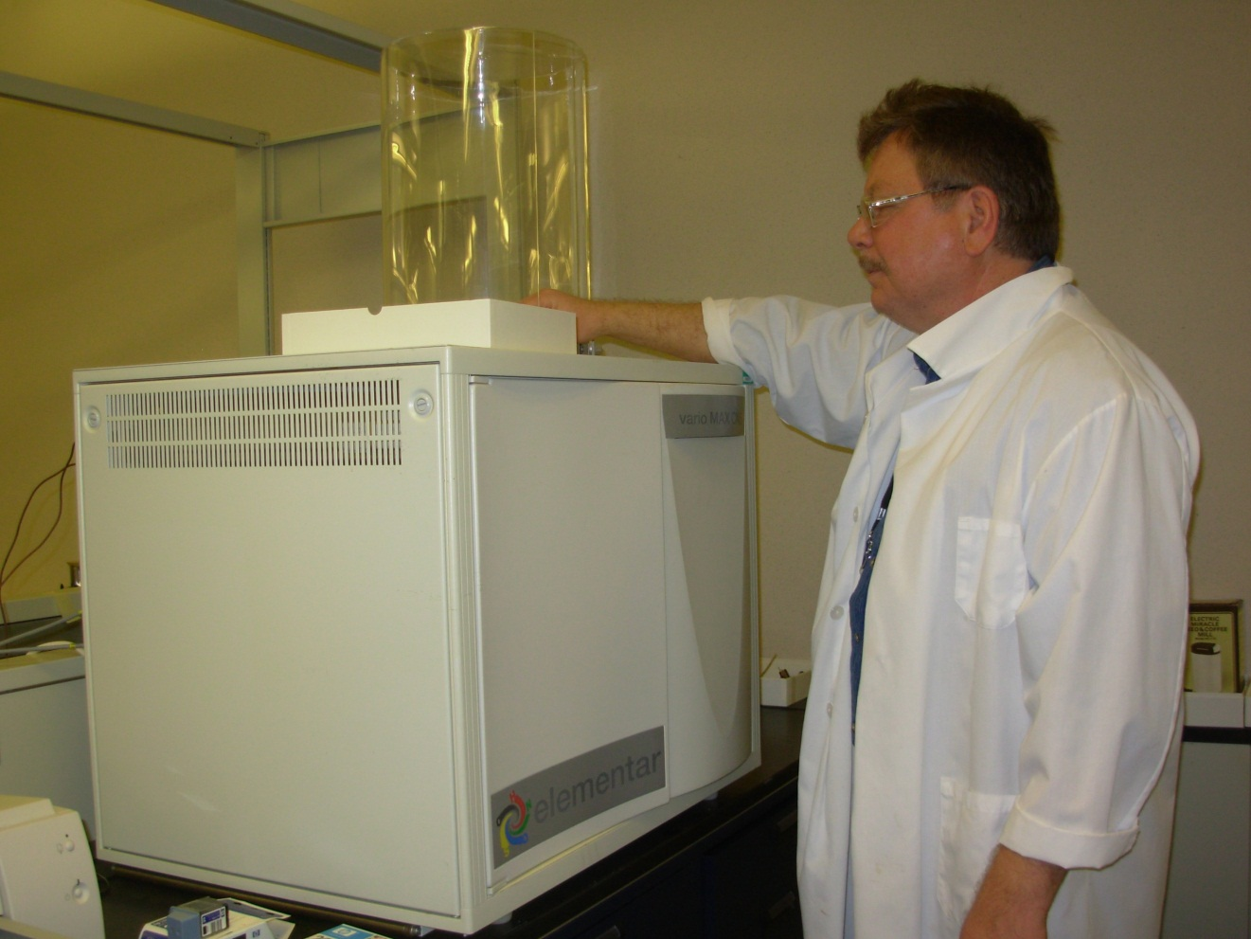
Coal Analysis Continued

Slide 11
Virgin Fuel Analysis

Slide 12
Virgin Fuel Flowchart
VIRGIN FUEL OILS
SAC 303
% SULFUR
HORIBA X-RAY
99006A
API GRAVITY PAAR DENSITY METER API60
% OIL ASH 99005
BTU ANALYSIS BOMB CALORIMETER 99003A

Slide 13
Virgin Oil Analysis
Samples are submitted in 500 ml Nalgene plastic containers.
Laboratory Analysis includes:
BTU - Analysis is performed on Parr 6400 Bomb Calorimeter.
Heat correction factors include:
the ignition thread consumed during combustion,
the amount of Na₂CO₃ used to titrate the sample and
the Sulfur result

Slide 14
Notes on Virgin Oil Analysis
% Sulfur - Analysis is performed on the Horiba X-ray Sulfur Analyzer. Reference method is ASTM D 4294. The sulfur analyzer uses energy-dispersive X-ray fluorescence spectroscopy to determine the sulfur content of petroleum products including fuel oil and diesel fuel.
API Gravity - Analysis is performed on the Paar Digital Density Meter. This method determines the specific gravity of petroleum (waste and virgin oils) through the use of a digital density meter. The American Petroleum Institute specific gravity is calculated internally by the density meter. The reference method is ASTM D 5002.
Oil Ash is analyzed according to ASTM D 482.

Slide 15
WDLF Flowchart
WASTE DERIVED LIQUID FUELS SAC 304
TOTAL HALIDES 70353E
% SULFUR 99006A
API GRAVITY API60
BTU ANALYSIS 99003A
TX Analysis done on the Mitsubishi TOX Analyzer

Slide 16
WDLF Analysis
Samples must be submitted in 275 cc seamless aluminum containers.
Laboratory Analysis includes:
BTU - Analysis is performed on Parr 6400 Bomb Calorimeter.
Heat correction factors include:
the ignition thread consumed during combustion,
the amount of Na2 CO3 used to titrate the sample, and
the Sulfur result from the Horiba X-ray Sulfur Analyzer
API Gravity - Analysis is performed on the Paar Digital Density Meter.

Slide 17
WDLF Analysis Continued
Total Halides (TX) is a measurement used to estimate the total quantity of halogenated material in new or used petroleum products. It is sensitive to compounds containing chloride, bromide and iodide, but does not detect fluorinated compounds.
The TX of waste fuels is analyzed by high temperature pyrolysis micro-coulometric determination on the Mitsubishi TOX Analyzer.
A 2 – 5 mg aliquot of a well-mixed sample of new or used petroleum product is placed into a quartz boat. The sample is then combusted to convert the total halides to a titratable species. It is then titrated electrolytically and measured using a microcoulometric detector. The TX is reported based on the chloride ion.
Reference method for TX is EPA Method 9076.
The TX result is reported is as mg/g.

Slide 18
WDLF Analysis Continued
TX of waste fuels is analyzed by high temperature pyrolysis micro-coulometric determination.

Slide 19
PAINT & SURFACE COATING ANALYSIS

Slide 20
PAINT ANALYSIS FLOWCHART
H₂O - BASED PAINT or COATING
SAC 301
Volumetric Karl Fischer Titration
99105A
Density
Digital Density Meter
99010E
Volatile Organic Content
99012E

Slide 21
PAINT ANALYSIS FLOWCHART
SOLVENT - BASED PAINT or COATING
SAC 300
Density
Digital Density Meter
99010E
Coulomatic Karl Fischer Titration
99005A
Volatile Organic Content
99012E

Slide 22
NOTES ON PAINT ANALYSIS
Water- based coatings contain greater than 5 % water.
Solvent- based coatings contain less than 5 % water.
A Manufacturer’s Safety Data Sheet or a Production Specification Sheet should be included with every paint sent to the laboratory.
A Paint sticker must be attached to every paint sample submitted for analysis.
The submission sheet should identify the coating sample as being either water-based or solvent-based.
Catalyzed coatings set quickly. Samples of those coatings must be submitted in fractions with the mix ratio provided.
The sample cans should be filled to the neck of the container and shipped the same day to prevent the loss of volatiles.
Samples must be submitted in 275 cc aluminum containers.

Slide 23
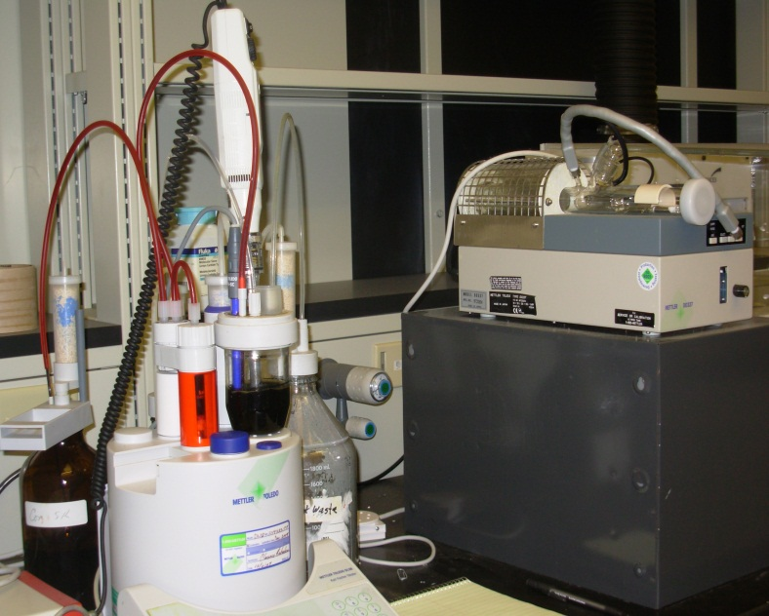
NOTES ON PAINT ANALYSIS Continued
The reference method for Water in Paints and Coatings by Karl Fischer Method is ASTM D 4017. The paint is dissolved in an appropriate solvent and titrated directly with a standardized reagent to an electrometric end point to determine the % water in the sample. The water analysis is performed using the Mettler Toledo DL-38 Karl Fischer Titrator.
The reference method for Volatile Content of Coatings is ASTM D 2369. The sample is weighed into an aluminum dish containing 3 mL of an appropriate solvent, dispersed and heated in an oven at 110 ºC for 60 minutes. The % Volatile Content is calculated from the loss in weight.
The reference method for Density of Liquids by Digital Density Meter is ASTM D 1475. A small volume of the sample is introduced into an oscillating sample tube and the change in oscillating frequency caused by the change in the mass of the tube is used in conjunction with the calibration data to determine the density of the sample. The density analysis is performed using the Paar DMA 48 Density Meter.

Slide 24

% NONVOLATILE CONTENT OF PAINTS
ASTM Method D 2697 - Volume Nonvolatile Matter in Clear and Pigmented Coatings (% nonvolatiles by weight).
The weight and volume of stainless steel disk is determined by weighing in air and in a liquid of known density.
After the disks are coated with paint and dried, the weight and volume of the coated disk is determined by weighing in air and in a liquid of known density.
The volume of the paint film is equal to the quotient of the weight loss of the coated disk (due to the Archimedes buoyancy effect) divided by the density of the liquid displaced.

Slide 25
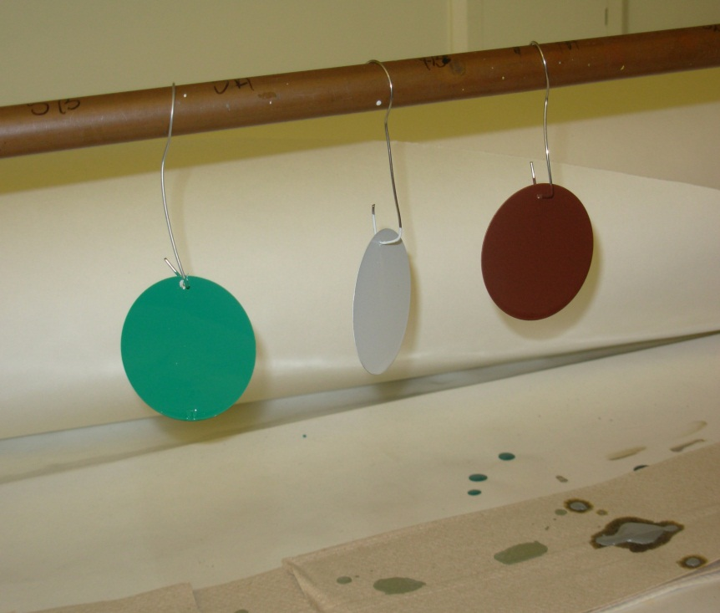
% NONVOLATILE CONTENT OF PAINTS Continued
From the measured weights and volumes of the disk before and after applying the coating, the weight and volume of the dried coating film are calculated.
Based on the density of the liquid coating and the weight percent nonvolatile matter, the volume of the liquid coating deposited on the coated disk is calculated.
The volume of the dried coating divided by the volume of liquid liquid coating, multiplied by 100, equals the volume % nonvolatile matter in the total liquid coating.

Slide 26
Microscopic ID Collection
Use small bottles or plastic bags for collection
Do not use paper towels or cotton swabs to collect samples
List possible sources of the material on the submission sheets
Collect reference samples for difficult cases
50 ml vial

Slide 27
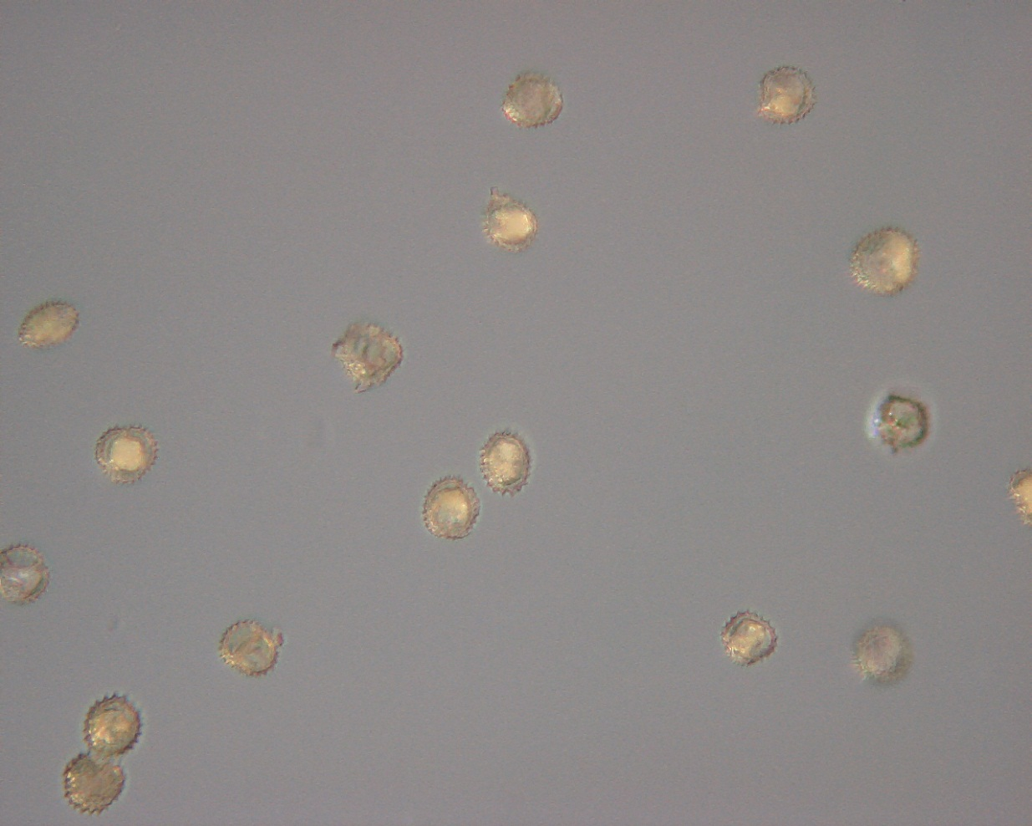
Microscopic ID Continued

Slide 28
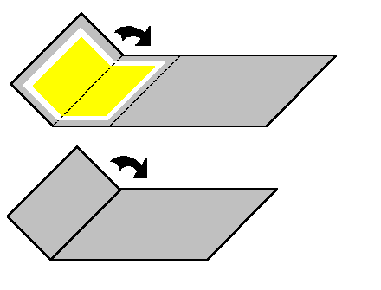
Hi-Vol Sampling Tips
Fold the 8 x 10 inch filter “long-ways” so that the particulate is contained on the inside of the fold.
Place any filter fragments inside the folded filter
Do not put Dickson charts inside the folded filter

Slide 29
Hi-Vol Sampling Tips
Do not moisten the flap on the mailer (Use the tabs to keep it shut)
Be gentle with the filters - they tear easily
Place the site bar code in the box on the left side of the filter mailer
Extra filters may be kept for up to a year from the date on the bar code
Email lwilkinson@pa.gov if you have questions

Slide 30
Hi-Vol Filter Sampling
Air is drawn through the hi-vol sampler and collected on the 8 x 10 inch glass fiber filter.
The mass of the particulate matter collected is determined by the difference in filter weights prior to and post sampling. The concentration of particulate matter is calculated by dividing the weight gain by the volume of air sampled and reported as ug/m³.
Filter samples can also be analyzed for sulfate, nitrate, lead and other metals and BaP.

Slide 31
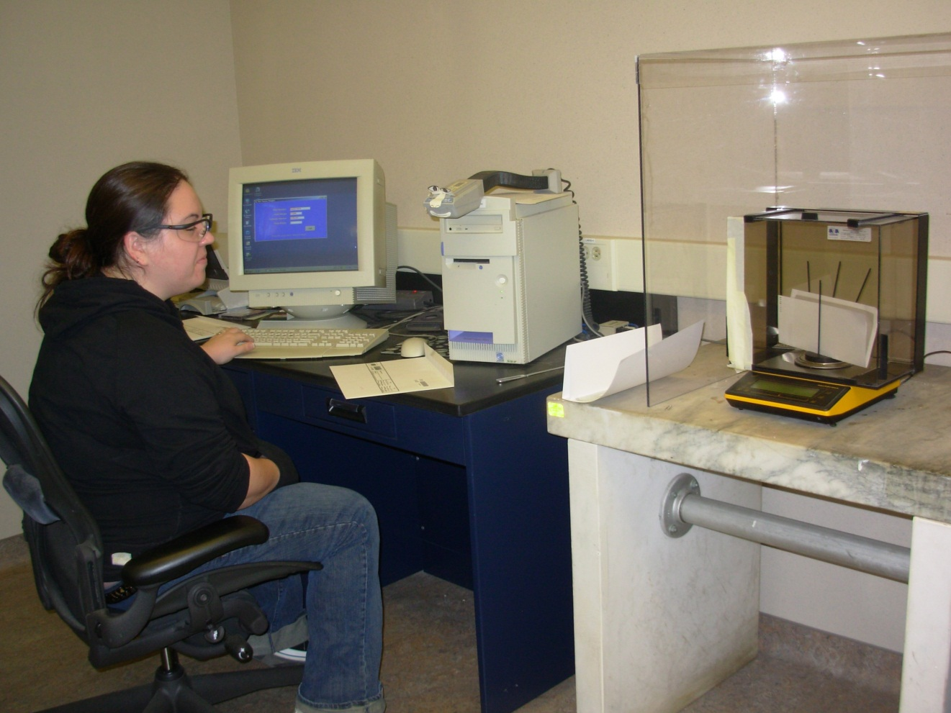
Hi-Vol Filter Sampling

Slide 32
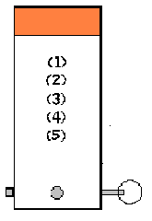
PM2.5 Monitoring
Do not handle filters
Apply site bar code to the submission sheet
Pre-freeze ice packs before shipping
Reset min/max thermometer before shipping

Slide 33
PM2.5 Monitoring CONTINUED
PM2.5 particulate is defined as any particulate
having a diameter less than or equal to 2.5 microns.
This procedure determines the mass of PM2.5 matter
collected on a Teflon filter. The filter is weighed
initially, sent to the field where a specified volume of
air is pulled through the filter and then returned to
the laboratory for a final weight. The difference in
mass is reported and combined with the air volume
to determine the concentration of PM2.5 particulate.
This is based on method EPA 454/R-98-005.

Slide 34
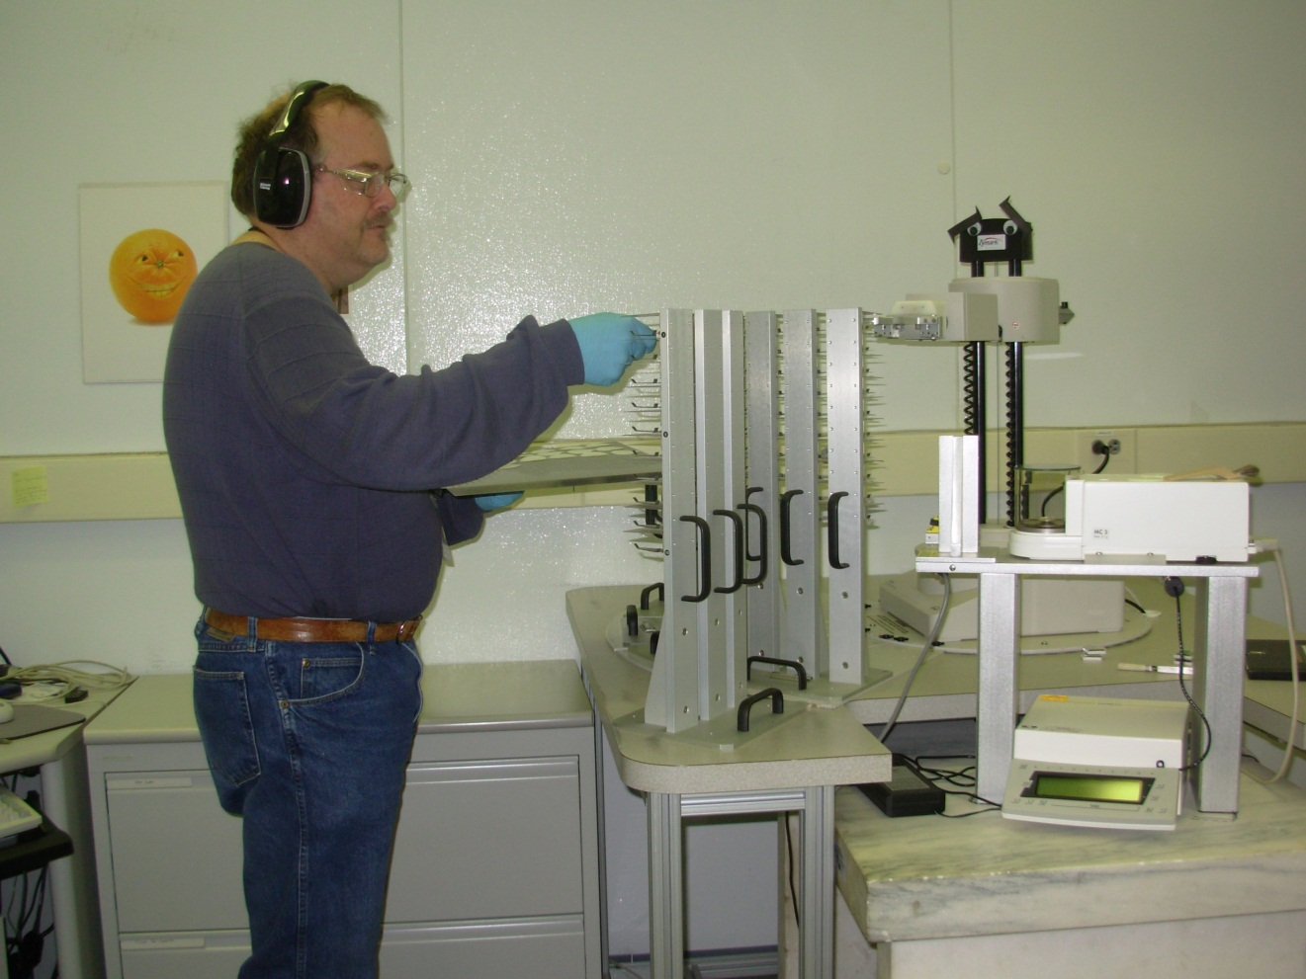
PM2.5 Monitoring CONTINUED

Slide 35
Jars are placed in the field for approximately 30 days.
Add 5 ml Copper Sulfate in summer to prevent algae growth.
Add 5 ml of Ethylene Glycol to prevent freezing in the winter
Plastic jars, holders and instructions for sampling dustfalls are available from BAQ Central Office

Slide 36
Dustfall Analysis CONTINUED
Particulate matter is collected via gravitational settling into an open-mouth container (dustfall jar) for about 30 days.
The dustfall jar is washed with distilled water, filtered and then evaporated. The insoluble mass is determined by the weight gain of the filter after filtration. The mass of the soluble matter is determined by the weight gain of the beaker after a portion of the filtrate is evaporated.
Additional analyses performed for dustfall samples include a microscopic examination, various metals and ions if requested.

Slide 37
Dustfall Analysis CONTINUED
Results reported for the dustfall sample include: dissolved particulate (g), insoluble particulate (g), % insoluble matter, dustfall (tons/sq²/month) and the microscopic examination of the insoluble particulate.
Metals analysis is performed on the insoluble portion of the dustfall sample after the microscopic exam is completed.

Slide 38
Analysis of Water Samples
n-Hexane Extractable Material (HEM) and Silica Gel Treated n-Hexane Extractable Material (SGT-HEM)
TOX - Total Organic Halides
Osmotic Pressure
Total Solids, Total Suspended Solids (TSS), Total Dissolved Solids (TDS) and Settleable Solids

Slide 39
n-Hexane Extractable Material (HEM) and Silica Gel Treated n-Hexane Extractable Material (SGT-HEM)
Reference method is EPA Method 1664A
The sample is extracted with hexane using a solid phase automated extractor. The extract is placed into a pre-weighed aluminum pan and the hexane is evaporated from the extract.
The pan and the extract is weighed and the HEM is reported as mg/L.
HEM is the material extracted from the water sample and was formerly called Oil & Grease.
Has a 28 day holding time.

Slide 40
n-Hexane Extractable Material (HEM) and Silica Gel Treated n-Hexane Extractable Material (SGT-HEM) CONTINUED
If the SGT-HEM analysis is requested, the HEM is re-dissolved in n-hexane.
Silica gel is added to the HEM to remove the absorbable materials.
The solution is filtered into a pre-weighed aluminum pan to remove the silica gel.
The hexane is evaporated and the SGT-HEM is weighed and reported as mg/L.
SGT-HEM is the material extracted from the water sample and was formerly called TPH – Total Petroleum Hydrocarbon.
Has a 28 day holding time.

Slide 41
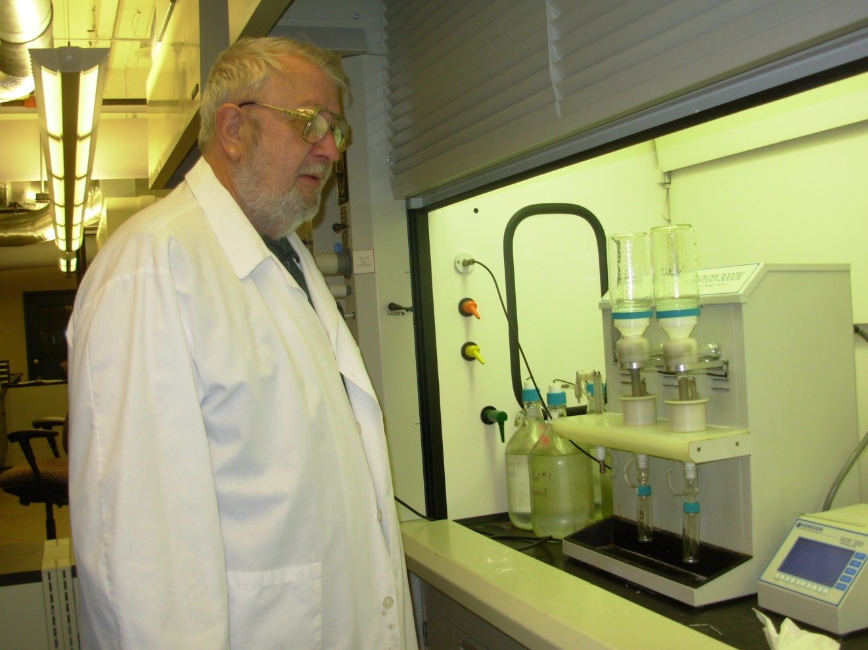
n-Hexane Extractable Material (HEM) and Silica Gel Treated n-Hexane Extractable Material (SGT-HEM) CONTINUED

Slide 42
TOX - Total Organic Halides
Reference method for TOX is Standard Methods 5320B.
A 50 mL aliquot of the sample is passed through a column containing 40 mg of activated carbon. The column is washed to remove any trapped inorganic halides and is then combusted to convert the adsorbed organohalides to a titratable species. It is then titrated electrolytically and measured using a microcoulometric detector. The TOX is reported as ug/L based on the chloride ion.

Slide 43
TOX - Total Organic Halides CONTINUED
This method detects all organic halides containing chlorine, bromine and iodine that are adsorbed on the activated carbon. Fluorine containing compounds are not determined by this method.
Has a 28 day holding time.

Slide 44
Osmotic Pressure
This testing procedure is a BOL developed method and is based on the instrument manufacturer references.
A 20 uL aliquot of the water sample is pipetted into a sample tube and placed into the osmometer for analysis. The osmotic pressure is measured by the instrument and reported as mOsmol/kg H₂O.
Has a 48 hour holding time.

Slide 45
Osmotic Pressure CONTINUED
Measuring the osmolality of a water sample is a way of determining the freezing point depression of that sample. Since the amount of total dissolved solids in a sample is directly proportional to the freezing point depression, knowledge of the freezing point depression aids in characterizing the severity of a pollution source.

Slide 46
Total Solids, Total Suspended Solids (TSS) & Total Dissolved Solids (TDS)
Solids refer to matter suspended or dissolved in water, wastewater or mine drainage samples.
Total solids (TSOL) is the material left in the dish after evaporation at 105 ºC.
TSOL includes the TSS and TDS portions.
Reference method for TSOL is USGS-I-3750.
TSOL is reported as mg/L.
Has a 7 day holding time.

Slide 47
Total Suspended Solids (TSS)
Total suspended solids (TSS) is the portion of material retained by the filter and is dried at 105ºC.
We have three (3) automated weighing systems – robots – used only to weigh the crucibles that are used for the TSS analysis.
The samples are poured and filtered by one of the Solids area team members.
Reference method for TSS is USGS-I-3765.
TSS is reported as mg/L.
Has a 7 day holding time.

Slide 48
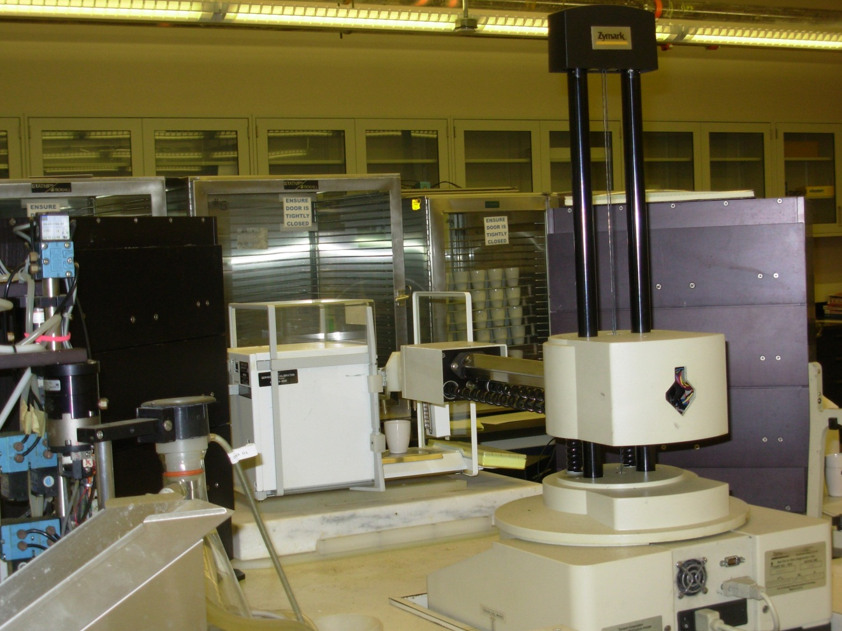
Total Suspended Solids (TSS) CONTINUED

Slide 49
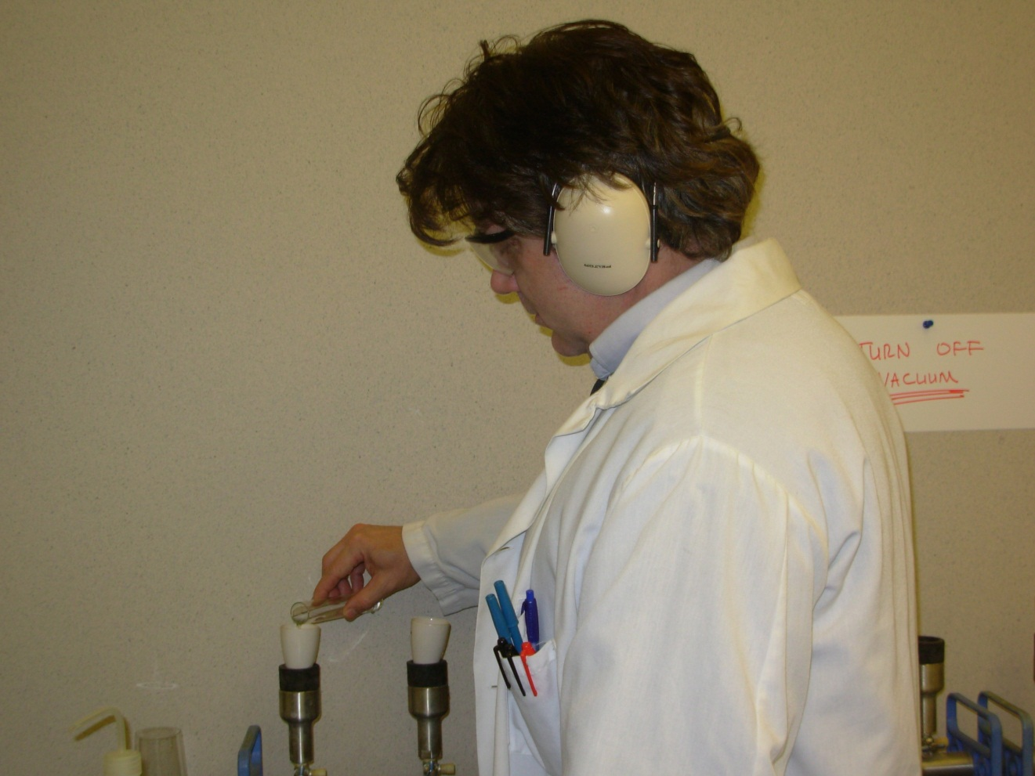
Total Suspended Solids (TSS) CONTINUED

Slide 50
Total Dissolved Solids (TDS)
Total dissolved solids (TDS) is the portion of material that passes through a filter and dried at 180ºC depending on the test requested.
The water sample is filtered through a glass fiber filter and the filtrate is evaporated to dryness in a pre-weighed dish.
The samples are poured and filtered by one of the Solids area team members.
Reference methods for TDS are USGS-I-1750 and Standard Methods 2540C.
TDS is reported as mg/L.
Has a 7 day holding time.

Slide 51
Settleable Solids
Settleable solids is the material that settles out of suspension of the water sample.
One liter of sample is required for this analysis and is poured into an Imhoff cone.
Let the sample settle for 45 minutes, stir and settle 15 minutes longer.
Settleable solids is reported as mL/L.
Has a 48 hour holding time.

Slide 52
THE END

