Slide 1

Dairy Farmers of America
PEDA 2014 Project
PEDA Board Meeting
May 18, 2015

Slide 2

Dairy Farmers of America Overview
DFA is a national milk marketing cooperative (dairy farmer-owned)
Own 33 plants in the U.S.
Middlebury Center, Tioga County
  55 Employees, hired 3 new employees in 2015 due to increased operations
  Main product is powdered milk used by their customers in the production of many food products. Also produce skim milk condense and cream, and specialty milk powders.

Slide 3
Overview of PEDA Project
Removal of 25 year-old mechanical burner, linkage and gas train (high maintenance costs)
Install new electronic controlled burner, VFD for blower motor, and new gas train to reduce electric consumption
Install an economizer on boiler feed water in order to reduce the amount of energy needed to produce steam for their processes

Slide 4
Project Timeline
Work began January 2015, and was completed February 2015
The project took just 1 month to complete
CSI Services, York, PA was the contractor used
  A total of 471 man-hours spent on the job (3-5 laborers)

Slide 5
Project Cost
PEDA 2014 Grant: $75,976
Matching Funds: $75,976 (50%)
Total Project Cost: $151,952

Slide 6
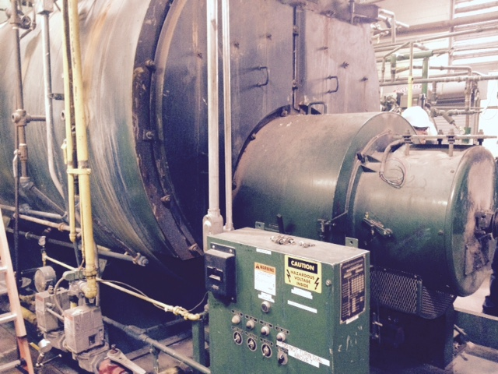
25-Year Old Mechanical Burner

Slide 7
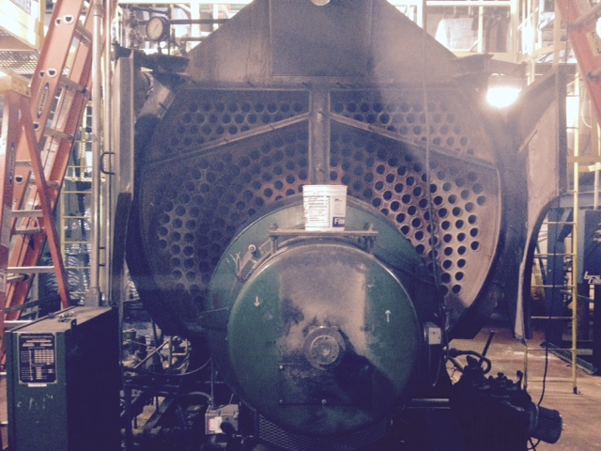
25-Year Old Mechanical Burner

Slide 8
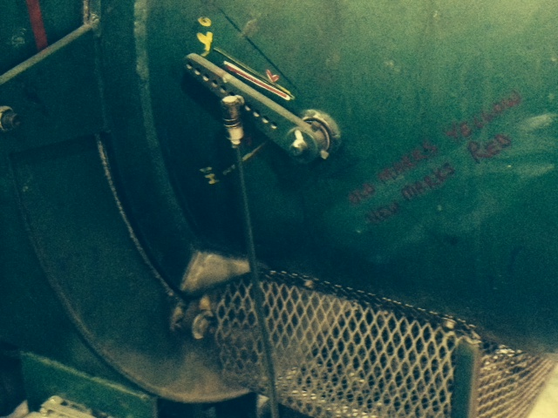
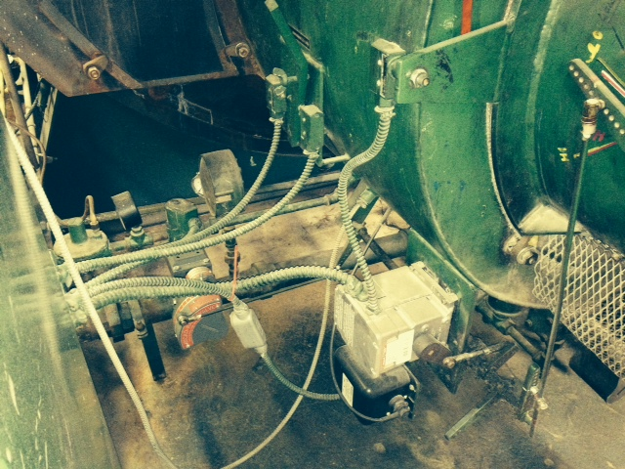
Burner linkage
Old Mechanical Burner Linkage

Slide 9
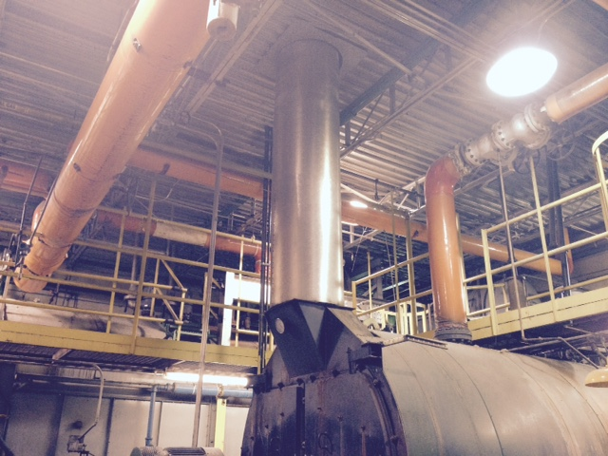
Old Boiler Stack

Slide 10
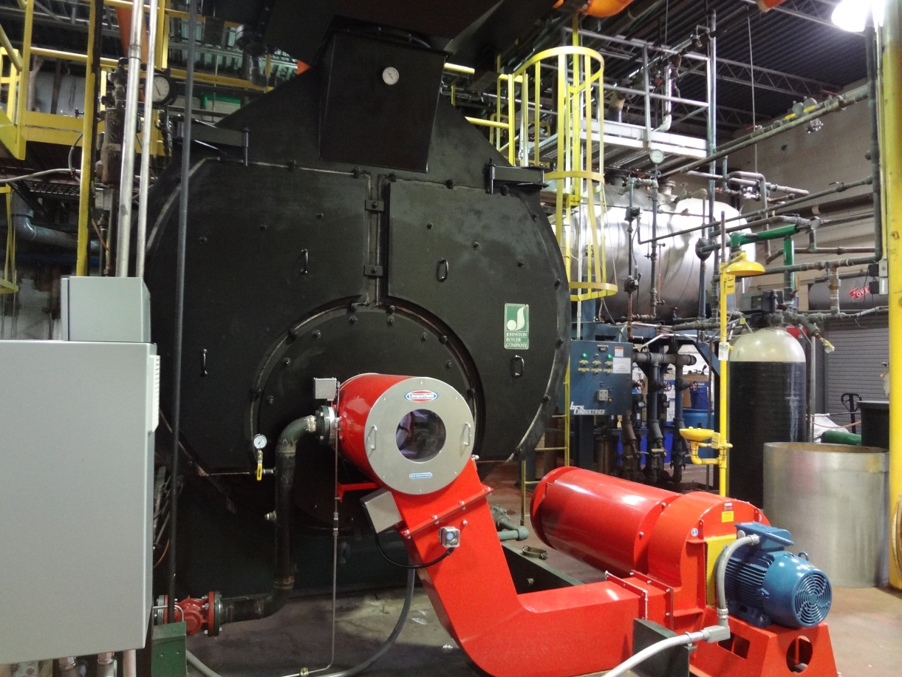
New Electronic-Controlled Burner

Slide 11
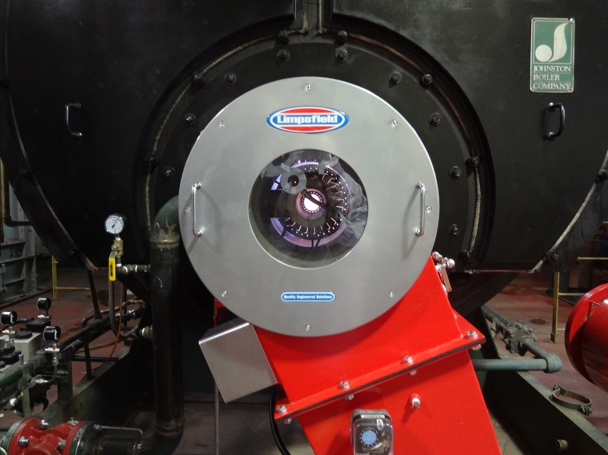
New Burner

Slide 12
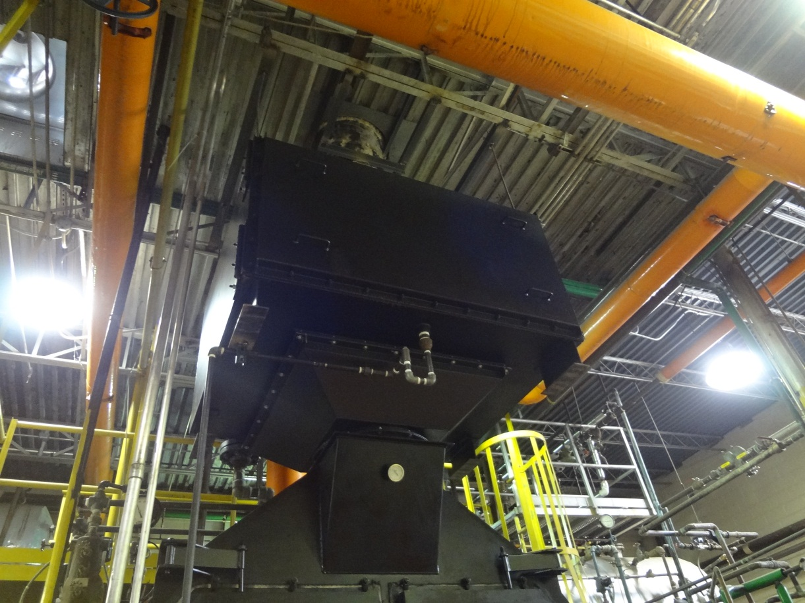
Economizer

Slide 13
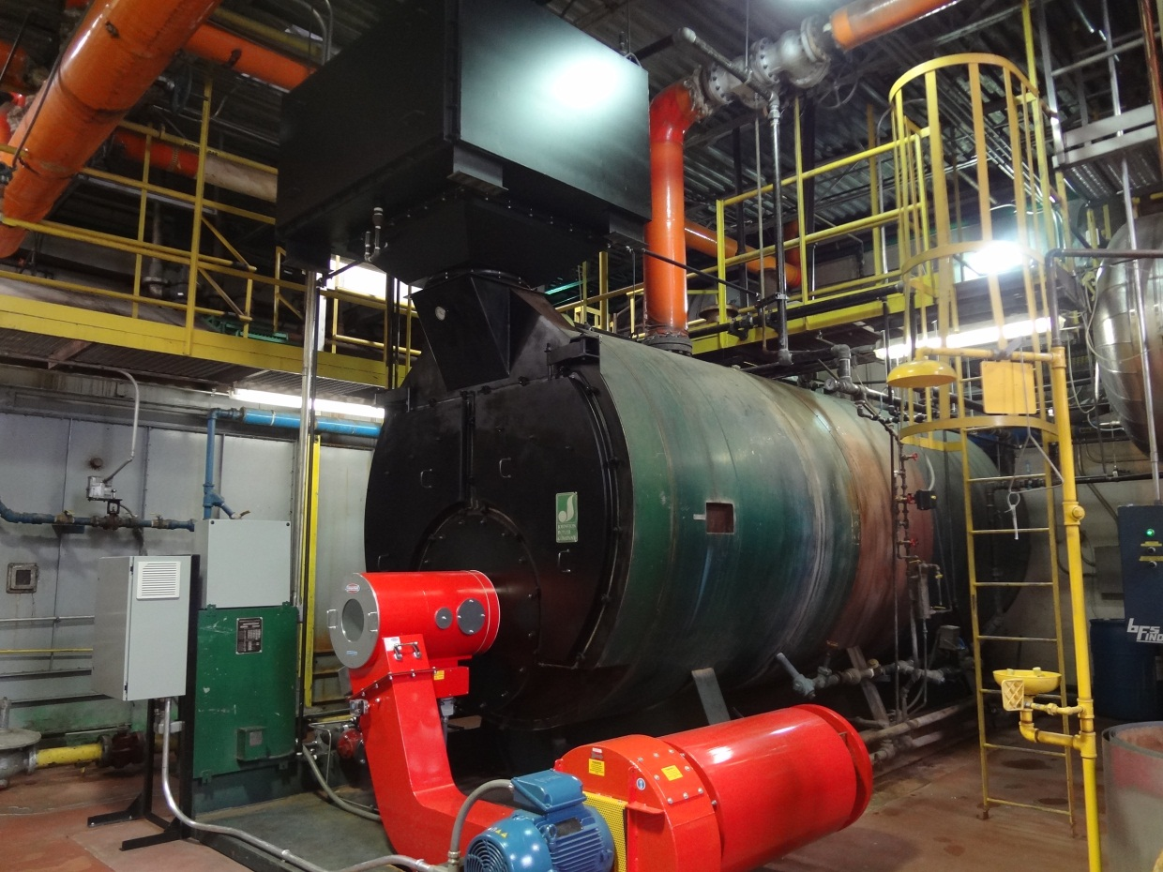
Finished Project

Slide 14

Before & After

Slide 15
Difficulties/ “Bumps in the Road”
The economizer was very difficult to place due to its size. Some of the steam lines had to be cut in order to fit the economizer in.
New air vents need to be added to the boiler room in order to allow adequate air flow for the boiler intake
But, overall, things went smoothly with the installation

Slide 16
Project Payback and Savings
Natural gas and electric savings
  averaging 400 DTH (400 MMBTU) /month
The new burner is expected to save approximately $70,000/year
The new economizer is expected to save approximately $20,000/year
The expected payback is <2 years
The burner is running at about 1/3 of its firing potential—it is extremely efficient.

Slide 17
Michelle Ferguson
DEP Northcentral Region miferguson@pa.gov 570-327-3783

