Slide 1
Finding Pennsylvania’s Solar Future
Solar for Economically Disadvantaged Citizens and Communities
Stories and Observations from the Field
Andrew Kleeman
SVP Ecosave
215 431 0565

Slide 2
Who Cares ?
Impact of Solar on Household Expenses | Low Income | Middle Income ⁽¹⁾
Family Income | 18,000 | 56,000
(1) 2015 US Census Bureau Data, Middle Income = US Median Household
Notes:
$18,000 is approx. 75% of the poverty threshold for a family of 4 at $24,600
$960 = $80/month
5 kW at 1200 kWh/kW = 6000 kWh. At 16 cents per kWh = $960 in electricity value

Slide 3
Who Cares ?
Impact of Solar on Household Expenses | Low Income | Middle Income ⁽¹⁾
Family Income | 18,000 | 56,000
Electrical Expense, Annual | $960 | $1,200
(1) 2015 US Census Bureau Data, Middle Income = US Median Household
Notes:
$18,000 is approx. 75% of the poverty threshold for a family of 4 at $24,600
$960 = $80/month
5 kW at 1200 kWh/kW = 6000 kWh. At 16 cents per kWh = $960 in electricity value

Slide 4
Who Cares ?
Impact of Solar on Household Expenses | Low Income | Middle Income ⁽¹⁾
Family Income | 18,000 | 56,000
Electrical Expense, Annual | $960 | $1,200
% of Annual Income | 5% | 2%
(1) 2015 US Census Bureau Data, Middle Income = US Median Household
Notes:
$18,000 is approx. 75% of the poverty threshold for a family of 4 at $24,600
$960 = $80/month
5 kW at 1200 kWh/kW = 6000 kWh. At 16 cents per kWh = $960 in electricity value

Slide 5
Who Cares ?
Impact of Solar on Household Expenses | Low Income | Middle Income ⁽¹⁾
Family Income | 18,000 | 56,000
Electrical Expense, Annual | $960 | $1,200
% of Annual Income | 5% | 2%
% of Electrical Expense from 5 kW PV | 100% | 80%
(1) 2015 US Census Bureau Data, Middle Income = US Median Household
Notes:
$18,000 is approx. 75% of the poverty threshold for a family of 4 at $24,600
$960 = $80/month
5 kW at 1200 kWh/kW = 6000 kWh. At 16 cents per kWh = $960 in electricity value

Slide 6
Who Cares ?
Impact of Solar on Household Expenses | Low Income | Middle Income ⁽¹⁾
Family Income | 18,000 | 56,000
Electrical Expense, Annual | $960 | $1,200
% of Annual Income | 5% | 2%
% of Electrical Expense from 5 kW PV | 100% | 80%
Impact on Quality of Life | Substantial | Modest
(1) 2015 US Census Bureau Data, Middle Income = US Median Household
Notes:
$18,000 is approx. 75% of the poverty threshold for a family of 4 at $24,600
$960 = $80/month
5 kW at 1200 kWh/kW = 6000 kWh. At 16 cents per kWh = $960 in electricity value

Slide 7
Ten Years After…
The Capital Investment for a 5 kW system in PA, on a Single Family Dwelling is less than half of what it was, but the ROI (as simple payback period) is fundamentally the same.

Slide 8
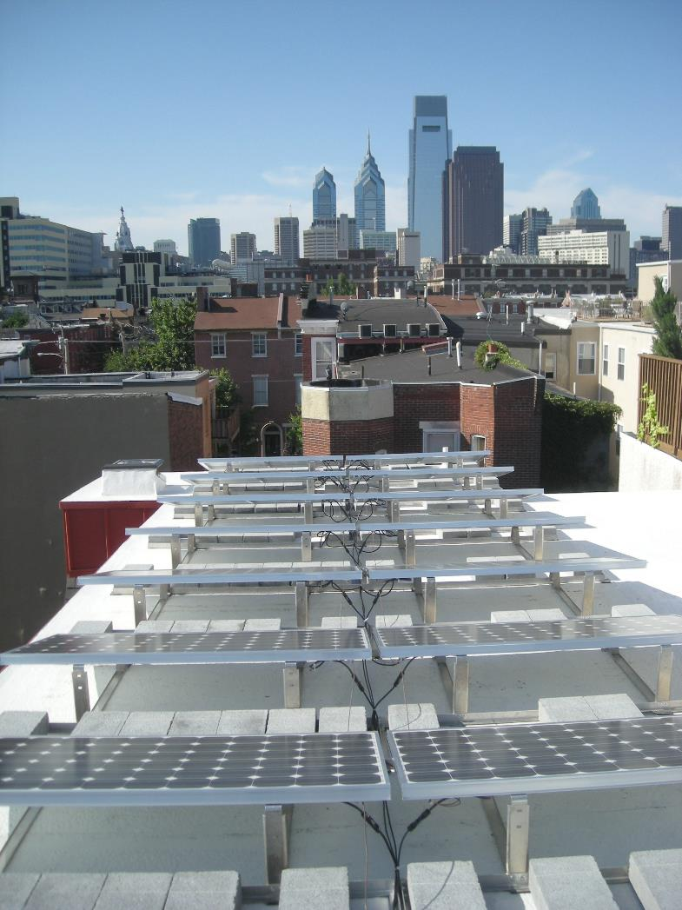
Challenges of
Individually Metered Low Income Solar

Slide 9
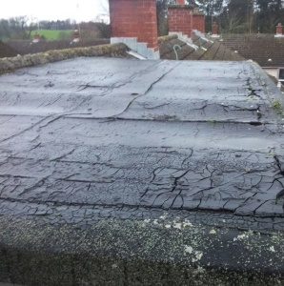
Challenges of
Individually Metered Low Income Solar
Roof Conditions

Slide 10
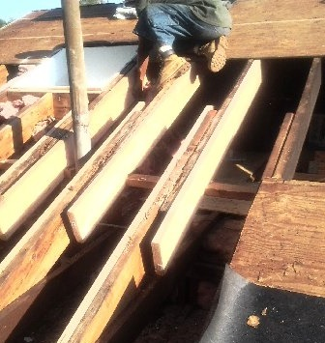
Challenges of
Individually Metered Low Income Solar
Roof Conditions
Structural Limitations

Slide 11
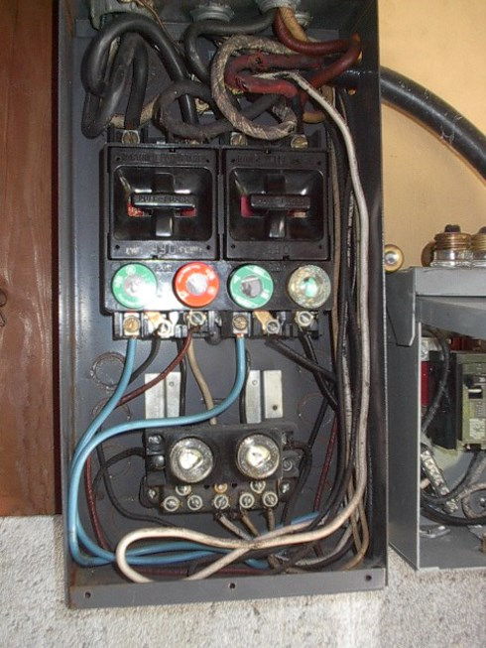
Challenges of
Individually Metered Low Income Solar
Roof Conditions
Structural Limitations
Electrical Service Obsolescence

Slide 12
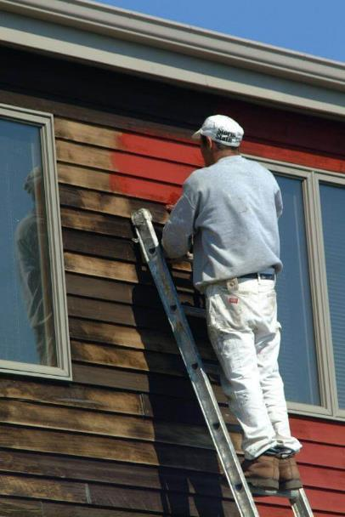
Challenges of
Individually Metered Low Income Solar
Roof Conditions
Structural Limitations
Electrical Service Obsolescence
No Provision for Maintenance

Slide 13

Challenges of
Individually Metered Low Income Solar
Roof Conditions
Structural Limitations
Electrical Service Obsolescence
No Provision for Maintenance
Inability to Monetize the ITC
Notes:
2016 – 2019: The tax credit remains at 30 percent of the cost of the system.
2020: Owners of new residential and commercial solar can deduct 26 percent of the cost of the system from their taxes.
2021: Owners of new residential and commercial solar can deduct 22 percent of the cost of the system from their taxes.
2022 onwards: Owners of new commercial solar energy systems can deduct 10 percent of the cost of the system from their taxes. There is no federal credit for residential solar energy systems.

Slide 14
Challenges of
Individually Metered Low Income Solar
Roof Conditions
Structural Limitations
Electrical Service Obsolescence
No Provision for Maintenance
Inability to Monetize the ITC
S C A L E

Slide 15
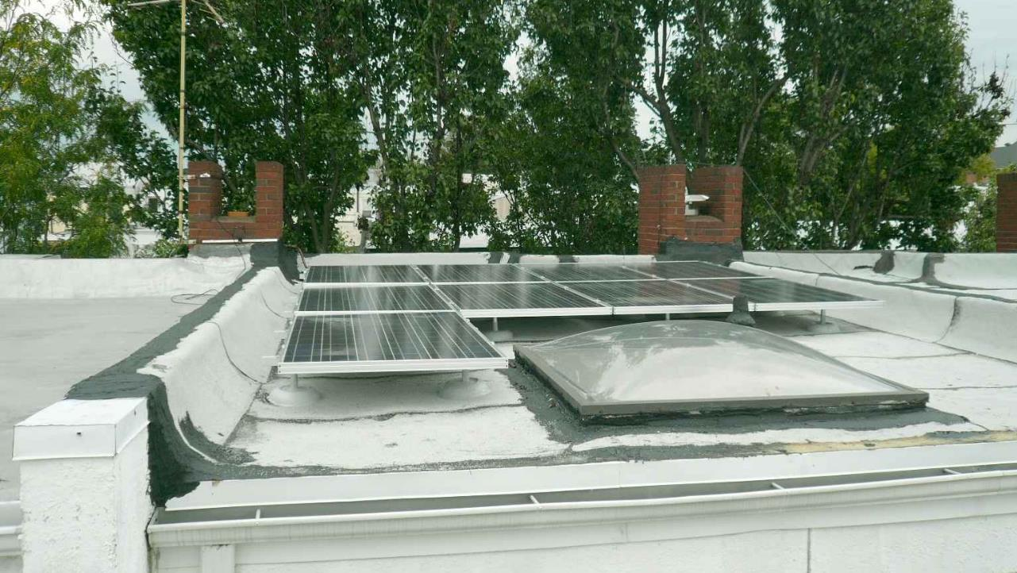
Notes:
Single string of (9) 260 watt modules = 2.3 kW system; and tat fit only after sacrificing tilt
City Council recently passed an increase to the Realty Transfer Tax of 0.1% which will generate enough revenue to support Council’s Housing Preservation priorities. Council released a bond in May 2017, focused on $60 million to be used to eliminate the waiting list for the Basic Systems Repair Program (“BSRP”), the Weatherization Assistance Program (“WAP”), and the Adaptive Modification Program (“AMP”). PEA encouraged Council to take another step and add $40 million additional for a loan program scheduled to go into effect in late 2017 for further to address fundamental home repair issues for those just above the income limits for the existing grant programs and fill in the gaps in existing repair services.

Slide 16
Challenges of
Individually Metered Low Income Solar
Larger Projects at new or renovated LIHTC or PHA sites, with a substantial common area load, or an ability to implement Community Solar overcome ALL of these Challenges
Roof Conditions
Structural Limitations
Electrical Service Obsolescence
No Provision for Maintenance
Inability to Monetize the ITC
S C A L E

Slide 17
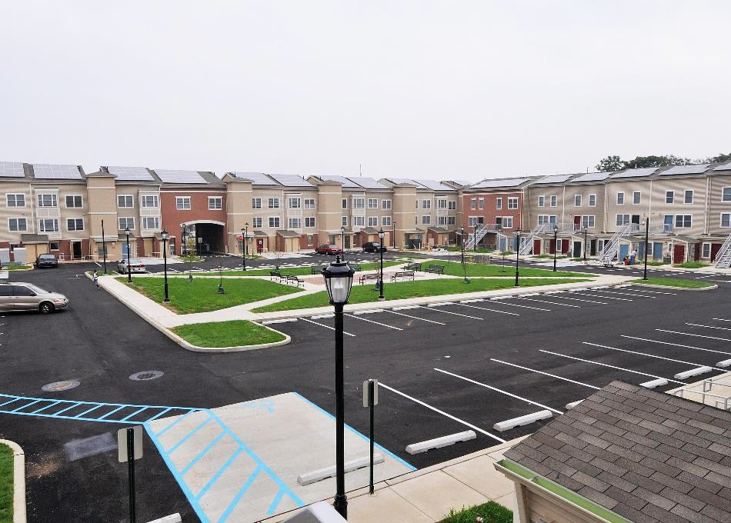
Public Housing Authority Success Story #1
Philadelphia Housing Authority’s Mantua Square:
$28 million ground-up, mixed use urban development with ample green space.
$10 million ARRA funding, inclusive of a 197 kW solar power system that drove ARRA funding point scoring in the application phase.
System offsets common area demand, and selected commercial spaces demand, yielding indirect value to residents.
Notes:
Start with one that is local and east to understand
Not 200 MW
All from one bucket
Value of solar to commercial spaces was in being able to offer submarket rents to draw commercial enterprises into an area that was devoid of businesses; the solar helped ensure a successful mixed use development

Slide 18
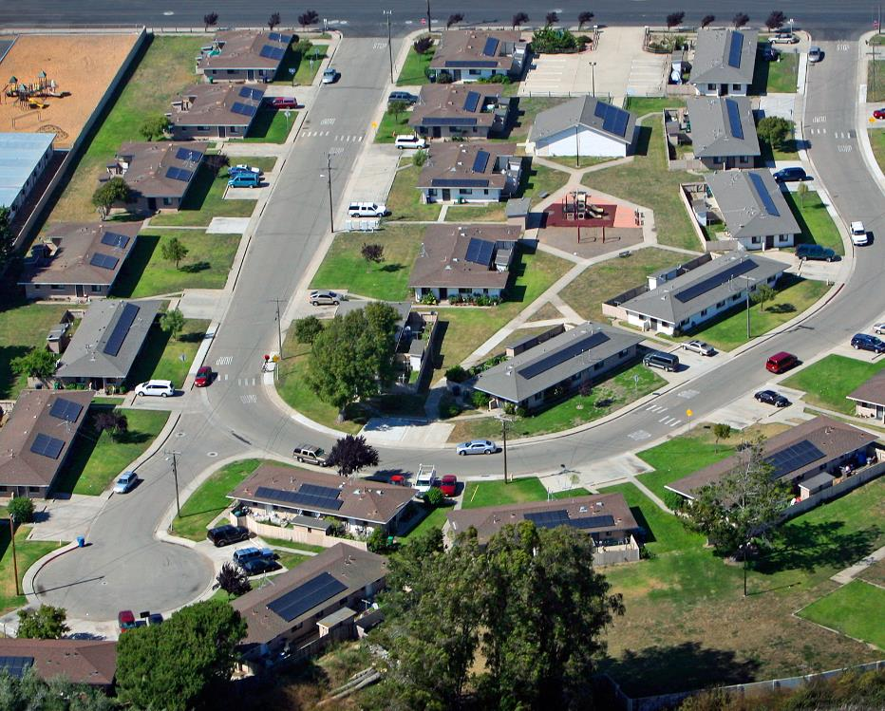
Public Housing Authority Success Story #2
Santa Barbara (CA) Housing Authority’s Portfolio EPC + Solar Project:
$12 million Energy Efficiency retrofit program at 856 scattered units, plus 1.7 MW (total) solar installation.
Targets to offset 100% of Resident consumption (not likely at 2 kW per dwelling unit, but pretty good!)
Clever and sophisticated aggregation of multiple funding sources (see next slide)
Notes:
Not 200 MW
Value of solar to commercial spaces was in being able to offer submarket rents to draw commercial enterprises into an area that was devoid of businesses; the solar helped ensure a successful mixed use development

Slide 19
Public Housing Authority Success Story #2
Santa Barbara (CA) Housing Authority’s Portfolio EPC + Solar Project:
Textbook Integration of multiple funding sources:
California Rebates
ARRA Grant
Long Term PPA @ $0.08/kWh, through a captive energy company, which allowed monetization of the ITC and MACRS depreciation
Leverage of cash flows created from the Energy Efficiency retrofits in Phase One
Notes:
Not 200 MW
Value of solar to commercial spaces was in being able to offer submarket rents to draw commercial enterprises into an area that was devoid of businesses; the solar helped ensure a successful mixed use development

Slide 20
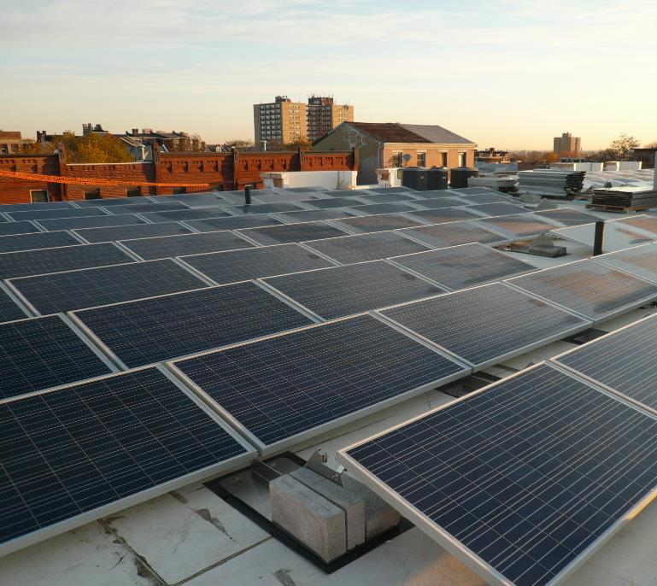
LIHTC Solar Project Success Stories
Multiple new Build LIHTC Projects in SEPA, sharing these characteristics:
Syndicated LIHTC groups are already set-up for pass-through monetization of the ITC and long term hold periods.
Project sizes allow PV system scale of at least 50 kW.
Development in parts of the State where electrical costs are higher than average.
Central Metering, or a substantial common area load.
Always seeking the additional layer of incentive – state, local, utility, wherever, whenever.
Notes:
See new PA Solar initiative announced 11-29-17

