Slide 1
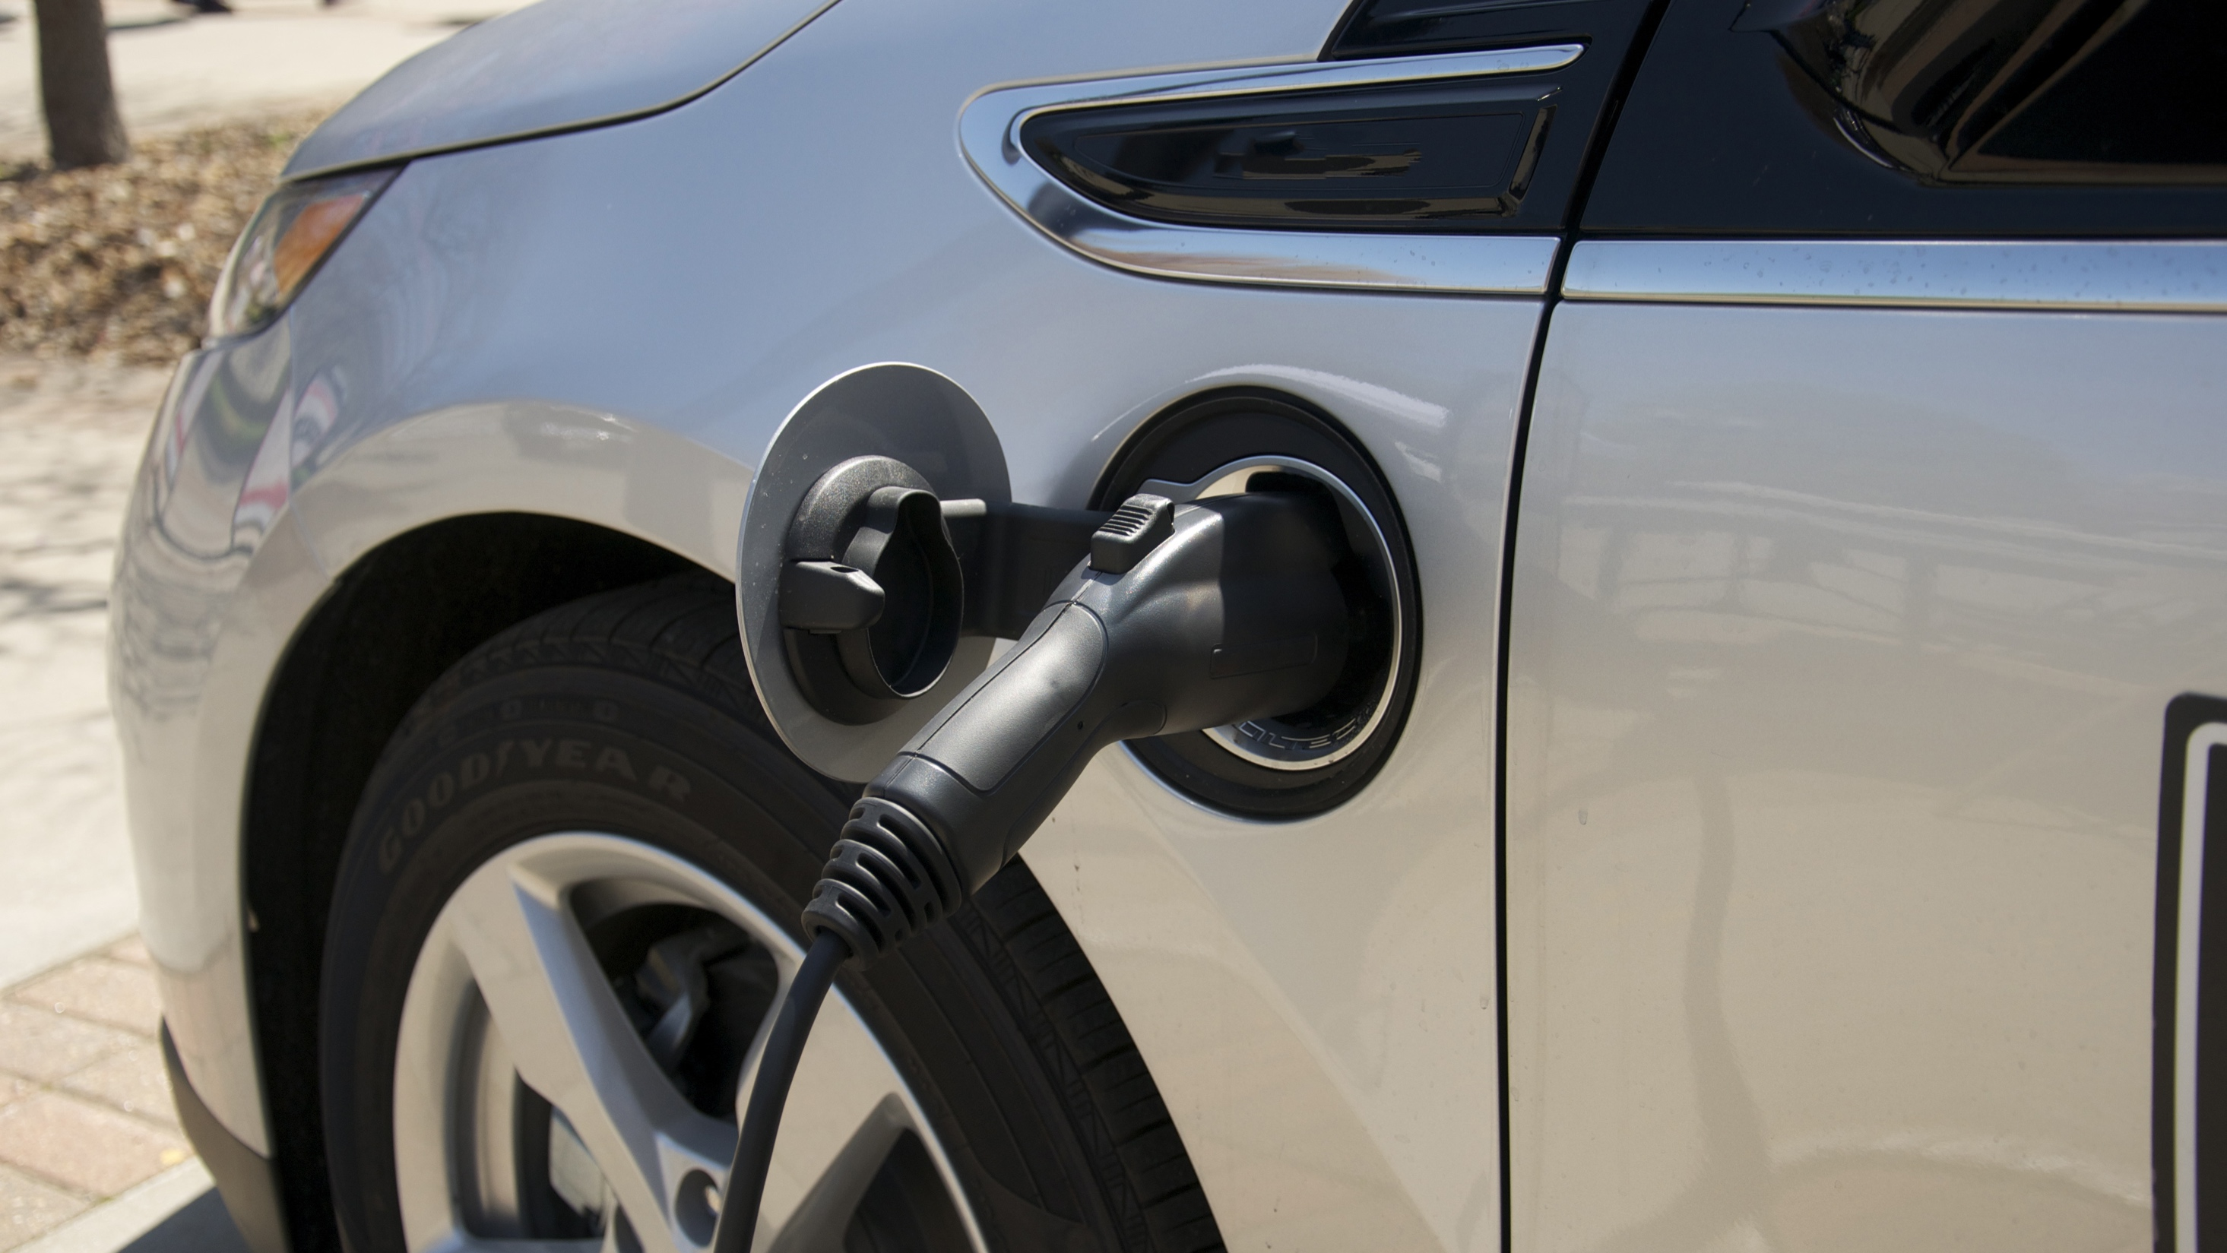

Pennsylvania electric vehicle roadmap
4/30/18

Slide 2
OVERVIEW
10:00-10:05am: Intro and Welcome
10:05-10:15am: PA DEP Secretary Welcome
10:15-12:00pm: Electric Vehicle Roadmap Background and Overview
12:00-12:30pm: BREAK FOR LUNCH
12:30m-1:30pm: Coalition Updates
1:30pm – 3:00pm: Business of the PA Drive Electric Coalition and Close of Meeting

Slide 3
OVERVIEW
10:00-10:05am: Intro and Welcome
10:05-10:15am: PA DEP Secretary Welcome
10:15-12:00pm: Electric Vehicle Roadmap Background and Overview
12:00-12:30pm: BREAK FOR LUNCH
12:30m-1:30pm: Coalition Updates
1:30pm – 3:00pm: Business of the PA Drive Electric Coalition and Close of Meeting

Slide 4
OVERVIEW
10:00-10:05am: Intro and Welcome
10:05-10:15am: PA DEP Secretary Welcome
10:15-12:00pm: Electric Vehicle Roadmap Background and Overview
12:00-12:30pm: BREAK FOR LUNCH
12:30m-1:30pm: Coalition Updates
1:30pm – 3:00pm: Business of the PA Drive Electric Coalition and Close of Meeting

Slide 5
OVERVIEW
10:00-10:05am: Intro and Welcome
10:05-10:15am: PA DEP Secretary Welcome
10:15-12:00pm: Electric Vehicle Roadmap Background and Overview
12:00-12:30pm: BREAK FOR LUNCH
12:30m-1:30pm: Coalition Updates
1:30pm – 3:00pm: Business of the PA Drive Electric Coalition and Close of Meeting

Slide 6
PROJECT SCOPE
Task No.
Description
(1)
Gather and compile federal, state, and local EV and EVSE data
(2)
Professional facilitation of PA EV Coalition meetings
(3)
Develop modeling scenarios
(4)
Create a Pennsylvania EV Roadmap

Slide 7
Stakeholder Engagement & Technical Analysis
Quarterly Meeting #1
Introduction & priorities for scenarios
Quarterly Meeting #2
Market barriers, opportunities, policy options
Quarterly Meeting #3
Scenario modeling results and draft recommendations
Quarterly Meeting #4
Presentation of final draft of roadmap
Notes:
In the interims, we facilitated subcommittee calls, conducted research, conducted interviews with experts, and wrote / edited the roadmap.
November, January, March, June

Slide 8
Roadmap Components
State of the EV Market in Pennsylvania
Next Generation EV Strategies
EV Market Penetration Scenario Modeling
Notes:
In the interims, we facilitated subcommittee calls, conducted research, conducted interviews with experts, and wrote / edited the roadmap.
November, January, March, June

Slide 9
1. State of the EV Market In Pennsylvania
Pennsylvania’s EV market is small, but growing
  0.6% EV (PHEV + BEV) market share in 2017 (24th nationwide; ZEV states are between 0.8%-4.9%)
  Number of EVs sold per year has increased an average of 36%/year between 2011 and 2017, to over 3,000 in 2017.
Market share of Zero Emission Vehicles in Pennsylvania, 2013-2017 (Source: Auto Alliance Advanced Technology Vehicle Sales Dashboard)
Annual sales of Zero Emission Vehicles in Pennsylvania, 2011-2017 (Source: Auto Alliance Advanced Technology Vehicle Sales Dashboard)
Notes:
In the interims, we facilitated subcommittee calls, conducted research, conducted interviews with experts, and wrote / edited the roadmap.
November, January, March, June

Slide 10
1. State of the EV Market In Pennsylvania
EVs are slightly higher share of registered vehicles in metro areas
  Philadelphia, where 26% of PA’s vehicles are registered, has highest EV share with 0.21%.
  38% of registered vehicles are outside of the six major metro areas, indicating need for a statewide strategy.
2017 Regional distribution of registered EVs in PA (Source: DVRPC and PennDOT)
Metropolitan Statistical Area (MSA) | BEVs | PHEVs | EVs | EV share of MSA total | Share of state LDVs in MSA
Allentown-Bethlehem-Easton, PA-NJ | 75 | 311 | 386 | 0.12% | 4.0%
Harrisburg-Carlisle, PA | 147 | 473 | 620 | 0.16% | 4.8%
Lancaster, PA | 116 | 359 | 475 | 0.14% | 4.2%
Philadelphia-Camden-Wilmington, PA-NJ-DE-MD | 1,536 | 2,839 | 4,375 | 0.21% | 26.1%
Pittsburgh, PA | 721 | 1,351 | 2,072 | 0.14% | 18.4%
Scranton-Wilkes-Barre, PA | 71 | 153 | 224 | 0.06% | 4.5%
Rest of the state | 885 | 2,310 | 3,195 | 0.11% | 37.8%
TOTALS | 3,551 | 7,796 | 11,347 | 0.14% | 100%
Note: Analysis of MSAs that span multiple states only includes counties within Pennsylvania.
Notes:
In the interims, we facilitated subcommittee calls, conducted research, conducted interviews with experts, and wrote / edited the roadmap.
November, January, March, June

Slide 11
1. State of the EV Market In PennsylvaniA
Snapshot of Pennsylvania’s public EVSE
  Categorization of publicly listed EVSE data: Public, Semi-public, and Tesla.
  NREL National Plug-in Electric Vehicle Infrastructure Analysis projects PA needs 13,600 L2 workplace chargers, 9,200 L2 public chargers, and 810 DCFC chargers to support a 20% EV market share by 2030.
  As of 2018, PA has ~6% of estimated needed Level 2 public plugs, and about 18% of its estimated needed DCFC plugs*.
Publicly listed EVSE in Pennsylvania as of February 2018 (Source: AFDC.gov)
EVSE type | Level 1/ Level 2 | DCFC | Total
Public plugs: Available to all EV drivers | 458 | 82 | 540
Semi-public plugs: Available to EV drivers with restrictions, such as being a customer, visitor, or employee of an establishment | 27 | 0 | 27
Tesla plugs: Available to Tesla drivers only | 86 | 62 | 148
Total | 571 | 144 | 715
Note: AFDC.gov does not collect data on workplace or residential EVSE
*Note: Includes semi-public and Tesla plugs
Notes:
In the interims, we facilitated subcommittee calls, conducted research, conducted interviews with experts, and wrote / edited the roadmap.
November, January, March, June

Slide 12
2. NEXT GENERATION STRATEIGES - TIMELINE
Primary category | Strategy | 0-2 years | 2-5 year | 5+ years
Targets and mandates | Utility transportation electrification mandate/directive
 | Statewide EV sales goals
Pricing-based policies | Residential and commercial EV rate designs
 | Expanded and improved AFIG rebate program
 | Utility-supported public and residential EVSE investment
Public planning and investment | Statewide EVSE network planning, investment, and communications
 | Fleet education, cooperative purchase, and technical assistance program
 | Municipal support, technical assistance, and grant program
Marketing, education, and outreach | EV Marketing and education campaign targeted at consumers
 | Workplace and multi-family EVSE education and outreach program
 | Dealer outreach and support program
Enabling regulations | EV-Ready building code amendments
Financing and business models | Explore development of financing for EVs/EVSE
Notes:
Questions
Should strategies only be classified as near term vs. long term? If so, what timeframe should the medium-term ones be moved to?
What should near term mean (how many years)?

Slide 13
NEAR-TERM STRATEGIES
Statewide EV sales goals
Utility transportation electrification directive
Expanded and Improved AFIG Rebate Program
Consumer marketing and education campaign
Dealer outreach and support program
Fleet education, cooperative purchase, and technical assistance program
Statewide EVSE network planning, investment, and communications program
Notes:
Questions
Should strategies only be classified as near term vs. long term? If so, what timeframe should the medium-term ones be moved to?
What should near term mean (how many years)?

Slide 14
STATEWIDE EV SALES GOALS
Category | Targets and Mandates
Time frame | Near-term (0-2 years)
Description: This strategy involves setting a statewide EV sales or deployment goal via legislative or administrative action by a certain date. Primarily, this strategy would focus on private light duty vehicles, though other sales goals could be set for the state fleet, municipal public fleets, and commercial fleets. In the future, Pennsylvania could consider adopting or joining a binding target like the ZEV mandate program that requires automakers to sell a certain share of ZEVs per year in states that have joined the program.
Pathway to implementation: Administrative or legislative action that sets EV deployment goals for certain horizon years for different fleets, including private vehicles, the state fleet, municipal and other public fleets, and commercial fleets. The DEPA Coalition will work to set a realistic but accelerated adoption target, and consider ways to incentivize stakeholders to reach those targets, such as providing incentives to dealers, fleet owners, and other key stakeholders who reach certain sales metrics.
Key Collaborators/Stakeholders: DEP, Drive Electric Pennsylvania Coalition members, PA Governor’s office, dealers, fleets, and municipalities.
Notes:
Examples from other states
Colorado’s Electric Vehicle Action Plan sets a goal to increase light duty EV adoption to reach 940,000 EVs deployed by 2030, a figure in line with the states’ earlier planning efforts’ high EV growth scenarios.
Washington State’s 2015 Electric Vehicle Action Plan adopted a goal of increasing the number of EVs on the state’s roads from 10,000 in 2014 to 50,000 by 2020. Progress towards the goal is tracked through the Results Washington dashboard.
Modeling scenarios: 358,000 EVs by 2028 in baseline scenario; 540,000 EVs by 2028 in ZEV MOU scenario; 966,000 by 2028 in 80x50 scenario.
Questions
Does description have right elements, level of detail?
Is the strategy in the right time frame?
Suggestions for Implementation Pathway?
Suggestions for Key Collaborators/Stakeholders?

Slide 15
UTILITY TRANSPORTATION ELECTRIFICATION DIRECTIVE
Category | Targets and Mandates; Public Planning and Investment
Time frame | Near-term (0-2 years)
Description: This strategy would enable and encourage utilities to invest in transportation electrification. As an example, the legislature could direct the Pennsylvania PUC to open a proceeding asking utilities to submit proposals that meet the certain criteria, such as 1) Achieve a fair and reasonable rate of return for projects that advance transportation electrification while providing long-term benefits to consumers, the grid, the utility, and society. 2) Encourage competition in the EVSE market and seek to achieve other policy goals to be determined by the legislature and PUC. 3) Include specific interventions such as EV electricity tariffs, EVSE investment, and education and outreach provisions.
Pathway to implementation: This strategy could be implemented through the passage of HB1446 or similar legislation, or through a PUC directive like in Maryland that makes EV proposals optional or begins with pilot projects.
Key Collaborators/Stakeholders: Legislature, PUC, utilities, third party charging providers, Drive Electric Pennsylvania Coalition.
Notes:
Examples from other states:
Maryland: The Public Service Commission (PSC) has required investor-owned utilities to participate in grid modernization proceedings and provided the option to file an EV-specific proposal through a formal PSC hearing process. The PSC has been conducting a stakeholder process to inform utilities’ filings, through which it has engaged ratepayer advocates, environmental advocates, charging providers, retail electricity providers, and the Department of Transportation, among others.
Washington State: ESHB 1353 authorized the state Public Utilities Commission to enable utilities to invest in EVSE and receive a rate of return. The PUC first gathered stakeholder feedback to develop a policy statement that is intended to guide utility proposals.
California: SB350 in California declares transportation electrification to be in the public interest, directing investor-owned utilities to develop plans for investing ratepayer funds to advance transportation electrification. All plans are then reviewed and approved by the PUC. The proposals from the three largest utilities in California total investments worth $1 billion through a variety of projects designed to accelerate EV deployment for a variety of vehicle classes. The proceedings have started with a set of smaller pilot priority review projects, and will be followed by larger standard review projects.
Oregon: In 2016, the Oregon legislature passed a bill requiring their PUC to direct electric utilities to file applications for transportation electrification programs.
Questions
Does description have right elements, level of detail?
Is the strategy in the right time frame?
Suggestions for Implementation Pathway?
Suggestions for Key Collaborators/Stakeholders?

Slide 16
EXPANDED AND IMPROVED AFIG REBATE PROGRAM
Category | Pricing-based policies
Time frame | Near-term (0-2 years)
Description: This program proposes to expand and improve the AFIG rebate program in a number of ways, including: Expanding the AFIG rebate program by increasing the total program budget, thereby allowing for a larger number of rebates than in past years. The current rebate level of $1,750/year would be held constant. Ensuring durability of the incentives should be considered, including potential utility involvement. Altering PA's program to be like Connecticut's "dealer assignment" where rebate is directly applied at point of sale Providing a share of the rebate to dealers Increasing rebate levels for LMI participants Expanding eligibility to leased and pre-owned EVs. As the EV market matures, the program should be evaluated by a review committee to update the rebate targeting.
Pathway to implementation: The Coalition or one of its subcommittees would continually evaluate and review the targeting and funding of the AFIG program, and make recommendations for future targeting and funding sources to enable the program to grow over time. This may involve legislative action to increase the size of the program. The Coalition would continually revise targeting to vehicle types that are most poised for growth. The program should be developed with strong ties to education and outreach efforts to consumers and dealers.
Key Collaborators/Stakeholders: DEP, Drive Electric Pennsylvania Coalition, dealers.
Notes:
Questions
Include more equity components?
Does this make sense to target to different vehicle/market segments over time?
Move to near term?
Should DEPA Coalition be the review committee?
Comment that funding levels for AFIG statutorily set: is this strategy feasible? Worth aiming for?
Does description have right elements, level of detail?
Is the strategy in the right time frame?
Suggestions for Implementation Pathway?
Suggestions for Key Collaborators/Stakeholders?

Slide 17
CONSUMER MARKETING AND EDUCATION CAMPAIGN
Category | Marketing, education, and outreach
Time frame | Near-term (0-2 years)
Description: This strategy would include the consumer-oriented educational programs identified by the DEPA Coalition. Principally this strategy would include 1) Creating and maintaining a DEPA Coalition centralized website, branded materials, social media presence, and potential media campaign informed by consumer survey research, and 2) Supporting Ride and Drives and other events designed to increase exposure to EVs.
Pathway to implementation: The Coalition will oversee the implementation and maintenance of a central website, branded materials, and social media presence, and will identify key partners to host Ride and Drives and other outreach events. A target for participation in outreach events will be developed by the Coalition based on the EV sales goal set. The Coalition will continue to meet to identify other key educational programs to increase consumer awareness and confidence in EVs. The Coalition will also identify whether the ongoing programs and efforts can be accomplished through partnerships and in-kind contributions from Coalition members, or whether additional funding will be needed.
Key Collaborators/Stakeholders: DEP, DEPA Coalition, Clean Cities Coalitions, utilities, dealers.
Notes:
Questions
Does description have right elements, level of detail?
Is the strategy in the right time frame?
Suggestions for Implementation Pathway?
Suggestions for Key Collaborators/Stakeholders?

Slide 18
DEALER OUTREACH AND SUPPORT PROGRAM
Category | Marketing, education, and outreach
Time frame | Near-term (0-2 years)
Description: This strategy would involve creating a statewide dealer outreach, education, and support program to provide tools and resources needed for dealers to sell more EVs, with an initial goal to recruit at least 10 dealerships in the largest MSA regions of Pennsylvania. This program should be closely integrated with the EV Sales Goals and AFIG Rebate strategies, by providing incentives to dealers who reach certain sales percentages or goals. The program could also involve developing a specialized sales tool kit and marketing or media kits for dealers, including tools like an Electric Showcase education center or Virtual EV showrooms.
Pathway to implementation: The Coalition would work with interested dealers, associations of dealers, and other key stakeholders to design a program to support and incentivize dealers to increase EV sales and participate in the AFIG rebate program.
Key Collaborators/Stakeholders: DEP, Drive Electric Pennsylvania Coalition, DGS, auto dealers, automakers.
Notes:
Questions
Does description have right elements, level of detail?
Is the strategy in the right time frame?
Suggestions for Implementation Pathway?
Suggestions for Key Collaborators/Stakeholders?

Slide 19
FLEET EDUCATION, COOPERATIVE PURCHASE, AND TECHNICAL ASSISTANCE PROGRAM
Category | Marketing, education, and outreach
Time frame | Near-term (0-2 years)
Description: A fleet education, cooperative purchase, and technical assistance program could include a variety of programs to support public and private fleet transition to electric vehicles and infrastructure technologies, including: Outreach to fleet managers, including ride and drive events for fleet operators Development of specialized tools, procurement guides, procurement templates, sample RFP language, and other materials to support fleet EV procurement Engagement with DGS Increased EV options to COSTARS members by promoting COSTARS participation by contracted EV vendors, as well as connecting municipalities with other EV/EVSE procurement options such as the National Joint Powers Alliance (NJPA) Purchasing Cooperative.
Pathway to implementation: The Coalition may design a program to provide technical support to a variety of Pennsylvania fleets, and may identify whether the ongoing programs and efforts can be accomplished through partnerships, or whether additional funding will be needed. The existing Alternative Fuels Technical Assistance Program could be adapted or expanded to implement this strategy. Over time, this strategy should be updated to refine the types of vehicles and EVSE offered through COSTARS.
Key Collaborators/Stakeholders: DEP, Drive Electric Pennsylvania Coalition, Clean Cities Coalitions, DGS, DVRPC and other MPOs, federal cooperative purchasing programs, public and private fleets, dealers, OEMs.
Notes:
Questions
Does description have right elements, level of detail?
Is the strategy in the right time frame?
Suggestions for Implementation Pathway?
Suggestions for Key Collaborators/Stakeholders?

Slide 20
STATEWIDE EVSE NETWORK PLANNING, INVESTMENT, AND COMMUNICATIONS PROGRAM
Category | Public Planning and Investment
Time frame | Near-term (0-2 years)
Description: Through this strategy, the state would lead planning efforts to ensure an adequate statewide public EVSE network to enable long distance travel on major corridors and to key destinations and tourist attractions such as state parks throughout the state. The state transportation agency would create a statewide public EVSE network plan that fills any gaps left by local and regional EVSE investment, develop an investment plan leveraging VW settlement or other available funds to fill those gaps, and establish a uniform signage and state EVSE route designation program to advertise and communicate public EVSE availability to drivers and complement federal Interstate highway designations.
Pathway to implementation: This strategy could be implemented by expanding the AFIG FAST Act Corridor Infrastructure Grant program to include a state route EVSE designation program, and developing a network plan and investment strategy. VW settlement funds may also be able to be leveraged for this strategy, through the PA Fueling Cleaner Grants and Rebates (total of $17.7M), designed to fund DCFC and Level 2 chargers respectively.
Key Collaborators/Stakeholders: DEP, Drive Electric Pennsylvania Coalition, PennDOT, utilities, third party charging providers, MPOs.
Notes:
Questions
Does description have right elements, level of detail?
Is the strategy in the right time frame?
Suggestions for Implementation Pathway?
Suggestions for Key Collaborators/Stakeholders?

Slide 21
MEDIUM-TERM STRATEGIES
Residential and commercial EV rate designs
Public and residential EVSE investment
Workplace and multi-family EVSE education and outreach program
Municipal technical assistance, planning, and grant program
Notes:
Questions
Should strategies only be classified as near term vs. long term? If so, what timeframe should the medium-term ones be moved to?
What should near term mean (how many years)?

Slide 22
RESIDENTIAL AND COMMERCIAL EV RATE DESIGNS
Category | Pricing-based policies
Time frame | Medium term (2-5 years)
Description: This strategy encourages the development of specialized EV rates for both residential and commercial applications across Pennsylvania utilities and electricity suppliers, as well as the deployment of advanced meters and other hardware and software technologies that may be needed to enable lower rates for off-peak charging. Some utilities are beginning to offer specialized EV rates, such as: Time-of-use rates (TOU) to encourage residential charging overnight Rates tailored to public EVSE, which tends to be utilized during the day Rates and demand charges tailored for DCFC, which draw electricity from the grid at a higher capacity. This strategy would involve pursuing solutions to mitigate high demand charges, such as pairing stationary storage with DCFC or introducing new rate designs.
Pathway to implementation: This strategy could be encouraged through the transportation electrification legislative initiative. Each utility and electricity supplier would be encouraged to analyze and propose rate designs based on their own peak periods, timelines for introducing advanced meters, and other considerations and constraints.
Key Collaborators/Stakeholders: PUC, utilities, electricity suppliers, third party charging providers.
Notes:
Questions
Should smart chargers be mentioned, given costs to consumers?
Does description have right elements, level of detail?
Is the strategy in the right time frame?
Suggestions for Implementation Pathway?
Suggestions for Key Collaborators/Stakeholders?

Slide 23
PUBLIC AND RESIDENTIAL EVSE INVESTMENT
Category | Pricing-based policies; Public Planning and Investment
Time frame | Medium term (2-5 years)
Description: Pennsylvania’s utilities could be enabled and encouraged to develop a range of programs to deploy different types of EVSE in their service territory, including single-family residential, multi-family residential, workplace, fleet, and public charging. Regulators would enable utilities to invest in EVSE and receive a fair and reasonable rate of return on their investment if the charging stations or incentives met certain criteria. The programs could be structured to enable utilities to own and operate charging infrastructure, as well as provide incentives that support ownership by site hosts like workplaces. The PUC may need to ensure that the competitive EVSE market is maintained and can grow as EV adoption increases, and monitor the level of investments that can be rate-based by utilities over time.
Pathway to implementation: Following a legislative or PUC directive for transportation electrification, utilities would work with regional planning agencies and key stakeholders in their service area to develop a proposal for EVSE investment. Could entail more specific targeting to non-attainment areas for air quality, or “priority areas” like has been defined in HB1446. To maintain market competition, the PUC could limit the number of public EVSE over time, or limit utility investment to sunset when EV sales reach a certain level or other benchmark signifying market maturity. Should also be closely coordinated with EVSE programs from VW Settlement funds and AFIG grant program for EVSE
Key Collaborators/Stakeholders: PUC, utilities, MPOs, third party charging providers, DEPA Coalition.
Notes:
Questions
Should this include utility in the title?
Does description have right elements, level of detail?
Is the strategy in the right time frame?
Suggestions for Implementation Pathway?
Suggestions for Key Collaborators/Stakeholders?

Slide 24
WORKPLACE AND MULTI-FAMILY EVSE EDUCATION AND OUTREACH PROGRAM
Category | Marketing, Outreach, and Education
Time frame | Medium term (2-5 years)
Description: The DEPA Coalition would conduct outreach and provide support for EVSE deployment to organizations such as large employers, higher education institutions, and multi-family property owners or management firms, with a goal to provide direct education and support to 20-30 new organizations/entities annually on topics such as 1) Strategies, options, and costs for workplace and/or public charging; 2) Policy options and incentives; 3) Communication strategies to reach their customer base, employees, or residents; and 4) Power management, scheduling and load considerations.
Pathway to implementation: The Coalition may design a program to provide the above support to Pennsylvania’s major employers, property owners, and other institutions, and may also identify whether the ongoing programs and efforts can be accomplished through partnerships, or whether additional funding would be needed to implement this strategy. A program could also be developed to encourage commitments from major employers, property owners, and other key stakeholders.
Key Collaborators/Stakeholders: DEP, Drive Electric Pennsylvania Coalition, Clean Cities, major employers, third-party charging providers, higher education institutions, property owners, contractors, and developers.
Notes:
Questions
Does description have right elements, level of detail?
Is the strategy in the right time frame?
Suggestions for Implementation Pathway?
Suggestions for Key Collaborators/Stakeholders?

Slide 25
MUNICIPAL TECHNICAL ASSISTANCE, PLANNING, AND GRANT PROGRAM
Category | Public Planning and Investment; Marketing, Education, and Outreach
Time frame | Medium term (2-5 years)
Description: DEP, the DEPA Coalition, or another state agency would provide centralized support to municipalities to implement EV-readiness policy, regulations, and planning at the local level by developing model EV-ready zoning ordinances, parking policies, streamlined EVSE permitting processes, cooperative purchasing programs, and other tools and resources that can be adopted and adapted by municipalities statewide. The program would also include a grant program for leading EV Accelerator municipalities to develop, pilot, and document lessons learned from such regulation and planning activities to support the continued improvement of the program and development of new resources. Such a grant program can be administered through a state-driven application process that ensures equitable and proportionate distribution of funds to urban, suburban, and rural communities.
Pathway to implementation: The Coalition will work to identify the needed level of resources to implement this program, and who the lead partners and municipalities could be. For any local grants, a strong evaluation and reporting requirement may be considered to document lessons learned for other municipalities. Resources such as the eCode360 Library of municipal codes and cooperative procurement resources such as Fleets for the Future should be leveraged to seek out best practices that can be adopted by Pennsylvania municipalities.
Key Collaborators/Stakeholders: DEP, DEPA Coalition, DCED, DVRPC and other MPOs, municipalities
Notes:
Questions
Does description have right elements, level of detail?
Is the strategy in the right time frame?
Suggestions for Implementation Pathway?
Suggestions for Key Collaborators/Stakeholders?

Slide 26
LONG-TERM STRATEGIES
Explore development of financing for EVSE
EV-Ready building codes
Notes:
Questions
Should strategies only be classified as near term vs. long term? If so, what timeframe should the medium-term ones be moved to?
What should near term mean (how many years)?

Slide 27
STRATEGY: EXPLORE DEVELOPMENT OF FINANCING FOR EVSE
Category | Financing and Business Models
Time frame | Long term (5+ years)
Description: This strategy would begin with a study of potential innovative financing mechanisms for EV/EVSE deployment with priority focused on identifying solutions for financing residential EVSE, fleet vehicles and EVSE, and/or supporting low income households to afford EV technologies. Financing strategies to investigate could include on-bill repayment, inclusion of fleet conversions in Energy Service Performance Contracting, battery leases, Property Assessed Clean Energy (PACE) for residential EVs/EVSE, etc. Financing programs could be through utilities or an expanded version of the existing ACE program that provides loans and loan guarantees.
Pathway to implementation: As the DEPA Coalition considers the ability to expand the AFIG program and other incentives over time, they could choose to fund a study to identify promising financing strategies target market segments, and pathways and key stakeholders for implementation.
Key Collaborators/Stakeholders: DEPA Coalition, DCED, ACE program, utilities, dealers and OEMs, financing institutions.
Notes:
Questions
Does description have right elements, level of detail?
Is the strategy in the right time frame?
Suggestions for Implementation Pathway?
Suggestions for Key Collaborators/Stakeholders?

Slide 28
STRATEGY: EV READY BUILDING CODES
Category | Enabling Regulations
Time frame | Long term (5+ years)
Description: This strategy would involve amending the state's building code to ensure EV readiness in new construction (such as pre-wiring for charging stations) is promoted through the building code while retaining local flexibility. While the current building code does not present any explicit barriers to installing EVSE, building codes can help make installation simpler and less expensive for residents and site hosts in the future by avoiding expensive retrofits. EV-ready building codes may include requirements such as a percentage of parking spaces in commercial or multi-family developments being made “EV-ready”, meaning having sufficient electrical capacity to support EV charging, and the installation of wire and conduit to provide electricity to EV charging spaces.
Pathway to implementation: This strategy would involve coordination of EVSE requirements with the state legislature as well as several Pennsylvania agencies and AHJs to add EVSE-ready requirements to the state’s recent adoption of the 2015 ICC suite of building codes. In addition, model ordinance language created for use by PA municipalities to include into their local zoning requirements via the Municipal Technical assistance strategy can serve to address similar objectives as changes to the building code may take time.
Key Collaborators/Stakeholders: Drive Electric Pennsylvania Coalition, DEP, PA Department of Labor and Industry, Review and Advisory Committee
Notes:
Questions
Model zoning codes covered in previous municipal strategy – or should it be its own strategy and replace this?
Does description have right elements, level of detail?
Is the strategy in the right time frame?
Suggestions for Implementation Pathway?
Suggestions for Key Collaborators/Stakeholders?

Slide 29
SUMMARY | STRATEGIES IN DRAFT 1
Primary category | Strategy | 0-2 years | 2-5 year | 5+ years
Targets and mandates | Utility transportation electrification mandate/directive
 | Statewide EV sales goals
Pricing-based policies | Residential and commercial EV rate designs
 | Expanded and improved AFIG rebate program
 | Utility-supported public and residential EVSE investment
Public planning and investment | Statewide EVSE network planning, investment, and communications
 | Fleet education, cooperative purchase, and technical assistance program
 | Municipal support, technical assistance, and grant program
Marketing, education, and outreach | EV Marketing and education campaign targeted at consumers
 | Workplace and multi-family EVSE education and outreach program
 | Dealer outreach and support program
Enabling regulations | EV-Ready building code amendments
Financing and business models | Explore development of financing for EVs/EVSE
Notes:
Questions
Should all of these strategies be included? Is 13 strategies too many?
Any other adjustments to timeline?

Slide 30
3. SCENARIO MODELING - APPROACH
Out to 3 Horizon Years….
2023
2028
2033
4 EV Adoption Models…
Technology Advancement
Low
High
1
2
Average of 3rd Party
Projections
Low
Business as Usual
Policy Support
3
4
High
ZEV MOU
80 x 50
…12 Scenario Results
Notes:
Scenario modeling was conducted to present a set of plausible futures for the PA EV market and it’s impact. As much as we’d like to be able to say we can predict the future, none of these scenarios are being put forward as a prediction of how the PA EV market will grow.
As a reminder of what we discussed in January, we modeled four scenarios out to three horizon years for a total of 12 scenario results. The four scenarios reflect the intersection of the level of policy support with the level of technology advancement.
PA’s BAU case represents the scenario driven by low policy support and low technology advancement, the Low-High is a moderate scenario driven by low policy support and high technology advancement. The ZEV MOU represents a scenario driven by high policy support and low technology advancement, and the 80x50 scenario represents an EV future driven by high policy support and high technology advancement.
Our modeling approach, inputs, and assumptions were all vetted by our strategic partners at the Volpe Transportation Center.

Slide 31
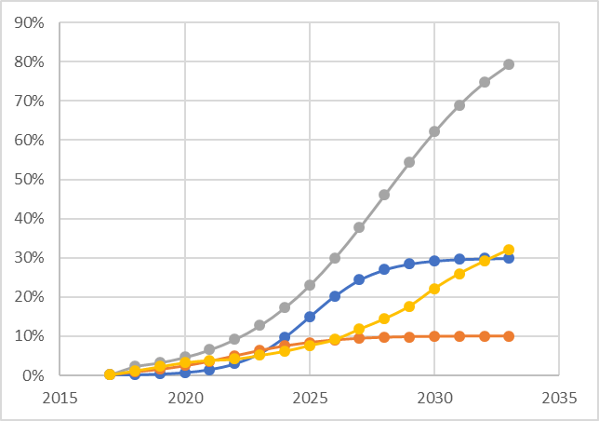
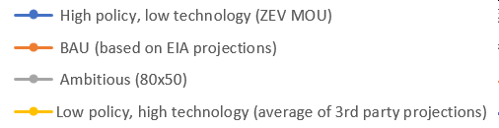
Scenario Modeling Results
PEV* sales as a percentage of total vehicle sales:
All Scenarios
Technology Advancement
Low
High
1
2
Low
Business as Usual
Average of 3rd Party
Projections
Policy Support
3
4
High
Ambitious
80 x 50
ZEV MOU
*For the purposes of this model, PEV is defined as battery electric and plug-in hybrids.
Notes:
The graph on the right shows PEV sales as a % of total LDV sales. For the purposes of this model, PEV is defined as both BEV and PHEV. Their results are presented together in these slides.
Grey, blue, yellow, orange lines…
Now I’ll go through each scenario’s results one by one.

Slide 32
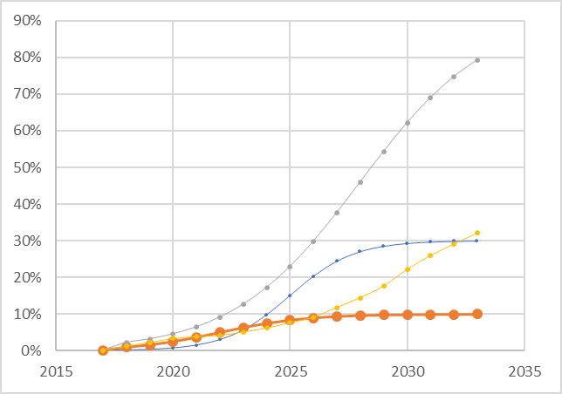
Scenario Modeling Results – Business as Usual
Technology Advancement
PEV* sales as a percentage of total vehicle sales
Low
High
1
2
Low
Business as Usual
Average of 3rd Party
Projections
Policy Support
3
4
High
Ambitious
80 x 50
ZEV MOU
 | 2023 | 2028 | 2033
PEV*: % of light duty sales | 6.3% | 9.6% | 10.0%
PEV: % of light duty fleet | 1.2% | 4.1% | 6.9%
Electric VMT: % of total VMT | 1.0% | 3.6% | 6.1%
*For the purposes of this model, PEV is defined as battery electric and plug-in hybrids.
Notes:
Shown by the orange curve in the graph on the right. As a reminder, this scenario is supported by EIA projections of EV adoption over time.
The table on the left shows the model results out to 2033.
By 2033, 10% of light duty sales are Evs
7% of the LD fleet is Evs
And 6% of total LDV miles traveled are by EVs

Slide 33
Scenario Modeling Results – Business as Usual
Technology Advancement
Low
High
1
2
Average of 3rd Party
Projections
Environmental Results to 2033
Low
Business as Usual
Policy Support
 | Result | 2033
Environmental | GHGs (metric tons) | 38,496,100
 | NOx (pounds) | 22,549,100
 | PM2.5 (pounds) | 2,296,700
3
4
High
Ambitious
80 x 50
ZEV MOU
Model Result | 2023 | 2028 | 2033
PEV*: % of light duty sales | 6.3% | 9.6% | 10.0%
PEV: % of light duty fleet | 1.2% | 4.1% | 6.9%
Electric VMT: % of total VMT | 1.0% | 3.6% | 6.1%
*For the purposes of this model, PEV is defined as battery electric and plug-in hybrids.
Notes:
This slide shows the environmental and economic results for BAU case
Not showing all results for each year on this slide, as it’s a lot of information to process in 45 minutes, but the complete results, methodology, and assumptions will be included in the roadmap document.
As we go through the slide deck for the following scenarios, the environmental results will be presented as a % change from the BAU scenario. In this scenario, GHG emissions in 2033 are about 38.5 million metric tons, NOX is about 22.5 million pounds, and PM2.5 is about 2.3 million pounds.
Below the environmental results are the economic results. We conducted a BCA for four different perspectives in PA. First I’ll explain what each of these perspectives means, then I’ll explain what the numbers represent.
TRC… SCT… PCT… NPCT….
Each of these values in the right hand column show the ratio of lifetime benefits to lifetime costs for each perspective. Therefore, if the value is greater than 1, it is cost-effective. If it’s below one, it is not cost effective (expensive) to that perspective, and if it’s right around 1, then the costs are equal to the benefits.
This scenario is cost-effective for all four perspectives.

Slide 34
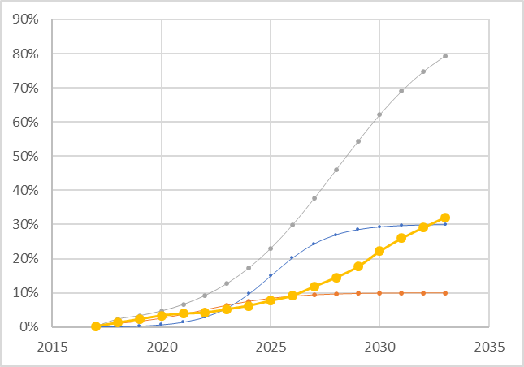
Scenario Modeling Results – Low Policy, High Tech
Technology Advancement
PEV* sales as a percentage of total vehicle sales
Low
High
1
2
Low
Business as Usual
Average of 3rd Party
Projections
Policy Support
3
4
High
Ambitious
80 x 50
ZEV MOU
 | 2023 | 2028 | 2033
PEV*: % of light duty sales | 5.2% | 14.5% | 32.1%
PEV: % of light duty fleet | 1.3% | 4.1% | 11.3%
Electric VMT: % of total VMT | 1.1% | 3.6% | 10.5%
*For the purposes of this model, PEV is defined as battery electric and plug-in hybrids.
Notes:
The low policy high tech scenario that averages projections from several 3rd party projections is shown by the yellow curve in the graph on the right.
The table on the left shows the model results out to 2033.
By 2033, 32% of light duty sales are Evs
11% of the LD fleet is Evs
And 10.5% of total LDV miles traveled are by EVs

Slide 35
Scenario Modeling Results – Low Policy, High Tech
Technology Advancement
Low
High
1
2
Environmental Results to 2033
Low
Business as Usual
Average of 3rd Party
Projections
 | Result | 2033
Environmental | GHGs (metric tons) | -2.8%
 | NOx (pounds) | -5.0%
 | PM2.5 (pounds) | -2.8%
Policy Support
3
4
High
Ambitious
80 x 50
ZEV MOU
 | 2023 | 2028 | 2033
PEV*: % of light duty sales | 5.2% | 14.5% | 32.1%
PEV: % of light duty fleet | 1.3% | 4.1% | 11.3%
Electric VMT: % of total VMT | 1.1% | 3.6% | 10.5%
*For the purposes of this model, PEV is defined as battery electric and plug-in hybrids.
Notes:
This slide shows the environmental and economic results….
By 2033 there is a 3% reduction in GHG emissions from the BAU
5% reduction in NOX
3% reduction in PM 2.5
This scenario is highly cost-effective for all four perspectives. This is because the scenario involves relatively low policy support but reaps many benefits from high technology advancement

Slide 36
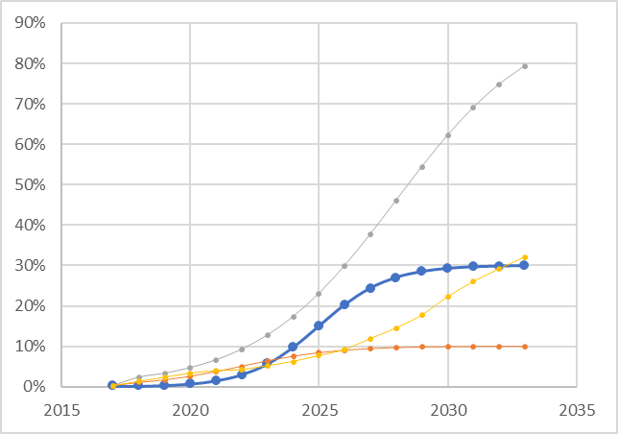
Scenario Modeling Results – ZEV MOU
Technology Advancement
PEV* sales as a percentage of total vehicle sales
Low
High
1
2
Low
Business as Usual
Average of 3rd Party
Projections
Policy Support
3
4
High
Ambitious
80 x 50
ZEV MOU
 | 2023 | 2028 | 2033
PEV*: % of light duty sales | 5.6% | 27.0% | 29.9%
PEV: % of light duty fleet | 0.6% | 6.1% | 15.7%
Electric VMT: % of total VMT | 0.5% | 5.5% | 14.5%
*For the purposes of this model, PEV is defined as battery electric and plug-in hybrids.
Notes:
Shown by the blue curve in the graph on the right.
The table on the left shows the model results out to 2033.
By 2033, 30% of light duty sales are Evs
16% of the LD fleet is Evs
And 14.5% of total LDV miles traveled are by Evs
ZEV MOU mandates 15% sales are EV by 2025. We modeled a similar rate of growth past 2025 that doesn’t exceed expert proejctions.

Slide 37
Scenario Modeling Results – ZEV MOU
Technology Advancement
Low
High
1
2
Environmental Results to 2033
Low
Business as Usual
Average of 3rd Party
Projections
 | Result | 2033
Environmental | GHGs (metric tons) | -3.2%
 | NOx (pounds) | -4.9%
 | PM2.5 (pounds) | -2.8%
Policy Support
3
4
High
Ambitious
80 x 50
ZEV MOU
 | 2023 | 2028 | 2033
PEV*: % of light duty sales | 5.6% | 27.0% | 29.9%
PEV: % of light duty fleet | 0.6% | 6.1% | 15.7%
Electric VMT: % of total VMT | 0.5% | 5.5% | 14.5%
*For the purposes of this model, PEV is defined as battery electric and plug-in hybrids.
Notes:
For the ZEV MOU scenario, by 2033 there is likely to be a 3% reduction in GHG emissions,
A 5% reduction in NOX, and
3% reduction in PM 2.5.
This scenario is cost effective only for the participants (EV owners) and society if environmental externalities are included.
For this to be considered CE to society, environmental benefits must be included.
In this scenario , there are high policy costs borne by the state, utilities, and programs, but without the assistance of technology advancement making Evs cheaper, you don’t see the benefit to all perspectives.

Slide 38
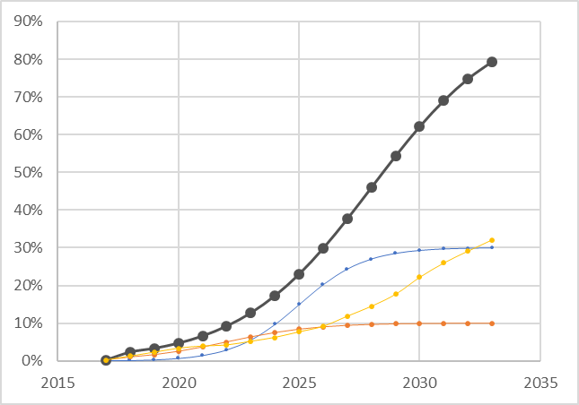
Scenario Modeling Results – 80 x 50
Technology Advancement
PEV* sales as a percentage of total vehicle sales
Low
High
1
2
EIA predictions
Average of predictions
From EPS, UBS,
Bloomberg, etc.
Low
Policy Support
3
4
High
ZEV MOU
80 x 50
 | 2023 | 2028 | 2033
PEV*: % of light duty sales | 12.7% | 46.0% | 79.3%
PEV: % of light duty fleet | 2.2% | 10.9% | 31.4%
Electric VMT: % of total VMT | 1.9% | 9.8% | 29.5%
*For the purposes of this model, PEV is defined as battery electric and plug-in hybrids.
Notes:
Black curve in the graph on the right
BY 2033, 79% of LDV sales will be Evs
31% of the LDV fleet will be Evs
30% of the LDV miles traveled will be driven by EVs

Slide 39
Scenario Modeling Results – 80 x 50
Technology Advancement
Low
High
1
2
Environmental Results to 2033
Low
Business as Usual
Average of 3rd Party
Projections
 | Result | 2033
Environmental | GHGs (metric tons) | -10.2%
 | NOx (pounds) | -18.6%
 | PM2.5 (pounds) | -10.1%
Policy Support
3
4
High
Ambitious
80 x 50
ZEV MOU
 | 2023 | 2028 | 2033
PEV*: % of light duty sales | 12.7% | 46.0% | 79.3%
PEV: % of light duty fleet | 2.2% | 10.9% | 31.4%
Electric VMT: % of total VMT | 1.9% | 9.8% | 29.5%
*For the purposes of this model, PEV is defined as battery electric and plug-in hybrids.
Notes:
By 2033, GHG emissions will be reduced by about 10% from BAU,
19% reduction in NOX
10% reduction in PM2.5
Benefits of reduced GHGs and Pollutants emissions will increase over time as the Pennsylvania grid increasingly relies on clean sources of electricity like solar and wind.
This scenario is cost-effective to all perspectives except for non-participants.
The primary benefit to nonparticipating ratepayers/taxpayers is grid benefits (downward pressure on rates due to more utility sales), whereas in every other test the primary benefit is gasoline savings. in this particular scenario, gas savings are enough to make the other tests cost effective, but grid benefits aren't enough to make the RIM cost-effective

Slide 40
OVERVIEW
10:00-10:05am: Intro and Welcome
10:05-10:15am: PA DEP Secretary Welcome
10:15-12:00pm: Electric Vehicle Roadmap Background and Overview
12:00-12:30pm: BREAK FOR LUNCH
12:30m-1:30pm: Coalition Updates
1:30pm – 3:00pm: Business of the PA Drive Electric Coalition and Close of Meeting

Slide 41
OVERVIEW
10:00-10:05am: Intro and Welcome
10:05-10:15am: PA DEP Secretary Welcome
10:15-12:00pm: Electric Vehicle Roadmap Background and Overview
12:00-12:30pm: BREAK FOR LUNCH
12:30m-1:30pm: Coalition Updates
1:30pm – 3:00pm: Business of the PA Drive Electric Coalition and Close of Meeting

Slide 42
OVERVIEW
10:00-10:05am: Intro and Welcome
10:05-10:15am: PA DEP Secretary Welcome
10:15-12:00pm: Electric Vehicle Roadmap Background and Overview
12:00-12:30pm: BREAK FOR LUNCH
12:30m-1:30pm: Coalition Updates
1:30pm – 3:00pm: Business of the PA Drive Electric Coalition and Close of Meeting

Slide 43
THANK YOU!
Any Questions?
Neil Veilleux | neil.veilleux@cadmusgroup.com
Erin Camp | erin.camp@cadmusgroup.com
Kelly Blynn | kelly.blynn@cadmusgroup.com
Stephe Yborra | stephe@yborraservices.com

