Slide 1
Moving From Debate to Action
Kyle Beatty, Willis Re Inc.
WRN content provided by:
Dr. James Done, NCAR
Dr. Jane Strachan, Univ. of Reading

Slide 2
Disclaimer
The statements and opinions included in this presentation are those of the individual speakers and do not necessarily represent the views of Willis Re Inc., its parent or sister companies, subsidiaries, affiliates, or its management.

Slide 3
“WHAT IS YOUR OPINION?”

Slide 4

THE CLIMATE CHANGE “DEBATE”
A. Global warming is simply not occurring
B. If global warming is occurring, we don't know why
C. We do know, however, that it is not caused by humans
D. Even if people cause it, global warming is not bad
E. In any event, global warming cannot be stopped

Slide 5
BUSINESS INTERESTS IN CLIMATE CHANGE
Financial risks (property catastrophe, investment returns, cap and trade…)
Costs of business (reporting and state/federal/global regulation…)
Litigation risk (D&O, pollution liability …)
Market demands (buyers, suppliers, employees…)
Investor demands (SEC, CDP…)
Competitive forces
New markets and products
Social responsibility / reputation
External Forces or Opportunities? – a matter of perspective

Slide 6
Physical risk - from direct impacts of Climate Change
Litigation risk – happening in US now, but not sticking
Competitive risk – change from carbon intensive processes & products
Reputation risk – real or perceived lack of response to Climate Change
Regulatory risk – federal and global regulation
Financial risk – associated with Cap & Trade market

Slide 7
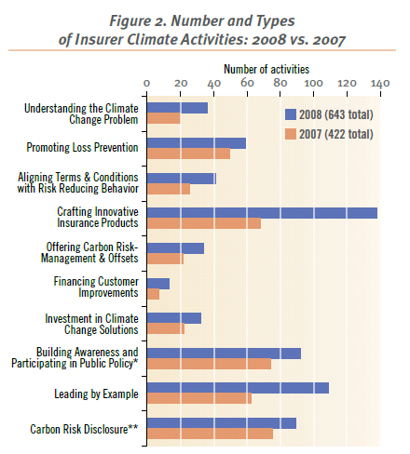
EXAMPLES OF INSURER CLIMATE ACTIVITIES
  Awareness of external stakeholders positions
  Targeted product design based on changes in consumer behavior
    “Green buildings”
    Liability coverage
    Pay-as-you-drive
    CCS project coverage
  Portfolio risk assessments
Source: Mills / CERES, 2009

Slide 8
NAIC CLIMATE DISCLUSURE SURVEY
Required to submit response to domestic regulator by May 1
8 question, qualitative survey
Approx. 300 insurers meet reporting requirements by 2011
Property Casualty Insurers Association of America, Jan. 8, 2010
“Our members’ concerns still resides in the intent of this effort and regulators’ responsibility and ability to ensure that such a survey, administered under their regulatory authority, is facilitated for the sole purpose and benefit of insurance consumers, insurer solvency and a competitive marketplace.”

Slide 9
LARGEST INSURANCE COLLABORATION
  Over 30 member institutions in the WRN

Slide 10
TWO PARALLEL TRACKS OF RESEARCH
Educational alliance with Scripps Oceanography Institute
  Educate primary insurers on current state of science
  Inform business strategies regarding risks and opportunities associated with climate change
Unprecedented research with Willis Research Network (WRN)
  Focus on the implication on regional hazard changes
  Conducted in partnership with global re/insurance industry

Slide 11
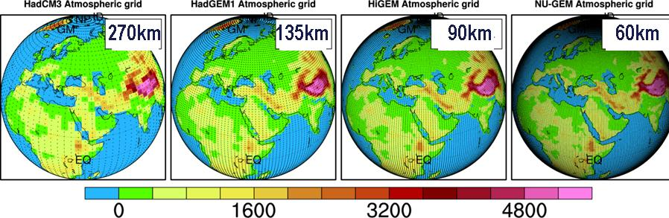
GLOBAL TROPICAL CYCLONE RESEARCH
  The Univ. of Reading and NCAR developing a global catastrophe event set from GCMs
    300 years of present day global climate conditions
    Specific focus on NH tropical cyclone patterns
    Goal to reduce reliance on limited historical data, with current focus on Asia-Pacific region

Slide 12
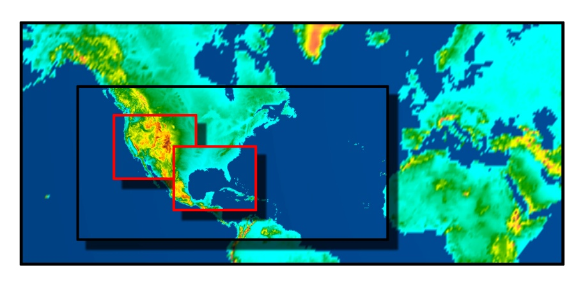
REGIONAL IMPLICATIONS OF CLIMATE CHANGE
  NCAR downscaling GCM outputs from A2 climate scenario to evaluate regional impacts
    Projections of critical hurricane parameters over the next 50 years, with confidence intervals
    Explore ways to combine these dynamical and statistical methods to create improved event sets
    Goal of producing an adaptable damage index
Global model data
4km
Image by Steve Dayo @UCAR
12km
36km

Slide 13

OUR GOALS
  Understand the current science
  Predict future climate with leading models
  Assess implications in a risk-based framework
  Consult with industry on management strategies

