Slide 1

Pennsylvania Home Energy Rebates
Public Feedback Meetings
Josh Shapiro, Governor
Jessica Shirley, Acting Secretary

Slide 2

Agenda
Introductions
Program Overview & Goals (HER & HEAR)
Justice40 Initiative
Program Participation
Questions & Feedback

Slide 3
Energy Programs Office Mission
Work as partners with individuals, organizations, governments and businesses to achieve a balance in the energy sector for deploying energy technologies that prevent pollution, protect our natural resources while ensuring affordable and abundant energy resources for Pennsylvanians that supports economic growth.

Slide 4
DOE's Home Energy Rebates
Home Efficiency Rebates (HER)
  Involves retrofitting homes to enhance energy efficiency
  PA allocated $129,980,260.00
Home Electrification and Appliance Rebates (HEAR)
  Encourages adoption of appliances that are electric and consume less energy and lower costs
  PA allocated $129,226,380.00

Slide 5
Program Goals
Enhance Quality of Life
Reduce Energy Burden
Reduce carbon emissions
Market Transformation
Equitable program distribution

Slide 6
Home Electrification & Appliance Rebates
Low-and Moderate-Income households (earning 150% or less of AMI)
  Higher rebate value to less than 80% AMI households
  Rebate capped at $14k/unit
High-Efficiency Equipment: Heat Pumps (HVAC & Water Heaters), Stoves, Clothes Dryers, etc.
Electrical Upgrades: Electric Load Service Center, Insulation, Air-Sealing, Ventilation, Wiring, etc.

Slide 7
Next Steps
Gather input on programs
Finalize Program Design in November 2024
Launch Program (anticipated Q1 2025)

Slide 8
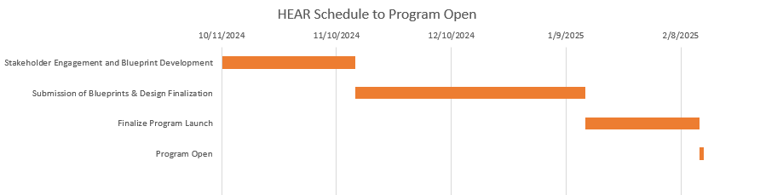
HEAR Tentative Timeline
NOTE: This schedule is subject to change based off the various approval windows the Home Energy Rebate Programs must go through

Slide 9
Home Efficiency Rebates
Low-Income Multi-family Affordable Housing
Need a minimum of 20% Energy Savings to participate
  Air-sealing, insulation, heat pump HVAC & Water Heaters, etc.
Higher rebates available at 35% or greater energy savings
Higher rebates available for families with incomes less than 80% AMI

Slide 10
Next Steps
Gather input on programs
Hire Program Implementer
Finalize Program Design in Nov/Dec 2024
Launch Program (anticipated Q2 2025)

Slide 11
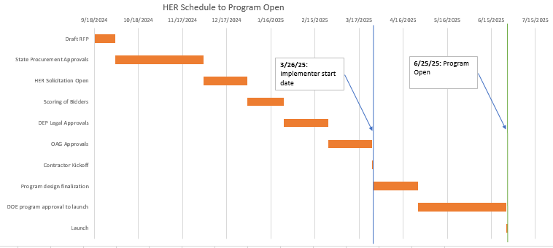
HER Tentative Timeline
NOTE: This schedule is subject to change based off the various approval windows the Home Energy Rebate Programs must go through

Slide 12
Justice40 Initiative
Ensure at least 40% of investments flow to disadvantaged communities (DACs)
Utilizing Federal CJEST map to define DACs
$200 contractor incentive for completing projects in DACs

Slide 13
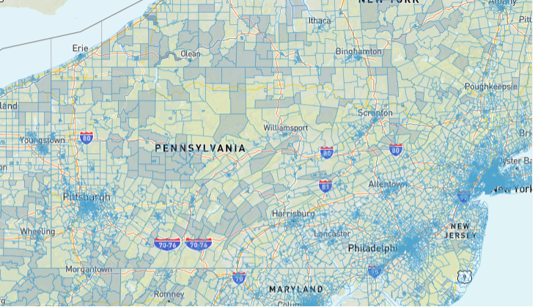
DACs in PA

Slide 14
Participation within Program
Documents: IRS 1040 Form, Employer W-2 for each member of household, proof of residence
Categorical eligibility examples:
Low-income Home Energy Assistance Program (LIHEAP)
Medicaid
Food Assistance Program (SNAP)
Head Start
Lifeline for Affordable Communications
National School Lunch Program (NSLP)
Housing Improvement Program (HIP)
Housing Opportunities for Persons with AIDS
Supplemental Security Income (SSI)
Home Weatherization Assistance Program (aka WAP)
Women, Infants & Children (WIC)
Asset Limited Income Constrained Employed (ALICE)
Public Housing Authorities

Slide 15
Feedback Sessions
Shamokin: Tuesday, October 15th @6pm
Pottstown: Wednesday, October 16th@ 6pm
Pittsburgh: Thursday, October 17th @ 6pm
Virtual: Monday, October 24th @ 6pm
Philadelphia: Tuesday, October 29th @ 6pm

Slide 16
Community Survey
Simply scan the QR code with your mobile device to access the survey.
The survey will take approximately 5 minutes of your time.
Your feedback is crucial to refining our processes and ensuring a seamless experience for everyone.
Stakeholder Survey QR Code:

Slide 17
Thank you!
With questions, email:
RA-EPHomeEngRebates@pa.gov

