Slide 1
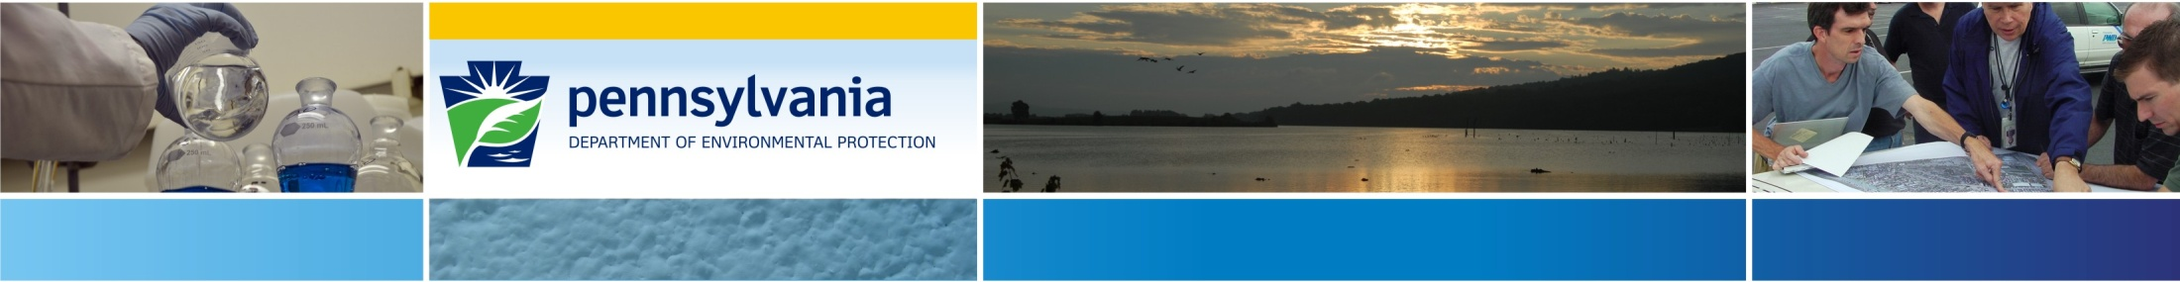

Act 2 Report Submissions
September 2024
Josh Shapiro, Governor
Jessica Shirley, Acting Secretary
Notes:
Wouldn’t it be great if every one of your submissions to the Department were accepted the first time without comment? I know that would be a time saver for DEP, and an even greater time saver for you as a remediator. My name is Carolyn Fair and I work in the Land Recycling Program and one of my assignments was to assemble a work team from across all six regions of DEP to address this goal: Complete Act 2 Report Submissions every time. The work team consisted of members from across the state and at all levels from Managers, to Administrative Assistants; veterans to new employees. This presentation summarizes what we found as keys to a complete Act 2 report submission. Let’s get started!

Slide 2
Overview
AGENDA:
Elements of a Report Submission
Additional Background on Important Submittal Pieces
Submittal Process
Common Errors
Notes:
As our agenda, we will cover what the basic elements of a report submittal are and then follow up with additional background on some of those important submittal pieces. Then we will cover the submittal process itself, and end with discussing some common errors that we see often.

Slide 3
Overview
GOALS:
To reduce errors and omissions in Act 2 Report Submittals
Eliminate Administrative Deficiencies and Disapprovals due to inaccurate submissions
Notes:
The two goals of the presentation are to reduce errors and omissions in Act 2 report submittals, and to eliminate Administrative Deficiencies and Disapprovals due to inaccurate submissions.

Slide 4
Helpful Documents/Links
Technical Guidance Manual (TGM) Section II
Forms and Lists (pa.gov)
Question and Answer Document (pa.gov)
ePermitting (pa.gov)
Notes:
This is a list of Helpful Documents and Links to assist with Act 2 Report submissions. Following the webinar, this presentation will be posted on the Land Recycling Program webpage, and you should find this page helpful then as these are active links. We will look at some details of each of these throughout this training. Reference Slide

Slide 5

Overview
Act 2 Report Submissions:
Notice of Intent to Remediate (NIR)
Remediation Reports
Final Report (FR)
Remedial Investigation Report
Risk Assessment Report
Cleanup Plan
Baseline Environmental Report
Notes:
When we talk about Act 2 Report Submissions, that includes the NIR as well as follow-up remediation reports that come in to the Department. Those remediation reports include the FR, Remedial Investigation Report, Risk Assessment Report, Cleanup Plan, and Baseline Environmental Report. Additional details can be found in the TGM Section II.A.3 regarding the Remediation Reports that need to be submitted depending on which Act 2 standard is being achieved.

Slide 6
Notice of Intent to Remediate
NIR Submissions: (TGM II.A.3)
NIR Package includes
Proof of municipal and public notification of NIR
NIR Form
Notes:
The Notice of Intent to Remediate or NIR submissions follow section II.A.3 of the TGM as is noted here on the slide. The package for an NIR submission includes … Reference Slide We will talk in detail about each of these elements starting with the NIR Form itself.

Slide 7
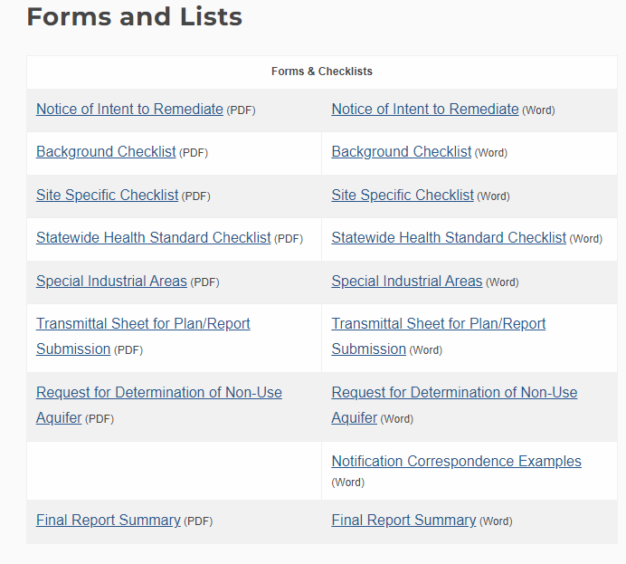
NIR Form
Notes:
The NIR Form can be found on the Forms and Lists link that we saw on Slide 4. This is what it looks like on the LRP webpage when you click that link. You will notice there are lots of helpful things on this page and we will talk about a few of them coming up here. The NIR form is here in red. Notice that for each of the forms listed there is a PDF version and a Word version. When you select the Notice of Intent to Remediate here it will take you to the form itself which looks like this:

Slide 8
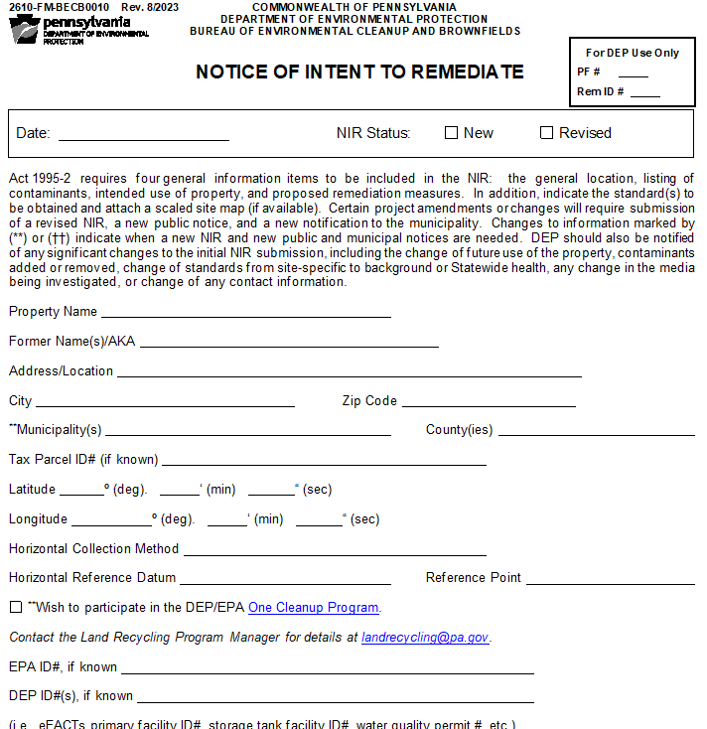
Notice of Intent to Remediate
Notes:
The NIR form has recently been updated so take a note if you may be using an old version that you have on your desktop to get this newest version. The first section is identifying information about the site.

Slide 9
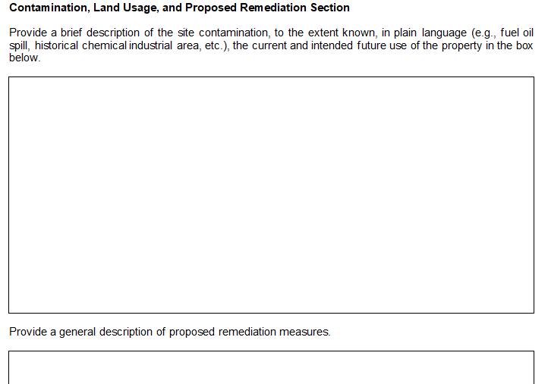
Notice of Intent to Remediate
Notes:
The next section is a description of the site contamination along with the current and intended future use of the property, and a description of the proposed remediation measures.

Slide 10
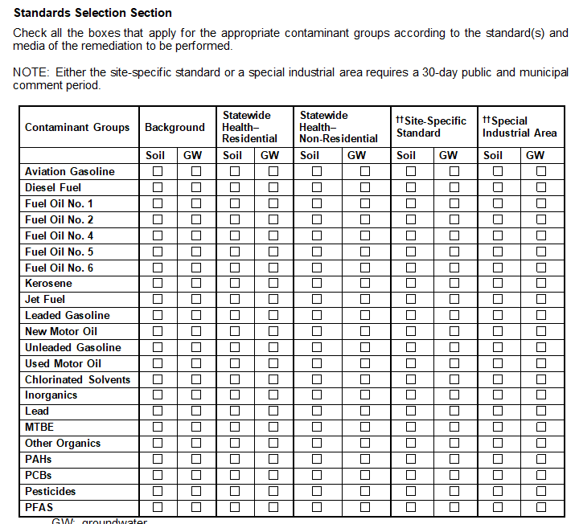
Notice of Intent to Remediate
Notes:
The next section allows the remediator to select the contaminant groups present on the site in soil and groundwater according to the Act 2 standard that will be met.

Slide 11
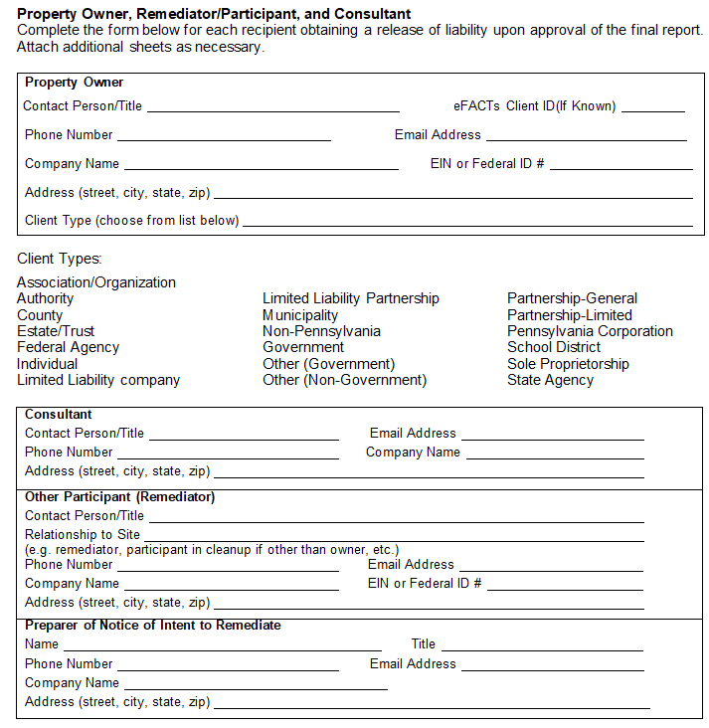
Notice of Intent to Remediate
Notes:
The final section of the NIR identifies all recipients who will obtain a release of liability when the final report is approved. This includes the Property Owner, the Consultant, any other Remediator identified as well as the preparer of the NIR.

Slide 12
Revision of an NIR
Notes:
Please note that on the first page of the NIR form, it asks you to indicate if the NIR is New or Revised. Let’s talk about the things that may trigger a revision to an NIR.

Slide 13
Revision of an NIR
A revised NIR along with new public and municipal notifications must be submitted through the same process for the following reasons:
Change or addition of municipality
Change to site-specific standard, combination of standards, or special industrial area
Change in project scope or future use of the property
Change to contaminants or media being investigated
Decision to participate in the One Cleanup Program
Notes:
You may need to submit a revised NIR for the reasons listed on this slide. Please note that if you do need to submit a revised NIR, that will have to come with NEW public and municipal notifications for that change. Reference Slide
So that covers the first element in the NIR submission package: the NIR form.

Slide 14
Proof of Notification
Proof of notification: (TGM II.A.3)
A copy of the proposed text of the newspaper notice and expected publication date. This includes publication in an online news site.
A copy of the letter mailed to the municipality along with one of the following:
a certified mail receipt
a read-receipt
a confirmation email from a municipal email account
Notes:
The next element in the NIR package is Proof of notification. Proof of notification is satisfied by the submission of 1 or 2 . While this slide is in reference to NIR specifically, these examples of proof of notification also apply to all Remediation Report submissions. Reference Slide The next three slides show examples of what this satisfactory Proof of notification looks like.

Slide 15
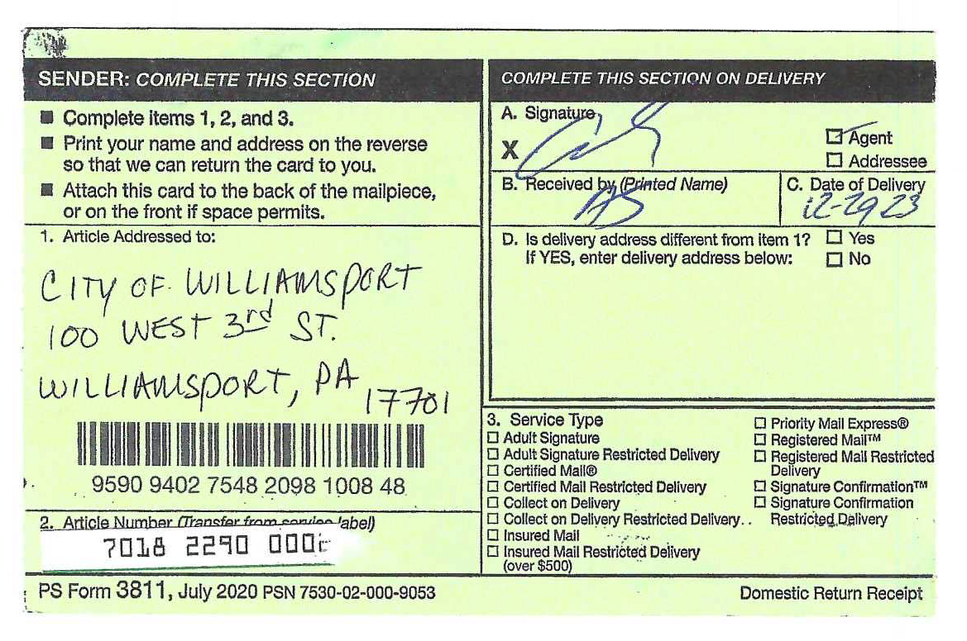
Proof of Notification
Proof of notification:
A certified mail receipt
Notes:
Proof of notification is satisfied by a certified mail receipt.

Slide 16
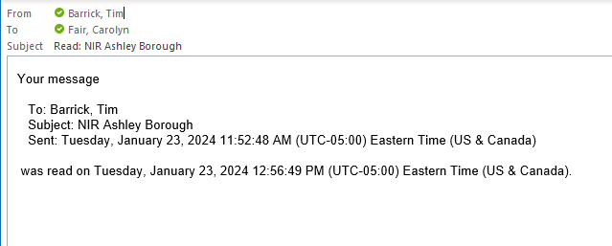
Proof of Notification
Proof of notification:
A read receipt
Notes:
Proof of notification is satisfied by a read receipt which is automatically returned from an email to the municipality.

Slide 17
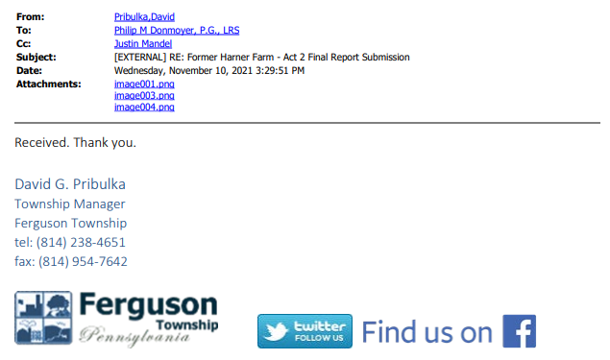
Proof of Notification
Proof of notification:
A confirmation email from a municipal email account
Notes:
Proof of notification is satisfied by a confirmation email coming from a municipal email account.

Slide 18
Remediation Reports
A 30-day public comment period following municipal & public notification is required for site-specific standard (SSS) or the special industrial area (SIA).
Applicant must inform the municipality of the 30-day comment period as well as their right to request a public involvement plan (PIP).
DEP will not accept an Act 2 report submission until after the 30-day comment period.
Notes:
When moving on to the Remediation Reports following the NIR, it is important to consider the public comment period needs. Reference Slide
So the public comment period is required only for SSS and the SIA standard, but sometimes you might start out with a submission under the Background or State-wide Health standards and later change to pursue a clean-up under the SSS or SIA. Please note that if you do change to pursuing SSS or SIA standard, you must go back and use the appropriate notice provisions and comment and review period.

Slide 19
Remediation Reports
Act 2 Remediation Report Submissions: (TGM II.A.3)
Report Package includes
Transmittal Sheet
Report(s) being submitted
FR Summary (For FR only)
Proof of Municipal and public notification
(Not required for background or Statewide health FR when submitted within 90 days of the date of release. Not required for baseline environmental reports under SIA)
Checklist (optional)
Fee
Notes:
Act 2 Remediation report submissions. So we are talking here about the reports following your NIR submittal and comment period if it applies. So the FR, Remedial Investigation Report, Risk Assessment Report, Cleanup Plan, and Baseline Environmental Report. This is what your report package looks like for those.
Reference Slide
These are the elements of a complete report submission, but please note that, when seeking site-specific standards, the required 30-day timeframe for the comment period following the NIR submittal must have elapsed before the report can be accepted.

Slide 20
Transmittal Sheet
Notes:
All reports following the NIR are initiated by a Transmittal Sheet. The word version allows you to fill out the form electronically for upload..

Slide 21
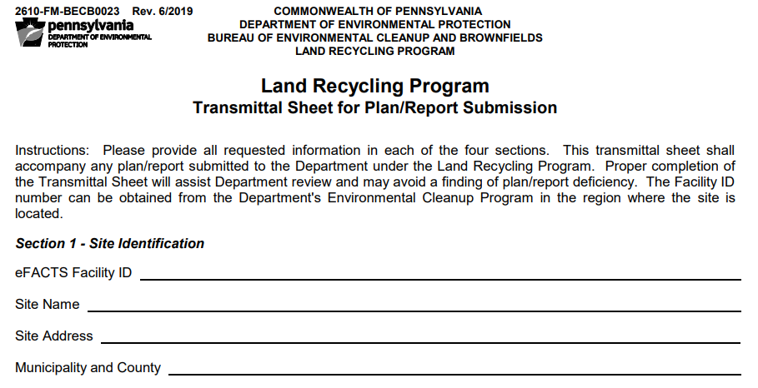
Transmittal Sheet
Notes:
This is what the Transmittal Sheet looks like. Section 1 consists of site identification

Slide 22
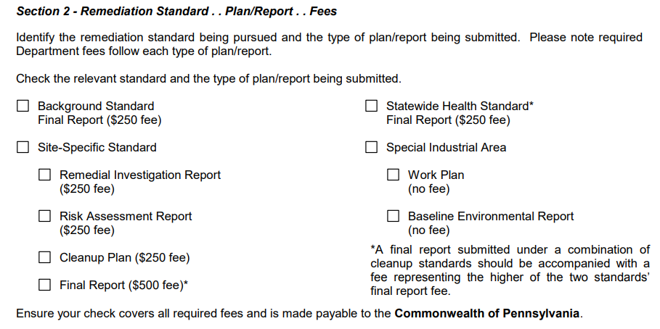
Transmittal Sheet
Notes:
Section 2 identifies all reports being submitted along with the fee required. If multiple reports are being submitted, be sure to add up all of the applicable fees and pay together with the submittal. Fee submittal is now all electronic, and it requires you to correctly identify the fees corresponding to any reports being submitted.

Slide 23
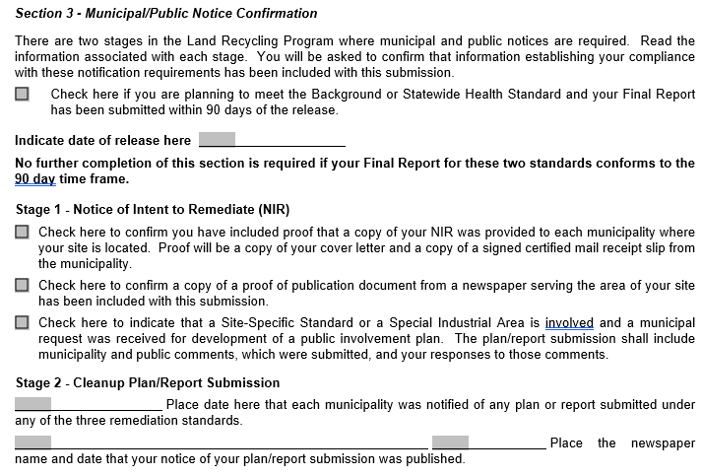
Transmittal Sheet
Notes:
Section 3 identifies the public notice requirement and reminds you of your obligation to provide proof of notification. You are actually checking the boxes that you are including proof of notification.

Slide 24
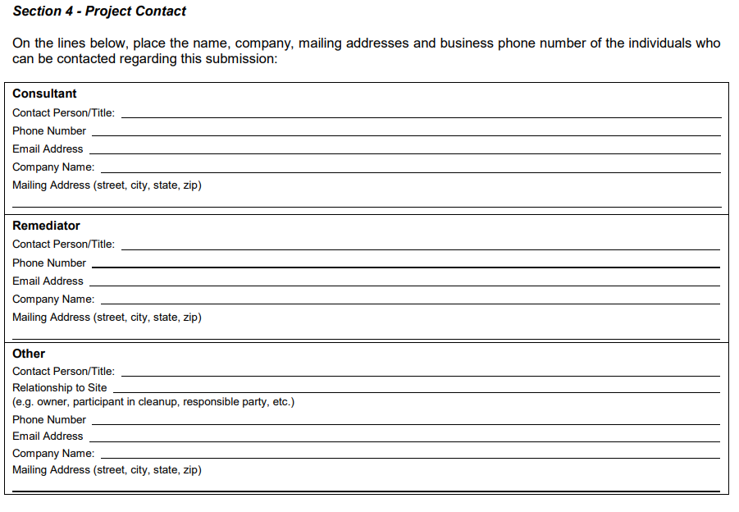
Transmittal Sheet
Notes:
Finally, Section 4 of the transmittal sheet identifies project contacts including the consultant and remediator
So that covers the Transmittal sheet. Then the report you are submitting. The next element of your report package is the FR Summary form

Slide 25
FR Summary
Notes:
The FR Summary Form can be found on the Forms and Lists link from Slide 4. This is part of your package only when you are submitting a Final Report

Slide 26
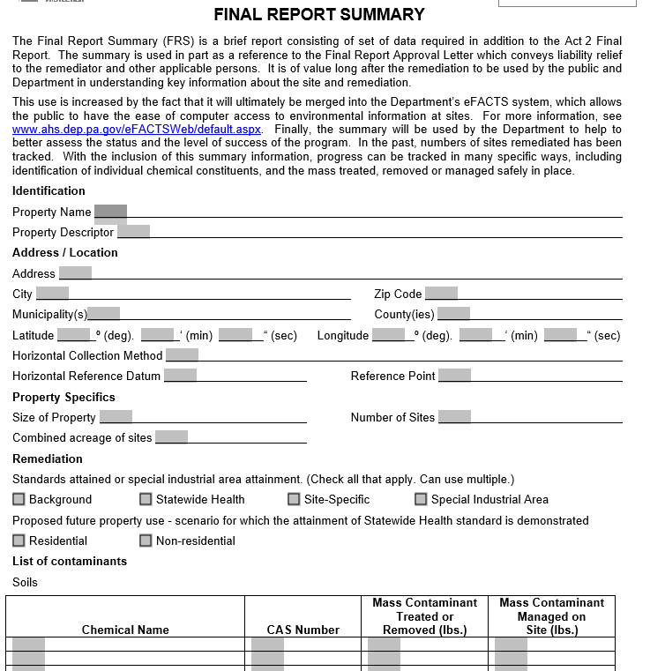
FR Summary
Notes:
The FR Summary is a form that looks like this and you are just filling out the form with data from your Final Report.

Slide 27
Remediation Reports
Act 2 Remediation Report Submissions: (TGM II.A.3)
Report Package includes
Transmittal Sheet
Report(s) being submitted
FR Summary (For FR only)
Proof of Municipal and public notification
(Not required for background or Statewide health FR when submitted within 90 days of the date of release. Not required for baseline environmental reports under SIA)
Checklist (optional)
Fee
Notes:
The next element of your report package is the proof of municipal and public notification which we talked about under the Notice of Intent to Remediate. So the same details apply here for your other report submissions.

Slide 28
Notification Templates
Templates are available for wording of notification to municipalities
Notes:
I just want to cover an additional tool to help with notification. Here on the Forms and Lists page are some notification correspondence examples. These are some templates that are available for wording of notification to municipalities. If you click the link here…

Slide 29
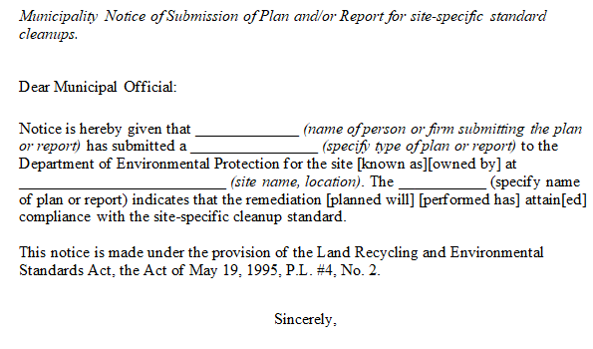
Notification Templates
Templates are available for wording of notification to municipalities
Notes:
You will find there are several templates for different reports and standards. The example shown here is for submission of a plan or report for a SS standard. I encourage you to check these out to see if you may find them helpful.

Slide 30
Checklists
Checklists are available to help make sure you have included everything needed
Notes:
The next element of your report package is the checklist.
These are completely optional, but they may help you to make sure you have included everything. Reference Slide

Slide 31
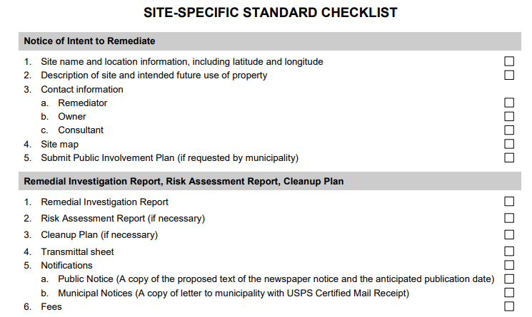
Checklists
Notes:
This is what the SSS checklist looks like

Slide 32
Additional Background
FR Summary
Public Notification
Public Involvement
Submission of Multiple Reports
Notes:
Now I just want to give you some additional background information on each of the items in this list that may be helpful in understanding their purpose and importance.

Slide 33
Additional Background
FR Summary
– DEP requests this as part of the submission
– Plain language summary
– Part of Public Record
Notes:
DEP uses the FR Summary as an accessible description of work to aid in review. The FR Summary is a piece of the “plain language summary” required by Section 901 of Act 2. It is also useful for the public to have such a summary available. The information included allows for tracking to assess the success of the program.

Slide 34
Additional Background
Public Notification –
Proof of notification is required to ensure public has been given opportunity to comment
1. Certified mail receipt, read-receipt, or confirmation email along with letter
2. Text of newspaper notice along with publication date
Notes:
The Public Notification period is very important to make sure everyone has been given opportunity to comment. The proof of notification proves to DEP that appropriate steps have been taken to notify the public. The examples of proof of notification that we talked about on slides 15-17 of this presentation should be provided along with the letter or email sent to the municipality or the newspaper text.

Slide 35
Additional Background
Public Involvement –
All SSS and SIA reports cannot be submitted until after 30 days from the NIR submittal to allow for comment.

Slide 36
Additional Background
Public Involvement Plan (PIP)
Plan between the Municipality and the Remediator
Allows for Municipality and public to comment on any concerns or inconsistencies
Municipality can request a PIP
If requested, the PIP
is submitted to both municipality and DEP
must be submitted before a Remedial Investigation Report for SSS, and before a Baseline Environmental Report for SIA
TGM Section II.A.3.c
Notes:
Public Involvement may take the form of a Public Involvement Plan (PIP) if a municipality would like. Reference Slide
Comments from the PIP need to be provided in each report. (Act 2 304(n)(2)(i)). Please read the TGM Section II.A.3.c for additional details regarding the Public Involvement Plan.

Slide 37
Additional Background
Submission of Multiple Reports
Multiple Reports can be submitted together
It is preferred that SSS FR be submitted separately
If one of the reports combined with the SSS FR is not approved, the entire package will be disapproved.
Consult the Q&A Document referenced on Slide 4 for further detail (Question II.5)
Notes:
Reference Slide bullet 1 and 2…
Remember we talked about all of the reports that are submitted under SSS : Remedial Inv, Cleanup, Risk Assessment
Bullet 3
For example: There is a risk of having the report package disapproved if the Cleanup Plan is not approved ahead of FR submission.

Slide 38
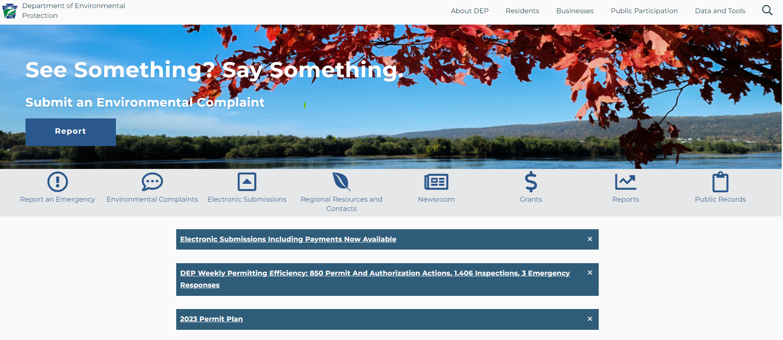

Submittal Process
Notes:
The only remaining element of the report package is the FEE.
All submissions and payments are now completed electronically. This process if the same for all reports: NIRs as well as other remediation reports. On the DEP webpage, look for “Electronic Submissions”…

Slide 39
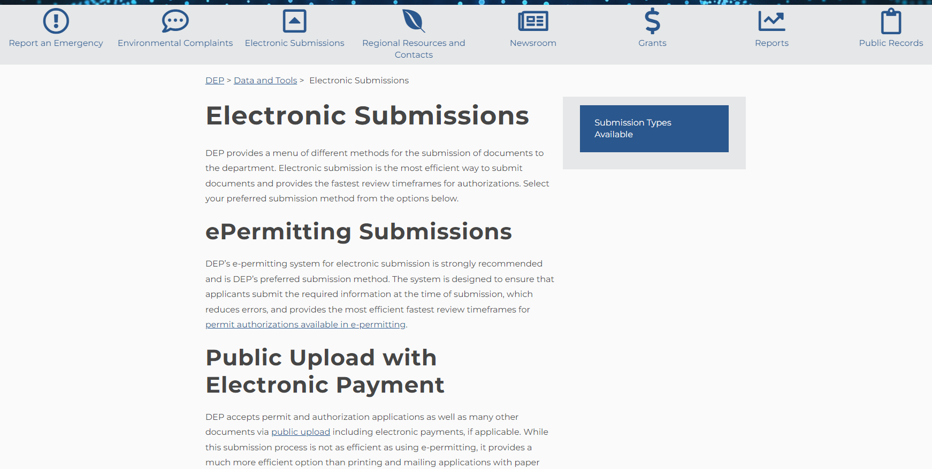
Submittal Process
Notes:
That brings you here…. Then select “public upload” which takes you to the ePermitting page.

Slide 40
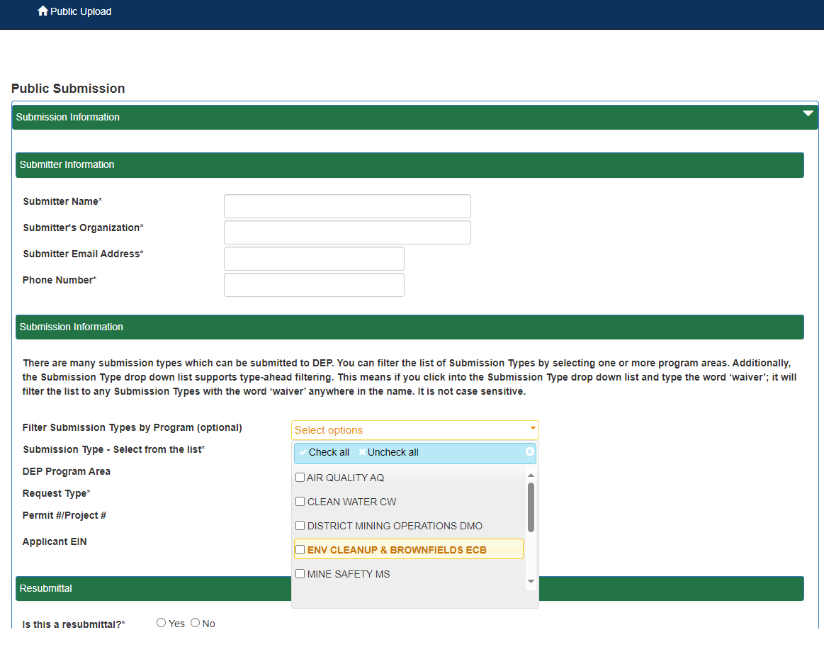
Submittal Process
Notes:
Note the “Public Upload” in the upper left that indicates you are on the correct page. In the “Submission Information” section, selecting “ENV CLEANUP & BROWNFIELDS ECB” in the Filter Submission Types by Program area will limit the forms you see available.

Slide 41
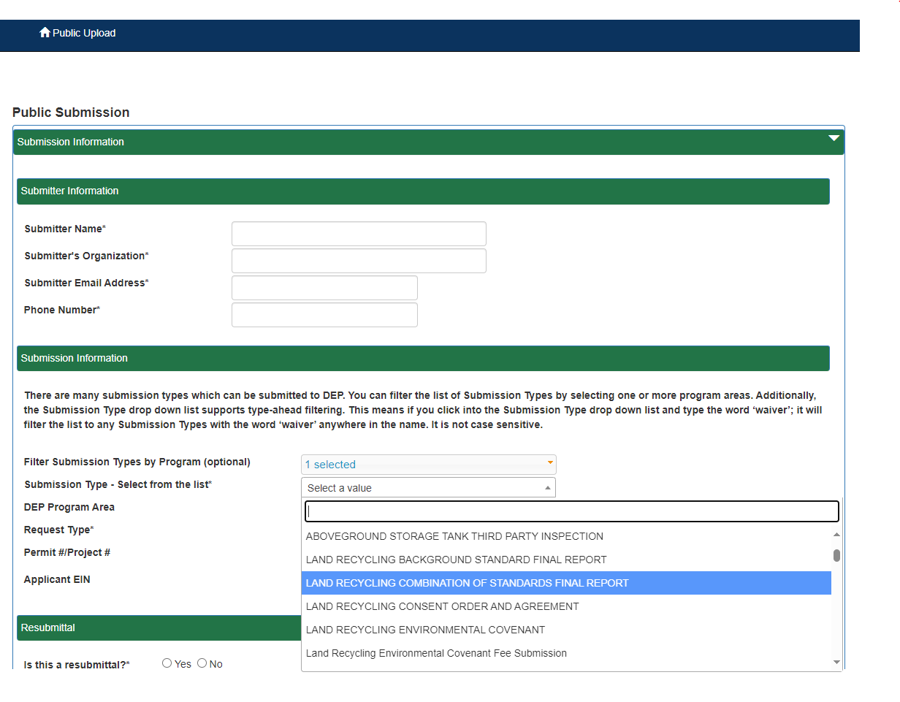
Submittal Process
Notes:
Next select the Submission Type from the drop-down. In this example, Land Recycling Combination of Standards Final Report is selected.

Slide 42
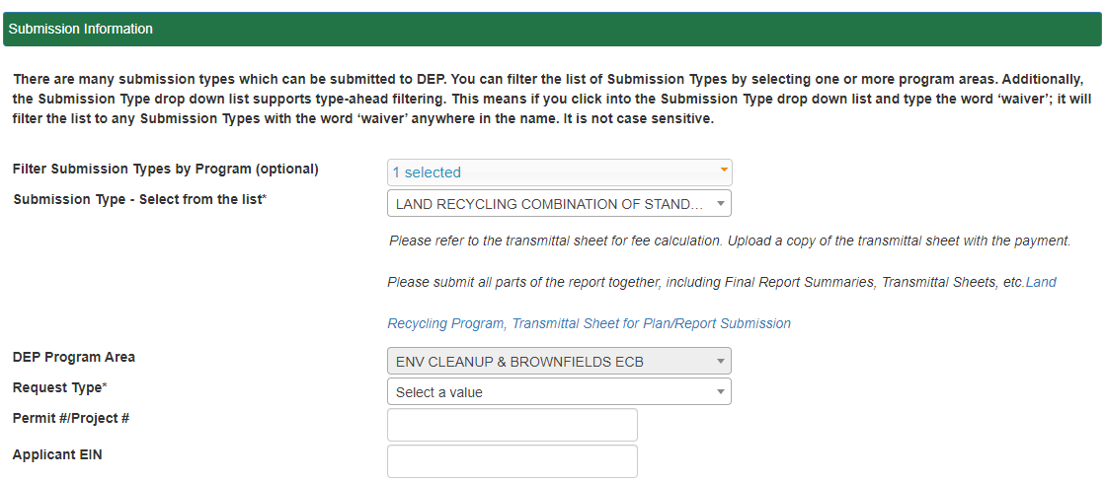
Submittal Process
Notes:
A link to the Transmittal Sheet appears which is helpful for selecting the fee appropriate for your submission, but this link is not a form where you can type directly in the fields. It may be easier to use the Word version of the Transmittal Sheet on the Forms & Lists site and then upload that.

Slide 43
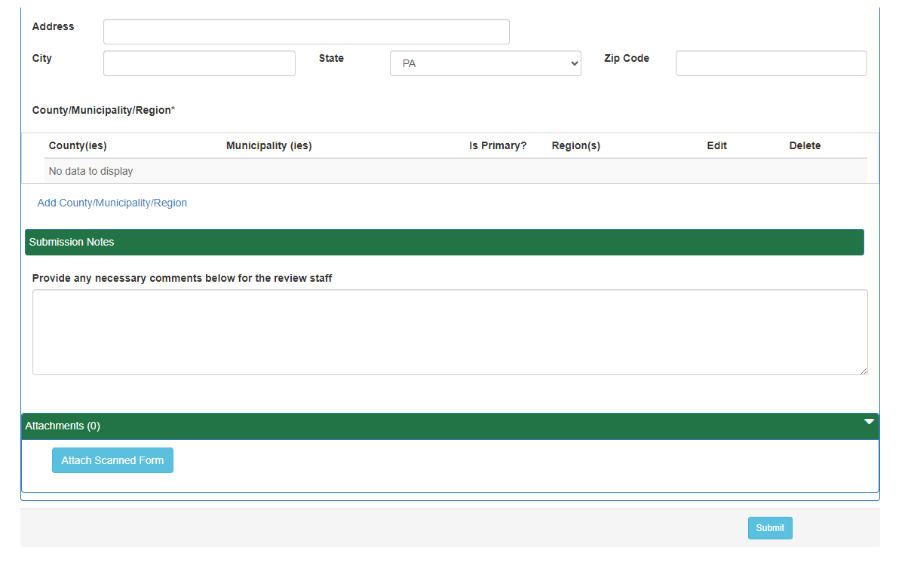
Submittal Process
Notes:
Use this link to attach the Transmittal Sheet and your report. Please use care in making sure you are submitting the correct fee. All fees are submitted electronically, and the report submission goes directly to OnBase from the ePermitting site. Then choose the Select button in the lower right.

Slide 44
Avoiding Common Errors
Required public notice – legal ad in local paper or online news site
Proof of public and municipal notice
Time for comment period and PIP
Professional Geologist seal
Combined reports submissions
Correct fee
Notes:
Finally, Let’s talk about some of the common errors that are seen in submissions and re-cap how they can be avoided.
1., 2., and 3. Public Notice along with proof of notice and time for comment period and PIP are common errors. Let’s walk through each of these.
4. Remember to affix the Professional Geologist seal when necessary.
5. Reports may be submitted together but please note that there is a risk that a Final Report may not be approved when other reports (especially Cleanup Plan) have not been approved first.
6. Please be sure that you have the correct fee for your submission. If multiple reports are submitted together, remember to add all the applicable fees together for your submission
Additional information on procedures for submission of NUA, RDA, waivers, and baseline work plans may be needed. Please feel free to reach out with questions regarding any of these items.

Slide 45
Next Steps
Training recording link on the Land Recycling webpage
PowerPoint available on webpage
List of helpful documents/links
Notes:
I hope you have found all of this information helpful and that it leads to more complete and successful submissions for you in the future. The next steps for this presentation is to make the information widely available going forward. To accomplish that, we will have the recorded webinar available in a link on the Land Recycling webpage. There will also be a link to the PowerPoint presentation itself for you to be able to view the information. Also on the webpage near these two links there will be a list of the helpful documents and other links to guide you smoothly through any submission.

Slide 46
Questions? ra-eplandrecycling@pa.gov
Notes:
At this time I would like to invite any questions you would like to ask that may have occurred to you during the presentation. I have lined up two members of the work group that created this presentation to answer your questions as they are more qualified than I am to answer them: Ben Thonus, Environmental Program Manager from the Southcentral region, and Pam Trowbridge, Professional Geologist Manager, also from the Southcentral regional office.

