Slide 1
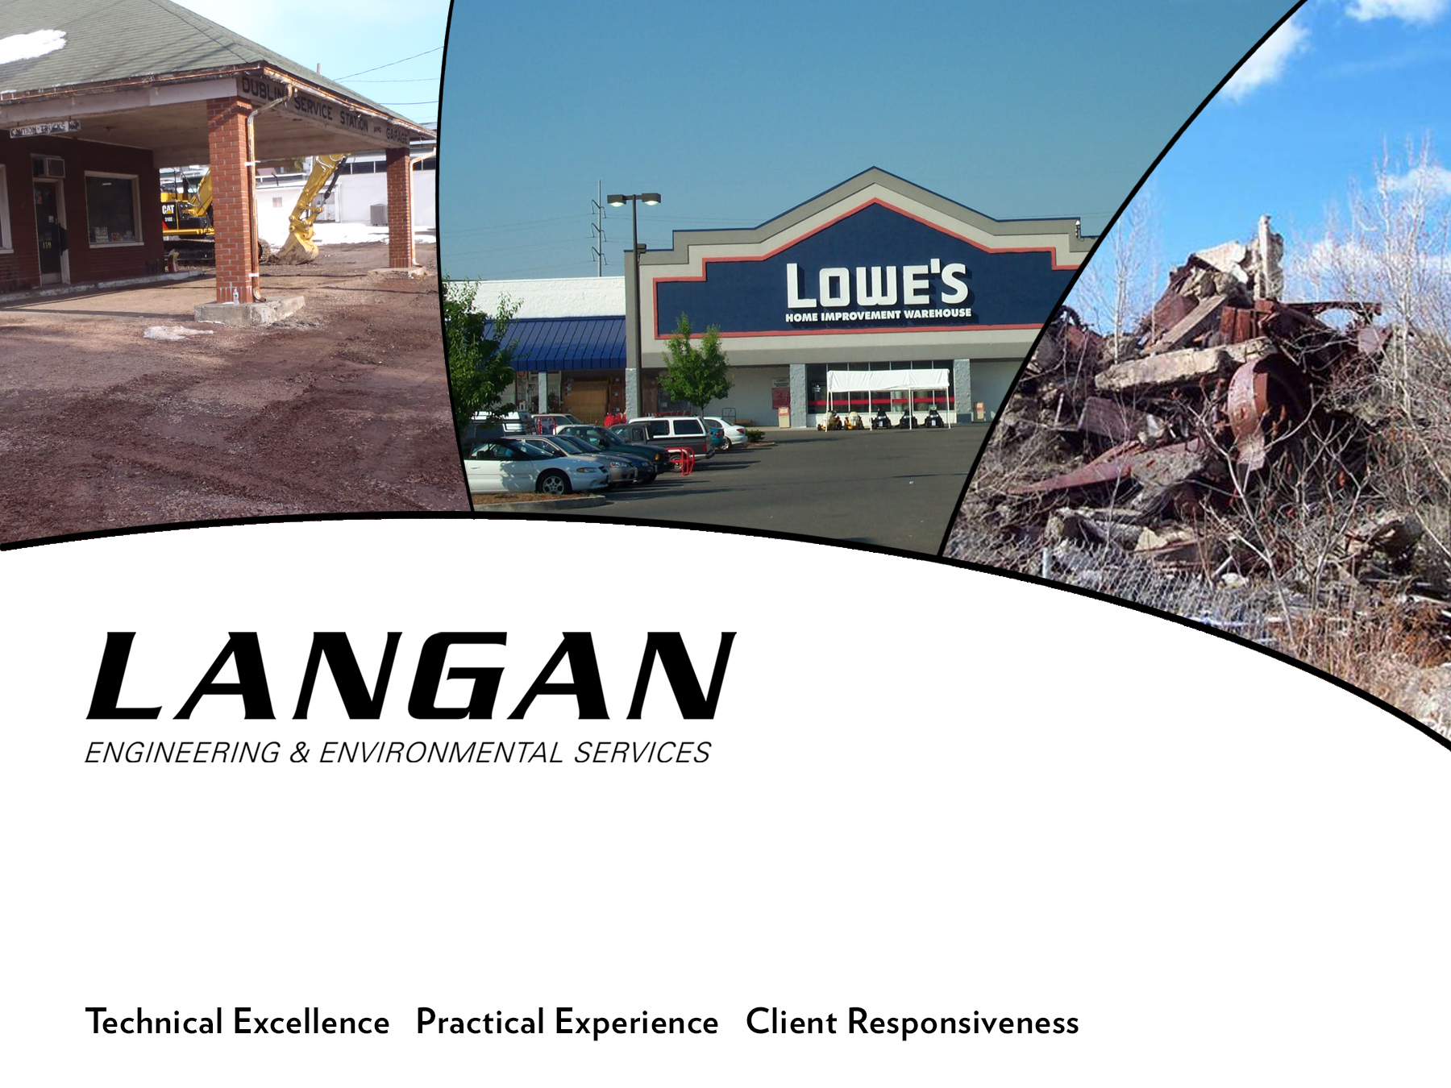

Slide 2
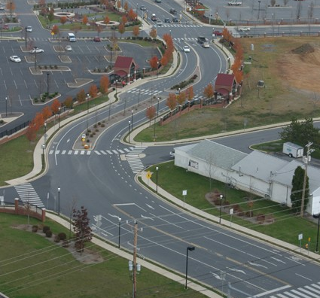
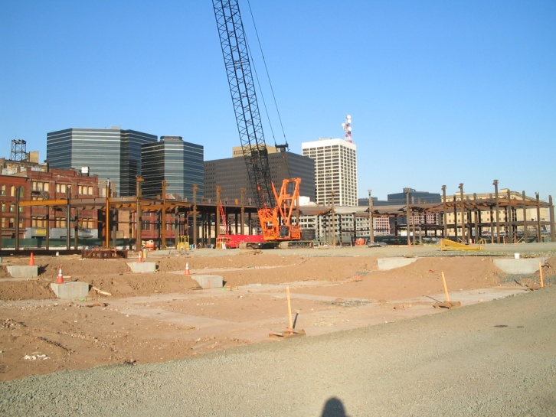
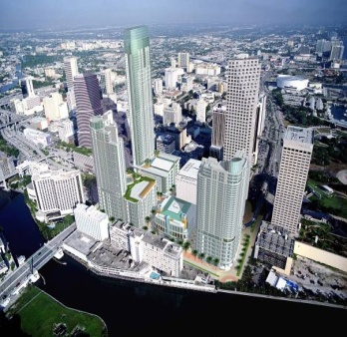
Grant Funding
Programs - Pennsylvania
Presented by;
Greg Firely
215-850-0009
gfirely@langan.com

Slide 3
Federal Grant Programs
U.S. EPA
Available Annually
Nation wide competition
$70 million set aside this fiscal year for brownfield grants
1 in 4 grants are awarded

Slide 4
U.S. EPA Brownfields Grant Programs
Assessments
Cleanup
Revolving Loan Funds
Multi Purpose
Area Wide Planning

Slide 5
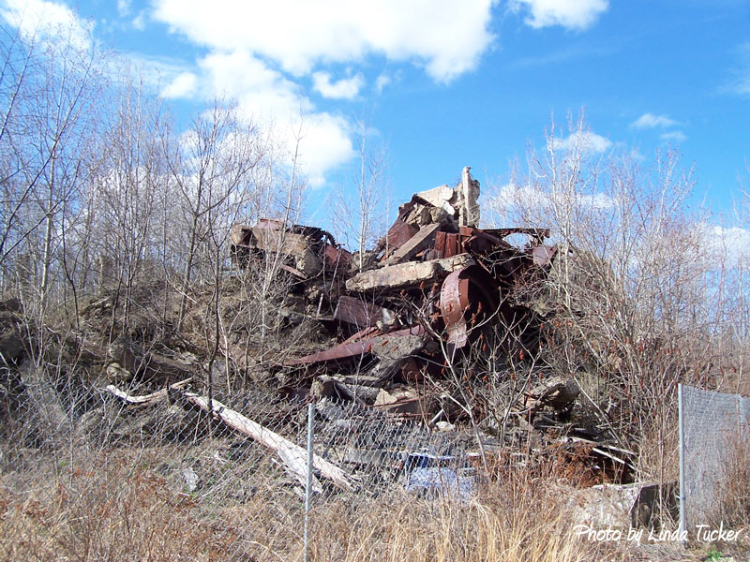
U.S. EPA Brownfields Grant Program
Focus on the re-use and redevelopment of brownfields

Slide 6
U.S. EPA Brownfield Assessment Grants
Eligibility – Government and Quasi-Governmental entities (Redevelopment Authorities)
Ownership Not Required – Must have access to site
Superfund NPL sites and federally owned land/facilities (DOD) are not eligible. FUDS are.
Petroleum and/or Hazardous Substances

Slide 7
U.S. EPA Brownfield Assessment Grants
Site-Specific

Slide 8
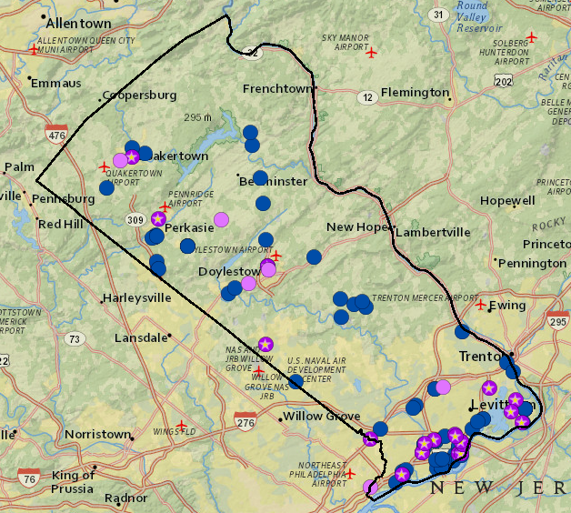
U.S. EPA Brownfield Assessment Grants
Community Wide

Slide 9
U.S. EPA Brownfield Assessment Grants
Available Funding
Community Wide Grants
Hazardous Substances $200,000
Petroleum Substances $200,000
Site Specific $350,000
Coalition $1,000,000

Slide 10
U.S. EPA Brownfield Assessment Grants
Assessment Activities
Inventory of Sites
Area Wide Planning
Phase I and Phase II Assessments
Reuse planning
Community Outreach

Slide 11
U.S. EPA Brownfield Cleanup Grants
Eligible applicants
Government entities, Quasi-Governmental entities (Redevelopment Authorities)
Non-Profits
Higher Education
Must own site, but must not be responsible for contamination

Slide 12
U.S. EPA Brownfield Cleanup Grants
Available funding - $200,000
Must have had a Phase I completed prior to ownership
Must have Phase II completed
Must provide 20% match
Cannot be responsible party

Slide 13
U.S. EPA Brownfields Revolving Loan Fund (RLF)
Eligible applicants – Government and Quasi-Government entities only
Make low-interest loans and sub-grants to carry out cleanup activities
Typical RLF amount $1,000,000
Useful to entice redevelopers

Slide 14
U.S. EPA Brownfields Multi-Purpose Grant
New Program
Combination Assessment and Cleanup
Only government or quasi-governmental entity
Must own site
Must have Phase 1 ESA complete
Must have previously been awardee
$400,000 available per grant

Slide 15
U.S. EPA Brownfields Area Wide Planning Grant
Eligible applicants – Government, Quasi Government; Indian Tribes, Non-Profits, the Metlakatla Indian Community
$175,000, no-match required
Focused on neighborhoods, corridors, etc.
Geared for community involvement in planning for brownfield redevelopment

Slide 16
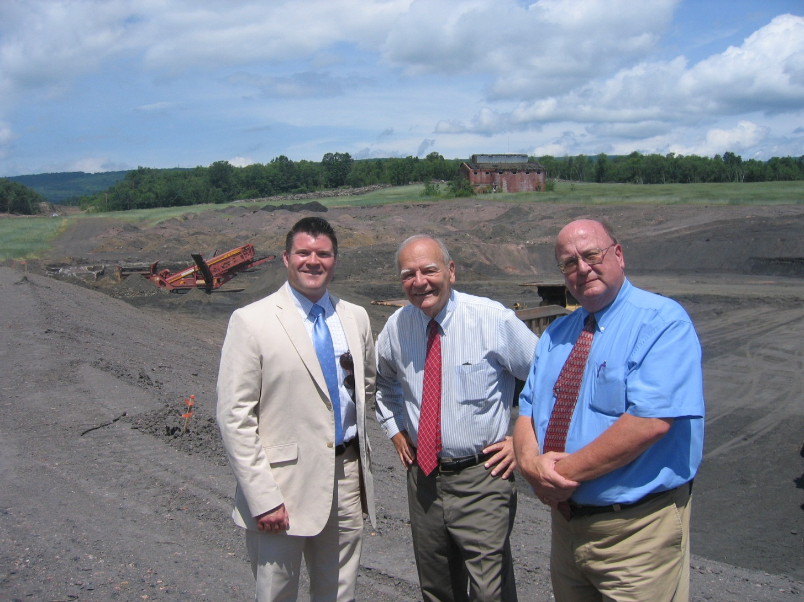
U.S. EPA Brownfields Grants In action

Slide 17
Taylor Borough
Time Line
2006 – U.S. EPA Brownfields Assessment Grant
$350,000
2010 – DCED – Industrial Site Reuse Program
$125,000
2010 – U.S. EPA Brownfields Cleanup Grant
$200,000
2010 – U.S. EPA Brownfields Community-Wide Assessment Grant
$200,000

Slide 18
US EPA Brownfield Grant Program
Nation Wide Program
Dispersed Over the U.S. EPA Regions

Slide 19
United State Economic Development Administration
Public Works / Economic Adjustment
Empowers distressed communities to revitalize, expand, and upgrade their physical infrastructure to attract new industry, encourage expansion, etc.
Infrastructure construction, improvements, extensions, brownfield development, engineering design, etc.

Slide 20
United State Economic Development Administration
Public Works / Economic Adjustment
Eligible entities
state, political subdivision of a state, district organization, Indian tribe, institution of higher education, or a non-profit acting in coordination with a political subdivision

Slide 21
United State Economic Development Administration
Public Works / Economic Adjustment
Empowers distressed communities to revitalize, expand, and upgrade their physical infrastructure to attract new industry, encourage expansion, etc.
Distressed Communities
An unemployment rate that is 1% greater than the national average (four previous 24-month period); or
Per capita income that is 80% or less the national average; or
A “special need” as determined by the EDA.

Slide 22
United State Economic Development Administration
Public Works / Economic Adjustment
Dollars and Cents
Approximately $150 million for FY2014
Application for FY15 being accepted until November
Matching Requirement, sliding scale 50-80%; dependent on “distressed communities” rating
Typical award $200,000 to $1 million

Slide 23
Act 13
Act 13 was established to provide funding to local and state entities within Pennsylvania for specific eligible activities.
Established funding for Counties and Municipalities with wells;
Unconventional Gas Well Fund; and those without
Marcellus Legacy Fund

Slide 24
Act 13
Unconventional Gas Well Fund
Construction / Repair or infrastructure
Emergency Preparedness
Environmental Programs
Preservation of waters
Tax reductions
Programs to increase affordable housing
Records management, GIS, and IT
Delivery of social services
Judicial services
Capital reserve
Career and technical centers for training of workers in oil and gas
Local planning initiatives

Slide 25
Act 13
Marcellus Legacy Fund
Acid mine drainage issues
Orphan or abandoned oil and gas well closure
Complying with PA Sewage Facilities Act
Planning, acquisition, development and rehab and repair of greenways, recreational trails, open space and parks

Slide 26
Additional Resources
United States Department of Agriculture
Pennsylvania Department of Conservation of Natural Resources
Private Entities

Slide 27
Additional Resources
Pennsylvania Department of Conservation of Natural Resources
Community Conservation Partnership Program (C2P2)
Recreational in nature, parks, open space, trails, equipment, etc.
Grants typically range from $10,000 - $120,000
Require 50% matching funds

Slide 28

Contact
Greg Firely
215-850-0009
gfirely@langan.com
Technical Excellence Practical Experience Client Responsiveness

