Slide 1
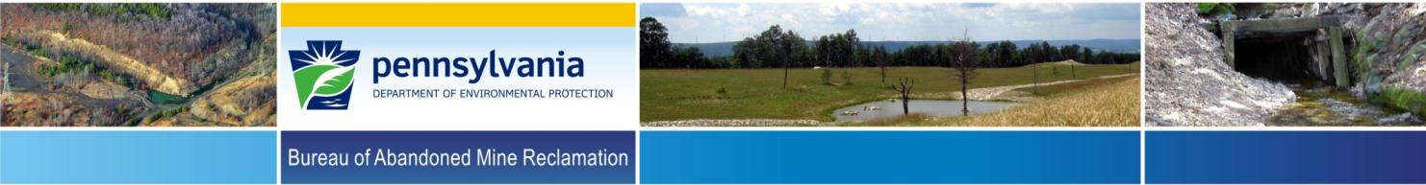
Planning and Implementation of the
2022 Abandoned Mine Land Economic Revitalization Program in Pennsylvania
Josh Shapiro, Governor
Richard Negrin, Secretary

Slide 2

Program Background
The 2022 Abandoned Mine Land Economic Revitalization (AMLER) Program was authorized by Congress under the Consolidated Appropriations Act, 2022 (Public Law 117-103 signed into law by President Biden on March 15, 2022) and provides an additional $26.63 million of U.S. Treasury funds to Pennsylvania’s Abandoned Mine Land (AML) Program.
The funds are to be used “to accelerate the remediation of AML sites with economic and community development end uses.”
This is the seventh year PA received funding from the AMLER Program.
For FY2022 Pennsylvania along with Kentucky and West Virginia, each received $26.63 million of AMLER Funding; Ohio, Alabama, and Virginia each received $10.65 million; and the Hopi, Navajo, and Crow Indian Tribes each received $3.55 million.

Slide 3
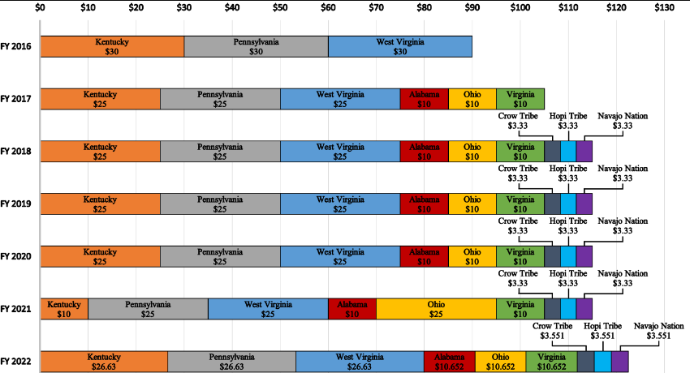
Program Background (Cont’d)
More details about the AMLER Program in PA and AMLER Projects undertaken in previous years can be found on DEP’s web site.

Slide 4

Program Guidance
The following is language from the Office of Surface Mining Reclamation and Enforcement’s (OSMRE’s) “Guidance for Project Eligibility Under the Abandoned Mine Land Economic Revitalization Program for Fiscal Year 2022”:
“State/Tribal AML Programs, in consultation with State/Tribal, local economic and community development authorities, must develop eligible projects that demonstrate a nexus with AML land and water reclamation, and economic and community development”

Slide 5

Use of Funds
States, Tribes, and local communities have the flexibility to use AMLER funds for both the reclamation of impacted lands and waters and brick and mortar needs related to the end-use development project.
The AMLER Program offers maximum flexibility in this regard, letting states, tribes, and local communities balance the needs of an individual project with the ability to fund other priority projects.

Slide 6

Project Selection Procedure
“Guidance for Project Eligibility under the Abandoned Mine Reclamation Economic Development Program for Fiscal Year 2022” was provided by OSMRE.
Three projects were selected as 2022 AMLER Program projects.
The Bureau of Abandoned Mine Reclamation has established the Abandoned Mine Land and Acid Mine Drainage (AML/AMD) Grant Program for potential AMLER Program projects from watershed groups and other non-governmental organizations, county conservation districts, other state agencies, non-profits, and others.

Slide 7
Project Selection Procedure (cont’d)
Project selection details from the first AML/AMD Grant Program round:
An application period was held October 3 through December 23, 2022.
Five proposals were received for AMLER funding.
Of the five proposals, one was selected as a 2022 AMLER Program project and the remaining proposals were assigned to other AMLER Program years.
Additional project selection details:
Two additional projects, previously assigned to other AMLER Program years, were reassigned as 2022 AMLER Program projects.

Slide 8

Proposed Projects
Vetting documents were submitted to OSMRE for all projects.
OSMRE reviewed the proposed projects and approved all projects by June 2023.

Slide 9
Grant Application Timeline
PA submitted its 2022 AMLER Program grant application to OSMRE on August 18, 2022.
PA’s AMLER Program grant application was awarded by OSMRE on December 28, 2022, with a November 1, 2022, through October 31, 2025, period of performance.

Slide 10
PA’s Plan for the Funding
As in previous years, the Bureau of Abandoned Mine Reclamation will allocate a majority of AMLER Program funds for reclamation projects of SMCRA Title IV eligible AML and abandoned mine drainage (AMD) problems.
Project partners will then fund and complete non-AML economic development aspects of the projects.

Slide 11

Project Types
The three 2022 AMLER Program projects include reclamation of the following AML features:
refuse pile reclamation
dangerous highwall
surface mine reclamation

Slide 12
Projects Location Map

Slide 13
Significant Benefits
In addition to eliminating a number high-priority AML/AMD features, benefits of the projects include:
safety enhancements in a designated state forest, off-road recreational vehicle area
water line extension to an established off-road park and campground
construction of various recreational facilities

Slide 14
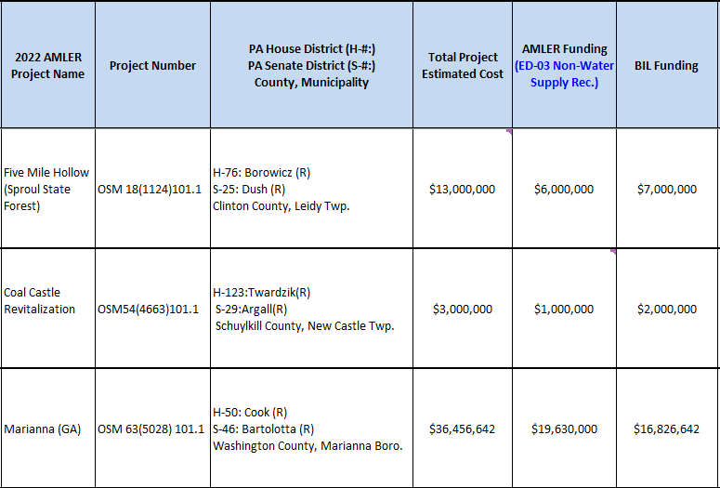
Pennsylvania’s 2022 AMLER Projects

Slide 15

Five Mile Hollow
Project Overview:
10,850 feet of Priority 2 Dangerous Highwall in Leidy Township, Clinton County will be address
74 acres of state forest will be reclaimed
The project site is located on public land and designated for all-terrain vehicle (ATV) use.
The ATV trail system and other public recreational opportunities present on and adjacent to this site are a significant economic benefit to the local community.

Slide 16
Five Mile Hollow
A mine drainage source remediation plan to reduce acid mine drainage pollution from the site and stream degradation of Huling Branch, Two Mile Run, and Kettle Creek will be implemented.
Source remediation will consist of the addition of alkaline materials, blended into the backfill, selective handling of acid forming spoil materials, the installation of subsurface drainage controls to capture groundwater and help isolate acid forming materials and the removal of any buried coal refuse or remaining crop line coal which may be degrading groundwater associated with the site.

Slide 17
Five Mile Hollow
The Five Mile Hollow Project is contiguous to the Bureau of Abandoned Mine Reclamation’s Huling Branch Project, DEP Project No. OSM 18(6672) 201.1, which received OSMRE’s National Abandoned Mine Reclamation Award in 2017 for the exemplary approach of addressing a variety of AML features.
The Five Mile hollow project will build upon and further enhance the environmental and economic impacts of the previous Huling Branch project.

Slide 18
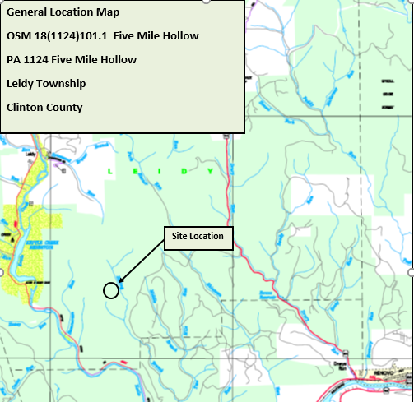
Five Mile Hollow
Project Location Map

Slide 19
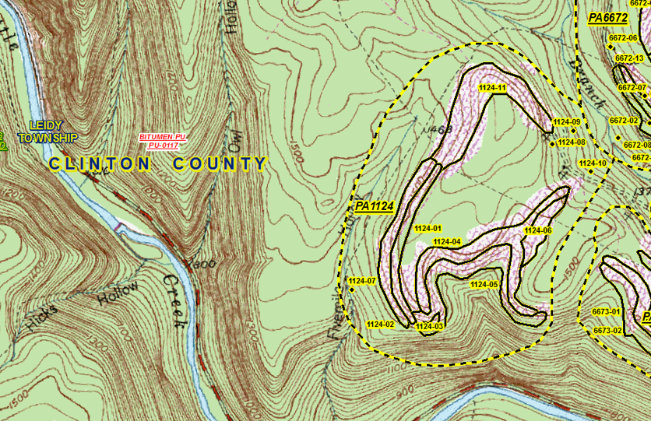
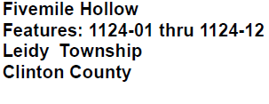
Five Mile Hollow
Project Area Map

Slide 20
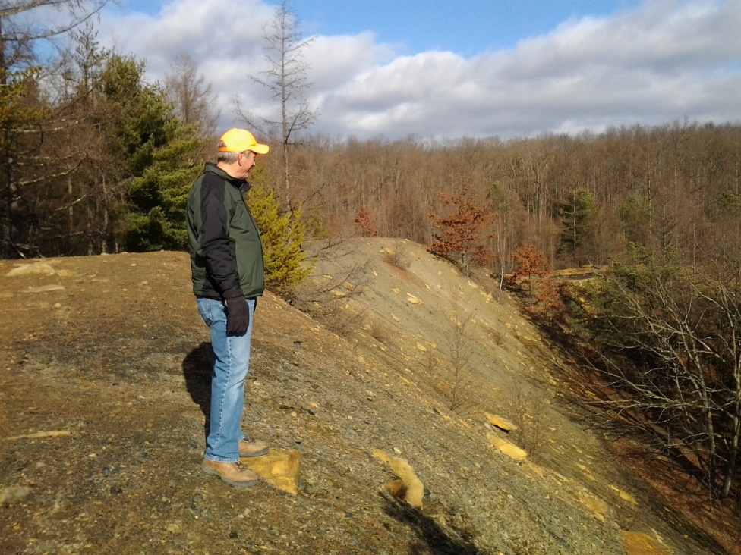
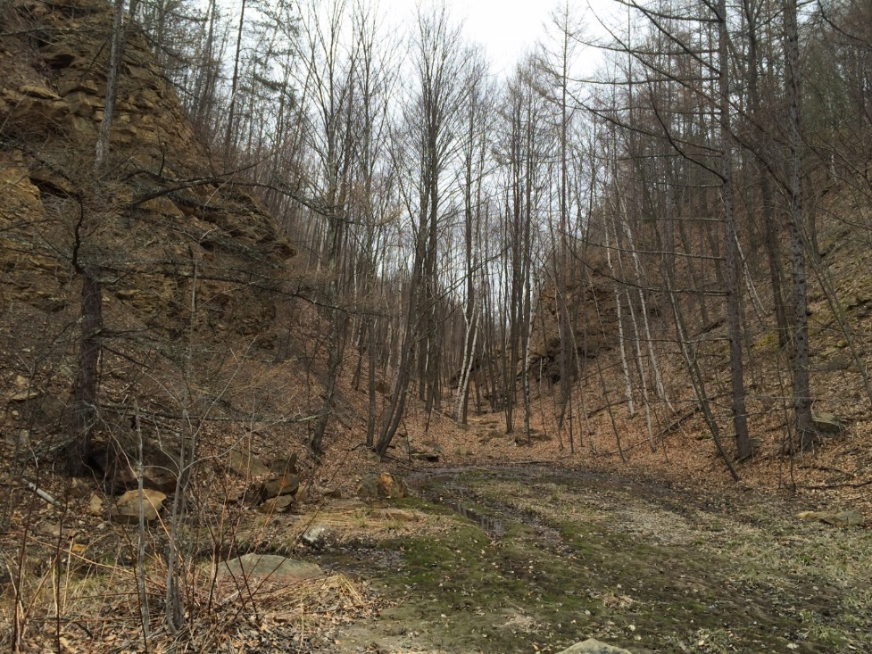
Five Mile Hollow
Project Pictures

Slide 21
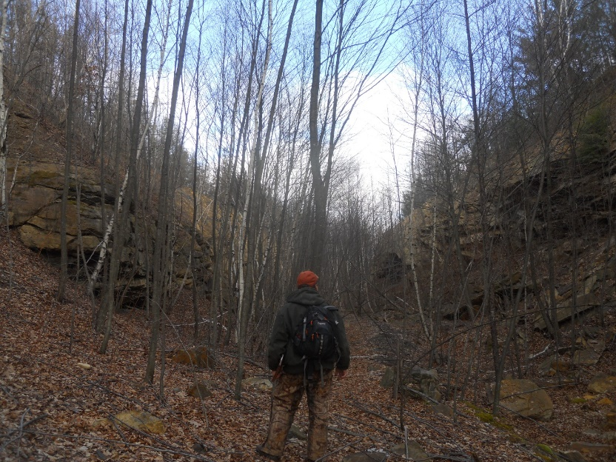
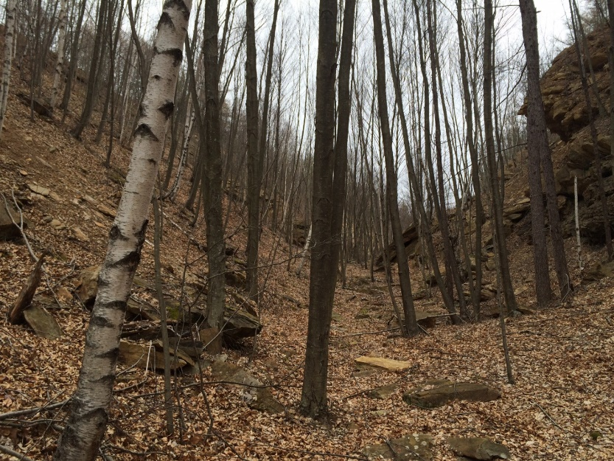
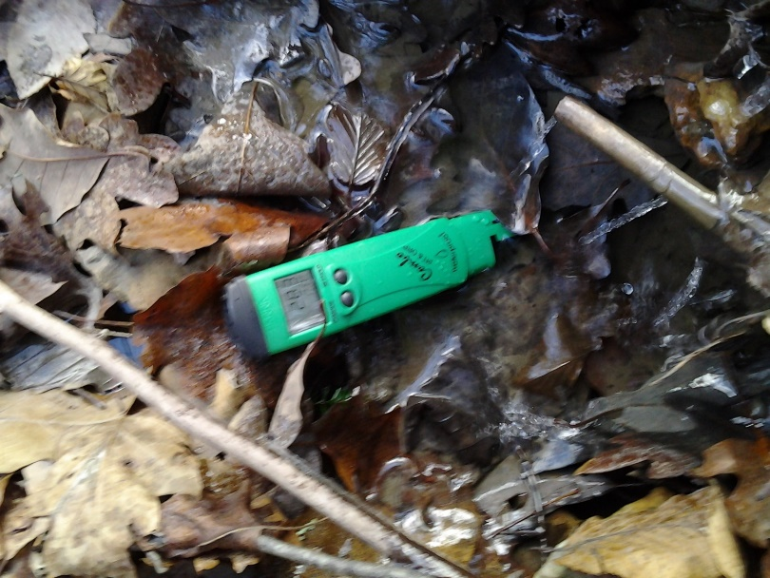
Five Mile Hollow
Project Pictures (cont’d)

Slide 22
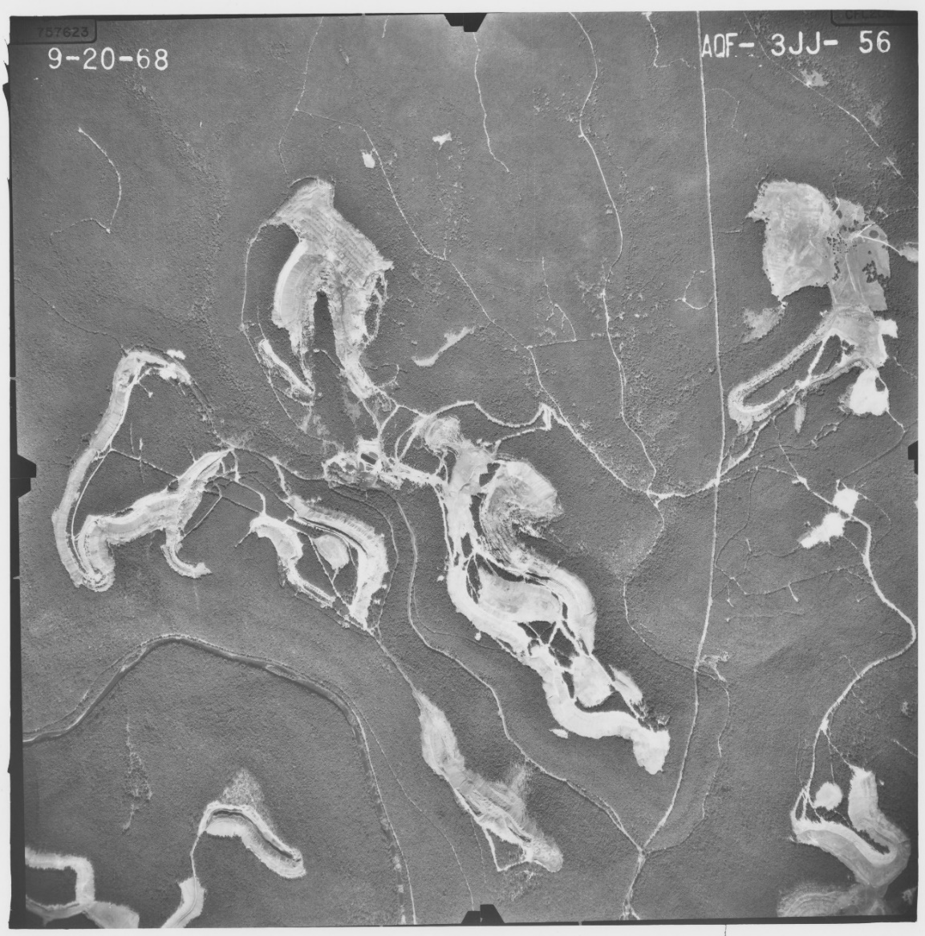
Five Mile Hollow
Project Pictures (cont’d)

Slide 23
Five Mile Hollow
Project Costs and Funding Sources
Estimated Project Cost: $13,000,000
Funding Sources:
AMLER Funding: $6,000,000
Bipartisan Infrastructure Law (BIL/IIJA) Funding: $7,000,000

Slide 24
Five Mile Hollow
AML/AMD Measurables:
74 acres of state forest property will be restored
10,850 linear feet of Dangerous Highwall will be reclaimed
Implementation of an acid mine drainage source remediation plan

Slide 25
Five Mile Hollow
Economic Development Measurables:
Improvement to the Sproul State Forest’s Whiskey Springs ATV trail system. This portion of the state forest hosts annual events including Relay For Life, Cruise for a Cure, and National Rattlesnake Enduro Race.
Increase in tourists and revenue at local campgrounds, hotels, and businesses.
Reclamation would promote a more natural environment for anticipated elk migration of the area. Elk migration of the project area would increase tourism and recreational opportunities.
Water quality improvement of The Huling Branch of Twomile Run and subsequent improvement in downstream Trout Stocked Fisheries (TSF)

Slide 26
Five Mile Hollow
Project Partners:
PA Department of Conservation and Natural Resources
PA Fish and Boat Commission
Clinton County Conservation District
Western Clinton Sportsman Association
Lycoming College & Penn State University (Hazelton)
Office of Surface Mining Reclamation and Enforcement
Pennsylvania Department of Environmental Protection

Slide 27
Coal Castle Revitalization
PROJECT OVERVIEW:
Reclamation of 56 acres of AML
Facilitate future commercial development to support more visitors to the area and the extreme off-road riding experience offered at the site
Reclaim a Dangerous Pile and Embankment, Hazardous Water Body, Pits and Spoil Area
Create 10-20 full and part-time jobs in addition to temporary construction job opportunities

Slide 28
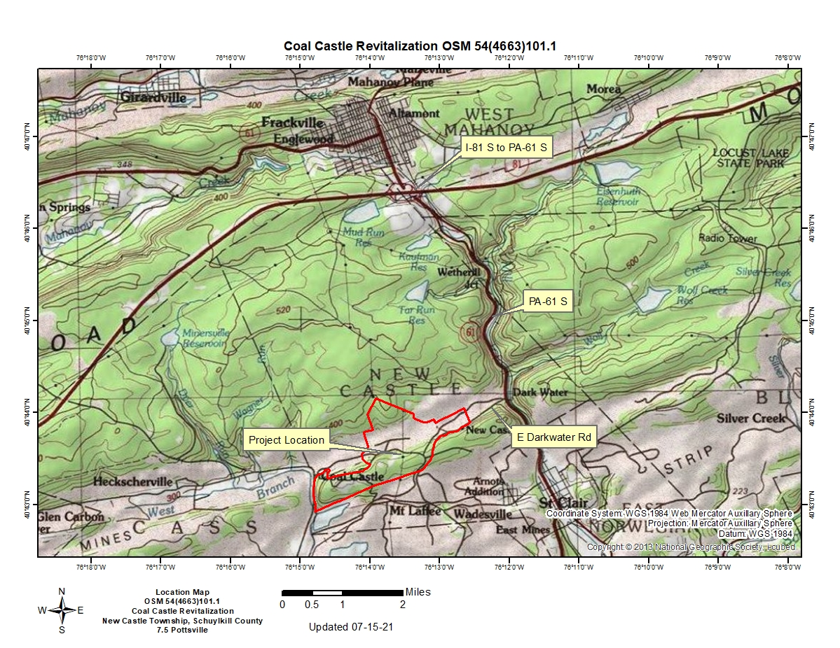
Coal Castle Revitalization
Project Location Map

Slide 29
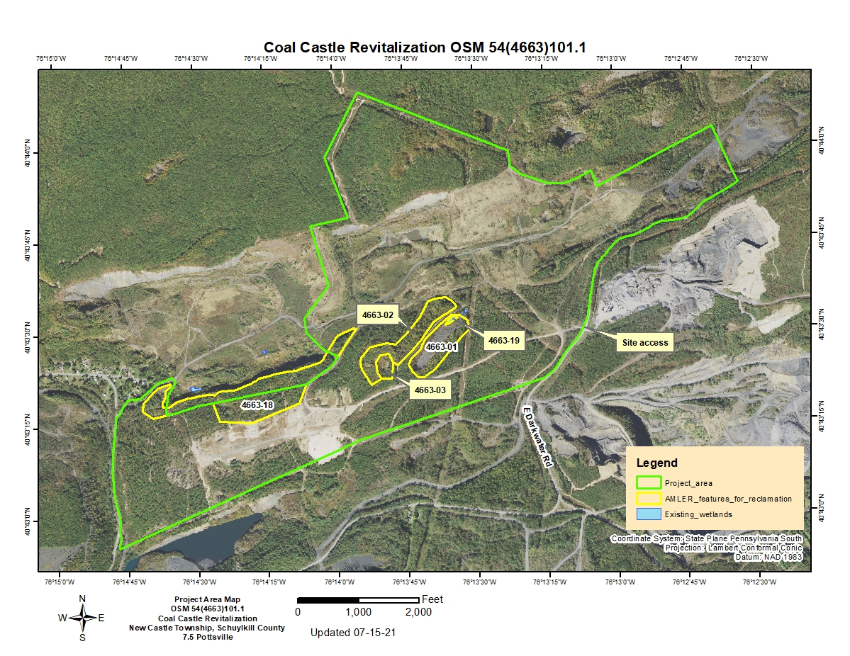
Coal Castle Revitalization
Project Area Map

Slide 30
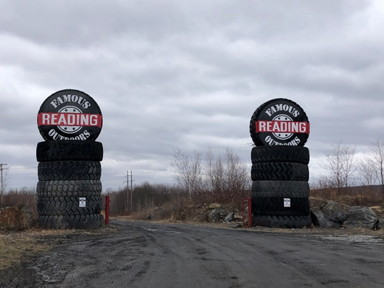
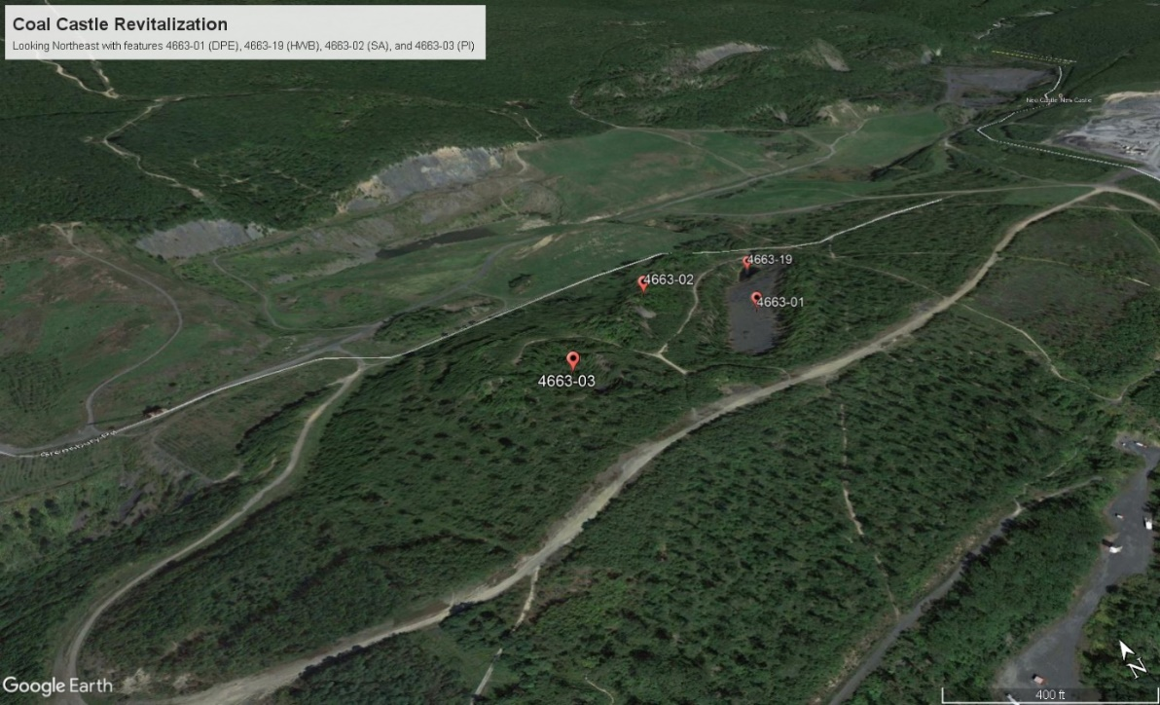
Coal Castle Revitalization
Project Pictures
Photo 1: Entrance to location from Darkwater Road.
Photo 2: Aerial view from Google Earth showing the P1 Dangerous Pile & Embankment, P1 Hazardous Water Body, P3 Spoil Area, and P3 Pit.

Slide 31
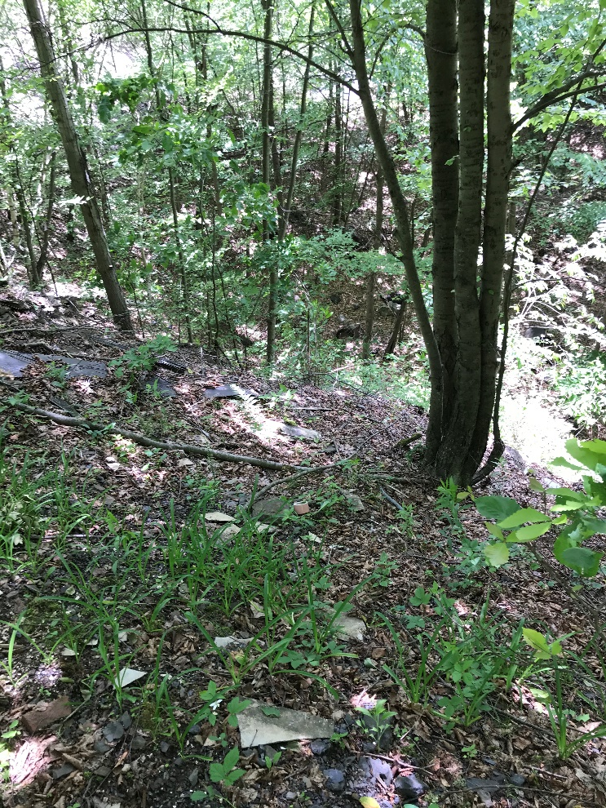
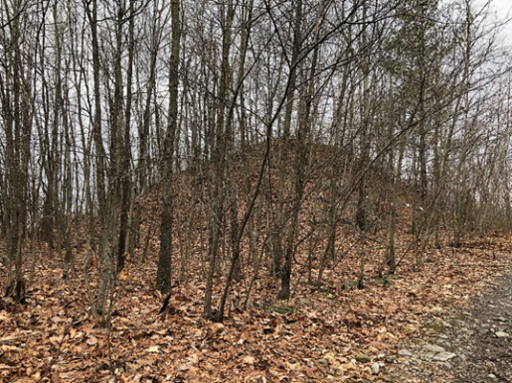
Coal Castle Revitalization
Photo 4, right: 4663-03, Pit, looking South.
Photo 3, below: 4663-02, Spoil Area, looking North.

Slide 32
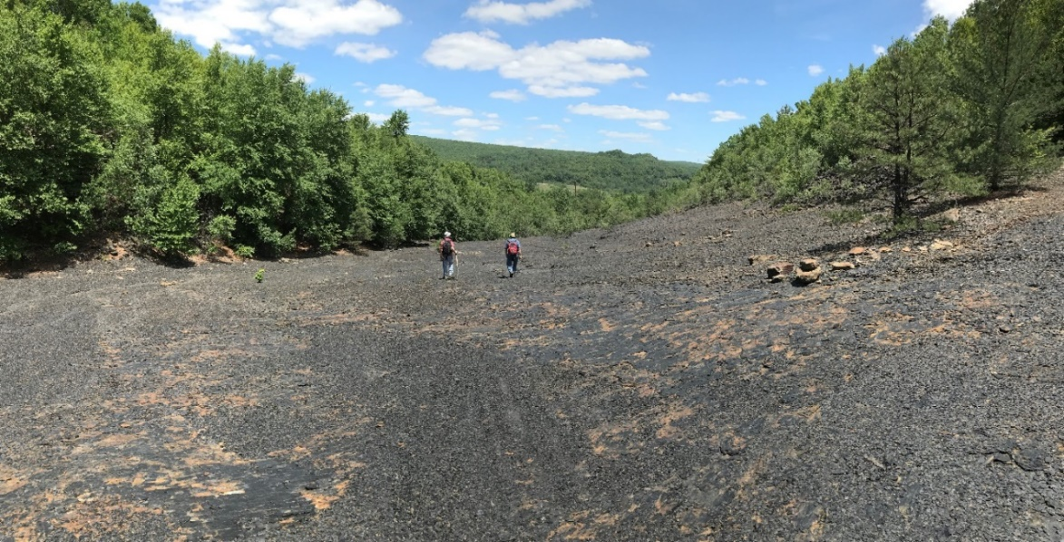
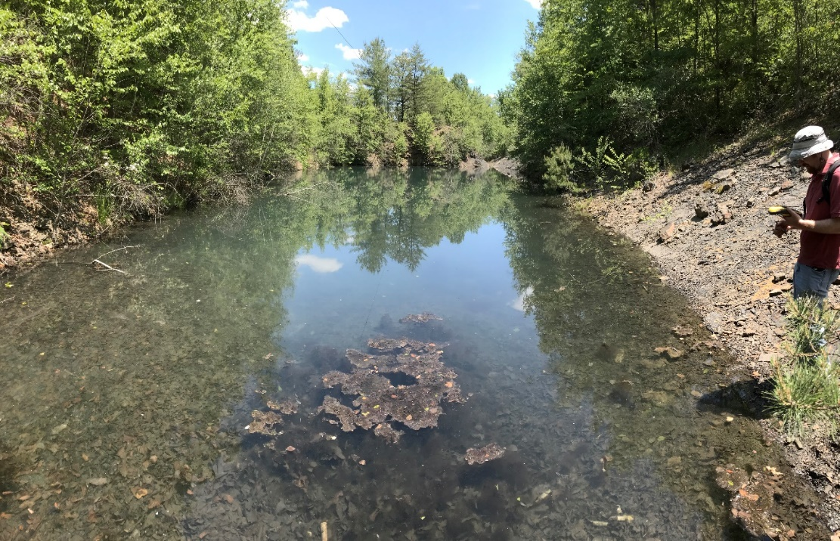
Coal Castle Revitalization
Photo 5, right: 4663-01, DPE, looking Northeast.
Photo 6, left: 4663-19, HWB, looking Northeast. Water body is a 0.3-acre impoundment. 4663-01, DPE, can be accessed by ATV trail in the upper left corner of the photo.

Slide 33
Coal Castle Revitalization
Project Cost and Funding Sources
Estimated Project Cost: $3,000,000
Funding Source:
AMLER Funding (Non-Water Supply Project): $1,000,000
Bipartisan Infrastructure Law (BIL/IIJA) Funding: $2,000,000

Slide 34
Coal Castle Revitalization
AML/AMD Measurables
11 acres of Priority 1 Dangerous Pile & Embankment
0.3-acre Priority 1 Hazardous Water Body
43 acres of Priority 3 Spoil Area
2 acres of Priority 3 Pits
56 total acres of AML will be reclaimed and suitable for development
Estimated 10-20 full and part time jobs will be created

Slide 35
Coal Castle Revitalization
Project Partners
Famous Reading Outdoors
Property owner of the AML site
New Castle Township
Schuylkill Headwaters Association
Office of Surface Mining Reclamation and Enforcement
PA Department of Environmental Protection

Slide 36
Marianna
PROJECT OVERVIEW:
Reclaim 27 acres of Priority 2 Dangerous Pile or Embankment (DPE). The volume of the DPE is approximately 825,000 cubic yards and comprised of steep, unstable coal refuse material.
Remove coal refuse material and haul the material to Emerald CRDA #2, a DEP-permitted coal refuse disposal area, located in Waynesburg, PA
Construct new soccer and baseball fields, a dog recreation area, athlete warm up area, and parking lots.
Construct a walking trail along Ten Mile Creek to include fishing access and promote wildlife observation.
The Township plans to complete a land study to determine if solar development would be feasible on the project site.
Promote recreational opportunities for the community and spur economic benefits to local businesses

Slide 37
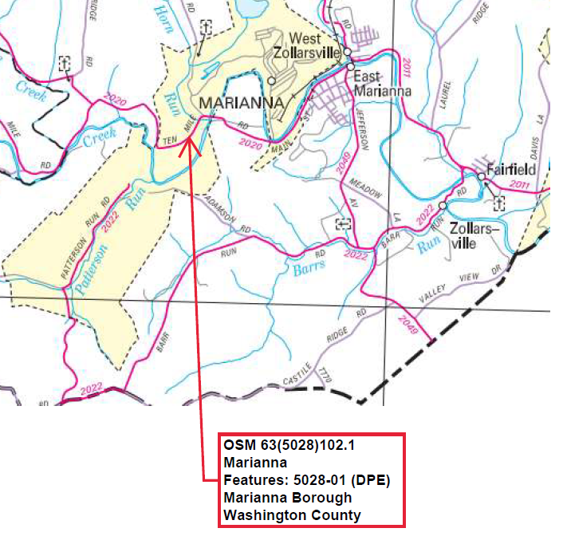
Marianna
Project Location Map

Slide 38
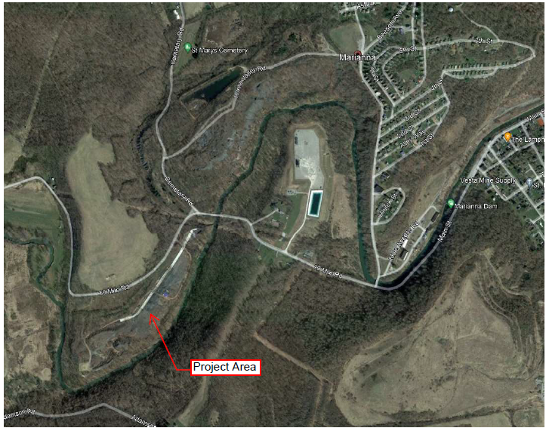
Marianna
Project Area Map
Project Area

Slide 39
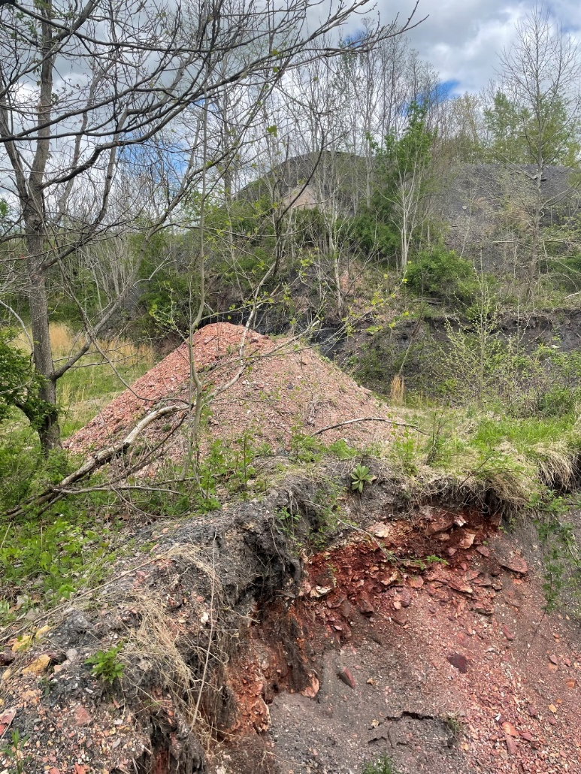
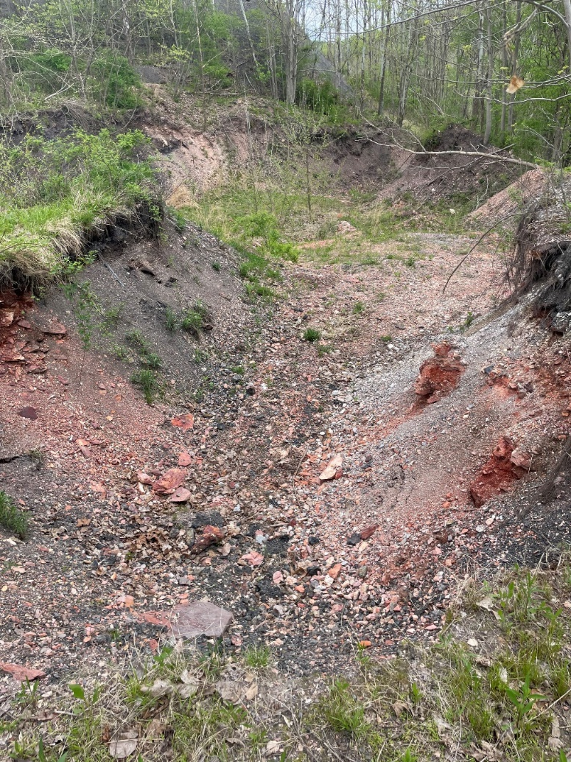
Marianna
Project Photos

Slide 40
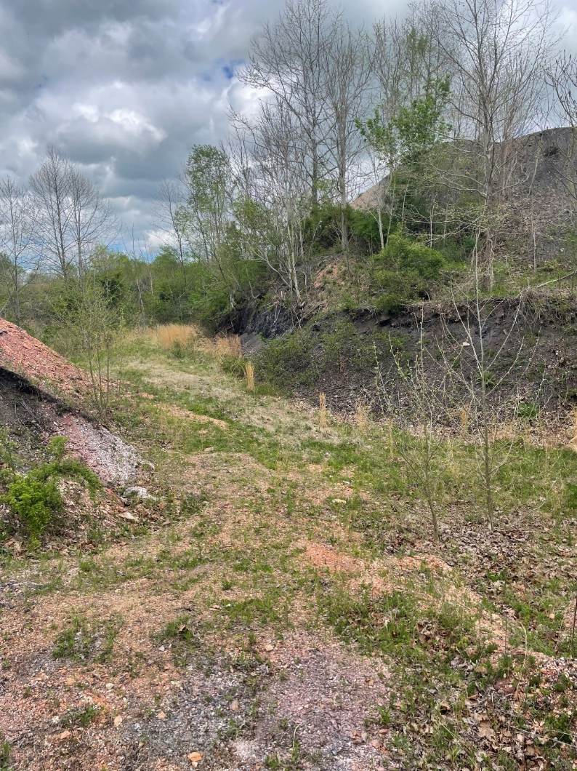
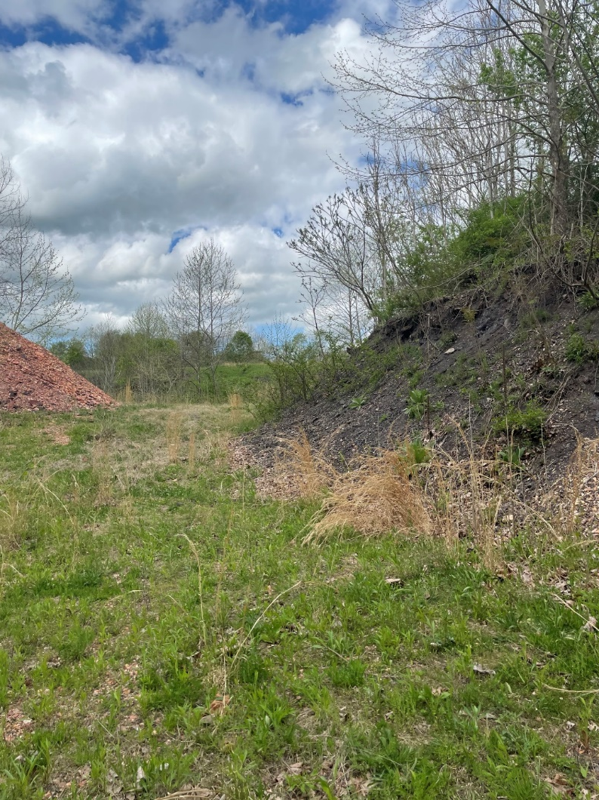
Marianna

Slide 41
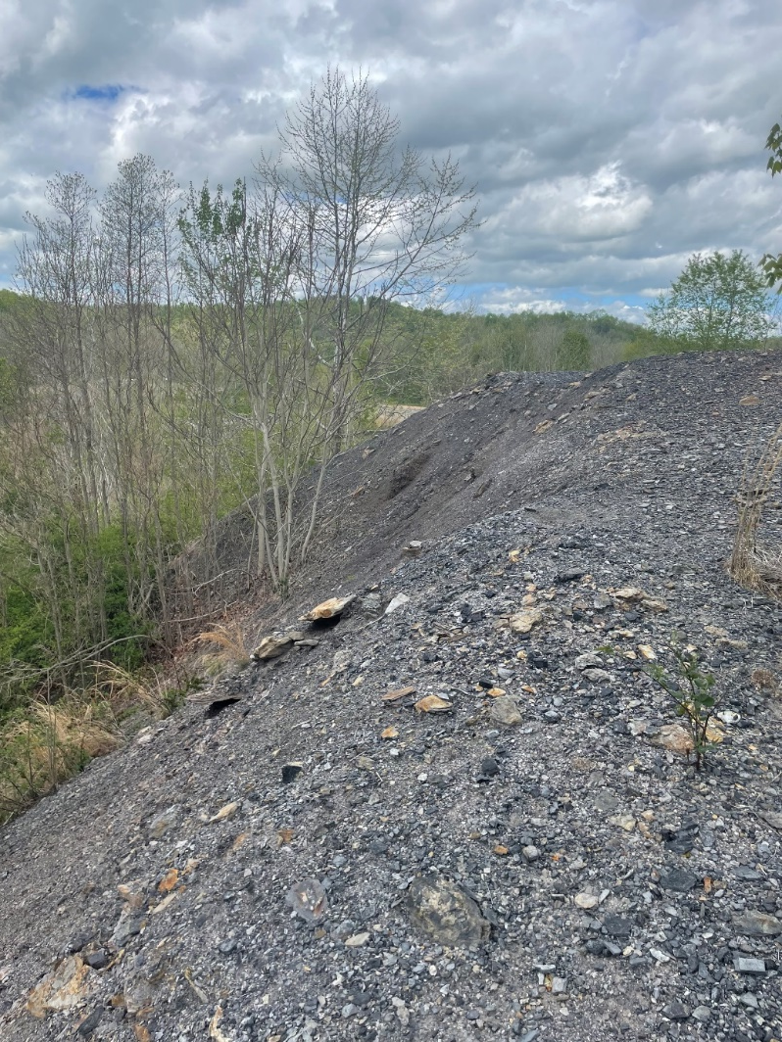
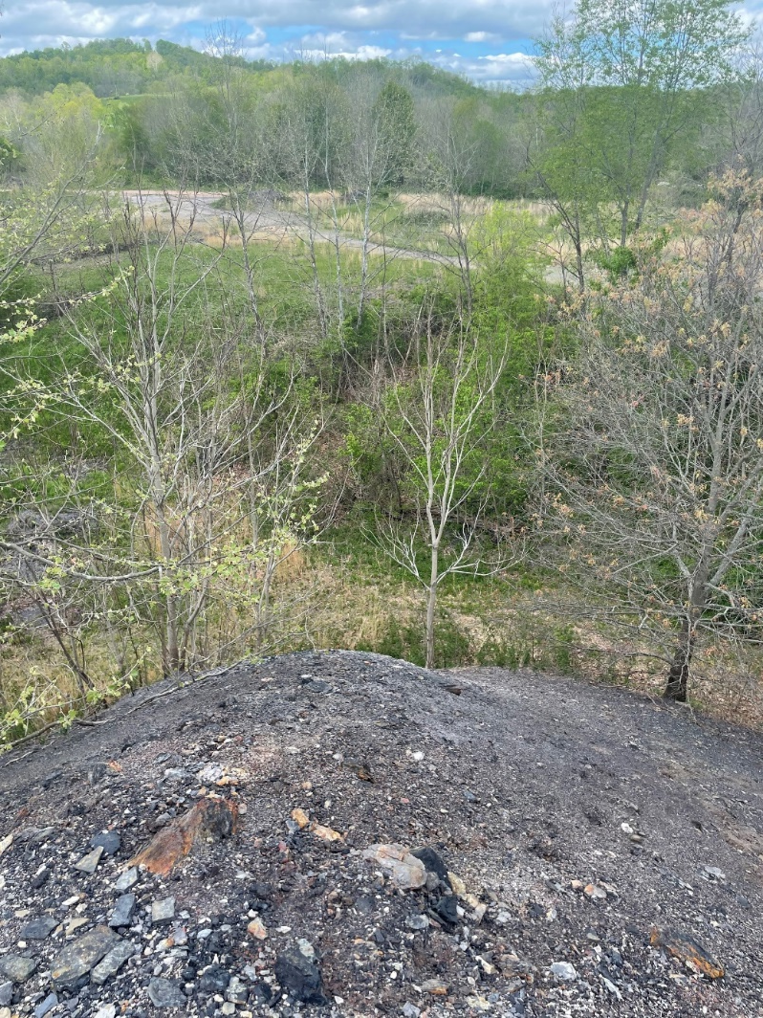
Marianna

Slide 42
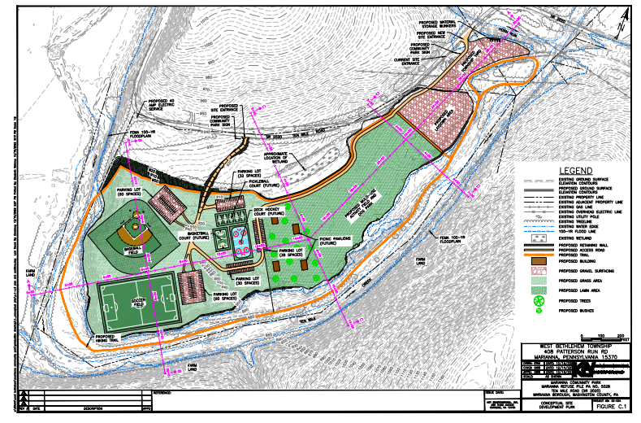
Marianna

Slide 43
Marianna
Project Cost and Funding Sources
Estimated Project Cost: $36,456,642
Funding Sources:
AMLER (Non-Water Supply Project): $19,630,000
BIL Funding: $16,826,642

Slide 44
Marianna
AML/AMD Measurables:
Reclaim approximately 27 acres of Dangerous Pile or Embankment (DPE)
Reduction in metal-laden runoff into Ten Mile Creek upon reclamation of DPE

Slide 45
Marianna
Economic Development Measurables:
The area will support full size baseball and soccer fields, a dog recreation area, athlete warm up area. Additionally, there will be a dog recreation area, athlete warm up area and parking lots.
A walking trail will be established along Ten Mile Creek which will also allow fishing access and wildlife observation.
West Bethlehem Township plans a continual investment for the community on this site. The Township plan includes adding a basketball court, five (5) pickleball courts, a deck hockey rink, a playground and pavilions. The Township will do a study to see if any land can be used for solar development.

Slide 46
Marianna
Project Partners:
Office of Surface Mining Reclamation and Enforcement
Pennsylvania Department of Environmental Protection
West Bethlehem Township
Natural Stream Foundations
Key Environmental, Inc.
Iron Synergy Holding, LLC
Trout CPA

Slide 47
For more information about the AMLER Program in Pennsylvania click here or visit www.dep.pa.gov and search ‘AMLER’.
Josh Shapiro, Governor
Richard Negrin, Secretary

