Slide 1
Draft Guidance on Trenchless Technology
Environmental Considerations for the Construction and Operation of Trenchless Technology
Presentation
to the
Oil and Gas Technical Advisory Board
December 2019
Harrisburg, PA

Slide 2
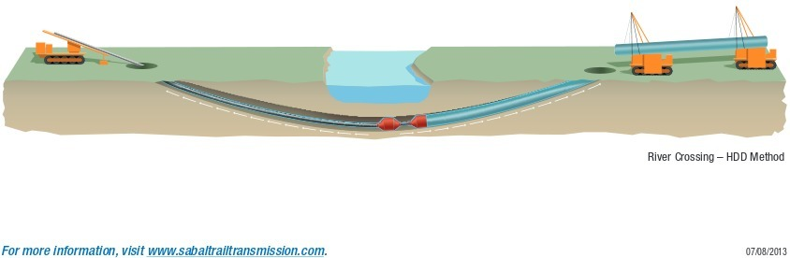
Trenchless Technology Technical Guidance Document
Charge of the Stakeholder workgroup: “Construction and Operation during Horizontal Directional Drilling (HDD)”
Stipulation states: Enhanced Best Practices ("EBP") in the design and execution of HDDs and HDD Inadvertent Return Assessment, Preparedness, Prevention and Contingency Plans
HDD workgroup and the Trenchless Technology Technical Guidance Document

Slide 3
Trenchless Technology Technical Guidance Document
Site-specific geological, topographical, and hydrological analysis to be considered
Type of analysis and documentation of adjacent features in the vicinity of the project footprint
Potential impact of the planned activity on or from adjacent features.

Slide 4
Trenchless Technology Technical Guidance Document
Enhanced Best Practices for:
  preventing and responding to Inadvertent Returns (IRs) and
  preventing and responding to hydrological impacts from IRs;
  groundwater quality and quantity protection;
  procedures to identify water supplies in the vicinity of a proposed HDD beyond the use of the Pennsylvania Groundwater Information System
Recommendations for permittee to conduct water supply testing (quality and quantity) for landowners within the vicinity of an HDD.

Slide 5
Contributors to the Guidance Document
State Agency Representatives
  DEP’s Regional Permit Coordination Office
  DEP’s Bureau of Oil and Gas
  DEP’s Bureau of Waterways Engineering
  Pennsylvania Public Utility Commission (PUC)
Appellant Representatives
  Clean Air Council
  Mountain Watershed Association
  Delaware Riverkeeper Network
Federal Agency Representatives
  Federal Energy Regulatory Commission (FERC)
  Pipeline and Hazardous Materials Safety Administration (PHMSA)
Industry Representatives
  Oil and Gas Experts
  Drilling Experts

Slide 6
Trenchless Technology Technical Guidance Document
Advisory Committees and Boards we are presenting to include:
  Water Resources Advisory Committee (WRAC) – October 30, 2019
  Agricultural Advisory Board (AAB) – November 7, 2019
  Oil and Gas Technical Advisory Board – December 18; AA declined
  Small Water Technical Advisory Committee – TBD
  Citizens Advisory Council (CAC) – TBD
  Bureau of Safe Drinking Water – Provided Comments on Draft
  Environmental Justice Advisory Board (EJAB) - TBD
  Sewage Advisory Committee - declined

Slide 7
Trenchless Technology Technical Guidance Document
Section 1. Preamble
Foreword/Executive Summary –
  policies, procedures, and best practices to aid in the prevention of adverse environmental impacts from construction utilizing trenchless technology.
  It is a road map for project proponents
  It outlines the steps and options to be considered when a project proponent, for any project (e.g., fiber optic, pipeline, etc.) proposes the use of a trenchless technology construction method
  It includes a suitability and feasibility analysis, as well as Environmental Considerations, a design and permitting section, and a construction and compliance section.

Slide 8
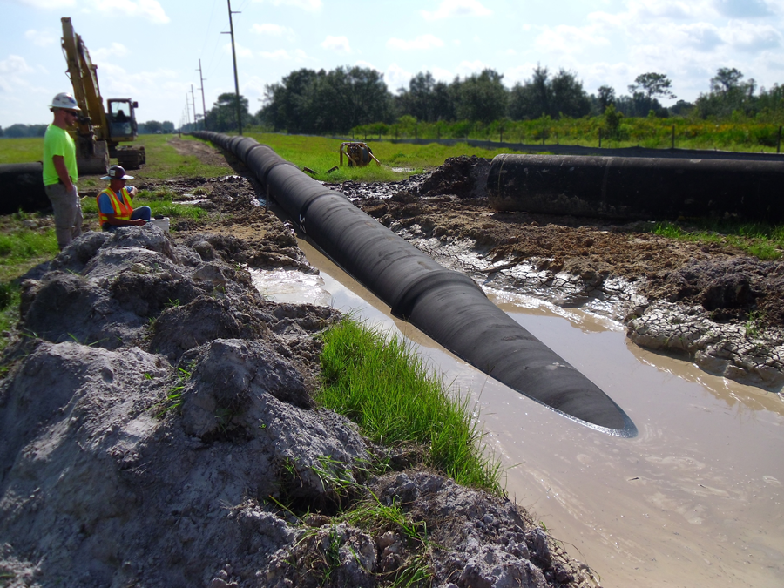
Trenchless Technology Technical Guidance Document
Section 1. Preamble, cont. -
B. Disclaimer
C. Authority
D. Purpose
E. Scope
F. Definitions

Slide 9
Trenchless Technology Technical Guidance Document
Section 2. Suitability, Feasibility, and Environmental Considerations
Proposed Alternative
Site Suitability Analysis – looks at the physical, technical, and geological constraints of the project.
  Existing Surface Conditions – (e.g., Topography, Water resources, cultural, etc).
  Subsurface Conditions – (e.g., geological conditions, soil interfaces and geological contacts, groundwater, existing utilities, such as cross bores, wells).
  Field Exploration – “ground truthing”. Geotech and Geophysical investigations and hydrogeologic investigations.

Slide 10
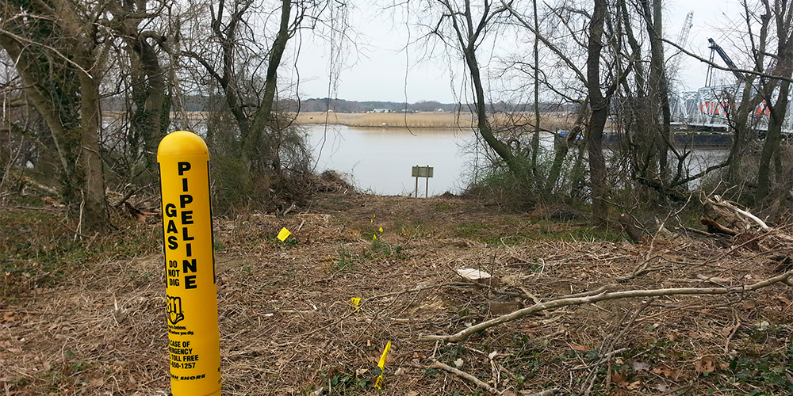
Trenchless Technology Technical Guidance Document
Section 2. Suitability, Feasibility, and Environmental Considerations, cont.
  C. Feasibility Analysis
  D. Environmental Considerations
E. Conclusion

Slide 11
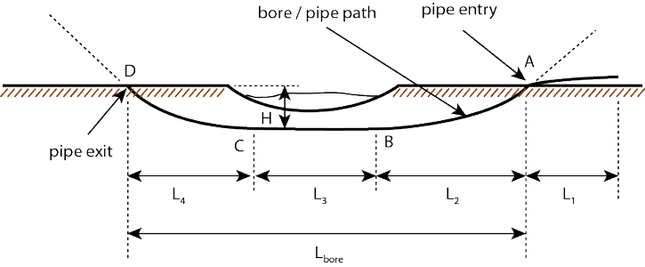
Trenchless Technology Technical Guidance Document
Section 3. Design and Permitting
Preferred Alternative
Design
  Site Constraints and Topographic Considerations
  Inadvertent Returns (IRs)
  Hole Flush
  Hole Stability
  Failure Mode Contingency Planning
  Water Supplies
  Waters of the Commonwealth
Confirmation
Permitting

Slide 12
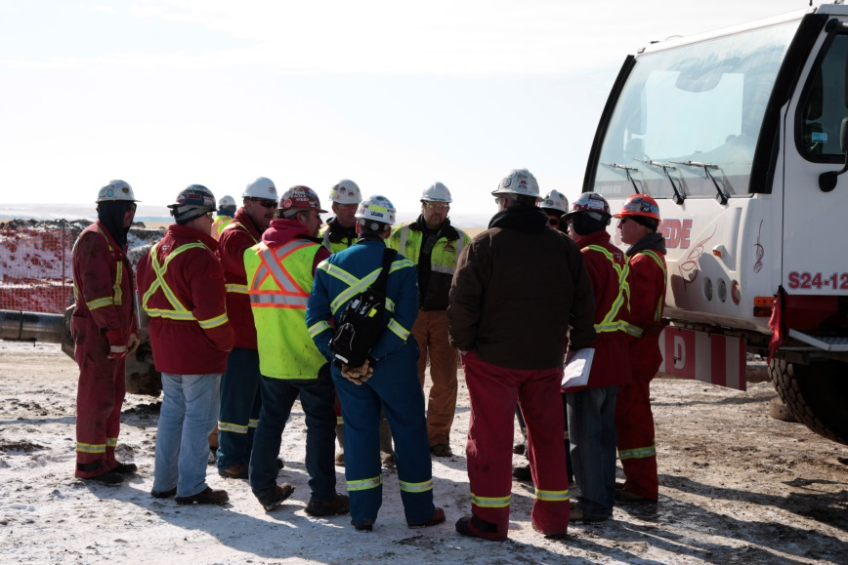
Trenchless Technology Technical Guidance Document
Section 4. Construction and Compliance
Preparedness, Prevention, and Contingency (PPC) Plan
Personnel, Responsibilities, and Trainings
Preconstruction Activities
Drilling Fluid Management

Slide 13
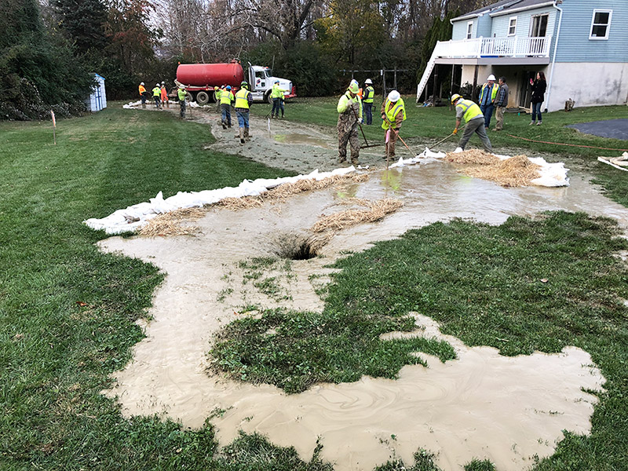
Trenchless Technology Technical Guidance Document
Section 4. Construction and Compliance, cont.
Inadvertent Return Minimization and Methodologies
  Instrumentation
  Fluid Circulation
  Loss of Circulation
Inspection, Compliance, Monitoring, and Emergency Response
  Inspection Protocols
  Monitoring Protocols
  Compliance
  Emergency Response Planning

Slide 14
Trenchless Technology Technical Guidance Document
Appendices
Trenchless Technology Risk Evaluation
Data Resource List
Bore & HDD Flowchart
Instructions for Determining Public Water Supply Source Locations using eMapPA
Example Template for a PPC Plan – Simple and Complex Projects
Example Notification Letter and Well Construction Questionnaire
Example letter conveying water quality results and notification of EPA maximum contaminant Level (MCL) exceedances
Technical Guidance Document – Plan Submittal Checklist(s)

Slide 15
Draft Guidance on Alternatives Analysis
Methods and Factors to Consider to complete Alternatives Analysis
Stipulation of Settlement: “The Department will seek stakeholder input for policy, procedure, and/or guidance development related to … The recommended methodology and factors to consider to complete an Alternatives Analysis under 25 Pa. Code § 105.13(e)(1)(viii).”
Alternative Analysis: A detailed analysis of alternatives to the proposed action, including alternative locations, routings or designs to avoid or minimize adverse environmental impacts.

Slide 16
Alternatives Analysis Technical Guidance Document has been developed via the same process as and in tandem with the Trenchless Technology Technical Guidance Document
Input from broad stakeholder interests and expertise including state and federal agencies, industries, and appellants
Stakeholder Draft comment period closed on November 29th, 2019
Anticipate to send to Advisory Committees and Boards for comment in early 2020

Slide 17
Trenchless Technology Technical Guidance Document
Questions

