Slide 1

Agriculture Initial Inspections Update
Ag Advisory Board
April 27, 2017
Tom Wolf, Governor
Patrick McDonnell, Acting Secretary

Slide 2

Agenda
Past – Quick Overview
Present – Restoration Strategy and Initial Ag Inspection Update
Future – Data Management

Slide 3
Agriculture Initial Inspections
Chapter 91 and Chapter 102 requirements
Small Agricultural Operations
Specific focus in the Chesapeake Bay Watershed

Slide 4
Agriculture Initial Inspections
Chapter 91 - Manure Management Plan Requirements
Chapter 102 - Ag E&S Requirements
Education and Outreach
Education and Outreach Visits
Manure Management and Ag E&S Workshops
Planning Assistance
Technical Assistance
Funding

Slide 5
Chesapeake Bay Watershed
From Rich Batiuk, EPA
Pennsylvania Nitrogen Loads: 2015-2025
113
79
2025
2015
78% Agriculture
20% Urban
2% Septic Systems
Where will the remaining nitrogen reductions* come from?
*Based on the jurisdictions’ Phase II WIPs.
Notes:
Responsible for 69 percent of remaining basinwide nitrogen load reductions by 2025
Agriculture will likely be responsible for much more than 80 percent of these nitrogen reductions by 2025

Slide 6
From Rich Batiuk, EPA
Chesapeake Bay Watershed
Pennsylvania Phosphorus Loads: 2015-2025
4.3
3.6
2025
2015
Where will the remaining phosphorus reductions* come from?
76% Agriculture
24% Urban
*Based on the jurisdictions’ Phase II WIPs.

Slide 7
Restoration Strategy: Six Elements
Address Pollutant Reduction
Quantify & Multiply BMPs
Improve Record-keeping
Identify Needed Changes
Establish a DEP Chesapeake Bay Office
Seek New Resources
Notes:
Address pollutant reduction by: a) meeting the EPA goal of inspecting 10 percent of farms and MS4s in the watershed annually, b) ensuring development and use of manure management and agricultural erosion and sediment control plans, and c) enforcement for non-compliance

Slide 8
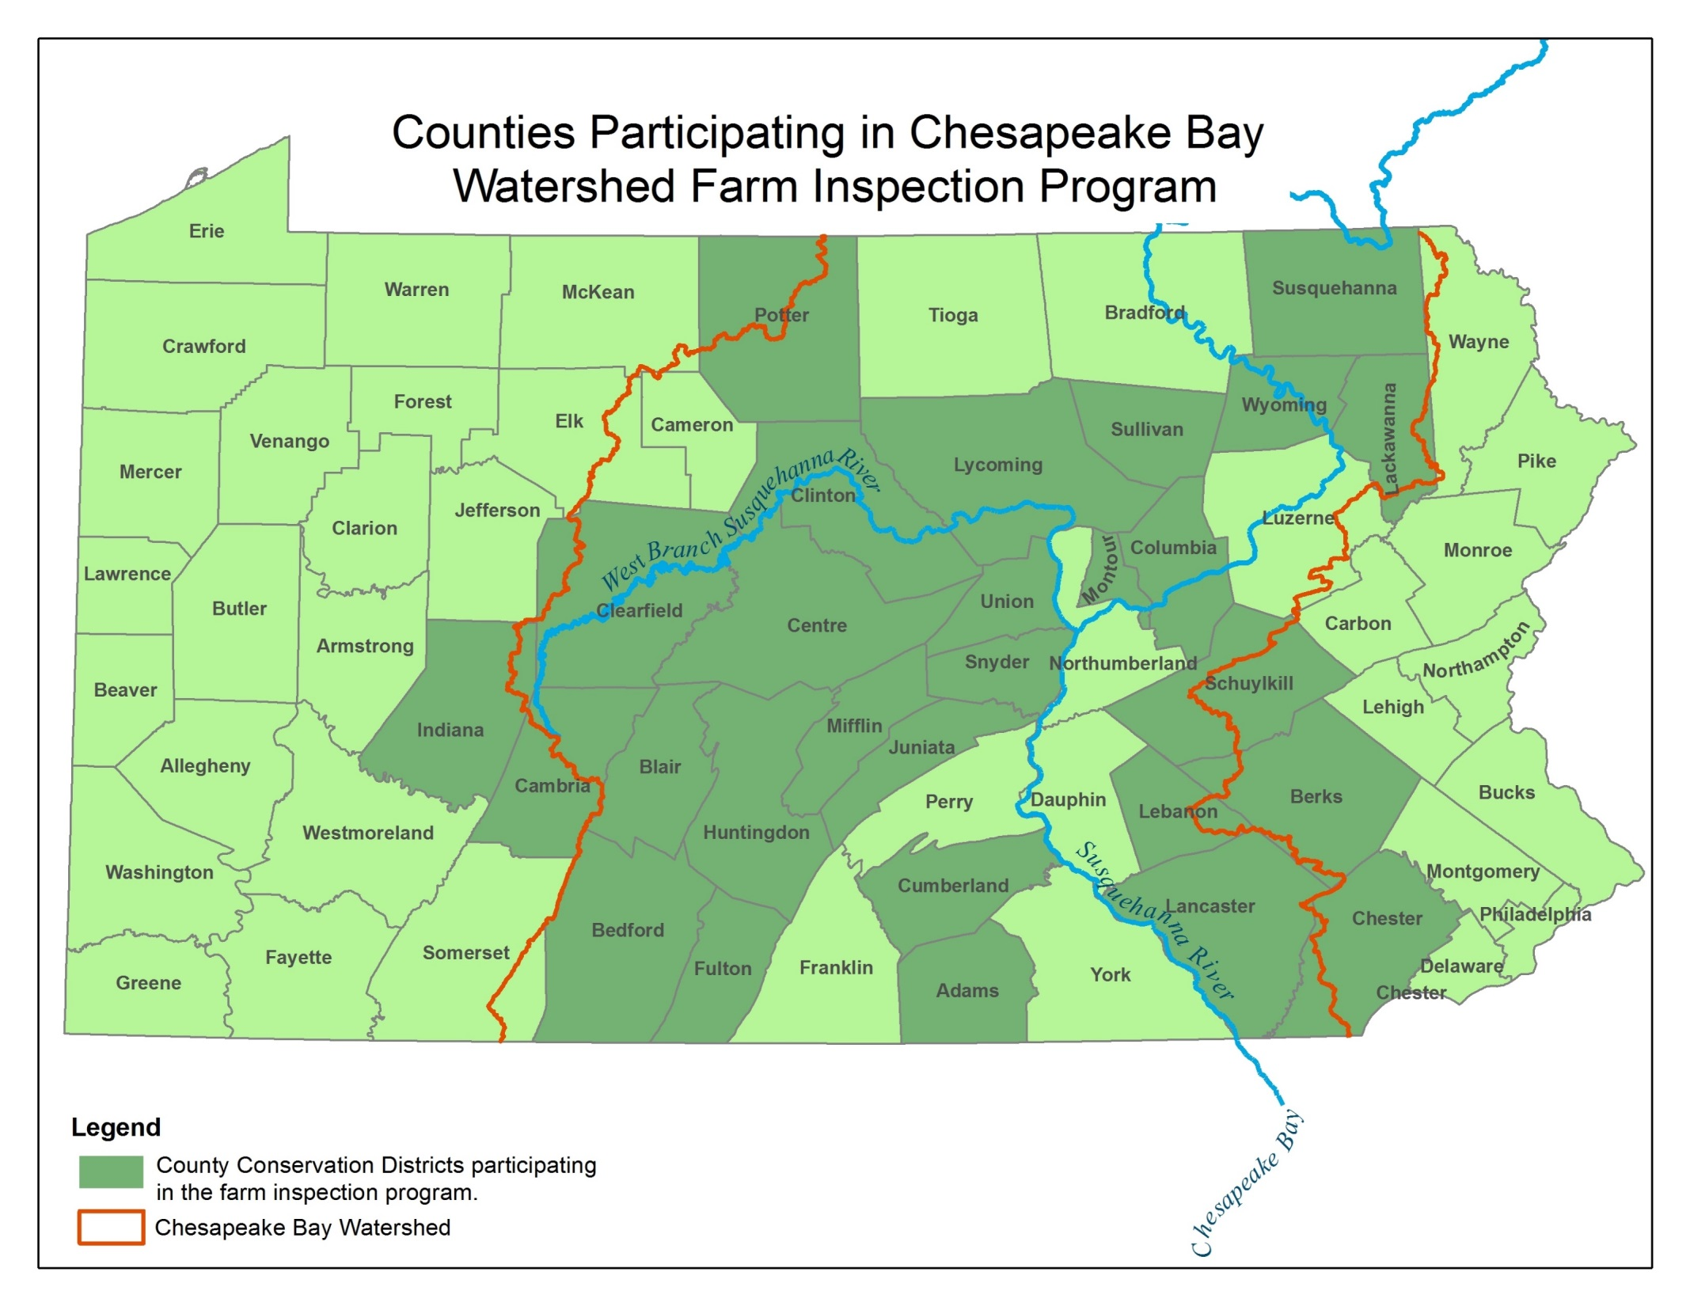

50
50
38
50
25
50
50
50
38
50
38
50
63
50
50
50
50
88
50
25
50
50
300
75
100
75
50
Notes:
This is the total amount of inspections that will be accomplished by each county conservation district annually.

Slide 9
Agricultural Inspection Initiative
DEP began inspections August 29, 2016
Districts began inspections October 3, 2016
Preliminary Results (as of December 31, 2016):
Over 500 Inspections Completed (29,400 + acres)
Over 326 by Conservation Districts
Over 177 by DEP
Notes:
Administratively Complete Manure Management Plan = 64%
95% of those with plans reported to be keeping records
Administratively Complete Agriculture E&S Plan = 60%
97% of those with plans reported to be implementing the plan
Number referred to DEP for follow-up enforcement action due to lack of plan(s) = 5

Slide 10
Agricultural Inspection Initiative
Pre-inspection notice
Inspection performed by Conservation District or DEP staff
Time frame to achieve compliance, if non-compliant
Follow-up activities and measures
Referral to DEP
Referral is made when the inspection is completed by CD and the operation remains in non-compliance

Slide 11
Agricultural Inspection Initiative
Manure Management – 273 out of 326 inspected by Districts were required to have MMP
195 farms reported having animals; 78 farms importing manure
175 farms have administratively complete Manure Management Plan (64% initial compliance)
71 farms (26% of those with planning requirement) reported using assistance to develop plans; the rest were developed by the farmer
167 farms (95% of farms with planning requirement) self-reported as implementing the plan
179 farms (66% of farms with planning requirement) self-reported following required application setbacks
144 farms (82% of farms with planning requirement) self-reported the completion of required application records

Slide 12
Agricultural Inspection Initiative
Agricultural Erosion and Sediment Control (Ag E&S) Plan –
256 out of 326 inspected by Districts were required to have Ag E&S Plan
155 farms (60% initial compliance) have administratively complete Ag E&S Plan
148 farms (95% of those with planning requirement) reported using assistance to develop plans
150 farms (97% of farms with planning requirement) self-reported as implementing the plan

Slide 13
Agricultural Inspection Initiative
Referrals (December 31, 2016 to April 1, 2017)
11 operations were referred to DEP for follow-up enforcement action due to lack of required MMP, Ag E&S Plan, or both
NOVs have been sent to 6 operations
Notes:
DEP has 30 days to send NOV
NOV allows an additional 90 days to achieve compliance.
As of April 6, compliance has been achieved for one operation during 90 day NOV time frame.

Slide 14
Agricultural Inspection Initiative – Future
Updating SOP and Inspection Form
Workgroup comprised of:
4 county conservation districts (Clinton, Union, Cumberland, Lancaster);
4 DEP Regional Offices (NCRO, NERO, SCRO, SERO)
DEP Central Office (Operations Division, Bureau of Clean Water)
Continue on course for inspecting 10% of agricultural operations per year
Notes:
Updating SOP and Inspection form due to EPA grant conditions and lessons learned thus far.

Slide 15
Agricultural Inspection Initiative -- Future
Worldview Development
Used the existing database design that was created for five Pennsylvania county conservation districts and Virginia Department of Environmental Quality
Submitted 2016 Progress Data Using the new Database Software
PracticeKeeper Software Launch to ALL Districts in July, 2017
6 Modules – Nutrient Management, E & S Planning, Watershed Projects, Complaints and BMPs
DEP staff and 9 Districts pilot testing starting now
Inspection Module forthcoming
Hardware for PracticeKeeper
Funding Distributed for tablets for in-the-field data collection
Tablets will also be used for completion of inspections
Notes:
Districts doing the pilot testing include Clinton, Susquehanna, Cumberland, Adams, who do not have PracticeKeeper now and Lancaster, Allegheny, Chester, Berks and Juniata Counties who do have it.

Slide 16
Contact Information:
Jill Whitcomb
Environmental Group Manager
NPS Compliance
jiwhitcomb@pa.gov
783-5205
Douglas Goodlander
Program Manager
Operations Division
dgoodlande@pa.gov
772-0141
Notes:
Thank Districts and Regional Offices for their dedication and efforts.

