Slide 1
Standard Animal Weights Agricultural Advisory Board April 27, 2017
Frank X. Schneider
Director, Nutrient and Odor Management Programs

Slide 2
Background
Staff would like to update the AAB on changes to the Standard Animal Weights that are utilized in the Act 38 Nutrient Management Program.
Staff is seeking a recommendation from the AAB to the State Conservation Commission (SCC).
The current animal weights that are used in the Act 38 Nutrient Management Plan (NMP) program were developed in 2010.
The original animal weights were published in 1997 for Act 6.
In 2007, a revision was made for Act 38.
In 2010, the weights were again revised to better reflect current Pennsylvania agriculture.

Slide 3
Regulations
83.262 (a) (1) (i) of the Act 38 regulations state:
Compute the animal weight for the agricultural operation by multiplying the average number of animals on the agricultural operation by the standard animal weight used by the livestock industry in this Commonwealth. The standard weights contained in guidance published by the Commission may be used to meet this requirement. Other animal weights may be used in place of those in the Commission guidance, if there is sufficient documentation to support their use. For those animal types not included in the Commission guidance, the average animal weight for the operation shall be used for this calculation, taking into account, if applicable, the range of animal weights throughout the time the animals are on the operation.

Slide 4
Public Comment
In September 2016, the SCC approved a 60-day public comment period on the draft standard animal weights and animal grouping.
On October 28, 2016 SCC staff released the draft for public comment and also briefed the NMAB and the DEP AAB.
The comment period ended December 30, 2016.

Slide 5
Public Comment
The public comment announcement asked for the following:
Comments on the draft weights.
Comments on the animal grouping.
When should the changes become effective?
How will the new animal weights be brought into existing Nutrient Management Plans (NMPs)?
How will the new animal weights be brought into existing Concentrated Animal Operation (CAO) / Concentrated Animal Feeding Operation (CAFO) calculations that show someone is not a CAO / CAFO?
How will these new weights and agronomy facts 54 be “rolled out”?

Slide 6
Public Comment
The SCC received 84 comments from 25 commentators.
Based off the comments received, we asked the PSU species specialists to review the draft again and make final adjustments.
Changed have occurred.

Slide 7
Proposed Dairy - Significant change, compared to 2010 version
Type of Animal | Standard Weight (lbs.) during Production (range)
Dairy
Holstein/Brown Swiss
Cow | 1,3001450
Heifer: 1–2 yr. | 900 1000 (650–1,150 750 – 1250)
Calf: 0–1 yr. | 375 420 (100–650 90 – 750)
Bull | 1,500 1700
Guernsey/Ayrshire
Cow | 1,100 1200
Heifer: 1–2 yr. | 800 865 (575–1,025 630 – 1100)
Calf: 0–1 yr. | 338 350 (100–575 70 – 630)
Bull | 1,250 1600
Jersey
Cow | 900 1000
Heifer: 1–2 yr. | 600 675 (400–800 500 – 850)
Calf: 0–1 yr. | 225 (50 – –400500)
Bull | 1,000 1200

Slide 8
Proposed Swine - Slight change, compared to 2010 version
Type of Animal | Standard Weight (lbs.) during Production (range)
Swine
Nursery pig | 350 (13 – 5–5745)
Wean to finish | 1430 (13 – 5-27365)
Grow finish | 165 5 (57 – 45–27365)
Gestating sow | 4500
Sow and litter | 470
Boar | 450

Slide 9
Poultry (Layer) - Significant change, compared to 2010 version
Type of Animal | Standard Weight (lbs.) during Production (range)
Poultry
Layer: 18–65 75 wk. | 3.103.13 (2.752.82 – –3.453.44)
Layer: 18–105 90 wk. | 3.153.14 (2.82 – 3.46) weighted avg.
Layer, brown egg: 20–65 18-75 wk. | 3.8 3.85 (3.3-4.3 3.35 – 4.34)
Layer, brown egg: 20–105 18-90 wk. | 4.00 3.85 (3.3-4.7 3.35 – 4.34)
Pullet: 0–18 16 wk. | 1.421.38 (0.08 – –2.752.67)
Pullet, brown egg: 0–16 wk. | 1.54 (0.08 – 3.0)
Layer, white egg breeder hen: 17-70 wk. | 3.25 (2.7 – 3.8)
Layer, white egg breeder rooster: 17-70 wk. | 4.37 (3.67 – 5.06)
Layer, brown egg breeder hen: 17-70 wk. | 3.55 (2.9 – 4.2)
Layer, brown egg breeder rooster: 17-70 wk. | 5.05 (4.5 – 5.06)

Slide 10
Poultry (Broiler) - Significant change, compared to 2010 version
Broiler, large: 0–53 days | 3.03.5 (0.09 – –6.07.0)
Broiler, medium: 0–35 days | 2.32.5 (0.09 – –4.55.0)
Roaster, male: 0–7 wk. | 4.7 (0.09 – 9.3)
Roaster, female: 0–9 wk. | 4.9 (0.09 – 9.8)
Broiler, breeder pullet: 0-20 wk. | 2.55 (0.09 – 5.0)
Broiler, breeder cockerel: 0-20 wk. | 3.55 (0.09 – 7.0)
Broiler, breeder hen: 20-65 wk. | 6.75 (5.0 – 8.5)
Broiler, breeder rooster: 20-65 wk. | 8.75 (7.0 – 10.5)

Slide 11
Poultry (Turkey) - Significant change, compared to 2010 version
Turkey, tom brooder: 0-6 wk. | 3.36 (0.22 – 6.5)
Turkey, hen brooder: 0-6 wk. | 2.74 (0.22 – 5.25)
Turkey, tom: 60–18 wk. | 20.025.25 (6.50. – 12–4044)
Turkey, hen regular: 60–12 wk. | 7.111.13 (5.250.12 – –1417)
Turkey, hen heavy: 6-16 wk. | 14.63 (5.25 – 24)

Slide 12
Poultry (Duck) - Significant change, compared to 2010 version
Duck, starter: 0–1743 days | 1.363.56 (0.22 – 2.5 11–7)
Duck, finisher: 17-38 days | 4.88 (2.5 – 7.25)
Duck, developer: 0-196 days | 3.21 (0.22 – 6.2)
Duck, layer | 6.85 (6.2 – 7.5)

Slide 13
Poultry (Other) - Significant change, compared to 2010 version
Guinea, growing: 0–14 to 24 wk. | 1.9 (0.06 – –3.75)
Guinea, mature | 3.75
Pheasant, growing: 0–13 to 43 wk. | 1.53 (0.05 – –3.0)
Pheasant, mature | 3.0
Chukar, growing: 0–13 to 43 wk. | 0.52 (0.04 – –1.0)
Chukar, mature | 1.0
Quail, growing: 0–13 to 43 wk. | 0.26 (0.02 – –0.5)
Quail, mature | 0.5

Slide 14
Beef - Slight change, compared to 2010 version
Type of Animal | Standard Weight (lbs..) during Production (range)
Beef
Calf: 0–8 mo. | 300 (100 – 500)
Backgrounding Cattle | 500 (300 – 700)
Finishing: 8–24 mo. | 950 (500 – 1400)
Replacement Heifer: 8 mo.-1 yr. | 500 (300 – 700)
Replacement Heifer: 1-2 yr. | 875 (700 – 1050)
Cow | 1400
Bull | 1500

Slide 15
Veal - Slight change, compared to 2010 version
Type of Animal | Standard Weight (lbs..) during Production (range)
Veal
Calf: 0–20 wk. | 280 (95 – 465)

Slide 16
Sheep and Goats - Significant change, compared to 2010 version
Type of Animal | Standard Weight (lbs..) during Production (range)
Larger Breed Sheep
Lamb: 0–1 yr. | 85 (10 – 180)
Ewe | 225
Ram | 300
Medium Breed Sheep
Lamb: 0–1 yr. | 80 (10 – 150)
Ewe | 175
Ram | 225
Smaller Breed Sheep
Lamb: 0–1 yr. | 45 (10 – 80)
Ewe | 100
Ram | 125
Meat Goats
Kid: 0–1 yr. | 65 (5 – 125)
Doe | 150
Buck | 200
Dairy Goats
Kid: 0–1 yr. | 45 (5 – 85)
Doe | 125
Buck | 170

Slide 17
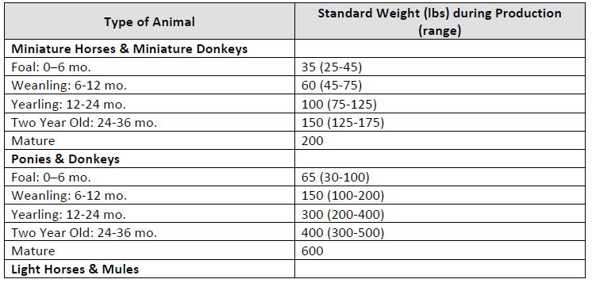
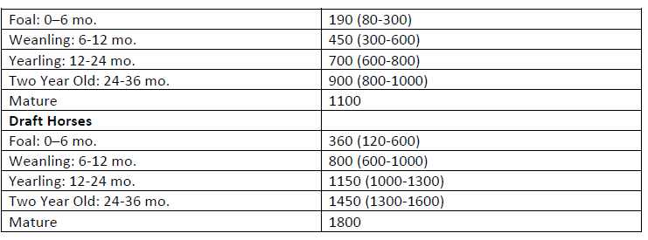
Equine - no change, compared to 2010 version

Slide 18
Bison - Significant change, compared to 2010 version
Type of Animal | Standard Weight (lbs..) during Production (range)
Bison
Calf: 0–1 yr. | 275 (50 – 500)
Yearling 1-2 yr. | 650 (500 – 800)
Cow | 1000
Bull | 1600

Slide 19
Deer - No change, compared to 2010 version
Type of Animal | Standard Weight (lbs..) during Production (range)
Deer
Fawn: 0-6 mo. | 36 (7 – 65)
Yearling Doe: 6-18 mo. | 95 (65 – 125)
Yearling Buck: 6-18 mo. | 110 (65 – 155)
Mature Doe | 145
Mature Buck | 200

Slide 20
Alpaca and Llama - Slight change, compared to 2010 version
Type of Animal | Standard Weight (lbs..) during Production (range)
Alpaca
Young | 80 (15 – 145)
Mature Female | 145
Mature Male | 170
Llama
Cria: 0-1 yr. | 75 (25– -125)
Yearling: 1-2 yr. | 213 (125 – 300)
Mature | 350

Slide 21
“Roll Out” / Implementation
The SCC will publish the revised Standard Animal Weights and groupings table in the PA Bulletin, as soon as practical, after the SCC approves.
Agronomy Fact Sheet 54 will be updated and published.
New Standard Weights will be updated in the Growing Animal Weight Calculator section of the NMP spreadsheet.
That NMP spreadsheet will be version 6.0.
NMP Spreadsheet 6.0 is proposed to be released in October 2017 and then must be used for all CY 2019 NMP and beyond (until replaced by the next version).
This release timing matches with the NM Technical Manual timing.

Slide 22
“Roll Out” / Implementation
A commercial Nutrient Management Specialist (NMS) must perform a CAO calculation that will be verified by a delegated conservation district or the SCC.
Delegated CD’s can perform “preliminary” or “draft” CAO calculations but when it is determined that an operator is close to the CAO threshold, a commercial NMS needs to be brought in to perform the actual calculation that will then be reviewed by the delegated CD or SCC.

Slide 23
“Roll Out” / Implementation Newly Identified CAOs
Note: we need to follow the regulations at (83.261. General.)
(1) (iii) For new operations defined as CAOs and commencing before October 1, 2006, a plan shall have been submitted prior to commencement of operations.
(3) Operations that become defined as CAOs after October 1, 2006, due to expansion of an existing operation or loss of rented or leased land. Existing operations that make changes to their operations that result in becoming defined as CAOs for the first time after October 1, 2006, shall meet the following:
(i) An agricultural operation which becomes a CAO after October 1, 2006, due to loss of land suitable for manure application, shall submit a plan within 6 months after the date which the operation becomes a CAO.
An agricultural operation which will become a CAO due to expansion of operations by the addition of animals shall obtain approval of the plan prior to the expansion.
(4) New operations. A new operation which will commence after October 1, 2006, and which will be a CAO, shall obtain approval of a plan meeting the requirements of this subchapter prior to the commencement of the operation.

Slide 24
“Roll Out” / Implementation Newly Identified CAOs – Due to Weight Changes Only
The NEW Standard WEIGHTS will become effective on October 1, 2019 (Start of Crop Year 2020)
It may be necessary to provide two CAO calculations.
The 1st CAO calculation will provide the AEU/Ac calculation prior to the release of the new standard weights.
If this CAO calculation show a CAO, the operator must follow previous guidance.
The 2nd CAO calculation will provide the AEU/Ac with the new standard weights.
Once the operation is confirmed to be a CAO, that CAO will have 2 crop years from that date to have an approved NMP.
These CAOs will need to have Crop Year 2020 NMPs
Plan approval before October 1, 2019, so plan should be submitted for review in June/July 2019
Note this is a 2 year roll out from when SCC approves weights until plan should be submitted for review and 2 1/12 years from weight approval until plan must be approved.

Slide 25
“Roll Out” / Implementation Existing CAOs and CAFOs
New weights will be brought into the NMP when the NMP is due to be amended.
This amendment may be at the triennial review or sooner, if one of the amendment criteria (“triggers”) are met before the triennial review.
Note that the 10% increase in AEUs “trigger”, for this standard weight update only, is merely for an expansion (addition) of animals and not based off the new standard animal weights until the triennial review time.
This would allow a 3-year phase in period for existing CAOs and CAFOs

Slide 26
“Roll Out” / Implementation New CAFOs
The NEW Standard WEIGHTS will become effective on October 1, 2019 (Start of Crop Year 2020)
If the CAFO is also a CAO, they will follow the CAO Guidance:
- The newly defined CAFO will be required to have an approved CAFO permit by the time that the new animal weights become effective (October 1, 2019).
- This requirement will necessitate that the newly defined CAFO submit an administratively complete CAFO permit application by April 1, 2019.

Slide 27
“Roll Out” / Implementation New VAO CAFOs
If a newly defined Voluntary Animal Operation (VAO) CAFO, Once the operation is confirmed to be a CAFO, using the NEW Standard Animal Weights, that CAFO will have up to 2 crop years to have an approved NMP and CAFO permit.
The newly defined CAFO will be required to have an approved CAFO permit by the time that the new animal weights become effective (October 1, 2019). This requirement will necessitate that the newly defined CAFO submit an administratively complete CAFO permit application by April 1, 2019.
Note this is a 2 year roll out from when SCC approves weights until plan should be submitted for review and 2 1/2 years from when the revised weights were approved by the SCC until the NMP must be approved.

Slide 28
Questions

