Slide 1

2024-2025 Chesapeake Bay Agricultural Inspections Annual Summary
Water Resources Advisory Committee
May 13, 2026
JOSH SHAPIRO, GOVERNOR | JESSICA SHIRLEY, SECRETARY

Slide 2

Developed annually since 2016
Showcases accomplishments of agricultural inspections in PA
Information derived from a reporting database
10th year milestone
Background Information
Notes:
The Chesapeake Bay Ag Inspection Annual Summary has been published for the ag inspection program since the inception of the program in 2015/2016.
It provides information about the goals and accomplishments of the inspection report and the challenges that were observed within the reporting year.
As the data is required to be entered into PK, the information is derived from database pulls from PK.
We are currently celebrating 10 year of the program since its inception.

Slide 3
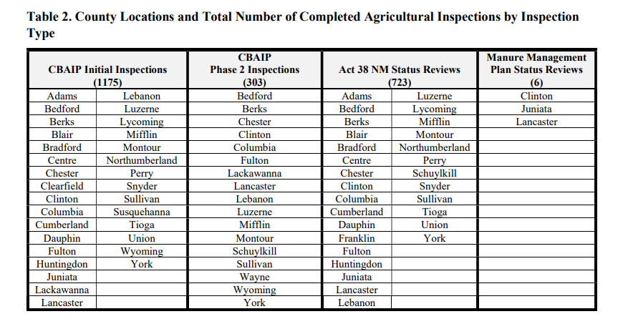
2024/2025 Chesapeake Bay Agricultural Inspections
County Locations and Total Number of Completed Agricultural Inspections by Inspection Type
Notes:
Across all ag inspection programs included within this annual summary, there were a total of 2,207 inspection from July 1, 2024 – June 30, 2025.
This year, a few CCDs did their first status review of Manure Management Plans, which represent the right column, the results of which have been integrated into our strategy to verify nutrient management bmps within the county where the status review was completed.

Slide 4
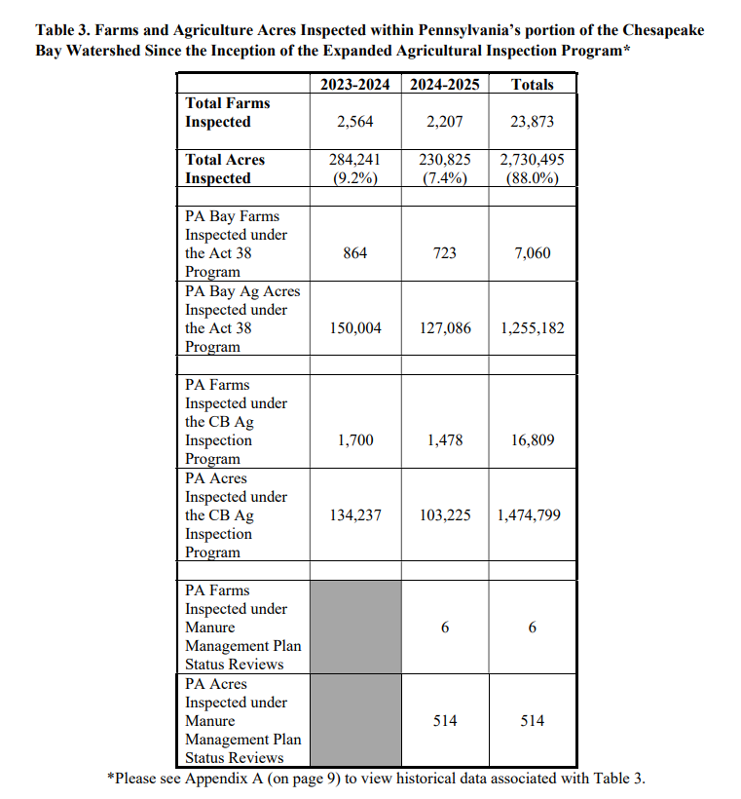
Agricultural Inspection Summary by Year
Farms and Agriculture Acres Inspected within Pennsylvania’s portion of the Chesapeake Bay Watershed Since the Inception of the Expanded Agricultural Inspection Program
Notes:
There was a decrease in total operations inspected from the previous years, which resulted in only inspecting 7.4% of the total acres inspected across the program compared to our goal of 10% total acres inspected.
I will go into details of several challenges that lead to the decrease later, but I will highlight, that there were several Act 38 Nutrient Management status review that were not entered into PK by CCDs and this is one of the reason that the total inspection numbers were down.

Slide 5
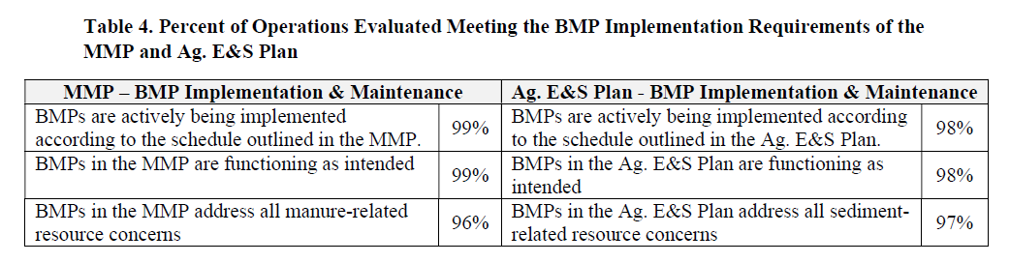
2024/2025 BMP Implementation
Percent of Operations Evaluated Meeting the BMP Implementation Requirements of the MMP and Ag E&S Plan
Notes:
The inspections that determined BMP implementation/maintenance resulted in verification that almost all BMPs are are being implemented

Slide 6
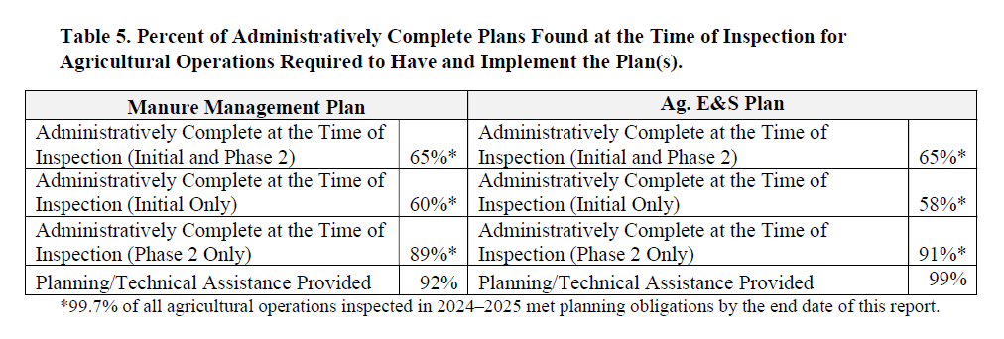
2024/2025 Administratively Complete Ag Plans
Percent of Administratively Complete Plans Found at the Time of Inspection for Agricultural Operations Required to Have and Implement the Plan(s)
Notes:
At the time of the initial and Phase 2 inspections, verification of administratively complete plans are completed; ensuring that those plans meet the obligations of the state regulations. The initial inspections resulted in approximately 60% of Manure Management Plans and Ag E&S Plans were administratively complete; however, at the time of the Phase 2 inspection approximately 90% of plans are administratively complete. For the plans that were not administratively completed at the time of the inspections, the District’s have been key in providing technical assistance with the development of those plans to get the operations in compliance with the state regulations.

Slide 7
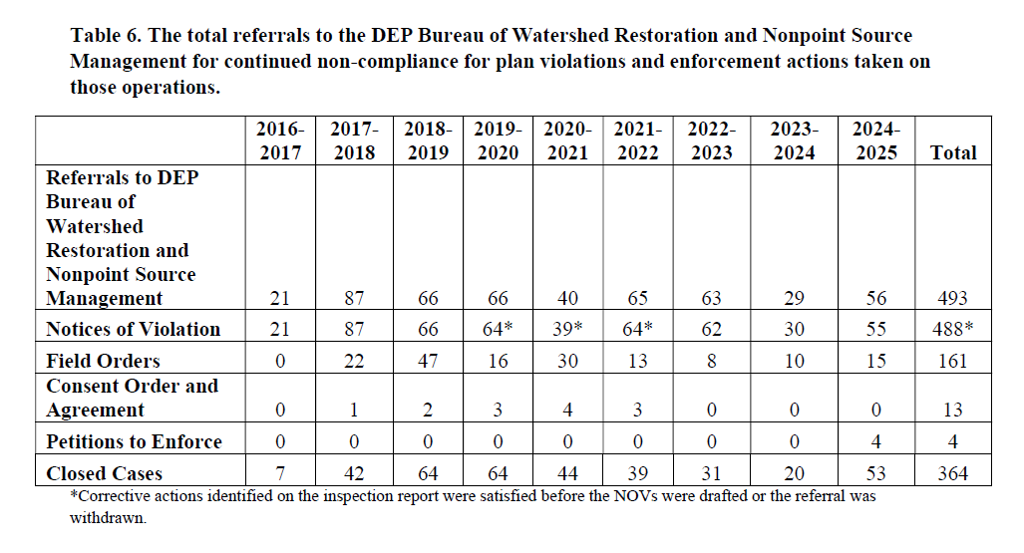
Referrals by Year
The total referrals to the DEP Bureau of Watershed Restoration and Nonpoint Source Management for continued non-compliance for plan-only violations and enforcement actions taken on those operations
Notes:
For any operations that the Districts or DEP regional offices cannot gain voluntary compliance with obtaining administratively complete MMP and Ag E&S plans, those cases are referred to DEP Central Office for enforcement. This does not include referrals that had water quality related violations as those are handled by the DEP regional offices.
For this reporting period, there were a total of 56 referrals and DEP Central Office was able to get compliance and ultimately close out 53 cases. A note about the cases for this reporting period, there were 4 that were referred to our legal counsel for pursuance of a Petition to Enforce, which did not occur in the prior years.

Slide 8
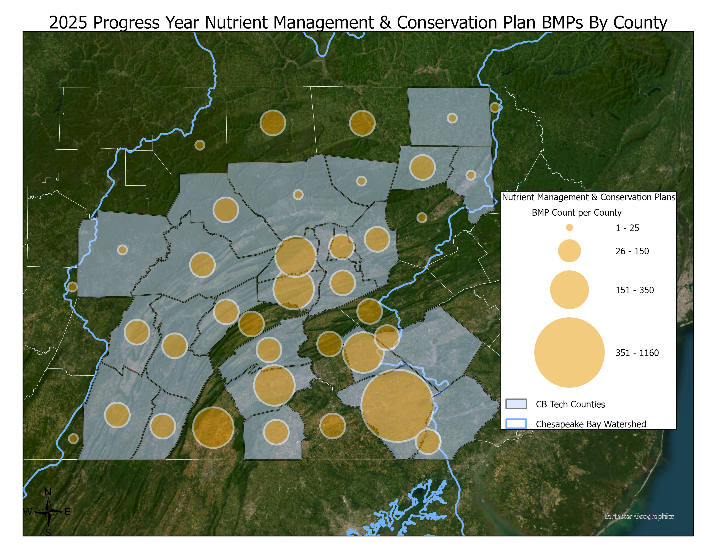
Nutrient Management BMPs
Over 824,645 reportable acres of core nitrogen and core phosphorus
Over 274,894 acres of supplemental nutrient management BMPs (nitrogen and phosphorus rate, timing, and placement combined)
Notes:
Nutrient Management BMPs are broken into core N/P and supplemental N/P and rate, timing and placement. There were approximately 825,000 reportable acres of core N/P and approximately 275,000 reportable acres of supplement nutrient management BMPs. The map shows reported BMPs by county with the relative sized circle of BMP count per county and the blue counties are counties that are covered by a Chesapeake Bay Technician.

Slide 9
Over 8,032 BMPs will be reported as verified for the first time
For BMPs not to fall out of the CAST modeling scenarios after their reporting lifespan, BMP reverification is necessary
  Over 1,617 BMP records will be reported as reverified
  Of these reverified BMPs, 94% passed the inspection
BMP Verification
Notes:
A component of this inspection program, is BMP verification/reverification.
Over 8,000 BMP were verified for the first time and approximately 2,600 BMPs were reverified after the BMP lifespan expired. In order for BMPs to remain in CAST modeling scenarios, those BMPs need to be reverified. Of the reverified BMPs, 94% passed the inspection and extended their reporting lifespan.

Slide 10
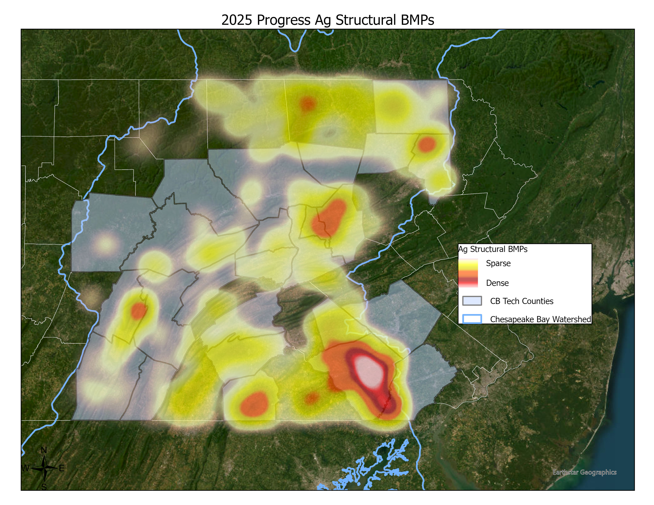
Agricultural Structural BMP Heat Map
Structural BMPs, such as grassed waterways, manure storage facilities, diversions, etc. were implemented across the watershed and reported for 2025.
The Chesapeake Bay Technician and Engineers were integral in getting these designed and installed.
Notes:
Here is a great depiction of ag structural BMPs, such as grassed waterways, manure storage facilities, and diversions, that were reported for 2025. There is a high density of BMPs reported in counties that have CB technicians and engineers, as they are integral in getting these designed, installed, and reverified.

Slide 11
Despite the following challenges, during this year, the program inspected more than 230,000 acres (7.4% of all agricultural acres in PA’s portion of the Bay watershed) on more than 2,200 farms:
Highly Pathogenic Avian Influenza
Staffing turnover
Increased numbers of Phase 2 inspections
Decreased farm size
Short of the annual program goal of 10% but not bad, considering these challenges!
2024/2025 Accomplishments and Challenges
Notes:
Despite the following challenges, the program inspected more then 230,000 acres on more than 2,200 farms during 2024/2025.
-Highly Pathogenic Avian Influenza – resulted in fewer overall inspections completed than we would expect in normal years. This year, the HPAI outbreak affected numerous animal types, including poultry and dairy cattle, so due to enhanced bio-security measures all agricultural inspection programs, including CAFOs, less inspections occur. The safety and wellbeing of our producers and livestock is of utmost importance, so extreme sensitivity was considered for bio-security measures.
-Staff turnover, for both Districts and DEP regional offices.
-With the increased numbers of Phase 2 inspections, the required output for Districts decreases as there is more time involved in completing Phase 2 inspections compared to initial inspections.
-The average operation size inspected decreased again this year. From last years reporting period to the current reporting period, the average operation size went down from 79 to 70 acres.
Inspected acres this year were 7.4% of the total agricultural acres in PA’s portion of the Bay watershed, which is short of the annual program goal of 10%, but not bad considering these significant challenges!

Slide 12
There were great accomplishments of the agricultural inspection in PA for 2024-2025 but there were many challenges that resulted in decreased results as compared to the previous reporting years.
Celebrated 10th year milestone
Able to continue to report the good work that the PA agricultural community is doing.
Summary
Notes:
There were great accomplishes with the ag inspection program, but it was not without challenges that has the overall program fall short of the program goal.
With 10 years of the program implementation, we are encouraged by the results and look forward to the continued success of the program. This program is just one way to be able to report the good work that the PA agricultural community is doing!

Slide 13
Get In Touch
Krista Crone
Bureau of Watershed Restoration and Nonpoint Source Management
Agriculture Compliance Section
717-772-3369 / krcrone@pa.gov
The Department of Environmental Protection’s mission is to protect Pennsylvania’s air, land and water resources and to provide for the health and safety of its residents and visitors, consistent with the rights and duties established under the Environmental Rights Amendment (Article 1, Section 27 of the Pennsylvania Constitution).

