Slide 1
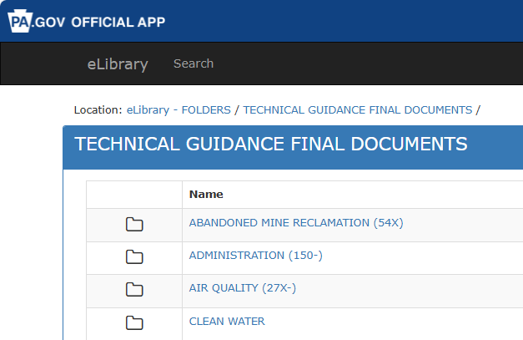
Air Program Guidance Documents Review Proposal
February 6, 2025

Slide 2
AQTAC Committee Project Proposal
Initiate an AQTAC led project to review the current PADEP Air Quality Program guidance documents. Provide PADEP with feedback and a list of potential priorities
Goal: Compare PADEP guidance to typical guidance provided by state environmental agencies
1.) Is applicable guidance missing?
2.) Is available guidance out-of-date or obsolete?
3.) Is guidance available? (DEP and community)

Slide 3
Why Initiate This Project?
PA is a key economic contributor and benefits when its processes align with its importance and impact. For instance:
PA Contributions - PA ranks 6th in a ranked comparison of US gross domestic product¹
PA Population - PA ranks 5th in US population²
AQTAC members have the knowledge and experience to contribute to a project with this scope.
¹https://www.statista.com/statistics/248023/us-gross-domestic-product-gdp-by-state/#:~:text=The%20gross%20domestic%20product%20(GDP,with%2035.07%20billion%20U.S.%20dollars.
²https://www.census.gov/data/tables/time-series/demo/popest/2020s-state-total.html

Slide 4
Why Initiate This Project?
As members of the regulated community as well as agency personnel, AQTAC likely provides a different perspective on guidance documents
PADEP may not have the staff available to prioritize the effort
Consistent application of regulatory requirements and clear requirements protect the environment while streamlining PADEP’s workload, improving regulatory analysis and industry planning and supporting growth

Slide 5
Potential Guidance Document Review Considerations
1.) Guidance Document Preparation Date
2.) Regulatory Change Impacts a.) Federal or State
3.) Policy Changes
4.) Guidance documents addressing significant PA environment and health impacts (these have changed over time)
5.) Guidance document addressing key PA industries (size, emissions or economic impact)

Slide 6
Potential Project Report Output
1.) List potential new guidance documents and/or categories where there are identified gaps
2.) List recommended updates to existing guidance documents based on the criteria
3.) Provide a proposed, prioritized guidance document list for creation and/or update based revisions
4.) Provide example guidance documents from states that may represent good or even best practice format and/or information by topic, if available

Slide 7
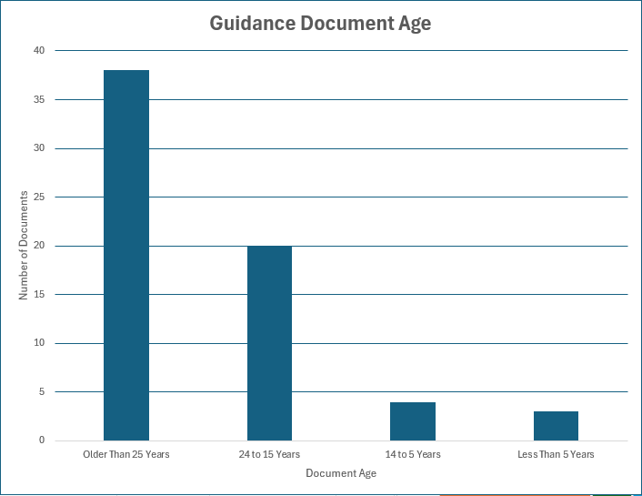
Guidance Document Age
Results from 67 guidance documents located in the Final Guidance Documents folder in eLibrary

Slide 8
Questions?

