Slide 1
CONSOL Energy
Pennsylvania State Inspection Forms – Digital Conversion

Slide 2
Introduction
There are eight (8) or more PA State Inspection forms that CONSOL uses for their daily inspection processes. These forms support all mining locations and specifically address the locations, sections, and type of installations for that mine. Under the current manual process, there are at least 50 and up to 100 active physical books being maintained.
There are requirements governed by Pennsylvania State to complete these inspections accurately and honestly. A person must hold an active certification and/or license that permits them to conduct a state inspection for an installation within the mine. All inspections must be documented in the appropriate book. The book must be filled out in ink, and then signed off and dated by the responsible person. This manual paper process can allow the transmission of the information and data to be completed in error or inconsistent.
All books are reviewed and signed off by the General Mine Foreman and the Superintendent of the respective mining location. The General Mine Foreman countersigns these books daily and the Superintendent is at least weekly.
In a partnership between CONSOL and KGC Solutions two forms were selected as prototypes to digitally transform the manual process as it is today. Field testing was completed using previously completed data to gather feedback from the field workers.

Slide 3
Area of Concern
This process is heavily audited and relied upon for the safety and well being of our employees and assets. Failure to maintain compliance of the law can result in safety implications, operational delays and agency reporting.

Slide 4
Prototype Selected Forms
Assistant Mine Foreman Onshift and Daily Report | Preshift Mine Examiner's Report

Slide 5
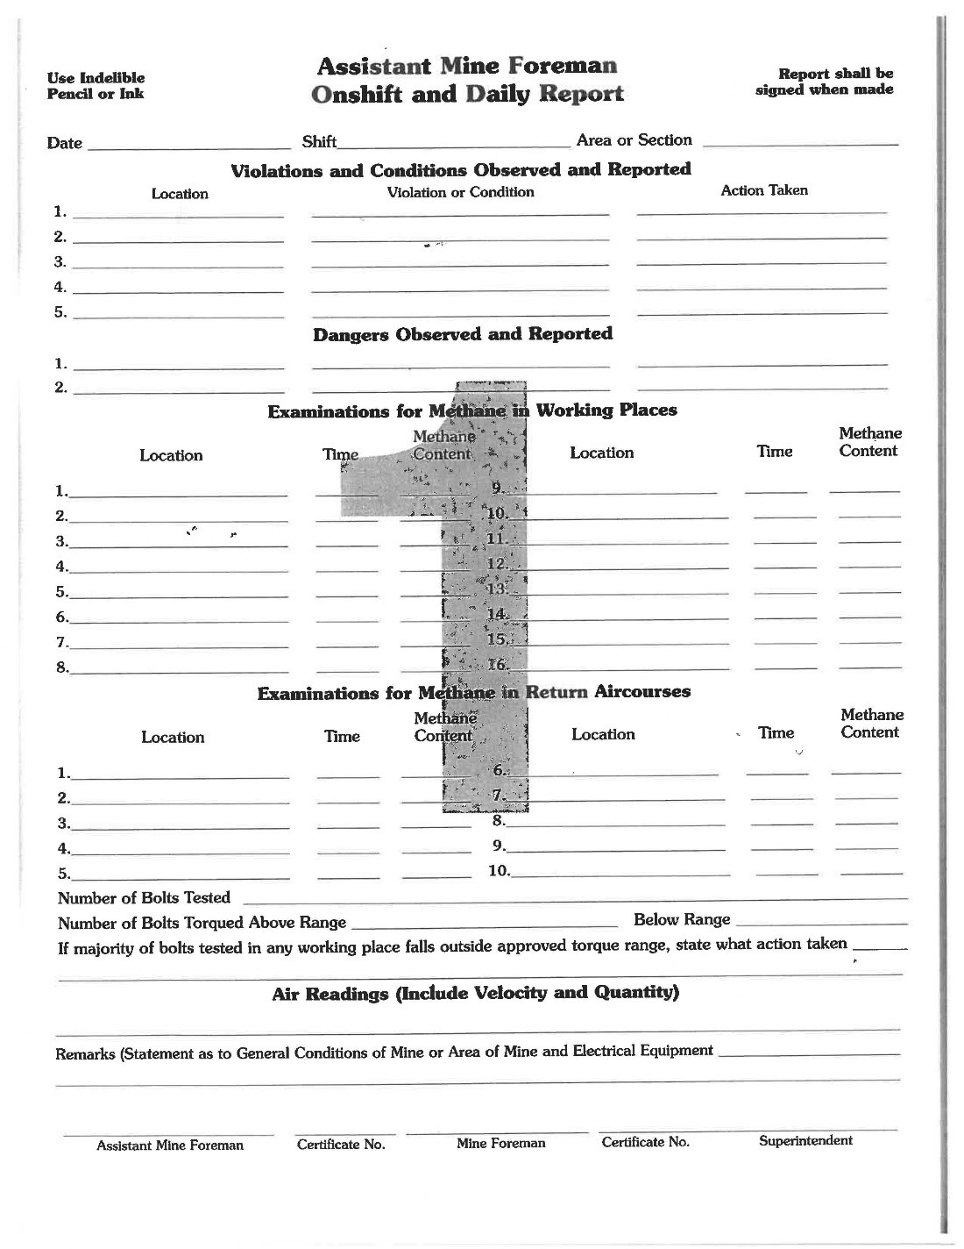
Assistant Mine Foreman Onshift and Daily Report
The current form is a single page document with multiple sections for data entry.

Slide 6
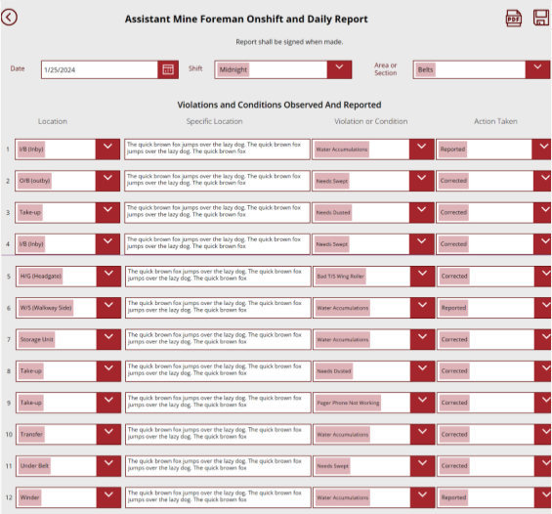
Assistant Mine Foreman Onshift and Daily Report
Converting this form to a digital form allows for consistent entries across all the employees completing the form. The digital form controls certain entries to drop down options, formatting numeric values, and expanding the narrative section allowing for a detailed description. Conditional logic is used to control what options are available to select in certain fields.

Slide 7
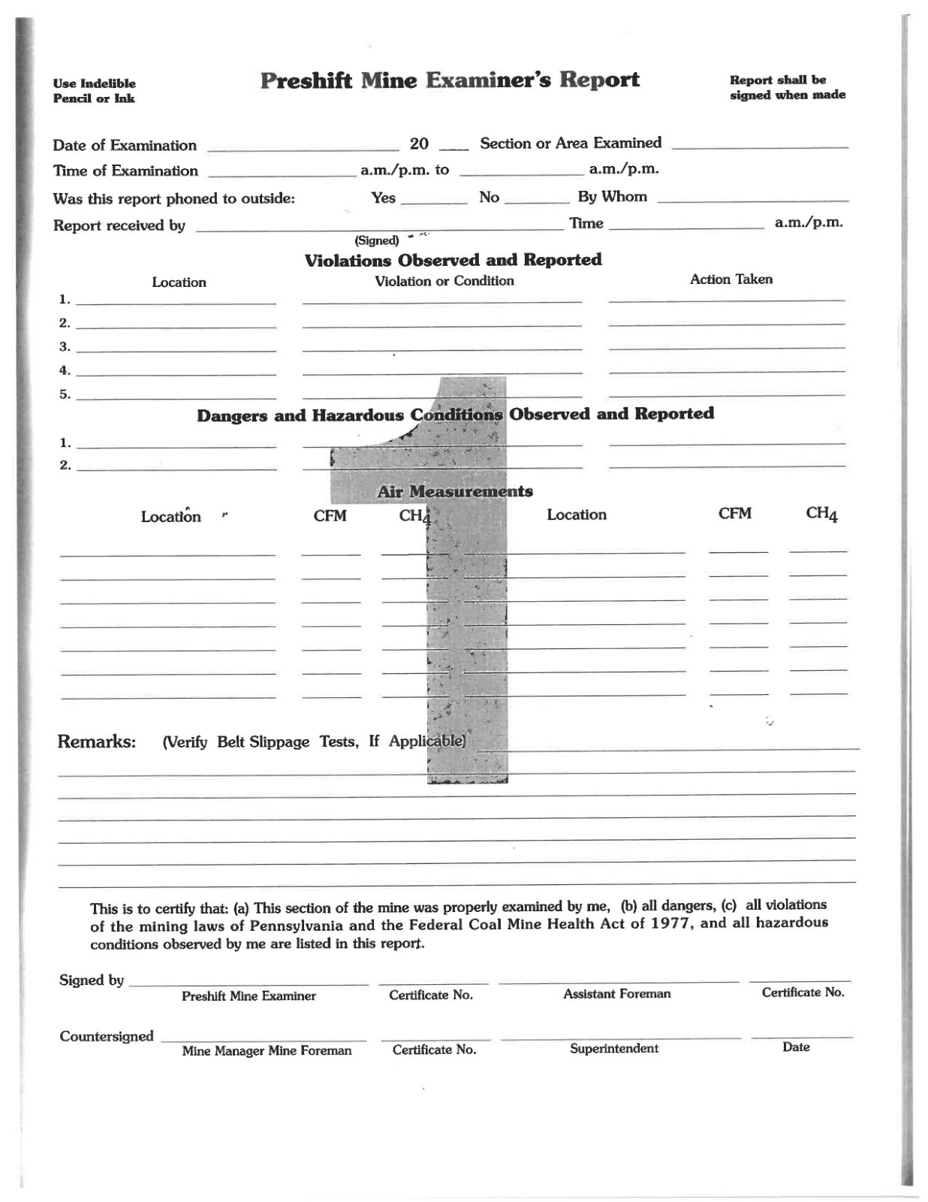
Preshift Mine Examiner’s Report
The current form is a single page document with multiple sections for data entry.

Slide 8
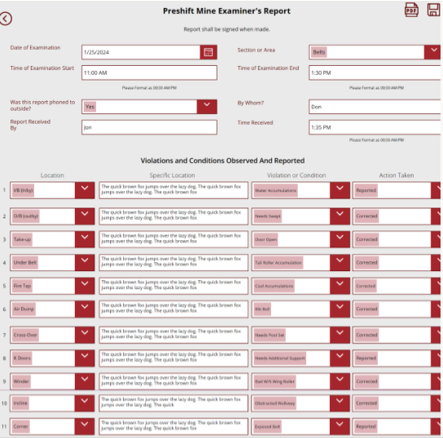
Assistant Mine Foreman Onshift and Daily Report
Converting this form to a digital form allows for consistent entries across all the employees completing the form. The digital form controls certain entries to drop down options, formatting numeric values, and expanding the narrative section allowing for a detailed description. Conditional logic is used to control what options are available to select in certain fields.

Slide 9
Security Considerations
Applications includes Microsoft 365 applications. These are integrated together using SharePoint, Power Apps, and Power Automate.

Slide 10
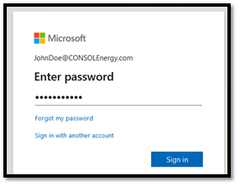
Authorized Users Only
The system is only accessible to an approved list of authorized users with a verified CONSOL Energy organizational Microsoft 365 account.

Slide 11

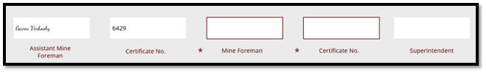
Role-Based Validation for Signatures and Responses
This system identifies the currently logged in user and limits their ability to edit either specific portions of the form or the entire form altogether based on who they are, what role they are assigned, and what phase in the process the form is in. The following screenshots demonstrates what this looks like in action:
When the Assistant Mine Foreman completes the form, they will only be able to sign for their own role and provide their own Certificate No, and all other fields are in read-only mode. This is indicated by the dark red border around the active field. These are also indicated with an asterisk, indicating the field is required to submit.
When the Mine Foreman logs in to update the same form, they will also only be able to sign for their own role and provide their own Certificate No, and all other fields are in read-only mode. Take note to the previously completed fields, with a signature and certificate number are locked. The Active fields are indicated with the red border and asterisk.

Slide 12
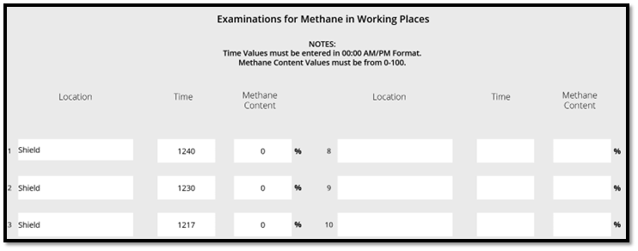
Locked Forms Once Submitted
When a form is created and submitted to the next role responsible for a signature, all detail fields for information such as when the inspection occurred, measurements of the methane content at the inspected site, and what violations were observed and reported are locked to prevent anyone from editing them in the future. This ensures that all signatures gathered during the process reviewed the same information as it was originally presented by the person performing the inspection. Once the final signature is entered, the entire form is locked and cannot be re-edited.

Slide 13
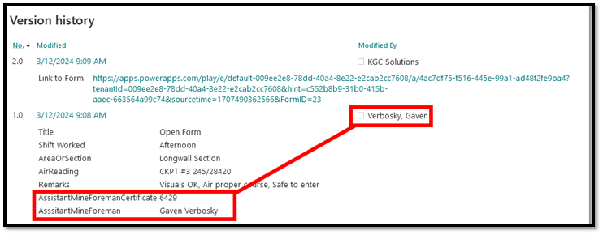
Auditable Version History
When any user saves a change to one of the forms, SharePoint Online’s robust version history feature captures what the change was, who made the change, and when the change occurred. This makes it easy to validate the authenticity of one’s digital signature, but impossible to forge the signature of someone else without detection.

