Slide 1

Proposed Rulemaking Chapter 109 (Safe Drinking Water) Disinfection Requirements Rule
Citizens Advisory Council Meeting
April 19, 2016
Tom Wolf, Governor
John Quigley, Secretary

Slide 2

History of Rulemaking
Received DEP regional staff input in Jan. 2014.
This proposed rulemaking was originally included in the Pre-Draft Proposed Revised Total Coliform Rule (RTCR) -- presented to TAC on 6/18/2014 and 9/23/2014.
On 4/21/2015, the EQB approved the proposed RTCR with modifications – which included splitting out the “non-RTCR” provisions for additional stakeholder input.
2

Slide 3
History of Rulemaking
TAC meetings were convened on 5/18, 5/26, 6/16 and 6/30/2015 to gather additional stakeholder input – 14 water systems and organizations delivered presentations.
Two additional meetings were held with large water systems on 6/29/2015 and 7/16/2015.
TAC provided a final set of recommendations on 7/15/2015.
3

Slide 4
Background and Purpose
Why is the Department amending the disinfectant residual requirements?
There are some alarming trends in WBDOs associated with distribution system defects.
Existing requirements are not protective of public health and are not enforceable – existing standards do not represent a true or meaningful residual.
4

Slide 5
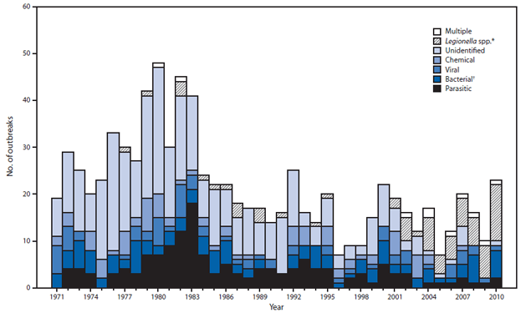
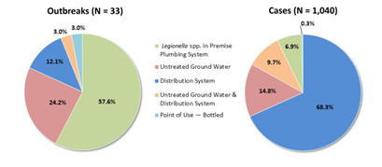
National Waterborne Disease Outbreaks
Source: CDC, MMWR, Vol. 62, No. 35, September 6, 2013
5

Slide 6
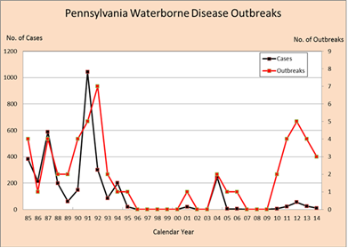
Pennsylvania Waterborne Disease Outbreaks
6

Slide 7
Purpose of Rulemaking
Incorporate minor clarifications needed to obtain primary enforcement authority (primacy).
Protect public health from pathogens associated with treatment breakthrough and distribution system/premise plumbing deficiencies through a multi-barrier approach designed to guard against microbial contamination by ensuring the adequacy of treatment for the inactivation of microbial pathogens and the integrity of drinking water distribution systems.
7

Slide 8
Pathways of Contamination
Pathogens can be introduced into potable water lines through:
Treatment breakthrough
Cross connections and backflow
Leaking pipes, valves, joints and seals
Water line breaks, repairs, and new construction
Storage tanks
8

Slide 9
Distribution System Disinfectant Residual
Required by state and federal regulations
Designated as the Best Available Technology (BAT) for compliance with the TCR and RTCR
Considered an important element in the multi-barrier strategy for protecting public health
Intended to maintain the integrity of the distribution system
Intended to control biofilm growth
9

Slide 10
Significant Provisions
Increases the minimum disinfectant residual in the distribution system from 0.02 mg/L to 0.2 mg/L to:
Ensure adequately disinfected water is delivered to all customers
Establish a comprehensive treatment technique that will drive the need for better operations which will improve overall water quality
Make PA consistent with existing industry standards
Make PA consistent with other states
10

Slide 11
Significant Provisions
Why is the proposed limit of 0.2 mg/L significant?
Scientific studies and data support the fact that residuals of 0.2 mg/L are effective at inactivating E. coli and other pathogens.
Due to analytical method limitations and interferences from organic and inorganic contaminants, when disinfectant residuals are < 0.2 mg/L, there may be little to no active disinfectant actually present.
11

Slide 12
Comparison to Other States
At least 23 other states have more stringent distribution system disinfectant residual requirements, including several nearby states such as West Virginia, Delaware and Ohio.
12

Slide 13
Comparison to Other States
State | Minimum Residual | State | Minimum Residual | State | Minimum Residual | State | Minimum Residual
Alabama* | 0.2 (F) 0.5 (T) | Indiana | 0.2 (F) 0.5 (T) | Missouri | 0.2 (T) | Oklahoma | 0.2 (F) 1.0 (T)
Colorado* | 0.2 | Iowa | 0.3 (F) 1.5 (T) | Nebraska | SW-0.2 (F) GW-0.1 (F) | Tennessee* | 0.2 (F)
Delaware | 0.3 (F) | Kansas* | 0.2 (F) 1.0 (T) | Nevada | 0.05 | Texas* | 0.2 (F) 0.5 (T)
Florida* | 0.2 (F) 0.6 (T) | Kentucky* | 0.2 (F) 0.5 (T) | New Jersey* | 0.05 | Vermont | 0.1 (F)
Georgia | 0.2 (F) | Louisiana* | 0.5 | North Carolina* | 0.2 (F) 1.0 (T) | West Virginia* | 0.2 (T)
Illinois* | 0.2 (F) 0.5 (T) | Minnesota | 0.1 | Ohio* | 0.2 (F) 1.0 (T )
* States with mandatory disinfection
13

Slide 14
Other Significant Provisions
Requires at least weekly monitoring at RTCR sites as per a sample siting plan.
Sets the standard at no more than one sample (for small systems) or no more than 5% of the samples (for med and large systems) out of compliance for 2 consecutive months.
Clarifies the disinfectant residual at the entry point by adding a zero to the minimum level = 0.20 mg/L.
Requires water systems to monitor, calculate and report log inactivation.
14

Slide 15
Applicability
Disinfectant residual requirements in the distribution system apply to all 1,982 community water systems, and 822 noncommunity water systems that have installed disinfection for a total of 2,804 water systems.
The CT/log inactivation monitoring and reporting requirements apply to all 353 filter plants which are operated by 319 water systems.
15

Slide 16
Estimated Costs
CT/Log Inactivation Monitoring at EP:
Cost to upgrade to electronic recording devices @ $1,500 for 25% of systems using strip chart recorders (29 systems)
29 x $1,500 = $43,500
Disinfectant Residuals in Distribution System:
Costs for automatic flushers ~ $2,000
Costs for booster chlorination stations ~ $200,000 - $250,000
Total estimated capital costs for 20% of large systems (6) = $780,000
16

Slide 17
Schedule and Next Steps
The EQB approved the proposal with a 60-day public comment period that ends on April 19.
Three public hearings were held.
March 28 in Harrisburg
April 5 in Norristown
April 7 in Pittsburgh
Additional meetings were also held with the large water system stakeholders.
17

Slide 18
Lisa Daniels, Director Bureau of Safe Drinking Water Dawn Hissner, Chief Operations, Monitoring & Compliance Bureau of Safe Drinking Water

