Slide 1

2016 Association of Public Health Laboratories (APHL) Peer Review of PA DEP Bureau of Laboratories
Citizens Advisory Council
May 17, 2016
Tom Wolf, Governor
John Quigley, Secretary

Slide 2
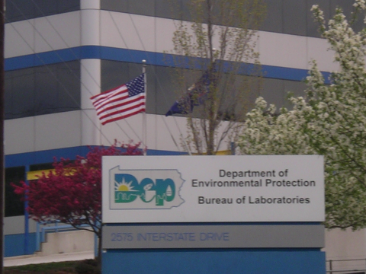

Slide 3

Background
2011 APHL Peer Review
Laboratories’ Strengths and Weaknesses
Staffing Reduction Impacts Since 2011 Review
Recommendations

Slide 4
APHL Peer Review
  A three-member APHL team conducted the site review: Dr. Megan Latshaw, APHL’s Director of Environmental Health; Dr. Michael Wichman, Environmental Laboratory Director at the University of Iowa State Hygienic Laboratory – Environmental Health Division; and Ms. Pandora Ray, APHL’s Director of the National Center for Public Health Laboratory Leadership.

Slide 5
Peer Review Scope
The primary objectives were to identify:
organizational strengths and weaknesses that may have been impacted by budget deficits and staff reductions
whether core laboratory functions and policies continue to assure public health, environmental protection, and fiscal responsibility to the Commonwealth of Pennsylvania, the Department of Environmental Protection, and other laboratory clients served

Slide 6
Findings
The BOL is a critical asset to the Commonwealth of PA and stands above many other laboratories with whom APHL works.
Examples of Unique Testing: TENORM Study, Cryptosporidium, Fish Eating Advisories, Gross Alpha & Beta Testing in Drinking Water
High Quality Work and Accreditation

Slide 7
2016 Peer Review
Successes since 2011 Report
Development of COOP
EPA Data Exchange Grant
Update to LIMS
Partnership with University
Implementation of New Technologies

Slide 8
2016 Peer Review
Since the review in 2011, however, the laboratory has moved from exceptional to adequate
The laboratory has maintained their accreditation and continues to have a reputation for high-quality work
Senior leadership is transparent about decisions, accesses to the staff’s concerns, empathizes with them, puts on lab coats to help, and develops creative solutions

Slide 9
Critical Recommendations
Return to 2011 staffing levels.
Collaborate with HR to develop a plan for:
  Making salary and benefits more equitable for managers.
  Making civil service designations more equitable across the DEP.
  Look into streamlining the overtime system as a temporary measure until staffing levels are sufficient. Consider a blanket approval during busy times.
Pursue designation by the Commonwealth as a critical asset that cannot be shut down in the event of a budget impasse.
Recommending that the BOL develop a strategic plan for the lab, outlining the next three years – what has to happen and how to get there. As part of that process, develop a vision for what the ideal laboratory would look like and what it would do.
Continue working closely with programs and encouraging them to use the laboratory’s services (as capacity allows).
Replace the neutralization system due to safety and efficiency concerns.

Slide 10
Other Recommendations
Keep a list of projects that the lab turns down or grants for which they cannot apply due to staffing constraints.
Develop exit interviews and a knowledge transfer process for when people leave.
Expanding the COOP to include loss of use of the existing building.
A LEAN assessment may identify unrealized efficiencies, although given the high workload of staff, it might be difficult to find time and resources to complete.
Develop a process for programs to print barcoded labels with testing information.
Do outreach to critical partners and clients to understand their needs and concerns (maybe a survey or focus group).
Develop a long-term plan for staffing the LC/MS/MS to give laboratory capability to do PFCs, hormones, toxins (including cyanotoxins).

Slide 11
Overall Review
The DEP BOL is overall, a well-managed, efficient, and highly functional laboratory and excellence in staff.
Impressive organizational culture using of cross-training staff to meet seasonal or emergency situations that may result in a surge of samples.
The quality management system is embedded in their work and operational processes which assures a high degree of proficiency and quality of the work output and is reflected in their accreditation status under NELAP.
BOL is driven by a culture of customer service and appears to meet customer needs despite significant reductions in staff over the past several years.

Slide 12
Real Time Example of Concerns
Pittsburgh Water and Sewer Authority Investigation of Lead in Drinking Water Emergency
Overtime for Backlogs and Holding Times

Slide 13
Message to Citizen Advisory Council
The critical concern with reduced staffing in the Peer Review reflects the overall concern for the staffing level with the entire DEP agency and our ability to perform basic functions in a timely fashion stressing us to our limits to protect public health and the environment.
Running a Marathon at a Sprinter’s Pace
Staff are at a breaking point
Concern for losing accreditation

Slide 14
Dr. Martina Q. McGarvey
Director, Bureau of Laboratories
mmcgarvey@pa.gov

