Slide 1
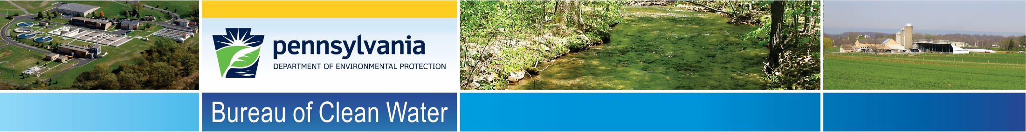
Triennial Review of
Water Quality Standards TR17
Updates to Chloride Criteria
Presented to
Citizens Advisory Council
June 21, 2016
Tom Wolf, Governor
Patrick McDonnell, Acting Secretary

Slide 2

Current Chloride Criterion
Pennsylvania’s existing chloride criterion was developed primarily for the protection of potable water supplies (PWS use).
The chloride criterion is not applied in all waters of this Commonwealth. It is applied only at the point of water supply intake.
A maximum level of 250 milligrams of chloride per liter of water.

Slide 3
Need for Aquatic Life Use Protection
Numerous toxicity tests show aquatic organisms found in Commonwealth waters are being negatively impacted by current chloride concentrations.
Aquatic life protection must be applied statewide to all waters, in order to protect sensitive organisms.

Slide 4
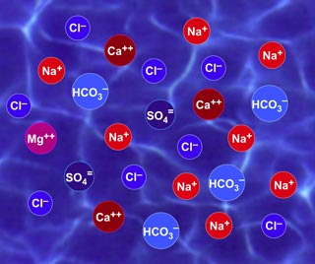

Ionic Composition
Freshwater sources are dominated by the cations Ca²⁺, Mg²⁺, K⁺ and Na⁺ and the anions HCO3⁻ , SO₄²⁻ and Cl⁻. (Wetzel, 1983)

Slide 5
Test Compound Determination
Data obtained from stream surveys of Pennsylvania waters confirmed the ionic composition is: >40% HCO3⁻/ Ca²⁺, followed by SO₄²⁻, Mg²⁺, Na⁺, K⁺ and Cl⁻.
Pennsylvania waters are calcium/bicarbonate dominant.

Slide 6
PA Water Ionic Composition

Slide 7
Acceptable Test Product
The order of chloride salt toxicity to freshwater organisms is KCl > MgCl₂ > CaCl₂ > NaCl. (Mount et al 1997)
NaCl is the least toxic to aquatic organisms.
Therefore, chloride toxicity to freshwater organisms was evaluated using NaCl as the test compound. Using NaCl ensures that the effect concentrations were derived from test where the effects are based on the chloride anion, not the associated cations.

Slide 8
Toxicological Study - Chloride
EPA and Chapter 93 criteria development methodologies were used to derive acute and chronic chloride criteria.
Data used was from:
approved U.S. EPA chloride toxicity dataset
results of the Stroud mayfly toxicity tests

Slide 9
Toxicological Study – Acute Chloride
Acute values were used from all acceptable data.
This resulted in 219 acute toxicity results for aquatic species (51 genera).

Slide 10
Acute Chloride Data Set
Genus |  | Genus |  | Genus
Epioblasma |  | Physa |  | Aciperser
Sphaerium |  | Rana |  | Cyprinella
Neocloeon |  | Pseudacris |  | Lepidostoma
Lampsilis |  | Lirceus |  | Lepomis
Anafroptilum |  | Macaffertium |  | Carassius
Ambystoma |  | Planorbella |  | Gambusia
Ceriodaphnia |  | Ephemerella |  | Oncorhynchus
Elliptio |  | Limnodrilus |  | Libellulidae
Procloeon |  | Bufo |  | Fundulus
Megalonaisas |  | Caecidotea |  | Gasterosteus
Lasmigona |  | Lumbriculus |  | Cambarus
Margaritifera |  | Nephelopsis |  | Anguilla
Brachionus |  | Erpobdella |  | Agria
Daphnia |  | Ameriurus
Isonychia |  | Pimephales
Musculium |  | Tubifex
Villosa |  | Chironomus
Gyraulus |  | Leptophlebia
Diaptomus |  | Lithobates

Slide 11
Toxicological Study – Acute Chloride
Based on the lethal or effect concentrations (LC50 or EC50), the four genera most sensitive to acute testing were:
Rank | Genus/ Species | GMAV mg/L
4 | Lampsilis (wavy-rayed lamp mussel) | 991
3 | Neocloeon (mayfly) | 959
2 | Sphaerium (fingernail clam) | 785
1 | Epioblasma (mussel) | 698

Slide 12
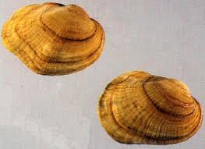
Toxicological Study - Chloride
The genus mean acute value (GMAV), 698 mg/L chloride includes the most sensitive organism (Northern Riffleshell).

Slide 13
Chronic Chloride Data Set
The chronic toxicity data set included 10 aquatic species.
Species
Pimephales promelas (Fathead minnow)
Oncorhynchus mykiss (Rainbow trout)
Daphnia ambigua (water flea)
Daphnia magna (water flea)
Daphnia pulex (water flea)
Ceriodaphnia dubia (water flea)
Lumbriculus variegatus (worm)
Neocloeon triangulifer (mayfly)
Anafroptilum semirufum (mayfly)
Procloeon fragile (mayfly)

Slide 14
Chronic Chloride Data Set
The four species most sensitive to the chronic testing are:
Rank | Species | SMCV mg/L
4 | Daphnia ambigua (water flea) | 259
3 | Procloeon fragile (mayfly) | 239
2 | Anafroptilum semirufum (mayfly) | 160
1 | Neocloeon triangulifer (mayfly) | 153

Slide 15
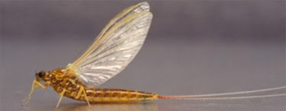
Toxicological Study - Chronic Chloride
The species mean chronic value (SMCV) for the most sensitive organism (Neocloeon triangulifer) is 153 mg/L chloride.

Slide 16
Calculation Definitions

Slide 17
Chloride Criteria Calculated
The final calculated acute/chronic ratio (FACR) from the acceptable data is 6.2.
FAV (final acute value) | 874.8
FAV for lowest GMAV | 698
FACR = (geo mean of SMAV/SMCV) | 6.2
CMC = FAV for lowest GMAV/2 | 349
CCC = (FAV/FACR) | 113
EPA has determined that the chloride toxicity is dependent on hardness and sulfate concentrations. As a result, the criteria will be equation based.

Slide 18
Recommended Aquatic Life Criteria
The recommended, proposed chloride criteria will be calculated using the following equations*:
Acute Chloride Criterion: CMC = 349
One hour average concentration should not exceed, more than once in three years
Acute Criterion (mg/L) = CMC(Hardness)^{0.205797}(Sulfate)^{-0.07452}
Chronic Chloride Criterion: CCC = 113
4 day average concentration should not exceed, more than once in three years
Chronic Criterion (mg/L) = CCC(Hardness)^{0.205797}(Sulfate)^{-0.07452}
*Hardness & sulfate exponents are based on studies
done by the Great Lakes Environmental Center

Slide 19
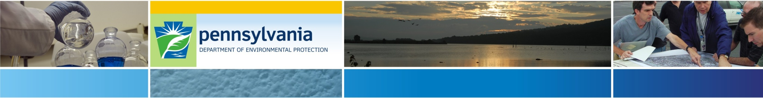
The Department would like to thank you for helping us take this course in developing a PA specific criterion for chloride.
Questions?
Rodney Kime
Bureau of Clean Water
rkime@pa.gov
(717) 787-9637

