Slide 1
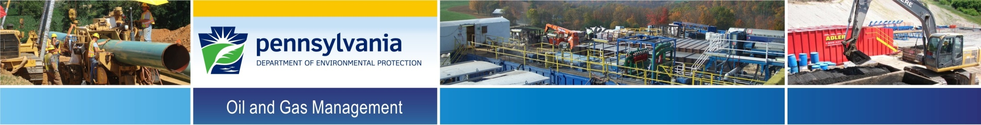
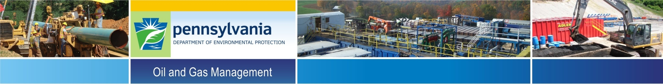
DEP Legacy Well Emissions Study
June 21, 2016
Citizens Advisory Council Meeting Presentation

Slide 2

DEP Mission
“To protect Pennsylvania’s air, land and water from pollution and to provide for the health and safety of its citizens through a cleaner environment. We will work as partners with individuals, organizations, governments and businesses to prevent pollution and restore our natural resources.”

Slide 3
Presentation Outline
Regulatory History of Well Plugging
Purpose of Study
Study Methods
Preliminary Results

Slide 4
Regulatory History of Well Plugging
1859 – First well drilled, “Drake well”, Titusville, PA
1878 – Wells first required to be plugged with wood and sediment
1881 – Plugging requirements updated: Fill well with sand or rock sediment and wooden plugs above third producing sand
1921 – Plugging requirements updated
Fill with sand or rock sediment and each producing strata plugged with wood plug
Requires venting of wells through coal layers
1952 – API standards for cement and well plugging published
1956 – Well permitting begins; modern plugging requirements
1984 – Modern environmentally-minded plugging requirements
1989 – First well plugged in DEP plugging program
Notes:
The evolution of plugging standards is important to this study because historical plugging practices employed techniques and materials which would be considered inadequate today. These wells, though plugged, may still pose a threat to human health and the environment.

Slide 5
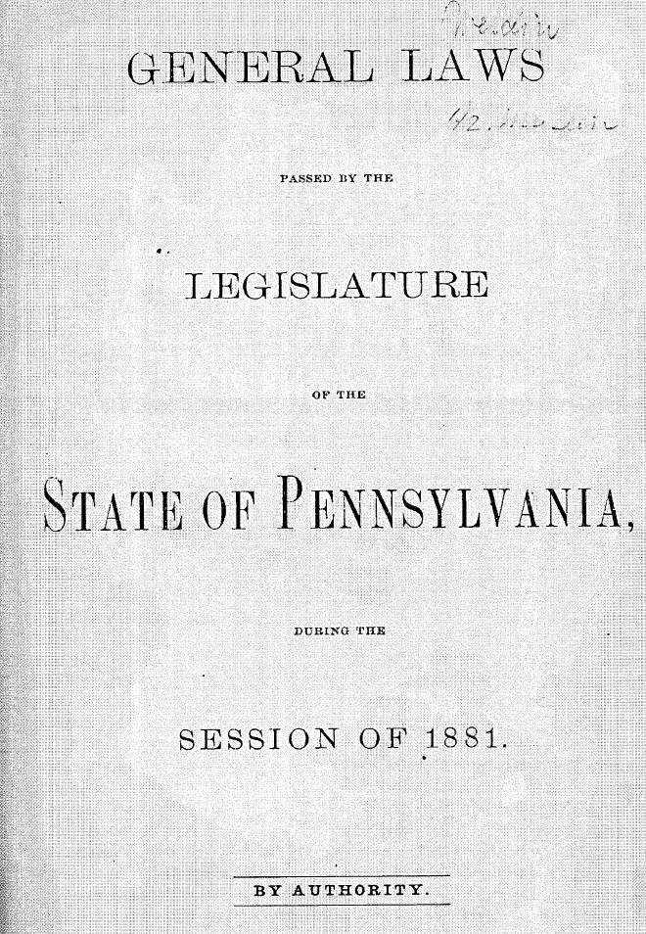
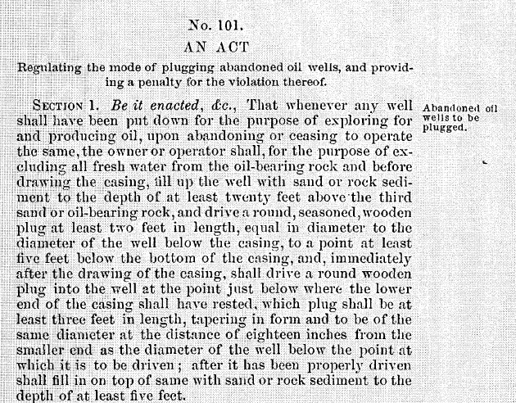
Regulatory History of Well Plugging

Slide 6
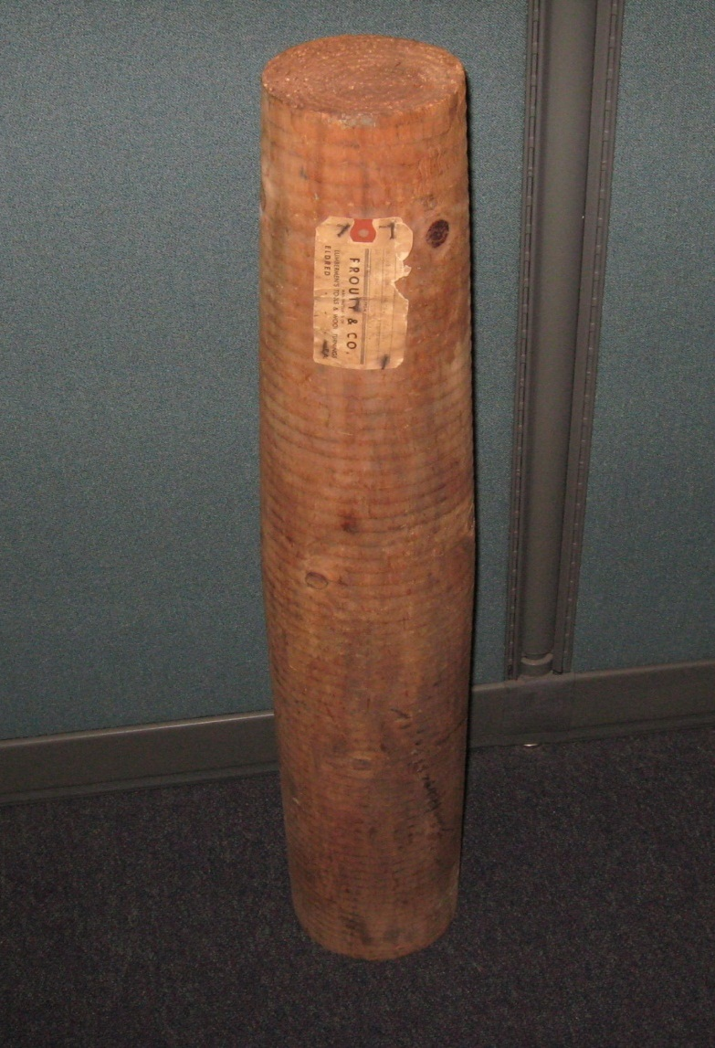
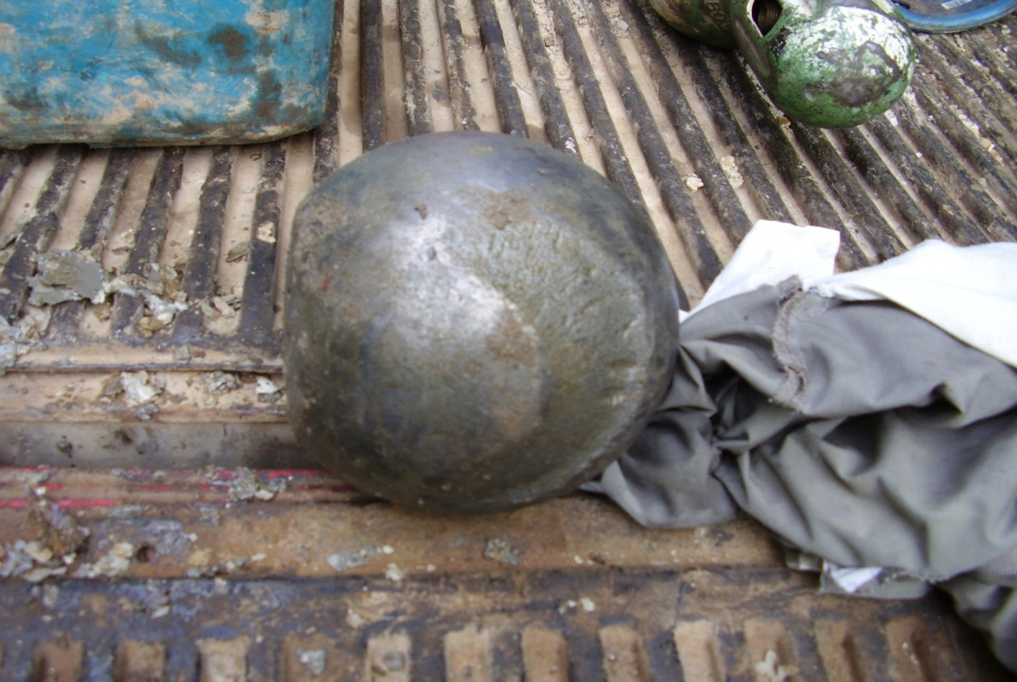
Regulatory History of Well Plugging
Notes:
Examples of old plug materials

Slide 7
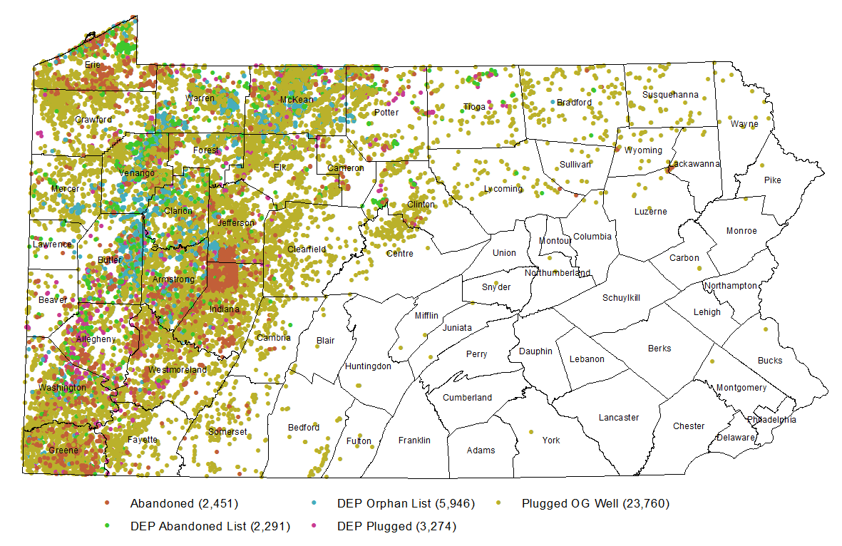
Legacy Oil and Gas Wells
Not shown:
Tens of thousands of known wells with missing coordinates
Approximately 200,000 abandoned and orphan wells not yet located

Slide 8
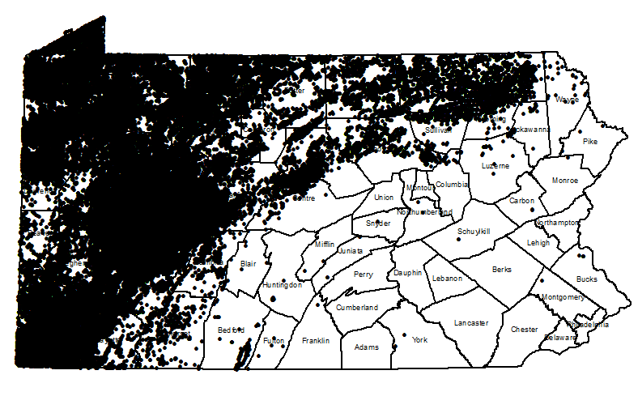
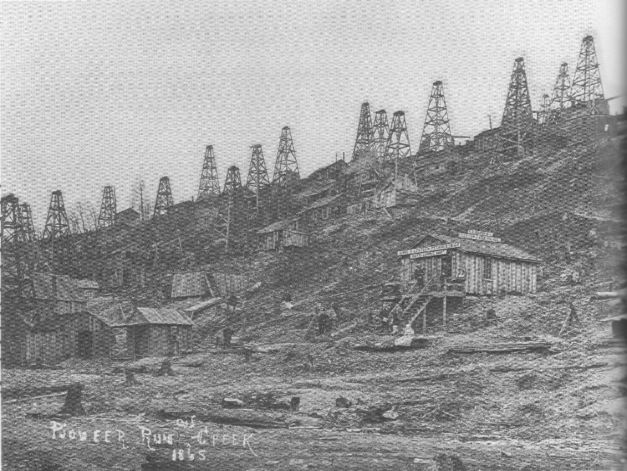
Legacy Oil and Gas Wells
Nearly 100 yrs of development prior to permitting requirements led to hundreds of thousands of un-accounted for wells.
?
Notes:
Pioneer Run oil field in 1859. Photo used with permission from the Pennsylvania Historical Collection and Museum Commission, Drake Well Museum Collection, Titusville, PA

Slide 9
Study: Purpose
Inspect representative sample of abandoned, orphan, and plugged wells, and assess well integrity in order to:
Provide insight into environmental hazards associated with legacy wells (greenhouse gas emissions, impacts to surface and groundwater by discharge of brine/oil/gas)
Quantify agency plugging liability
Inform regulatory changes
Help us understand database accuracy issues

Slide 10
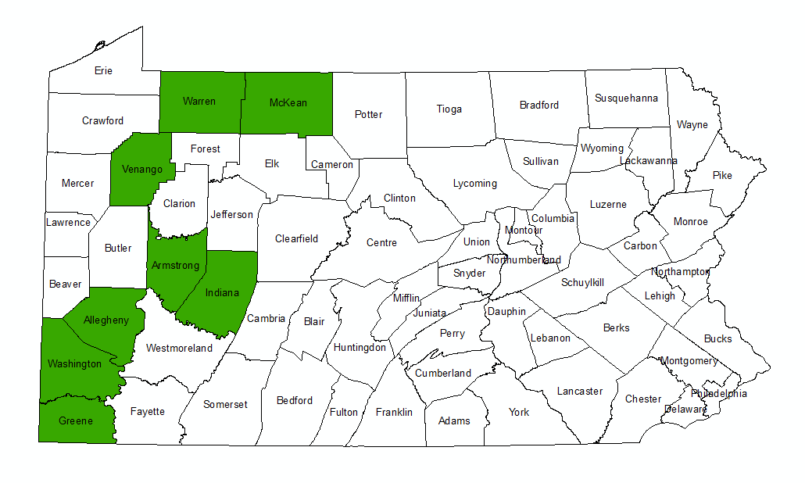
Study Methods
Counties included in study:
Notes:
Counties with a relatively high density of wells. Selected counties which would be representative of both deep and shallow oil and gas operations.

Slide 11
Study Methods
Wells located on public lands are proposed in Northwest District for ease of access
DEP plugged wells located on both public and private lands are proposed in the Southwest District to increase population size
Well types considered in study:
Oil, gas, combination, undetermined
Notes:
Oil, gas, and combination wells will be considered for this study in both regions. DEP-plugged wells of undetermined type will also be considered in the Southwest region to increase the sampled population size.

Slide 12
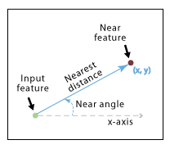
Study Methods
Data cleanup:
2 databases compared for spatial discrepancies
WIS (DCNR) and eFACTS (DEP)
Locational discrepancies > 50 ft. removed from study
Wells located on public lands identified
Study areas restricted to public lands in NW for ease of access. Expanded to private lands in SW to increase sample size
Oil, gas, combination, undetermined well types considered

Slide 13
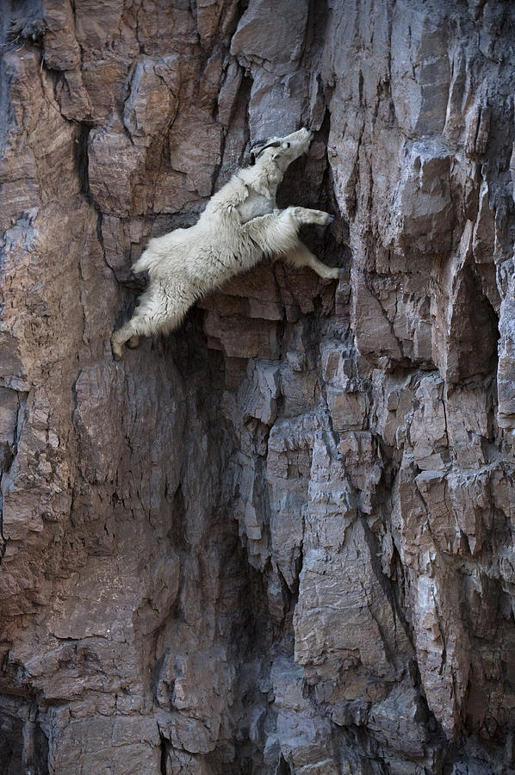
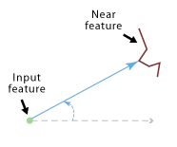
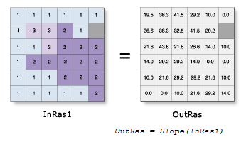
Study Methods
Well site accessibility:
Included only wells located within ¼ mile of roads, and generally on a grade of less than 10%
Notes:
Oil, gas, and combination wells will be considered for this study in both regions. DEP-plugged wells of undetermined type will also be considered in the Southwest region to increase the sampled population size.

Slide 14
Study Methods
Sample size was selected to balance statistical significance with available resources.
Region | Sample Size
Northwest | 114
Southwest | 94
Notes:
Note: Data cleanup involved removing records without location data, no location discrepancies between databases. 95% +/- 15% confident that the mean of the sample size is statistically the same as the mean of the population (sample is representative of total population)

Slide 15
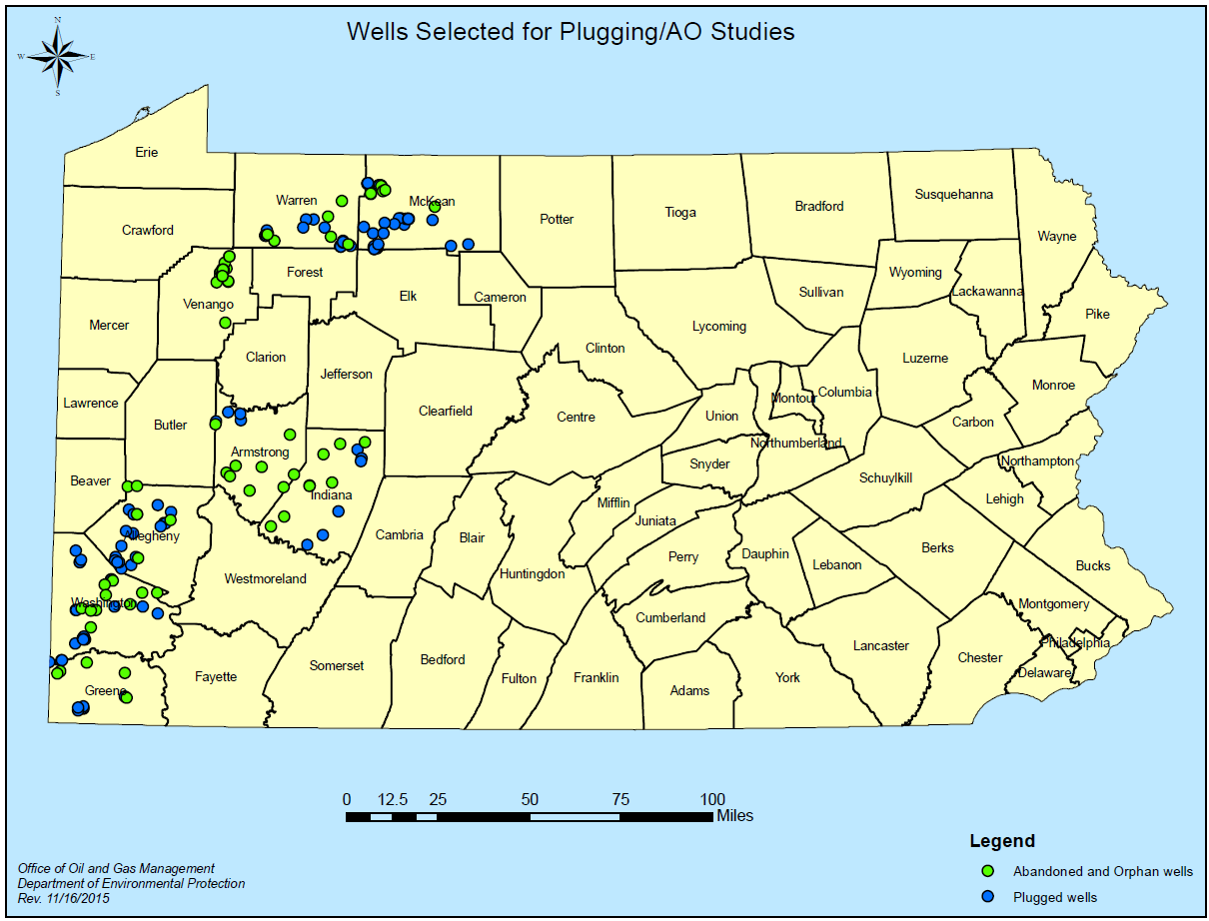

Plugging/AO Study Methods

Slide 16
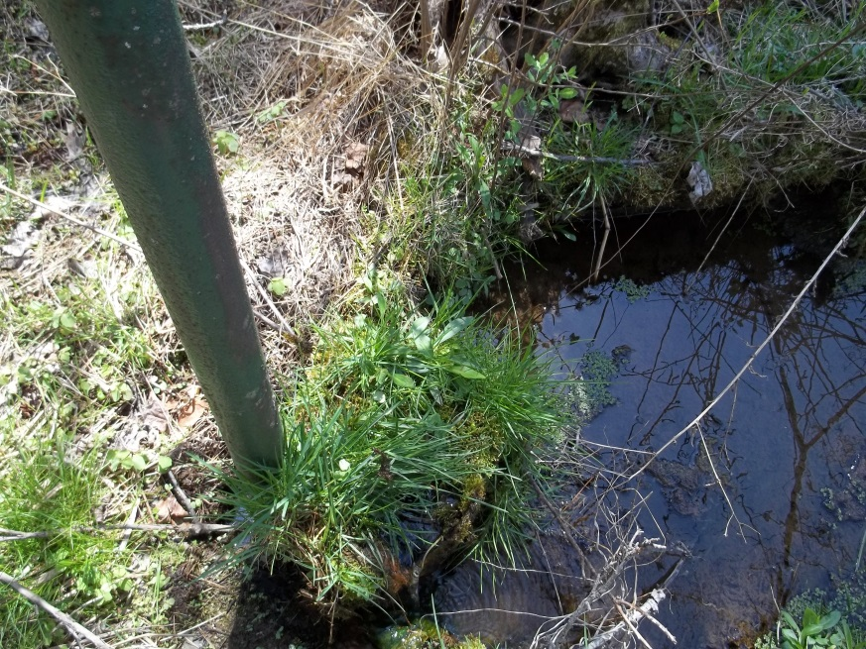
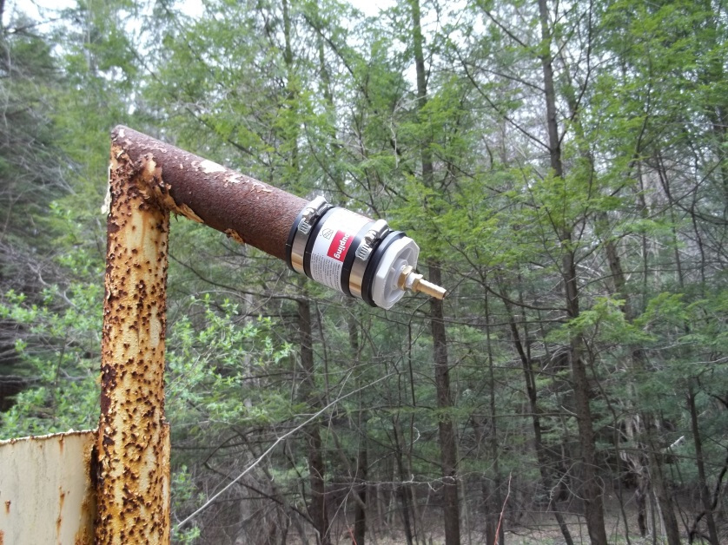
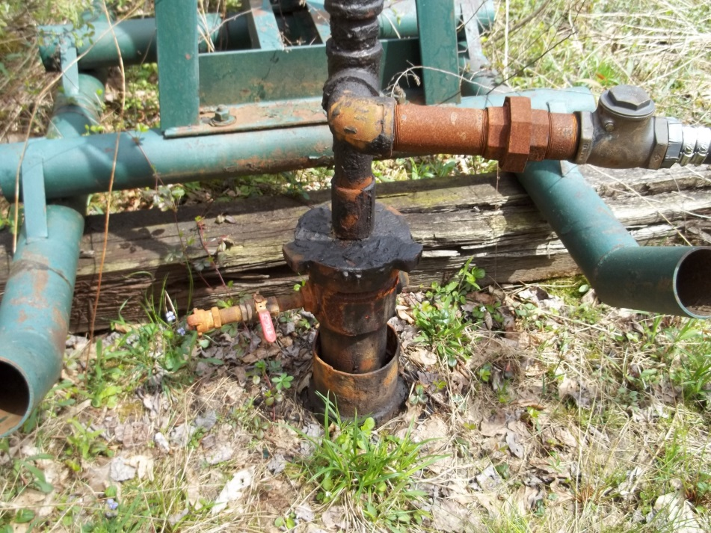
Plugging/AO Study Methods
Field Observations:
Methane concentrations
Flow rate
Oil, brine discharges
Verify coordinates

Slide 17
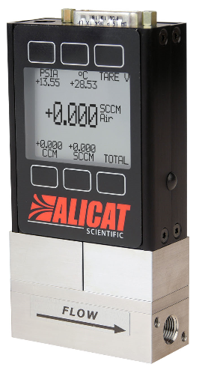
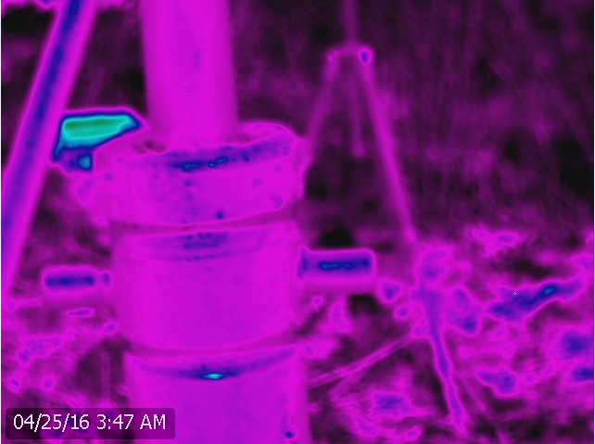
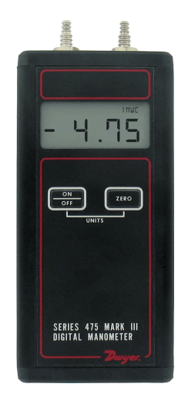

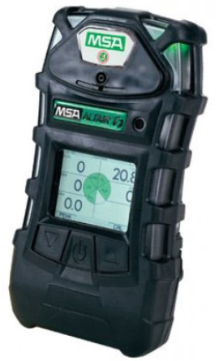
Study Methods

Slide 18
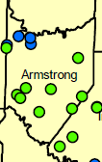
Preliminary Findings – Armstrong Co.
Total wells selected: 13
9 A/O
4 Plugged
Total wells inspected: 3, indicated as abandoned/orphan in eFACTS, 1 was found to be plugged upon inspection
Total wells positively identified: 3
2 wells were not located
8 wells have not been visited as of 6/15/2016
No discharges of gas, oil, brine detected

Slide 19
Preliminary Findings – Greene Co.
Total wells selected: 14
5 A/O
9 Plugged
Total wells inspected: 6 plugged
Total wells positively identified: 6
8 wells have not been visited as of 6/15/2016
No discharges of gas, oil, brine detected

Slide 20
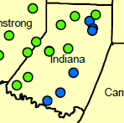
Preliminary Findings – Indiana Co.
Total wells selected: 14
6 A/O
7 Plugged
1 status changed to Active, 063-26473, removed from study
Total wells inspected: 11
Total wells not located: 2 plugged

Slide 21
Preliminary Findings – Indiana Co., cont.
4 wells had measureable concentrations of gas ranging from 43% LEL to 100 % gas
1 Plugged
3 Abandoned
2 of those wells had measureable flow ranging from 1.8 cfd to 1456 cfd
1 Plugged
1 Abandoned
1 orphan well was discharging water to a wetland at approximately 4 gpm, no apparent impact to vegetation
Notes:
Be ready to explain difference between LEL and % gas (100% LEL for methane = 5% methane by volume)

Slide 22
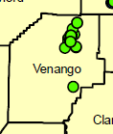
Preliminary Findings – Venango Co.
Total wells selected: 26
26 A/O
Total wells inspected: 13
Total wells positively identified: 10
9 wells have not been visited as of 6/1/2016
3 well locations had no casing, just hole in the ground
4 wells were not located
No discharges of gas, oil, brine detected

Slide 23
Conclusion
Hundreds of thousands of legacy wells are potential sources of environmental impacts (methane emissions, oil/brine/gas to surface and groundwater)
Legacy Well Emissions Study Aims to:
Provide insight into methane emissions from plugged/abandoned and orphan wells
Assist in identifying any needed changes in regulations
Quantify agency plugging liability
Equipment investment needs

Slide 24
Conclusion
Preliminary Results:
Contrast between wells in SW and NW
SW: Greater density of legacy gas wells. Wells located and identified with relative ease. Gas emissions and water discharges already noted.
NW: Greater density of legacy oil wells. Wells difficult to locate, missing casings. No discharges noted as of yet.
41 wells down, 167 to go!

Slide 25

Thank You!
Questions?
Lindsay A. Byron
Geologic Specialist
lbyron@pa.gov
Stewart Beattie
Information Specialist
stebeattie@pa.gov
Bureau of Oil & Gas Planning & Program Mgmt
717.772.0219

