Slide 1
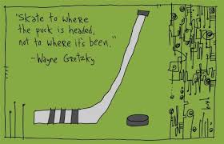
DEP Workforce Planning and Civil Service Reform Update
May 2016

Slide 2
Civil Service Reform Update
May 2016
State Civil Service Hiring Reform (Senate Bill 1154)
Vacancy Based Postings
    Increased Staffing Flexibility, Improved Applicant Quality and Pools, Improved Hiring/Selection Capability
Rule of 3 Change
    Administer/Enforce Hiring With Greater Flexibility
Electronic/On-line Communications
    Manage Agency Recruitment/Staffing Processes via Email Rather than US Mail

Slide 3
DEP Workforce and Succession Planning Update
May 2016

Slide 4
DEP Workforce and Succession Planning Update
May 2016

Slide 5
DEP WORKFORCE DEMOGRAPHICS
Department of Environmental Protection (DEP)
2,689 authorized salaried positions
177 wage positions
95% of positions are civil service covered
70% of positions are union covered
72% of the workforce is located in the field (6 regional offices, 18 district offices and 6 mining offices)
DEP uses about 250 different job titles

Slide 6
DEP Workforce and Succession Planning Update
May 2016
DEP Workforce Demographics
Total Workforce
Average Age: 47
Average Length of Service: 15 years
Leadership
Average Age: 50
Average Length of Service: 21 years
Employees Eligible for Retirement
Thirty Percent (30%) of DEP’s Workforce is Eligible to Retire in the Next Four Years (by 2019)
  Eligibility does not always lead to immediate retirement. Used as a planning tool.
  Anticipate trend to remain steady within current system (pay, benefits, pension). Expect trend to pick up with pension reform.

Slide 7
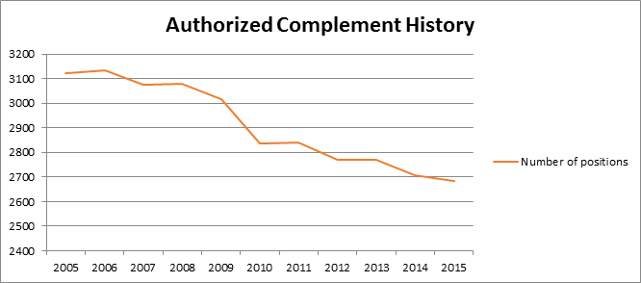
DEP Workforce and Succession Planning Update
May 2016
Fiscal Year End | 2005 | 2006 | 2007 | 2008 | 2009 | 2010 | 2011 | 2012 | 2013 | 2014 | 2015
Number of Auth. Sal. Positions | 3122 | 3132 | 3076 | 3079 | 3018 | 2835 | 2839 | 2770 | 2770 | 2708 | 2683

Slide 8
DEP Workforce and Succession Planning Update
May 2016
  Complement Reduction Comparison
  Over the Past 10 Years
  DEP Lost 14% of its Complement Since 2005 While Its Mission Experienced Expansion and Additional Environmentally Critical Issues

Slide 9
DEP Workforce and Succession Planning Update
May 2016
Background Information Driving the Workforce Planning Imperative
  Increasing Difficult to Perform Mission and Meet Functional Requirement In Light of Complement and Funding Constraints
  13% of DEP’s Complement Could Retire with Full Benefits Immediately
  30% (and Rising) of DEP’s Complement Could Retire With Full Benefits Within Four (4) Years
  In Addition to Staffing Volume, Staffing Composition is an Increasing Concern for DEP

Slide 10
DEP Workforce and Succession Planning Update
May 2016
Generational Changes in the Workplace
According to the PEW Research Center, millennials now outnumber baby boomers in the total workforce, 76 million to 75 million
  It is estimated that millennials will make up 75% of the total workforce in 10 years
The DEP generational breakdown of the permanent complement shows that baby boomers currently outnumber millennials by a multiple of 2.7 times
  That circumstance leads to an impending and very sizeable shift from baby boomers to millennials that will be occurring in the relatively near future

Slide 11
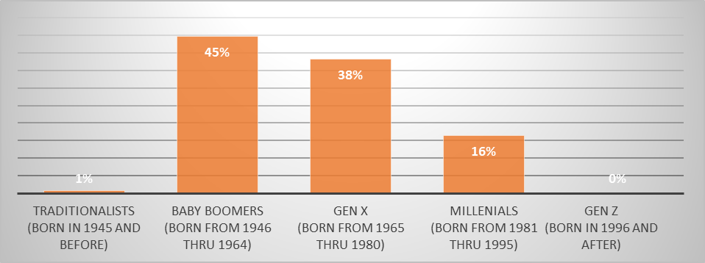
DEP Workforce and Succession Planning Update
May 2016
By Generation Breakout of DEP’s Workforce

Slide 12
DEP Workforce and Succession Planning Update
May 2016
What Were We Doing?
What is New?
Providing Semi – Annual Workforce Statistics Report
Meeting with Management on Retirement Projections s
Weaving Workforce Stats into Open Civil Service Exams
Developing Electronic Tools for Easy HR Data Access
Developing Culture and Expectations
Working More with Executive Leadership
Creating a HR “Center of Excellence” to Drive Workforce Planning Action(s)
Established/running a Proof of Concept Pilot
Refocus on Employee and Organizational Development Initiatives
Working on Enterprise Development of Manager-based Electronic Tools for Easy Data Access (Dashboard Type Tool)
Developing Culture and Expectations

Slide 13
DEP Workforce and Succession Planning Update
May 2016
Developing DEP’s Workforce Planning Practice
  Crafted a “Practical Approach and Guide to Workforce Planning” for the Department in February/March 2016
  Grounded the Guide in/on Workforce Planning Best Practices
  Developed with Guide with the Insight(s) of Executive Leadership
    Contains Tools/Templates to Facilitate a User Friendly Methodology that Helps Pinpoint and Define Issues
    Supports an Agile/Flexible Approach
  Launched a “Proof of Concept” Pilot in the Deputate for Waste, Air, Radiation and Remediation in March 2016
    Currently Framing Top Issues
  Establishing an “HR Center of Excellence” to Facilitate Implementation of Targeted Workforce Planning
    Dependent on Being Able to Fill HR Vacancies

Slide 14
DEP Workforce and Succession Planning Update
May 2016
Fundamental Framework for the Workforce Planning Model
Alignment with Strategic Direction
Analyze Supply, Demand and Discrepancies/Gaps
Create an Action Plan to Address Discrepancies/Gaps
Implement the Action Plan
Post Implementation – Monitor and Periodically Evaluate/Adjust the Plan

Slide 15
DEP Workforce and Succession Planning Update
May 2016
Key Goals of DEP’s Workforce Planning Initiative
  Develop Customized Approaches/Programs
  Break Down Traditional Barriers to Effective Workforce Planning
  Develop a Data-Driven Workforce Planning Culture
  Focus on the Supply and Demand of Essential Human Capital
  Building Action Planning Capability to Address the Gaps and Discrepancies Between the Current Supply and the Need/Demand for Human Capital
  At the End of the Day, the Approach Will Improve the “People Health” of the Department and Maximize the Organizational Capacity to Address Business Goals and Objectives

Slide 16
DEP Workforce and Succession Planning Update
May 2016
Key Workforce Planning Questions Moving Forward, Driven by the Process/Practice Model:
What type of talent is required?
  Staffing levels and skill composition across key job titles/occupations?
Do we have the talent and are we developing it?
  What talents do we have to search outside for?
Which segments of the employee population are most critical to the strategy?
  Is our employee/organizational development focus directed there?
What type of culture do we need to build, not only to achieve the objectives, but also to attract and retain the talent we require?
  Is more time and attention required to drive a cultural transformation?
What organizational structures and systems are in place that will help or hinder achieving our goals?
  What actions are needed to improve organizational effectiveness?

Slide 17
DEP Workforce and Succession Planning Update
May 2016
Replacement Planning Template for Mid/Higher Level Management
Bureau of (Name)
 |  |  | Name
 |  |  | Bureau Director
 |  |  |  |  |  |  | Rank | Name |  | Readiness
Name |  |  |  |  |  |  | Name
Division Manager |  |  |  |  |  |  | Division Manager
Rank | Name |  | Readiness |  |  |  | Rank | Name |  | Readiness
Name |  |  |  |  |  |  | Name
Division Manager |  |  |  |  |  |  | Division Manager
Rank | Name |  | Readiness |  |  |  | Rank | Name |  | Readiness
C = Competitive (if rank cannot be quantified)
Readiness: Yes - or – not yet; if not yet, indicate time frame Confidential

Slide 18
DEP Workforce and Succession Planning Update
May 2016
Criticality Assessment Template (critical to mission/goals/objectives)
For the identification/documentation and development of workforce planning needs
Prompts action planning aimed at addressing the requirements that were identified
Key Employee Based Losses in Next Five Years
 | Name | Position | Issue (Y/N) | Replacement Candidates Identified (Name) | Ready (Y/N)
1
2
Etc.
Top Job Title/Occupation Based Staffing Issues
Rank | Job Title / Occupation | Number of Positions | Unaddressed Needs
1
2
Etc.
Confidential

Slide 19
Questions?
DEP Workforce and Succession Planning Update
May 2016

