Slide 1
Fukushima Radiation Releases & Decommission Three Mile Island Now
Tom Bailey
Citizens Advisory Council 9/19/17

Slide 2
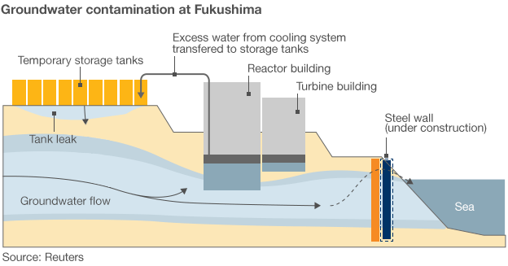

Slide 3
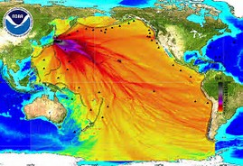
Radioactive Plume in Pacific Ocean

Slide 4
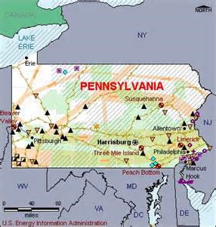
Pennsylvania’s Five Nuclear Stations

