Slide 1
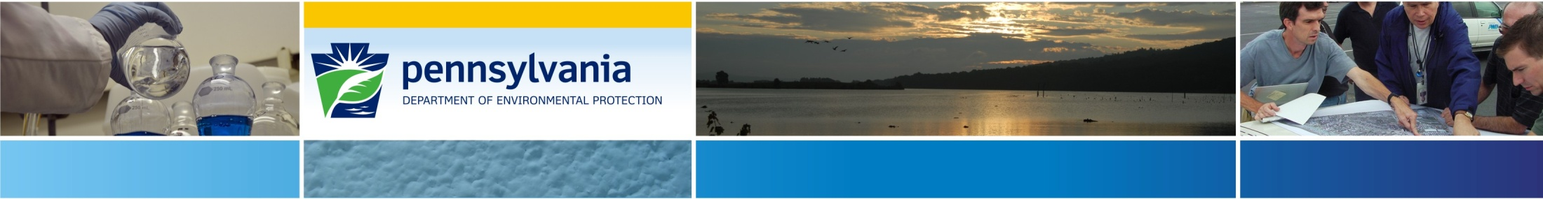
Pennsylvania General Energy Co., LLC Phase IV Pipeline project
Virtual Public Hearing
July 2, 2024
Josh Shapiro, Governor
Jessica Shirley, Acting Secretary

Slide 2

Hearing Agenda
DEP introductory comments
Brief informational presentation by applicant
Ground rules for hearing
Public testimony (3 minutes per registered person)
Conclusion

Slide 3
DEP Staff Introductions
DEP Eastern Oil and Gas District Staff
Dan Harvey, P.E., Environmental Group Manager
Christopher Yeakel, Aquatic Biologist Supervisor
Erin Chambers, Aquatic Biologist
Christopher Mileto, Project Manager

Slide 4
DEP Staff Introductions
DEP Bureau of Oil and Gas Management
Kurt Klapkowski, Deputy Secretary
Dan Counahan, Director of District Oil & Gas Operations
Alexandria Barravecchio, Acting Environmental Program Manager
Todd Wallace, Executive Assistant

Slide 5
DEP Staff Introductions
DEP Northcentral Regional & Support Staff
Megan Lehman, Regional Communications Manager
Lisa Meade, Local Government Liaison
Darek Jagiela, Digital Communications Support

Slide 6
Purpose of Tonight’s Hearing
Accept public comments as part of DEP permit review for Phase IV Pipeline Project proposed by PGE for Cummings and McHenry Townships, Lycoming County
Transcript will be created

Slide 7
Submitting Written Comment
Written comments accepted through 7/22/24
Email to RA-EPEASTERNOGPRG@pa.gov
or mail to DEP’s Williamsport office
All comments carry equal weight with DEP

Slide 8
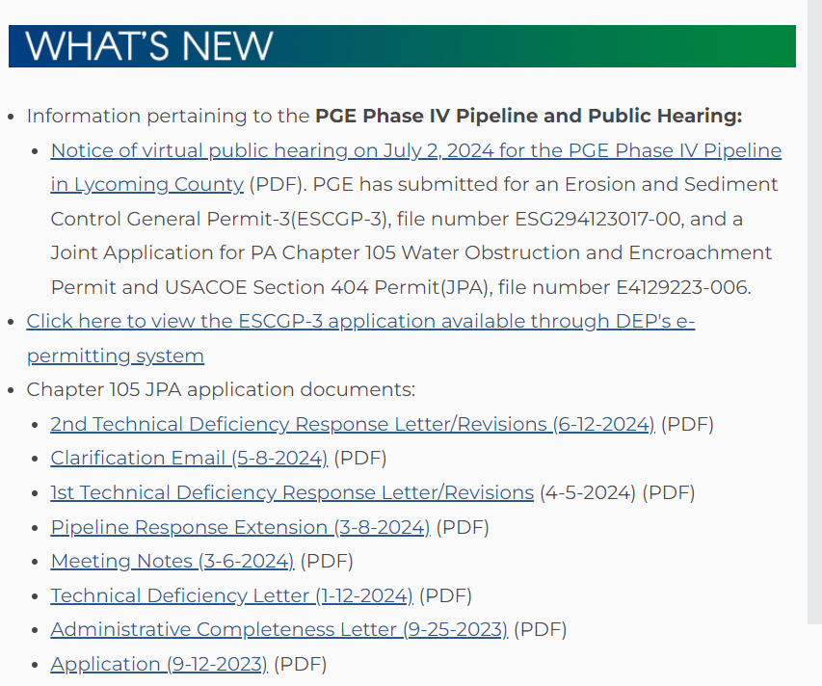
For More Information
https://www.dep.pa.gov/About/Regional/North-central-Regional-Office/Community-Information/Pages/default.aspx
DEP Northcentral Region >
Community Information >
Scroll down to
“What’s New”

Slide 9
Applicant Brief Comments
Nathan Harris, President
Pennsylvania General Energy Co., LLC (PGE)

Slide 10
Phase IV
Alternatives
6 alternatives considered
Multiple alternatives were rejected by landowners
PGE has amended the tree planting plan where the pipeline closely parallels or crosses the Midstate trail
(Slide and map provided by PGE)

Slide 11
Ground Rules for Hearing
Speakers called in order of sign up
We will unmute your line
Say and spell your name, then give comments
Three minutes per person
Watch onscreen timer
After warning to finish your sentence, if you exceed your time, you will be muted

Slide 12
Public Testimony
Three minutes per registered speaker

Slide 13
Thank you for attending!
This concludes this evening’s virtual public hearing.

