Slide 1

Schools Chemical Cleanout Campaign
Chemical Management Training
2017 Campaign

Slide 2

Agenda
8:30 Welcome/Organization
Introduction
School Chemical Incidents
Hazard Recognition
Importance of Chemical Safety
Commitment, Roles, and Responsibilities
Chemical MANAGEMENT Plans
Essential Components
First Steps
Safety Data Sheets (SDS)
Labeling

Slide 3
Agenda
Chemical MANAGEMENT Plans (cont.)
Labeling
Chemical Storage
11:30 – 12:30 LUNCH
Chemical MANAGEMENT Plans (Cont.)
Control Measures
Spill Prevention and Response Planning
Reduction of Stored Chemicals
Chemical Disposal

Slide 4
Agenda
EHS CASE STUDY
CHEMICAL CLEANOUT PROGRAM
REVIEW AND QUESTIONS
3:30 DEPARTURE

Slide 5
Chemical Handling Incidents
They are occurring everyday. What can be learned from them?
Some of us may have witnessed unsafe behavior or minor accidents, and yet, rather than viewing these incidents with concern and as opportunities to modify practices and behavior, we often have failed to act upon these “teachable moments.”
From Prudent Practices in the Laboratory: Handling and Management of Chemical Hazards – Preface
http://www.nap.edu/catalog.php?record_id=12654

Slide 6
Chemical Handling Incidents
Wednesday October 24
A Pennsylvania High School Teacher Hurt when Chemistry Experiment Explodes
Notes:
Wednesday October 24, 2012
Derry High School Teacher Hurt when Chemistry Experiment Explodes

Slide 7
Chemical Handling Incidents
Wednesday October 10
A Pennsylvania Teacher Hospitalized after ‘Chemical Spill’
Notes:
Wednesday October 10, 2012
Albert Gallatin Teacher Hospitalized after ‘Chemical Spill

Slide 8
Chemical Handling Incidents
Tuesday August 28
School Evacuated after 12 Students Injured in Science Lab Explosion at Moss Vale High School
Notes:
Tuesday August 28, 2012
School Evacuated after 12 Students Injured in Science Lab Explosion at Moss Vale High School

Slide 9
Chemical Handling Incidents
Thursday February 23
Fire Erupts in a Pennsylvania High School Chemistry Lab
    Lab Experiment Sparks Tanana Middle School Evacuation
Notes:
Thursday February 23, 2012
Fire Erupts in Hamburg High Chemistry Lab
Lab Experiment Sparks Tanana Middle School Evacuation

Slide 10
Chemical Handling Incidents
Thursday November 10
    Chemical Spill Clears a High School in Pennsylvania
Notes:
Thursday November 10, 2010
Chemical Spill Clears the Line Mountain High School

Slide 11
Chemical Handling Incidents
Friday December 9
    Canby High School Evacuated After Chemistry Lab Fire
Notes:
Friday December 9, 2011
Canby High School Evacuated After Chemistry Lab Fire

Slide 12
Chemical Handling Incidents
Monday January 23, 2006
Eight Injured in Lab Explosion at
Western Reserve Academy
http://cenm.ag/rainbow
    Link to follow-up article http://cen.acs.org/content/dam/cen/93/46/09346-educ.pdf

Slide 13
Chemical Handling Incidents
Seven flash incidents in a one year span
9/13/13 Frisco, TX: Two students and a teacher injured…
10/3/13 Douglas County, GA: One student suffered burns on 25% of her body …
11/12/13 Avondale, AZ: Four students and a teacher injured …
11/25/13 Chicago, IL: One student suffered second-degree burns on her hands and four other student were injured …
1/2/14 New York, NY: Two students burned …
9/3/14 Reno, NV: Eleven children and two adults injured ...
9/15/14 Denver, CO: Four students hospitalized , one with serious burns …
Notes:
Chemistry Experiment Sparked Explosion in Va. High School That Hurt Students 10/30/2015
Two students are in fair condition with burns after a demonstration in a chemistry classroom in Northern Virginia sparked an explosion on Friday.
The blast Friday morning at W.T. Woodson High School in Fairfax, Virginia, was accidental and occurred as a teacher performed an experiment, Fairfax County Fire Chief Richard Bowers said.
"It was a demonstration of fire in the different colors," Bowers said. "The students were observing the experiment when the explosion occurred."
The exact nature of the experiment performed at Woodson wasn't known immediately.
An exercise often known as "the rainbow experiment" has previously left students with serious injuries and should not be performed in classrooms, according to the U.S. Chemical Safety Board and the American Chemical Society.
"These demonstrations present an unacceptable risk of flash fires and deflagrations that can cause serious injuries to students and teachers," the ACS said.
In New York City, a botched rainbow experiment -- which shows how various mineral salts produce flames in different colors when mixed with highly flammable methanol -- left a 16-year-old high school student with serious injuries in January 2014. In Hudson, Ohio, the same experiment left a 15-year-old prep school student and model with devastating burns in January 2006.
Woodson student Daniel Dorlester said he was in the classroom full of 30 10th grade students when the blast erupted about 9:40 a.m.
"It was kind of a fireball, but it wasn't like a 'whoosh' thing that went up, it went out," he said. "[The teacher] decided to add more alcohol straight from the bottle, and at that point, it blew up and everyone started evacuating."
Dorlester made it out of the room unhurt, though a sweatshirt he had left elsewhere in the classroom went up in flames.
"I didn't know what to think of it, I just knew that I needed to get out of there," he said.
Three other students had less serious, non-life-threatening injuries. They were taken to Inova Fairfax Hospital and had been released by 4 p.m. Friday.
The teacher also sustained minor burns and was treated on the scene. She stayed at the school to talk to authorities, Fairfax Fire Capt. Randy Bittinger said.
"Again, non-life-threatening, but she does want to make sure that she lets everybody knows what occurred and gets that investigation taken care of," Bittinger said.
Officials said 50 percent of the chemistry classroom was damaged by water, smoke and fire. The fire caused $7,500 in damage, Bowers said.
"It was a small fire," said Dan Schmidt, from the Fairfax County fire department, said. "Firefighters, along with the sprinkler system, put out the fire."
The school was evacuated after the fire, which was contained to a single room. A hazmat team evaluated the school.
"Anything to take precautionary measures is, I think, the recommended route when it comes to the safety of children and students," Schmidt said.
Chopper4 footage showed evacuated students gathering near the football field outside the school. Other students were taken to tennis courts.
Friday was the last day of the marking period, so students had been scheduled for early dismissal even before the fire occurred, said John Torre, a spokesman for Fairfax County Public Schools. Students were dismissed at 12:55 p.m., their scheduled time. Parents were notified of the situation, Torre said.
FCPS Superintendent Karen Garza said in a release Friday that she was "deeply saddened" by the injuries.
"FCPS is truly like a family, and as such, we are all deeply concerned about what happened today," Garza said in the release. "I know this incident has affected the Woodson community and, as a district, we will provide as much support and assistance for students, staff members, and families as is needed."
She also praised "the quick and calm actions of the Woodson leadership and staff" in conducting a safe evacuation.

Slide 14
Chemical Handling Incidents
The Chemical Safety Board outlines key lessons:
Due to flash fire hazards and the potential for serious injuries, bulk containers of flammable chemicals should not be utilized in educational demonstrations when small quantities are sufficient.
Implement strict safety controls when demonstrations necessitate handling hazardous chemicals — including written procedures, effective training, and the required use of appropriate personal protective equipment for all participants.
Conduct a comprehensive hazard review prior to performing any educational demonstration.
Provide a safety barrier between the demonstration and the audience.
Notes:
“These key lessons, if followed, will prevent future injuries. Educators should substitute or minimize the use of flammable chemicals and perform an effective hazard review prior to conducting an educational demonstration. Safety must be the absolute priority and educators should demonstrate chemical safety concepts as well as the science topic.”
Statement by CSB Chairperson Rafael Moure-Erason

Slide 15
Chemical Handling Incidents
Each individual influences the “culture of safety” in the laboratory. All of us should recognize that the safety of each of us depends on teamwork and personal responsibility as well as the knowledge of chemistry.
From Prudent Practices in the Laboratory: Handling and Management of Chemical Hazards – Preface

Slide 16
Hazard Recognition & Classification
Since the age of alchemy, laboratory chemicals have demonstrated dramatic and dangerous properties. Some are insidious poisons.
From Prudent Practices in the Laboratory: Handling and Management of Chemical Hazards – Chapter 1

Slide 17
Hazard Recognition & Classification
Handling and use of chemicals comes with inherent hazards, classified into two main groups.
  Physical Safety Hazards
  Chemical Health Hazards

Slide 18
Physical Safety Hazards
Are substances that are prone to cause fire, explosion, or other conditions which may lead to burns, skin cuts and abrasions, exposure to temperature extremes, or other injuries.
Examples
Compressed Gases
Explosives
Flammables
Organic Peroxides
Oxidizers
Unstable Substances
Water-reactive Substances

Slide 19
Chemical Health Hazards
Are substances that are hazardous to health when they enter the human body in sufficient quantity.
Examples
Carcinogens
Corrosives
Highly Toxic Substances
Irritants
Sensitizers
Notes:
The toxicity depends greatly on phase (e.g., gas, liquid, or solid) of substance, route of entry, duration of exposure and the quantity which is absorbed into the body. A substance can have acute or chronic health effects.

Slide 20
Chemical Health Hazards
There are four main routes by which chemical substances can enter the body:
Inhalation (dusts, fumes, mists or vapors)
Ingestion (eating or drinking with contaminated hands or in a contaminated laboratory)
Absorption (contact with liquid, dusts, fumes, mists or vapors)
Injection (accidental puncture of the skin with contaminated glass or metal)
Notes:
The toxicity depends greatly on phase (e.g., gas, liquid, or solid) of substance, route of entry, duration of exposure and the quantity which is absorbed into the body. A substance can have acute or chronic health effects.

Slide 21
Substance Classes and Health Effects
Acids Acetic, hydrochloric, nitric, sulfuric, etc. are corrosive to skin and mucous membranes.
Alcohols Methanol induces blindness and ethanol depresses the central nervous system via ingestion or prolonged inhalation.
Aldehydes and ketones Acetaldehyde and acetone are irritants and have narcotic effects via inhalation, absorption, or ingestion.
Aliphatics Acetylene, methane and ethane are central nervous system depressants, asphyxiants, and neurotoxins.

Slide 22
Substance Classes and Health Effects
Alkali hydroxides can cause severe tissue burns and bronchial spasms.
Asphyxiants Reduces the oxygen carrying capacity of the blood (e.g., CO) or displaces atmospheric oxygen (e.g. CO₂).
Oxides of nonmetals are corrosive to the skin and destructive to respiratory tissues.
Halogens are corrosive and highly irritating to tissues.
Metal fumes/vapors can cause systemic poisoning via ingestion and inhalation. Toxic effects may be compounded with prolonged exposure.

Slide 23
Hazard Recognition & Classification
The ability to accurately identify and assess hazards in the laboratory is not a skill that comes naturally; it must be taught and encouraged through training and ongoing organizational support.
From Prudent Practices in the Laboratory: Handling and Management of Chemical Hazards - Chapter 1

Slide 24
Importance of Safety
A crucial component of chemical education at every level is to nurture basic attitudes and habits of prudent behavior so that safety is a valued and inseparable part of all laboratory activities.
From Prudent Practices in the Laboratory: Handling and Management of Chemical Hazards – Chapter 1

Slide 25
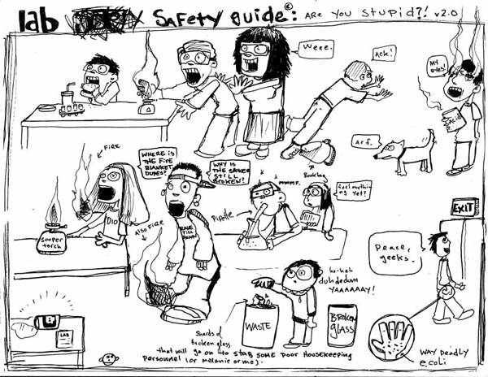
IMPORTANCE OF SAFETY
Da Rulz by Anthony Lowe, Guilford College

Slide 26
Importance of Safety
It is essential for all involved in the science instruction program to develop a positive approach to a safe and healthy environment in the school.
Safety and health should be an integral part of the planning, preparation, and implementation of any science program.
Safe management of chemicals and the enforcement of safety rules in schools, classrooms, and laboratories are the responsibility of the principal, teachers, operations staff and students, each assuming their role and share of the program.

Slide 27
Stakeholder Groups and Roles
Principal | Recognize the need and provide support for changes necessary to ensure a safe and healthful learning environment
Teachers | Identify and implement class room changes necessary to ensure a safe and healthful learning environment and mentor students in safe practices
Operations Staff (Maintenance, B/G, Facilities) | Implement operational changes necessary to ensure a safe and healthful learning environment
Students | Follow the rules and respect the principal, teachers, and operations staff in their efforts to provide a safe and healthful learning environment
Notes:
The Principal’s Role and Responsibilities
Recognize the need for establishing safety and health instruction as a fundamental part of the science curriculum.
Initiate development of a laboratory safety program and provide the support necessary for implementation.
Hold the teachers accountable for operating their classrooms and labs in a safe manner.
Ensure school wide compliance with applicable federal, state and local regulations with regard to safety such as the Occupational Safety and Health Act of 1970 and the Pennsylvania Worker and Community Right to Know Act (34 PA Code Chapters 301-323) .
The Teacher’s Role and Responsibilities
Provide a safe and healthful learning environment for the students through implementation of the school’s safety plan.
Instruct the students in the basic safety practices required in the school laboratories.
Impress the need for caution and preparation before working with chemicals in school laboratories.
Instruct the students regarding the hazards that are associated with the chemicals being used.
Provide safety information and training to the students for each stage of the experiment.
The Student’s Role and Responsibilities
Respect the principal, teachers, and operations staff in their efforts to provide a safe and healthful learning environment.
Learn the basic safety practices required in the school laboratories.
Follow teacher instruction and exercise the proper caution when working with chemicals in school laboratories.
Heed the hazard warnings associated with any chemicals being utilized.
Pay close attention to the safety information and training provided for each stage of the experiment.

Slide 28
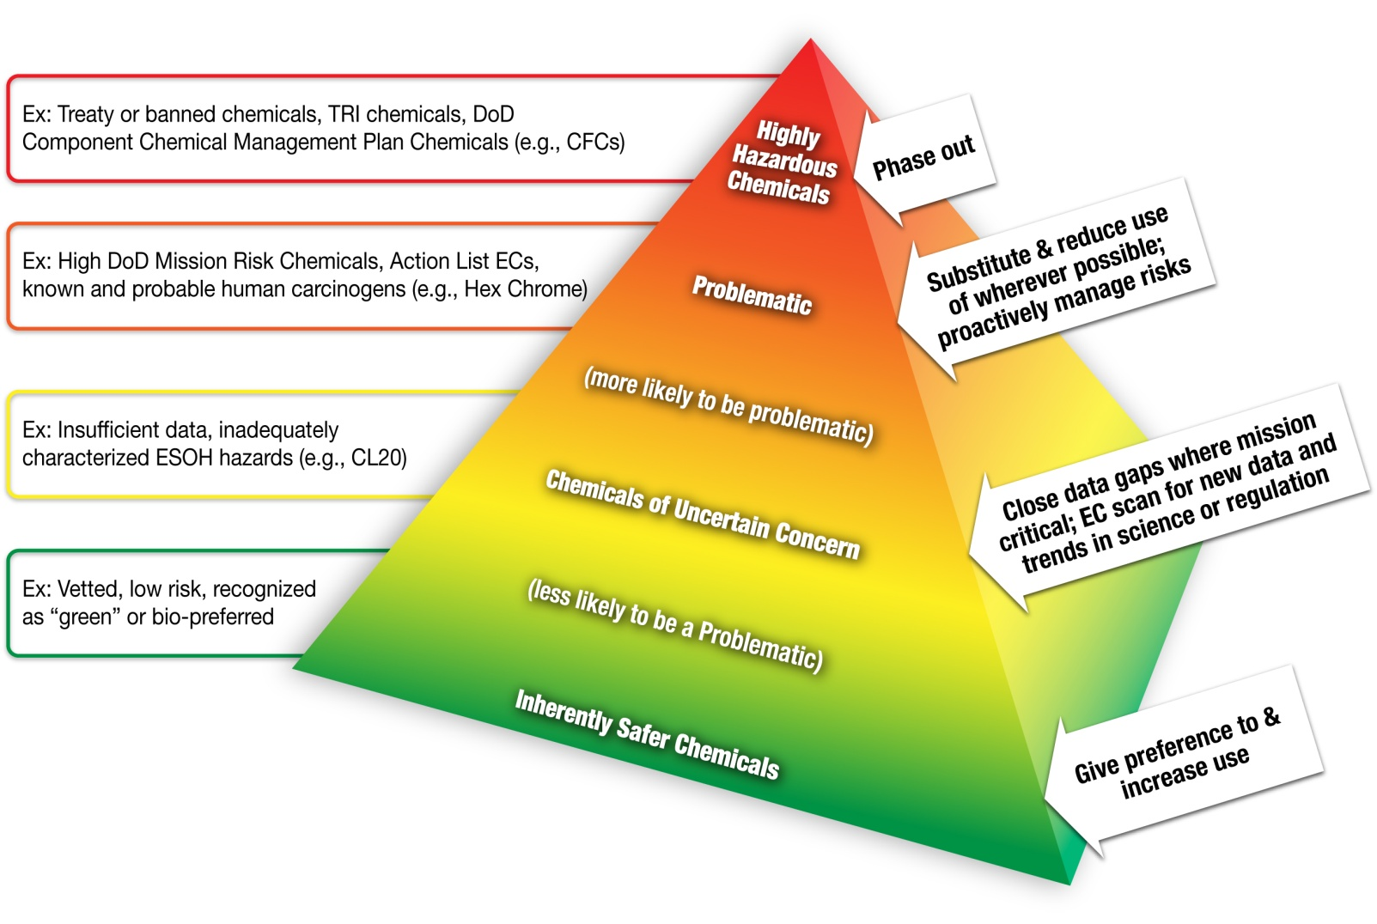
The Written Plan for
Chemical Management
Chemical Management Strategy Pyramid from DoD policy manual

Slide 29
The Chemical Management Plan
A Chemical Management Plan (CMP) is a written program stating the policies, procedures, and responsibilities that serve to protect employees, students, visitors, and others from the hazards associated with the chemicals used in that particular work place.

Slide 30
CMP Essential Components
Standard Operating Procedures (SOPs)
Control Measures
Safety Equipment
Chemical Hazard Information
Training Requirements
Approval Mechanism for Lab Procedures
Medical Records Protocols
Responsible Parties
Special Requirements
Mechanism for Plan Evaluation
Notes:
1. Standard Operating Procedure (SOP)
is a document consisting of step-by-step information on how to safely execute a task involving handling, use, storage or disposal of a chemical.
2. Controls Measures
Any system, procedure, process, device or other means of eliminating, preventing, reducing or mitigating the risk of exposure to hazards. Controls include physical equipment, process control systems, management processes, operating or maintenance procedures, the emergency plan.
Control measures include actions that can be taken to reduce the potential of exposure to the hazard, or the control measure could be to remove the hazard or to reduce the likelihood of the risk of the exposure to that hazard being realized.
The selection of control measures may include elimination of highly hazardous substances, substitution of safer alternatives, isolation, engineering controls, administrative controls and personal protective equipment.
Safety Equipment
A detailed plan, checklist, or inspection process to ensure laboratory chemical hoods and other protective equipment are installed and functioning properly.
Chemical Hazard Information
Information for persons working with hazardous substances specifying the hazards of the chemicals in the work area, the location of the CMP, signs and symptoms associated with hazardous chemical exposures, the permissible or recommended exposure limits of the chemicals, and the location and availability of information on the hazards, safe handling, storage, and disposal of hazardous chemicals (not limited to Safety Data Sheets [SDSs]).
5. Training Requirements
SOPs should be written, detailed activities that are relevant to the safety and health considerations of each activity as they involve the use of hazardous chemicals.
6. Approval Mechanism for Lab Procedures
The circumstances under which a particular laboratory operation or procedure requires prior approval from the appropriate administrator.
7. Medical Records Protocols
The plan shall detail requirements for medical consultation and medical examinations. At a minimum, medical reviews shall occur whenever (1) a person develops signs or symptoms associated with a hazardous chemical, (2) exposure monitoring reveals an exposure level routinely above the action level, and/or (3) an event takes place in the work area, such as a spill, leak, explosion, or any other occurrence resulting in the likelihood of a hazardous exposure.
8. Responsible Parties
The plan shall designate the personnel responsible for the implementation of the CHP, including the assignment of a Chemical Coordinator.
9. Special Requirements
Special requirements shall be included for additional protection when working with particularly hazardous substances, including “select carcinogens,” reproductive toxins, and substances with a high degree of acute toxicity.
10. Evaluation of Plan
The plan must have provisions for an annual review.

Slide 31
CMP Actions: The First Three Steps
Designate a Chemical Coordinator
Perform a thorough chemical inventory and implement an inventory tracking system(an accurate inventory makes ‘retain’ or ‘dispose’ decisions possible)
Implement purchase control protocols
Notes:
Make any necessary improvements to chemical storage areas (security, compatibility , containment, lighting and ventilation)

Slide 32
Chemical Coordinator Responsibilities
Developing and/or Approving SOPs
Reviewing and ordering safety supplies
Coordinating the inventory of chemicals
Reviewing and Approving Chemical Orders
Establishing and Enforcing Disposal Procedures

Slide 33
Chemical Inventory and Tracking System
An accurate inventory is necessary to identify all chemicals that are present in the school.
The inventory will enable the chemical coordinator to evaluate the chemicals and determine which are surplus or unsafe.
The inventory will also enable the chemical coordinator to reign in duplicate purchasing.
  The information collected should include storage location, chemical name, and container information (size, type, number and condition).

Slide 34
Chemical Inventory and Tracking System
In conjunction with an accurate inventory, a tracking system is necessary.
Tracking options vary from the simple - paper card system through the sophisticated - electronic database of chemicals with barcode scanners.

Slide 35
Purchase Control Protocols
Centralized chemical purchasing with the Chemical Coordinator reviewing purchasing requests and linking the purchases to the inventory tracking system.
Training for receiving personnel to ensure proper handling methods are practiced from the moment of receipt.
Purchasing the least hazardous chemical that will do the job.

Slide 36
Purchase Control Protocols
Curtailing acceptance of donated chemicals, unless they undergo the same review as chemicals for purchase.
Ensuring that a Safety Data Sheet (SDS) is received for each chemical or product purchased.
Reducing the quantity of hazardous substances in storage to the amount sufficient until the next order is placed.
Implementing a control system and enforcing it.
Notes:
These SDS need to be readily accessible to both personnel who use the products and to emergency responders.
Perhaps try when a chemical or product is received, mark the date on the package or case. When an individual container is opened, mark this date on it, along with the expiration date, for products that have a limited shelf life after opening.

Slide 37
Safety Data Sheets
    The OSHA Hazard Communication Standard (HCS) requires chemical manufacturers, distributors, or importers to provide Safety Data Sheets (SDS) to communicate the hazards associated with chemical products.
    As of June 1, 2015, the HCS requires SDS to be in a uniform format with specific section numbers, headings, and associated information under the headings.
    The SDS must be readily accessible to the personnel handling the products. Appendix D of 29 CFR 1910.1200 provides a detailed description of SDS content.
Notes:
These SDS need to be readily accessible to both personnel who use the products and to emergency responders.
Perhaps try when a chemical or product is received, mark the date on the package or case. When an individual container is opened, mark this date on it, along with the expiration date, for products that have a limited shelf life after opening.

Slide 38
Safety Data Sheets – Section Headings
  Section 1 Identification
  Section 2 Hazard(s) identification
  Section 3 Composition/information on ingredients
  Section 4 First-aid measures
  Section 5 Fire-fighting measures
  Section 6 Accidental release measures
  Section 7 Handling and storage
  Section 8 Exposure controls/personal protection

Slide 39
Safety Data Sheets – Section Headings
  Section 9 Physical and chemical properties
  Section 10 Stability and reactivity
  Section 11 Toxicological information
  Section 12 Ecological information
  Section 13 Disposal considerations
  Section 14 Transport information
  Section 15 Regulatory information
  Section 16 Other information

Slide 40
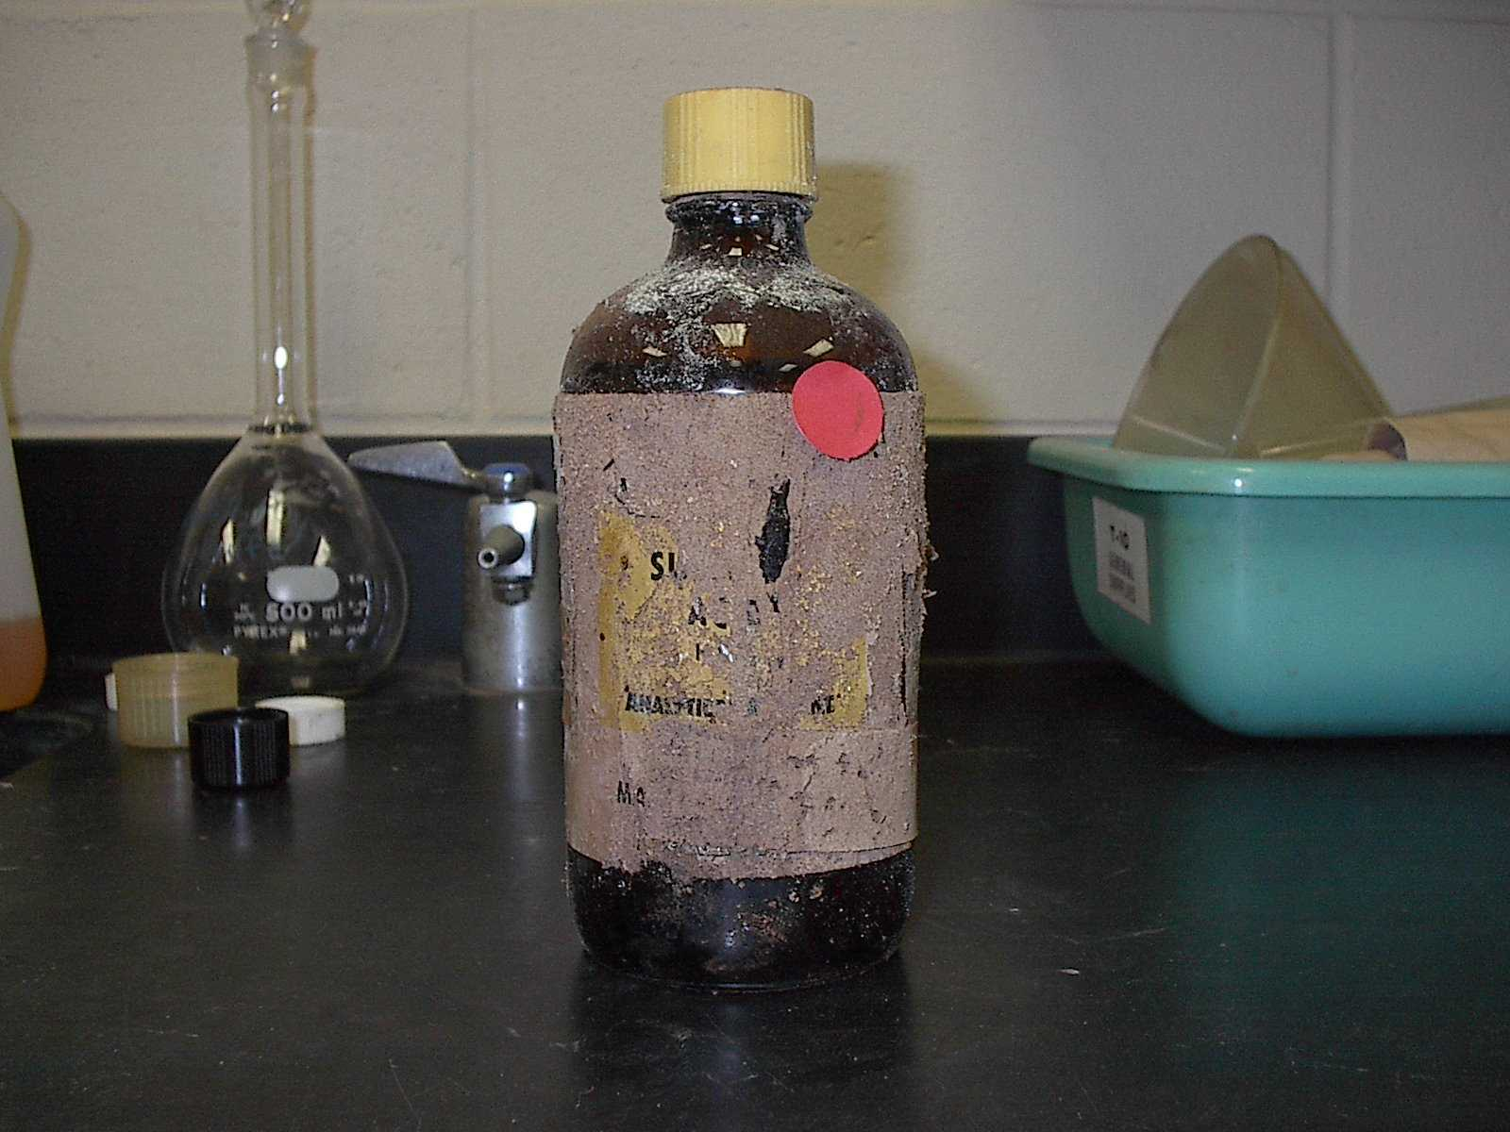
Labeling

Slide 41
Labeling
The revised OSHA Hazard Communication Standard, 29 CFR 1910.1200 (HCS) includes changes to the hazardous chemical labeling requirements (applicable to all hazardous chemicals shipped after June 1, 2015) .

Slide 42
GHS Label Format Key Elements
Signal Word is a “safety sign header” that indicates hazard level. “Danger” is the most severe, while “Warning” is less severe.
Product Name or Identifier provides the product or chemical name as identified on the SDS.
Hazard Pictograms are GHS symbols used to identify hazardous products.
Precautionary Statements are phrases that are tied to each hazard statement. They describe general preventative, response, storage or disposal precautions.
Manufacturer Information identifies the manufacturer’s company name, address and telephone number.
Hazard Statements are phrases that describe the nature of hazardous products and the degree of hazard.

Slide 43
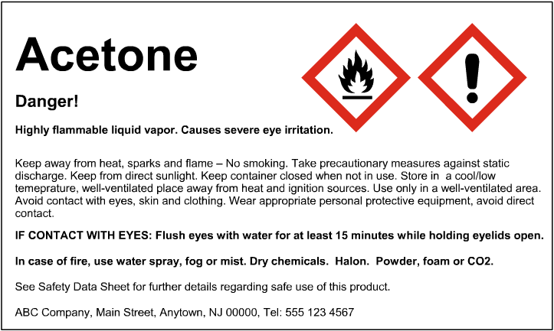
1. Signal Word
2. Product Identifier
3. Hazard Pictograms
6. Hazard Statements
5. Manufacturer Information
4. Precautionary Statements

Slide 44
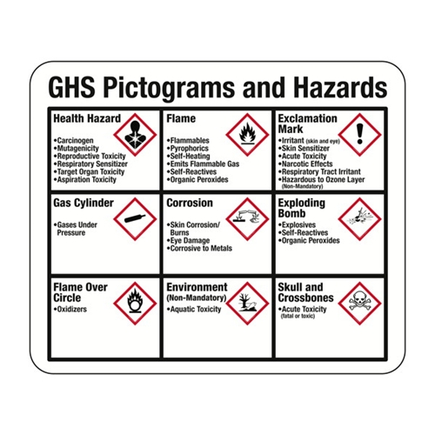
Notes:
The environmental pictogram is not mandatory but may be used to provide additional information.
It is important to note that the OSHA pictograms do not replace the diamond-shaped labels that the U.S. Department of Transportation (DOT) requires for the transport of chemicals, including chemical drums, chemical totes, tanks or other containers.

Slide 45
Labeling - On Original Containers
Upon delivery – verify that the label contains the GHS key elements (signal word, identifier, hazard pictograms, precautionary statements, manufacturer information and hazard statements)
Ongoing requirement: labels must be maintained in a manner which continues to be legible (including hazards and directions for use)
Suggested addition – dates
(received, opened, use by)

Slide 46
Labeling Basics
Use labels with good adhesive.
Use a permanent marker (waterproof and fade resistant) or laser (not inkjet) printer.
Print clearly and visibly.
Replace damaged, faded or semi-attached labels.

Slide 47
Labeling - Secondary Containers
Upon transferring material from the original container to an alternate container, this container is referred to as a “secondary container.”
The secondary container must be compatible with the substance being stored.
Label all secondary containers used for storage with the same information as the original container label.

Slide 48
Labeling - Prepared Solutions
The secondary container must be compatible with the solution being stored in it.
Label containers of prepared solutions for storage as follows
  Chemical name
  Name of person who prepared the solution
  Necessary handling and hazard information
  Concentration or purity
  Date prepared
  Expiration or “use by” date

Slide 49
Labeling - Immediate Use
All chemicals to be used within a given day or classroom session should be clearly labeled.
Label all containers in immediate use with the following:
  Chemical name
  Necessary handling and hazard information
Notes:
If an employer transfers hazardous chemicals from a labeled container to a portable container that is only intended for immediate use by the employee who performs the transfer, no labels are required for the portable container.

Slide 50
Labeling - Peroxide Forming Substances
    Use the contents within six months of opening (three months for the severe peroxide forming chemicals)
Date received
Date first opened
Date to be disposed of
Notes:
Steps you can take to limit the formation of peroxides in uninhibited peroxide-forming solvents
include tracking the use of the chemical. Record the date it is first opened, and mark it on the
container or on a hang tag on the neck of the bottle. Use the contents within six months (three
months for the severe peroxide forming chemicals listed in Appendix B, and discard any unused
material after that time. Never allow peroxide-forming solvents to contact any metal objects.
Contamination by metals can lead to explosive decomposition. Store the material at the lowest
possible temperature but do not refrigerate or freeze it. Keep the material in opaque containers
away from light sources. Additionally, wipe down the threads of the bottle after pouring, and
purge the container head space with nitrogen gas before closing it.

Slide 51
Labeling - Waste Chemicals
WASTE” or “HAZARDOUS WASTE”
Chemical name (as it appears on the SDS)
Accumulation start date
Hazard(s) associated with the chemical waste

Slide 52
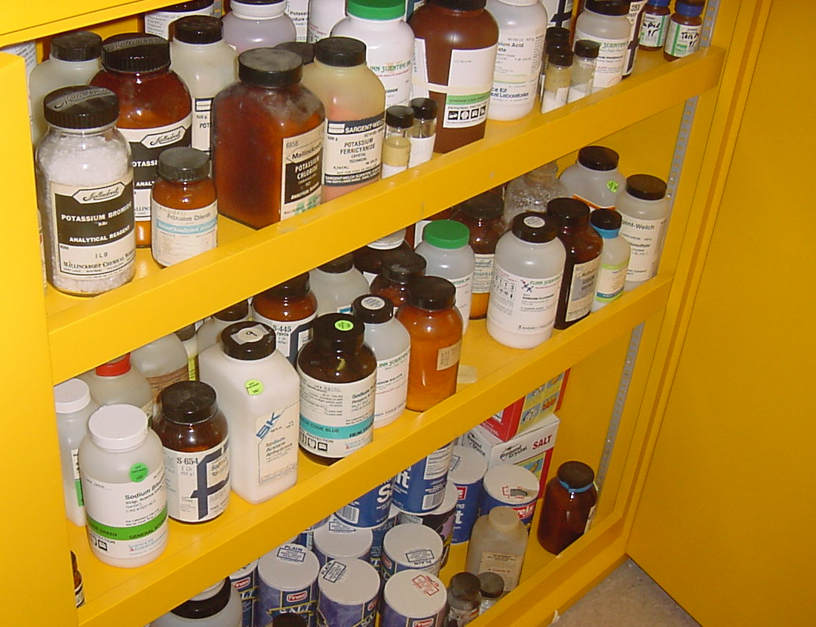
Chemical Storage

Slide 53
Chemical Storage
The safe storage of hazardous chemicals is an essential part of an integrated chemical management program.
Improper storage of chemicals increases the risk of adverse reactions in the event of container failure, spillage, fire or other emergency.
Proper storage of chemicals lowers the risk of adverse reactions by segregation of incompatibles.

Slide 54
Chemical Storage - Flammables
Do:
Keep containers of flammable and volatile chemicals tightly capped.
Store flammable liquids in special storage cabinets, well away from oxidizers.
Don’t:
Store flammable chemicals in a regular refrigerator.
Store combustible materials around or on top of flammable material storage cabinets.

Slide 55
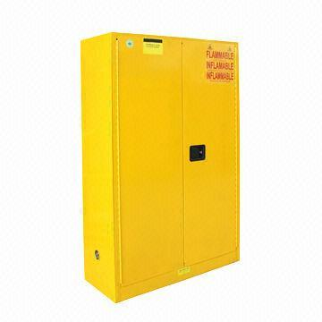
Chemical Storage - Flammables
A fundamental means of fire protection is the use of flammable storage cabinets.

Slide 56
Chemical Storage - Flammables
OSHA specifies in 29 CFR 1910.106(d)(3)(ii)(a) that metal cabinets for storage of flammables be constructed as follows:
    Bottom, top, and sides of cabinet must be at least No. 18 gage sheet steel.
    Cabinet must be double-walled with 1½-inch airspace.
    Joints must be riveted, welded, or made tight by some equally effective means.
    Door must have a three-point latch.
    Door sill must be raised at least 2 inches above the cabinet bottom to retain spilled liquid within the cabinet.
    Cabinet must be labeled in conspicuous lettering “Flammable—Keep Fire Away.”

Slide 57
Chemical Storage - Corrosives
Store corrosive materials in corrosion-resistant containers and cabinets.
Store acids and bases separately.
Store oxidizing acids, such as nitric acid and perchloric acid separate from other acids.
Store corrosive chemicals on shelves at or below eye level.

Slide 58
Chemical Storage
Store heavier containers at a level that is consistent with its size and anticipated use.
Secondary containment totes should be used to minimize the flow of material in the event of a spill or container leak.
The materials should be segregated by hazard category.

Slide 59
Chemical Storage - Segregation
There are a variety of laboratory chemical segregation plans available for use - they are based on hazard class or compatibility.
Other plans are derivations from that outlined in the National Research Council’s Prudent Practices in the Laboratory: Handling and Disposal of Chemicals.
Many universities publish diagrams of recommended chemical storage systems on their websites.
Chemical supply companies also often have recommended plans for chemical storage in their catalogs or other distributed reference manuals.
Many of these systems are based on a series of codes for functional classes of chemicals.

Slide 60
FLINN COMPATIBLE CHEMICAL FAMILY CODES
INORGANIC #1 Metals, Hydrides | ORGANIC # 1 Acids, Amino Acids, Anhydrides, Peracids
INORGANIC # 2 Acetates, Halides, Sulfates, Sulfites, Thiosulfates, Phosphates, Halogens | ORGANIC # 2 Alcohols, Glycols, Amines, Amides, Imines, Imides, Sugars
INORGANIC # 3 Amides, Nitrates (except Ammonium Nitrate), Nitrites, Azides | ORGANIC # 3 Hydrocarbons, Esters, Aldehydes, Oils
INORGANIC # 4 Hydroxides, Oxides, Silicates, Carbonates, Carbon | ORGANIC # 4 Ethers, Ketones, Ketenes, Halogenated Hydrocarbons, Ethylene Oxide
INORGANIC # 5 Sulfide, Selenides, Phosphides, Carbides, Nitrides | ORGANIC # 5 Epoxy Compounds, Isocyanates
INORGANIC # 6 Bromates, Chlorates, Perchlorates, Chlorites, Hypochlorites, Peroxides, Hydrogen Peroxide | ORGANIC # 6 Azides, Organic Peroxides, Hydroperoxides
INORGANIC # 7 Arsenate, Cyanides, Cyanates | ORGANIC # 7 Sulfides, Polysulfides, Sulfoxides, Nitriles
INORGANIC # 8 Borates, Chromates, Manganates, Permanganates | ORGANIC # 8 Phenols, Cresols
INORGANIC # 9 Acids (except Nitric) | ORGANIC # 9 Dyes, Stains, Indicators
INORGANIC # 10 Sulfur, Phosphorus, Arsenic, Phosphorus Pentoxide | ORGANIC MISC.
INORGANIC MISC.

Slide 61
Storage Precautions– Peroxide Forming
Identify all peroxide forming chemicals in the inventory.
Write the opening date and discard date on the containers of chemicals that may degrade to become potentially explosive.
Store in airtight containers in a dark, cool, and dry place.
Discard or test peroxide forming chemicals before the expiration date printed on the container label.
If precipitate appears in an organic chemical that may form an explosive peroxide (e.g., crystals around the neck or cap of bottle), or if an oily layer appears, do not move it.
Inspect peroxide forming chemicals often for evidence of contamination or degradation. If you suspect a material may have become explosive, post warning signs so others do not handle or disturb the material.

Slide 62
Gas Cylinder Handling, Storage & Use
A variety of materials are packaged in compressed gas cylinders:
    atmospheric gases (N₂, O₂, CO₂)
    noble gases (He, Ne, Ar, Xe)
    fuel gases (CH₄, C₂H₆, C₃H₈)
    refrigerant gases (CFCs)
    corrosive gases (F₂, Cl₂)
    poison gases (CO, H₂S)

Slide 63
Gas Cylinder Handling, Storage & Use
The hazards associated with these compressed gases include:
    oxygen displacement
    fire & explosion
    toxic effects
    the physical hazards of a ruptured cylinder
An example of an extreme hazard may occur would be if the cylinder valve gets sheared off in an accidental fall, the cylinder literally would become a rocket that can smash through a cinder block wall.
The Occupational Safety and Health Administration (OSHA) references general handling requirements for compressed gases in 29 CFR 1910.101.

Slide 64
Gas Cylinder Handling, Storage & Use
Per 29 CFR 1910.101(a) gas cylinders must be inspected to ensure that they are in a "safe condition".
Visual and other inspections must be conducted as described in the Department of Transportation (DOT) hazardous materials regulations (49 CFR 171 - 179).
Manufacturers recommend at least an annual visual inspection, or depending on the use, a visual inspection at even shorter time intervals.
When DOT regulations are not applicable, visual and other inspections must be conducted as prescribed in the Compressed Gas Association's C-6 standards for visual inspection of compressed gas cylinders.
Notes:
Compressed Gas Association Pamphlets
C-6: steel compressed gas cylinders
C-6.1: for visual inspection of aluminum compressed gas cylinders
C-6.2: for visual inspection of fiber reinforced compressed gas cylinder
C-8: standard for requalification of DOT-3HT, CTC-3HT and TC-3HTM seamless steel cylinders

Slide 65
Gas Cylinder Handling, Storage & Use
Per 29 CFR 1910.101(b), the handling, storage and utilization of compressed gas cylinders must be in accordance with CGA Pamphlet P-1 Safe Handling of Compressed Gas Cylinders.
When being stored, gas cylinders should be properly secured at all times to prevent tipping, falling or rolling.
Cylinders holding pure oxygen or flammable gas must be mechanically grounded.
Store cylinders in a cool, dry, well-ventilated, fire-resistant area.
When a gas cylinder is empty or not being used, ensure that the valve is closed, the regulator removed and that the valve protector cap is secured in place.
Notes:
They can be secured with straps or chains connected to a wall bracket or other fixed surface, or by use of a stand or cylinder cage.
It is also recommended that the appropriate NFPA 702 diamond be posted in order to assist first responders in the event of a fire.
Cylinders that are out of hydro or are empty should be properly labeled/placarded, and segregated from those in use.

Slide 66
Gas Cylinder Handling, Storage & Use
When moving cylinders use hand trucks designed for that purpose.
When transporting by vehicle, secure cylinders so that they do not tip, fall, roll, or potentially fall from the vehicle.
Take precautions so that gas cylinders are not dropped or allowed to strike each other or other objects. Dropping or striking may damage the gas cylinder valve.
Consult the appropriate safety data sheet (SDS) and cylinder label for detailed information on the chemical contained in the gas cylinder.
Notes:
Please check with your state to determine the requirements for placarding and labeling the vehicle when transporting.
Specific chemical handling and storage precautions will be outlined in the SDS. The SDS will also have specifications for appropriate personal protective equipment for worker protection. Remember, while cylinders all have the same physical hazards associated with them, the material inside might have additional hazards that you must be aware of.

Slide 67

Control Measures

Slide 68
Control Measures
Any system, procedure, process, device or other means of eliminating, preventing, reducing or mitigating the risk of exposure to hazards.
Examples:
    physical equipment
    process control systems
    management processes
    operating or maintenance procedures
    the contingency plan
Notes:
Control measures include actions that can be taken to reduce the potential of exposure to the hazard, or the control measure could be to remove the hazard or to reduce the likelihood of the risk of the exposure to that hazard being realized.

Slide 69
Control Measures
Selection of control measures in order of preference:
  Elimination of Highly Hazardous Substances
  Substitution of Safer Alternatives
  Isolation
  Engineering controls
  Administrative Controls
  Personal Protective Equipment
Notes:
Control measures include actions that can be taken to reduce the potential of exposure to the hazard, or the control measure could be to remove the hazard or to reduce the likelihood of the risk of the exposure to that hazard being realized.

Slide 70
Hierarchy of Control Measures
Eliminate
Substitute
Isolate
Engineering Controls
Administrative Controls
Personal Protective Equipment
Most Preferred
Least Preferred

Slide 71
Control Measures
Elimination, Substitution and Isolation are the preferred methods of reducing the risks of exposure to hazardous substances. After exhausting those routes, Engineering and Administrative Controls should be implemented before relying on Personal Protective Equipment.
Notes:
Control measures include actions that can be taken to reduce the potential of exposure to the hazard, or the control measure could be to remove the hazard or to reduce the likelihood of the risk of the exposure to that hazard being realized.

Slide 72
Elimination of High Risk Chemicals
Due to their hazardous characteristics and the high risk associated with them, elimination should be given serious consideration.
    Mercury
    Peroxide Forming Solvents and Metals
    Strong Oxidizers
    Highly Reactive Chemicals
    Highly Toxic Chemicals
    Chemicals Regulated by the DEA
    Radioactive Materials
    Formaldehyde
Notes:
Teachers who want to use any of these chemicals for a unique science experiment should either purchase the smallest amount possible, or a dilute solution. It is preferable to present a similar experiment that does not require the use of a high risk chemical. Students should not be permitted to handle or perform experiments using any of the following high risk chemicals.

Slide 73
Substitution of Safer Alternatives
Toxic chemicals/equipment | Possible substitution(s)
Mercury thermometers | Digital and alcohol thermometers
Mercury barometer | Aneroid or digital pressure sensors
Methyl orange or methyl red | Bromophenol blue, bromothymol blue
Lead chromate | Copper carbonate
p-Dichlorobenzene | Lauric acid
Dichromate/sulfuric acid mixture | Ordinary detergents, enzymatic cleaners
Alcoholic potassium hydroxide | Ordinary detergents, enzymatic cleaners

Slide 74
Isolation
When Elimination or Substitution of a substance with a severe hazard alert isn’t an option, take steps to isolate the substance .
Consider Flinn’s “Devil Control” 3 step process:
  Determine if any of these substances are part of the inventory.
  Become familiar with their hazardous character by reviewing the detailed listing for each substance.
  Contain and control these “devil” chemicals by using clear plastic bags & ties, paint cans, and cat litter to safely store them.
  Refer to Flinn’s List of the 40 Devils as well as Flinn’s Seven Step Plan to Clean Up Your Storage Area - available at www.flinnsci.com .
Notes:
(severely poisonous, severely toxic, severely flammable, severely corrosive, strong oxidizer, carcinogen or lachrymator)

Slide 75
Engineering Controls
Engineering controls eliminate or reduce exposure to a chemical or physical hazard through the use or substitution of engineered machinery or equipment.
Examples include: self-capping syringe needles, ventilation systems, sound-dampening materials to reduce noise levels, safety interlocks, and various types of shielding.
Exposure to airborne hazardous chemicals are often controlled through the use of ventilation.

Slide 76
Engineering Controls
Ventilation is the process of supplying fresh air to an enclosed space in order to refresh/remove/replace the existing atmosphere.
Two types of ventilation are commonly used:
    Dilution Ventilation
    Local Exhaust Ventilation
Notes:
Dilution ventilation usually involves opening a window or setting up a fan to allow fresh air to come into the room. Dilution ventilation is typically appropriate when using a cleaner or paint on large surfaces, where the material is not especially hazardous. It would not be appropriate for performing laboratory experiments with volatile chemicals. Dilution ventilation is also used to control the build-up of airborne chemical contaminants in storage areas.
Local exhaust ventilation is a control that mechanically extracts the airborne dusts, mists, fumes or vapors from the point of generation and removes them from the building. The most common example in a school would be a laboratory-style hood, but other applications, such as welding hoods in metal shop, may also be present. Laboratory fume hoods should not be used for chemical storage. You should always store chemicals in the appropriate flammable cabinet, acid cabinet, or chemical stock room.

Slide 77
Engineering Controls
Dilution Ventilation simply dilutes the concentration of the hazardous material in the air by bringing in fresh air. Examples include window and cooling fans - or simply opening a window.
This method is sufficient when all of the following apply:
  The quantity of hazardous material is small and constant.
  The air movement is sufficient to keep the concentration of hazardous material at acceptable levels.
  The materials have low toxicity and flammability.
  The material will not otherwise adversely affect the surroundings or other workers (corrosion, foul odors, harmful dusts).

Slide 78
Engineering Controls
Local Exhaust Ventilation encloses the material, equipment or process as much as possible and ensures that air flow is into the enclosure at necessary rates, for example a fume hood.
Local exhaust ventilation systems typically have the following components:
  An enclosure or inlet to collect the contaminated air at the source of its generation (or as close as possible).
  Ductwork which conveys the contaminated air away from the source.
  A fan or other air-moving device to provide the necessary air flow.
  An exhaust for discharging the contaminated air.
Notes:
Local exhaust ventilation is preferred whenever feasible.
For local exhaust ventilation to work properly:
a. Do not block or obstruct the air intake or the fresh make-up air source.
b. Perform operations within the fume hood or air intake area.
c. Do not position yourself between the contaminant source and the air intake - otherwise you will be exposing yourself to high concentrations of the contaminant.
d. Make sure the ventilation system is operating properly and is not damaged.
e. Ensure that the ventilation system is compatible with the materials you are using - for example, special fume hoods must be used for perchloric acid to prevent the buildup of dangerously explosive deposits in the ductwork!

Slide 79
Administrative Controls
Administrative Controls involve controlling who has accesses the hazardous chemicals, how often, and how much of each chemical is present.
Access to chemical storerooms should be limited, and the rooms and storage cabinets should be kept locked.
Only experienced personnel, who are familiar with the hazards and appropriate exposure controls, should be permitted to handle the chemicals.
The chemical coordinator can also control the exposure risk by limiting the quantities of hazardous chemicals purchased and in storage at any one time.

Slide 80





Personal Protective Equipment

Slide 81
Personal Protective Equipment
  Personal protective equipment (PPE) is often used when the risk of contact with a hazardous material cannot be otherwise controlled. It is a barrier between the material and the user, either by physically preventing contact, or by filtering the chemical from the atmosphere.
PPE is therefore the last line of defense before the chemical contacts the user. As such, it should not be the primary means of controlling the exposure risk.
Anyone at risk of coming into contact with a hazardous material, including accidental contact and spills, should wear appropriate PPE to prevent or minimize exposure.

Slide 82
Personal Protective Equipment
The selection of appropriate PPE requires that you recognize and evaluate each hazard, identify the potential routes of exposure, determine the required performance characteristics of the protective equipment, evaluate the cost of the various options, and then make the selection of appropriate PPE.
Eye and Face Protection
Hand and Arm Protection
Body Protection
Respiratory Protection

Slide 83
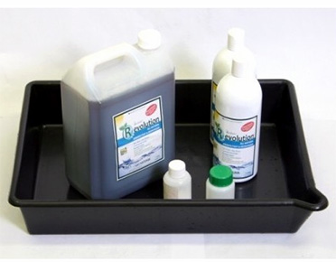
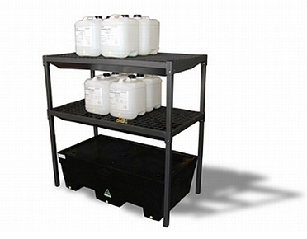
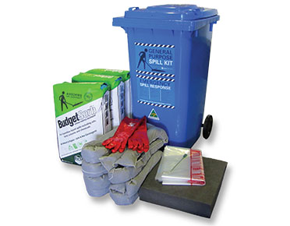


Spill Prevention and Response

Slide 84
Spill Prevention and Response
Many spills in the laboratory can be prevented. Development and implementation of good laboratory practices will significantly reduce the likelihood of spills.
A planned response to spills, including proper staging of cleanup material/equipment, will reduce the eventual costs (in injury, pollution, dollars, etc.).
Note: Advance planning is a must.
Refer to the Guide for Chemical Spill Response Planning in Laboratories prepared by the American Chemical Society's CEI/CCS Task Force on Laboratory Waste Management American Chemical Society, Washington, DC 1995.
https://www.acs.org/content/acs/en/about/governance/committees/chemicalsafety/publications/guide-for-chemical-spill-response.html

Slide 85
Spill Prevention and Response
Spill Prevention Measures
Spills can occur during a chemical's storage,
transportation, transfer, as well as in the actual use.

Slide 86
Spill Prevention and Response
Spill Prevention Measures for Storage Areas
Utilize sturdy shelves and properly designed storage areas to minimize breakage and tipping.
Store chemicals by hazard class and compatibility.
Store large containers closer to the floor.
Move containers stored on shelves sufficiently away from the shelf edge to minimize the danger of falling.
Add lips to storage shelves to reduce the danger of falling.
Conduct regular inspection of chemical storage areas and address container integrity issues promptly.

Slide 87
Spill Prevention and Response
Spill Prevention Measures During Transport
Utilize carts and containment trays.
Utilize safety containers for frequently used volatile solvents.
Utilize rubberized buckets to carry acid bottles.
Secure containers with straps.
Conduct regular training on container handling.

Slide 88
Spill Prevention and Response
Spill Prevention Measures for Liquids Transfer
Pay careful attention to the size of containers to avoid overfilling.
Utilize pumps or other mechanical devices rather than simply pouring directly into a container.
Utilize secondary containment to capture any leaks.
Follow bonding /grounding procedures when transferring flammable liquids.

Slide 89
Spill Prevention and Response
Spill Prevention Measures During Use
Secure containers (beaker, flasks, test tubes, etc.) and equipment to minimize the possibility of tipping.
Plan experimental reactions to anticipate and to provide controls for undesired outcomes such as overheating.
Provide secondary containment in the event of spills.
Check hoses and tubing for holes or leaks before use.

Slide 90
Spill Prevention and Response
Spill Prevention - General Measures
Reduce clutter and unnecessary materials.
Eliminate tripping hazards and other obstructions from aisles/walkways.
Keep containers closed, except when adding or removing contents.

Slide 91
Spill Prevention and Response
Spill Response Planning
In spite of our best efforts, spills happen. When they do, it makes sense to respond to them as carefully and efficiently as possible.
In most cases, laboratory spills involve small quantities of materials and, if precautions are taken, present minimal hazards.

Slide 92
Spill Prevention and Response
Spill Response Planning
In-house clean up is appropriate for simple spills, since trained personnel should be:
  familiar with the spilled material's hazardous characteristics
  able to respond quickly
  aware of other potential hazards or complicating factors in the spill area
  familiar with the proper cleanup procedures
Complex spills require outside assistance because of the spill's size or its unusual hazards. Never downplay the seriousness of potentially hazardous spills.
Notes:
A simple spill is defined as one that
• does not spread rapidly,
• does not endanger people or property except by direct contact, and
• does not endanger the environment.
To determine whether a spill is simple or complex (which is often the hardest part of spill response), you need to know (1) the hazard(s) posed by the spilled chemical and (2) the spill's potential impact. Both these factors are, in large part, determined by the spill's size.
Though small amounts of some chemicals pose environmental problems, most environmental risks are presented by large-quantity releases of materials. A large-quantity release that threatens the environment is not a simple spill, but requires the attention of trained responders.

Slide 93
Spill Prevention and Response
Spill Response Planning
Identify the hazards relevant to the chemicals in the school
Compose response procedures that address the hazards
Stage the equipment & materials and provide training necessary to execute the response procedures
Notes:
A. Identify the Hazards
When planning laboratory work and preparing for potential problems, determine the hazard class of all the chemicals to be used. The following chemical properties are of most concern when preparing for possible chemical spills:
• ignitability
• reactivity (to air or water)
• corrosivity
• toxicity
B. Compose Response Procedures
Spill Response Procedures should detail the initial steps to take when a spill occurs and include such elements as staff responsibilities, communication methods, instructions on using spill response materials & equipment, and spill cleanup and residue disposal.
Spill response procedures should include
• a listing of appropriate ppe, tools and materials required for spill cleanup and an explanation of their proper use
• appropriate evacuation zones and procedures
• availability of fire suppression equipment
• disposal containers for spill cleanup materials
• the first aid procedures that might be required
C. Stage Equipment & Materials and provide training
Before starting any work with chemicals, verify that all necessary safety equipment and spill cleanup materials are available and in good working order. Additionally, ensure that the individuals who may be involved in spill response are properly trained in equipment use and spill cleanup procedures. Finally, regularly inspect all materials and equipment to ensure that they will function properly when needed.

Slide 94
Spill Prevention and Response
Spill Response Planning – Cleanup steps
1. Prevent the spread of dusts and vapors.
2. Neutralize acids and bases, if necessary.
3. Control the spread of the liquid.
4. Absorb the liquid.
5. Collect the cleanup residues.
6. Containerize the wastes in preparation for disposal.
7. Decontaminate the affected area and equipment.
Notes:
An important step when determining whether a spill is "simple" is evaluating the quantity of material released. If a spilled chemical is not hazardous, its cleanup (without the assistance of an emergency response team) is dependent on the ability to control the spill, as well as the availability of sufficient spill control materials (e.g., an absorbent for liquids). Factors that may complicate a cleanup effort (such as the unique characteristics of a spill's surroundings or the restricted access to a spill) must be determined on a case-by-case basis.
The more toxic, corrosive, or flammable a material is, the less likely that the spill can be defined as "simple". Thresholds for flammable liquids and solids, as well as volatile toxics, should be relatively low. Spills of reactive chemicals should only be managed by trained responders (who may be in-house). In general, simple spill thresholds for liquids will be lower than the thresholds for solids. Additionally, simple spill thresholds for volatiles will be lower than the thresholds for non-volatiles.

Slide 95
Spill Prevention and Response
Spill Response Planning – Spill Kits
Equipment and materials designated for spill response should be placed in containers (5-gallon buckets to 55-gallon drums) that are:
  Visible
  Accessible
  Securable
  Properly sized

Slide 96
Spill Prevention and Response
Spill Response Planning – Spill Kit Components
The Kits should be stocked to address the types of spills that may occur.
  Residue Management Equipment
  Absorbents
  Personal Protective Equipment
  Special Chemicals
Notes:
Before starting any work with chemicals, verify that all necessary safety equipment and spill cleanup materials are available and in good working order. Additionally, ensure that the individuals who may be involved in spill response are properly trained in equipment use and spill cleanup procedures. Finally, regularly inspect all materials and equipment to ensure that they will function properly when needed.

Slide 97
Spill Prevention and Response
Spill Response Planning - Spill Kit Components
  Residue Management Equipment
    Whisk broom or hand-held brush
    Plastic dust pan
    Metal dust pan
    Large, sealable (e.g., ZipLoc) plastic bags
    5-gallon plastic drum liners
    5-gallon waste disposal container with lid

Slide 98
Spill Prevention and Response
Spill Response Planning - Spill Kit Components
  Absorbents
    Paper towels
    Pillows and brooms
    Sheets and pads
    Loose bulk (e.g., cat litter)

Slide 99
Spill Prevention and Response
Spill Response Planning – Spill Kit Components
  Personal Protective Equipment (PPE)
    Chemical splash goggles
    Face shields
    Gloves (appropriate for the material in the lab)
    Lab coat or aprons
    Tyvek suits
    Shoe/foot coverings

Slide 100
Spill Prevention and Response
Spill Response Planning – Spill Kit Components
  Special Chemicals
    Neutralizers (citric acid, sodium bicarbonate, etc.)
    Special reactants (chelating agents, etc.)
    Decontaminants and biostats (e.g., for blood-borne pathogen cleanup)

Slide 101
Spill Prevention and Response
Spill Response Planning – Mercury
Mercury spills rarely present an imminent hazard unless the spill occurs in an area with extremely poor ventilation. The main exposure route of mercury is via vapor inhalation. Consequently, if metallic mercury is not cleaned up adequately, the tiny droplets remaining in surface cracks and crevices may yield toxic vapors for years.
Notes:
When a mercury spill occurs, first cordon off the spill area to prevent people from inadvertently tracking the contamination over a much larger area. Generally, a special mercury vacuum cleaner provides the best method of mercury spill cleanup. DO NOT use a regular vacuum cleaner, because you will only disperse toxic vapors into the air and contaminate your vacuum cleaner. If a special mercury vacuum is not available, first use an appropriate suction device to collect the big droplets, then use a special absorbent (available from most laboratory supply vendors) to amalgamate smaller mercury droplets.
Spills exceeding 1 gram of mercury (the amount contained in a thermometer) should be cleaned by a professional environmental clean-up contractor that has the monitoring equipment to screen for mercury vapors.
Ideally, mercury spills should be prevented in the first place. Examine all uses of mercury to see if substitutes are available. If substitutes are not available, use trays or other equipment to provide spill containment. Spilled mercury often accumulates in sink traps. Be prepared to contain the mercury when servicing such facilities.

Slide 102
Reduction of Stored Chemicals
All laboratories that use chemicals inevitably produce chemical waste that must be properly removed or disposed of at an appropriate facility. It is crucial to minimize both the toxicity and the amount of chemical waste that is generated.
A waste management and reduction policy that conforms to state and local regulations should be established by the school or school district.

Slide 103
Reduction of Stored Chemicals
Several things that can be done to minimize hazards, waste generation, and control costs:
Purchase chemicals in the smallest quantity needed.
Use safer chemical substitutes/alternatives such as chemicals which have been determined to be less harmful or toxic.
Use micro scale experiments.
Chemical experiments using smaller quantities of chemicals
Consider detoxification or waste neutralization steps.

Slide 104
Reduction of Stored Chemicals
Use interactive teaching software and demonstration videos in lieu of experiments that generate large amounts of chemical waste.
Use preweighed or premeasured chemical packets (no excess chemicals remain).
  EPA’s Green Chemistry Program and the ACS Green Chemistry Institute promote the use of innovative technologies to reduce or eliminate the use or generation of hazardous substances:
  www.epa.gov/greenchemistry/
  http://www.acs.org/content/acs/en/greenchemistry.html

Slide 105
CHEMICAL MANAGEMENT PLAN – Chemical Disposal
REMINDER - Any chemical discarded or intended to be discarded is a “chemical waste.”
Defining Hazardous Waste
Hazardous chemical waste as designated by the Environmental Protection Agency (EPA) or State authority is waste that presents a danger to human health and/or the environment.
The law regulates various chemicals and their activities from “cradle to grave” - from the point they are generated as hazardous waste until they are properly destroyed, incinerated, or landfilled.

Slide 106
CHEMICAL MANAGEMENT PLAN – Chemical Disposal
To be a hazardous waste, the waste must first be classified as a solid waste.
A solid waste is defined as any solid, liquid, or contained gaseous material that is being disposed, discarded, incinerated, recycled, or is inherently waste-like.
Once a solid waste has been identified, the next step is to determine if it is a hazardous waste, which can be accomplished by deeming the waste as a “characteristic waste” or a “listed waste.”

Slide 107
CHEMICAL MANAGEMENT PLAN – Chemical Disposal
According to EPA regulations, there are four characteristics that define a waste as hazardous:
Ignitability
Corrosivity
Reactivity
Toxicity
If you require further assistance in determining your hazardous waste status, contact your local PADEP Office and request the Waste Management Section.
http://www.dep.pa.gov/About/Regional/Pages/default.aspx#.VrTWJvMo4dV

Slide 108
CHEMICAL MANAGEMENT PLAN – Chemical Disposal
Storing Chemical Waste
Store all waste in containers that are in good condition and are compatible with their contents.
Clearly and permanently label each container as to its contents and label as hazardous waste (refer section titled How Should Chemical Containers Be Labeled? for specific information).
Store waste in a designated area away from normal laboratory operations and to prevent unauthorized access.

Slide 109
CHEMICAL MANAGEMENT PLAN – Chemical Disposal
Store waste bottles away from sinks and floor drains.
Do not completely fill waste bottles; leave several inches of space at the top of each waste container.
Cap all waste bottles and/or containers.

Slide 110
CHEMICAL MANAGEMENT PLAN – Chemical Disposal
Disposal Warnings
HAZARDOUS WASTES SHOULD NEVER BE DUMPED IN ANY DRAINS, SEPTIC TANKS, OR STORM SEWERS.
DO NOT MIX HAZARDOUS WASTES TOGETHER.
DO NOT MIX NONHAZARDOUS WASTE WITH HAZARDOUS WASTE - in doing so you only create more hazardous waste, which creates higher disposal costs.

Slide 111
CHEMICAL MANAGEMENT PLAN – Universal Waste Rule
Purpose of the Universal Waste Rule
In 1995, in order to facilitate hazardous waste recycling, the EPA established simplified regulations for gathering and disposal of certain broadly generated waste, designated as universal waste.
These wastes are subject all hazardous waste regulations, and they are not required to be calculated as hazardous waste when determining a school’s generator status.

Slide 112
CHEMICAL MANAGEMENT PLAN – Universal Waste Rule
Substances Included Within the Universal Waste Rule
Universal wastes identified in the Rule are listed below.
Hazardous waste batteries
Fluorescent lamps
Mercury-containing devices (thermostats, thermometers, etc.)
Pesticides that have been retracted, put on hold, or gathered for discarding
Oil-based finishes
Photographic solutions

Slide 113
A Case Study of Environmental, Health & Safety Issues Involving the Burlington, MA Public School System
"Tips, suggestions, and resources for investigating and resolving EHS issues in Schools"
prepared by
Todd H. Dresser, Environmental Engineer
formerly of Burlington Board of Health
EPA Point of Contact: Gary Bertram
http://eric.ed.gov/?id=ED460571

Slide 114
Abstract
An investigation was initiated concerning the environmental health within the Burlington, Massachusetts public school system to determine what specific environmental hazards were present and determine ways of eliminating them. This report presents 20 case studies that detail the environmental health issues involved, the approaches taken in investigating each problem, observations on conditions contributing to the hazard's development, the actions taken to eliminate the hazard, the lessons learned, and tips and suggestions concerning preventive management. Each case study concludes with advice on resources that can be used to help schools in investigating and eliminating each environmental hazard. Hazards investigated include the following: chemicals; asbestos; indoor air quality; pesticides; radioactive materials; fire prevention; radon; formaldehyde; safety equipment; spill and emergency response planning; underground storage tanks; and discharges to sanitary drains.

Slide 115
Table of Contents
Introduction
1.Chemical management and usage
2.Asbestos management
3.Indoor air quality
4.Pesticide usage
5.Mercury management and exposure prevention
6.Radioactive materials
7.Fire prevention
8.Pollution prevention
9.Hazardous waste generation and management
10.Formaldehyde
11.Radon
12.Chemical fume hoods
13.Eye washes and deluge showers
14.Safety equipment
15.Hazards/issues by department
16.Spill and emergency response plans
17.Ceramic kilns
18.Underground storage tanks
19.Lasers in the classroom
20.Discharges to the sanitary drains

Slide 116
Introduction
In 1992, I began an extensive review of environmental, and health and safety (EHS) issues involving the Burlington, Massachusetts public school system. During this evaluation, I have investigated and researched a broad variety of concerns and potential problems outlined in the table of contents. Many of the conditions I encountered represented significant safety hazards or potential environmental problems. While attempting to research and resolve these problems, I also noted a lack of readily available guidance for identifying EHS issues in schools as well as a hesitancy by regulatory agencies to get involved with school issues.
Based on this premise, I intend to report the results of my ongoing evaluation so that it may be used as a guide by parents, staff, and public officials when reviewing EHS issues in their school system. I believe the snapshot provided by this report is consistent to the types and severity of problems that could be found in schools nation wide. I urge all of you to consider the results reported here and to review these issues at your schools. Even though some of the anecdotes I will report may suggest otherwise, our story is a success story in that we have made the effort to identify the concerns and to take action to correct the problems. I hope this study will enable you to do the same.
I plan to provide a general description of the issues I have reviewed. My intent is to provide the layman with an understanding of the issue, potential problems associated with the issue, tips and suggestions for assisting the evaluation, and lessons I have learned. I will also provide information describing some of the resources I have utilized during this effort.

Slide 117
Chemical Management & Usage - Summary
A series of explosions and fires prompted the Burlington Board of Health (BOH) in 1992 to initiate a comprehensive review of chemical storage, usage, and disposal within the Burlington public school system. This section provides a summary of BOH findings as well as brief discussions of several recent hazardous materials incidents involving local schools. The discussion has been divided into areas of interest related to various sections of the school department (e.g. subsections related to the high school art and science departments). In addition, tips, suggestions, lessons learned, and a listing of potentially useful resources have also been provided to assist the reader in conducting a similar assessment at their school.
Significant observations noted during the chemical hygiene assessment process included:
the discovery of chemical hazards at all grade levels
b) a long-term practice of accepting chemical donations had caused the high school to
become a potential disposal option for local industry
c) prior to this investigation little effort was exerted to determine environmental, or
health and safety considerations associated with chemical usage within the classroom

Slide 118
Chemical Management & Usage – Summary cont.
Major achievements resulting from this activity have included:
  the removal of approximately 80 drums of hazardous chemicals which included radioactive materials, explosives, controlled narcotics, and poisonous gases
  b) the establishment of formal chemical disposal practices
  c) the creation of chemical review procedures
These efforts have enabled BOH to improve the safety of the students and faculty, improve indoor air quality, promote the proper disposal of hazardous waste, and to strive for enhanced regulatory compliance.

Slide 119
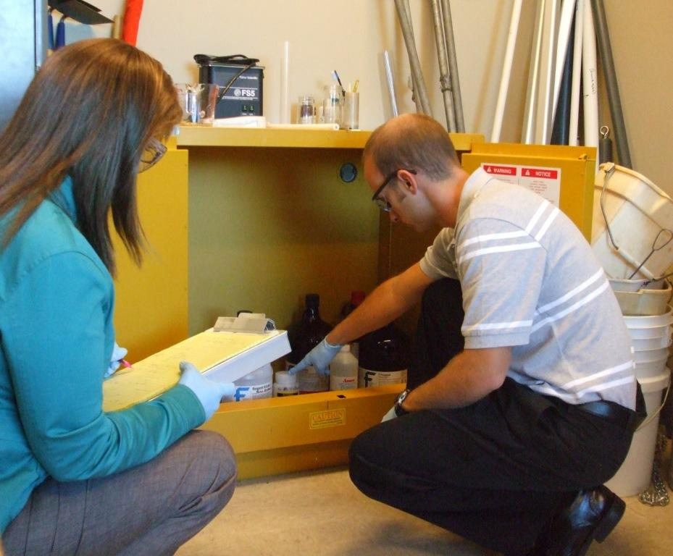
SAFETY DURING INVENTORY

Slide 120
Safety During the Inventory
Wear appropriate personal protective equipment (PPE) when conducting the inventory. This should include closed-toe shoes, safety glasses, and latex or nitrile exam gloves (at a minimum).
The chemical inventory should only be performed by personnel who have adequate knowledge and experience with chemical safety and use. Students should not be permitted to perform the chemical inventory. Make a note of any such hazardous conditions on the inventory form.
Chemicals may pose risks because of their hazardous characteristics (flammability, corrosivity, reactivity or toxicity) and/or because their containers and contents may have deteriorated over time. Chemicals that have become shock-sensitive or containers that have become pressurized or damaged can cause serious injuries.

Slide 121
Safety During the Inventory
Don’t move bulging, leaking, or deteriorated containers, unless you are sure it is safe. Don’t move any container that contains crystals in a liquid or both liquid and solid phase chemical. These are potentially explosive and should be left alone.
Don’t attempt to open any unidentified solvent bottles, or bottles that contain any of the peroxide-forming chemicals.
During the inventory, you will likely have to move and turn some chemical containers to be able to read the label. A flashlight and small mirror should be on hand to enable you to read labels on the backs of containers that are not safe to move, and to see items in the back of storage cabinets.

Slide 122
Safety During the Inventory
Always have a telephone or other means of communication handy to summon help in the event of a spill or emergency. Review the written spill response plan that includes a list of emergency phone numbers.
Also note the locations of the nearest emergency eyewash and shower before starting the inventory in each area.
Wear appropriate personal protective equipment (PPE) when conducting the inventory. This should include closed-toe shoes, safety glasses, and latex or nitrile exam gloves (at a minimum).

Slide 123
Safety During the Inventory
The chemical inventory should only be performed by personnel who have adequate knowledge and experience with chemical safety and use. Students should not be permitted to perform the chemical inventory. Make a note of any such hazardous conditions on the inventory form.

Slide 124
PENNSYLVANIA DEPARTMENT OF
ENVIRONMENTAL PROTECTION
Schools Chemical Cleanout Campaign (SC3)
2016
Application
The Excel Workbook will contain the following worksheets:

Slide 125
WORKSHEET NO. 1
Registration Information
This worksheet contains basic information related to your school and the contact person whom, if the school is selected, will be actively involved in the SC3 Cleanout Project. Please complete all of the information related to your school’s name, location, mailing address, and school district information. Information is also requested relating to your school’s population, curriculum, and facility information. If your school is selected for this project, the emergency contacts will need to be present on the day that the chemical cleanout will take place.

Slide 127
WORKSHEET NO. 2
Questionnaire
This worksheet asks a series of questions related to your school’s current chemical management practices, policies, and procedures. You may need to solicit information from several sources, in order to answer all the questions presented. Please include a description of the corresponding conditions, as well as you can. The more detail you provide, the better we will be able to evaluate your school’s needs.

Slide 128


Slide 129
WORKSHEET NO. 3
Chemical Inventory (Known)
This worksheet is an inventory form to be used to list all of the chemicals found in your school classrooms and throughout the school buildings. Please solicit information throughout your school, including teachers and school staff who may utilize chemicals, mercury-containing equipment or thermometers from nursing areas and science departments, and materials used in vocational or technical programs (e.g., art classes). A listing of common chemicals and their CAS Registry Number can be found at:
http://oaspub.epa.gov/enviro/tri_lookups.tri_cas_lookup.

Slide 130
NOTE
This project will not accept waste coming from the maintenance of vehicles. This includes waste oil, cleaning solvents and other chemicals used for maintenance. The project will not accept bulk containers or other wastes generated by maintenance operations, such as solvents, floor cleaning solutions, waxes, etc. The intent of this project is to help schools clean out excess hazardous and dangerous chemicals (primarily coming from chemistry and the science departments). Furthermore, all bulk containers of waste pesticides will need to be arranged through the Pennsylvania “CHEMSWEEP Program”. If you have waste pesticides needing disposal, please see information on the following website:
http://www.agriculture.state.pa.us/portal/server.pt/gateway/PTARGS_0_2_24476_10297_0_43/http;/10.41.0.36/AgWebsite/ProgramDetail.aspx?name=CHEMSWEEP-Waste-Pesticide-Disposal-Program&navid=12&parentnavid=0&palid=108&

Slide 131
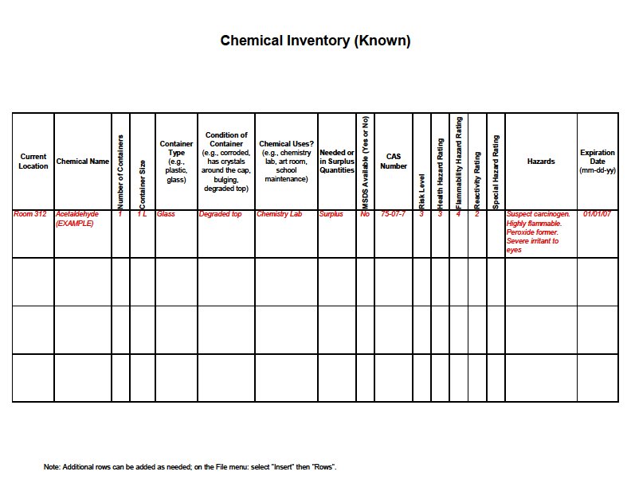

Slide 132
WORKSHEET NO. 4
Chemical Inventory (Unknown)
This worksheet is an inventory form for any chemicals or bottles you may come across that are difficult to identify. In these instances, record as much information as you can safely collect from the substance and/or its container.
Then refer to Mystery Substance Identification The Identification of Unlabeled Chemicals Found on School Premises published by Flinn Scientific, Inc.. It provides a step-by-step procedure for classifying substances for disposal.
https://www.flinnsci.com/media/755029/mystery.pdf

Slide 133
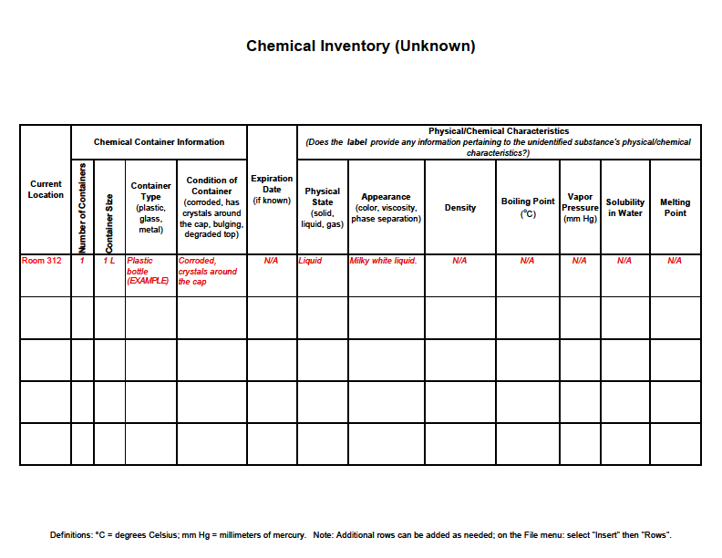

Slide 134
Lessons Learned
Communication
Coordination
Preparation

Slide 135
2011 Summary of Waste

Slide 136
Kevin M. Beer
Environmental Group Manager kbeer@pa.gov 717.787.6052
Schools Chemical Cleanout Campaign: http://www.dep.pa.gov/Business/Land/Waste/SolidWaste/HazardousWaste/Minimization/Pages/Schools-SC3.aspx#.VrOsVfMo4dU

