Slide 1
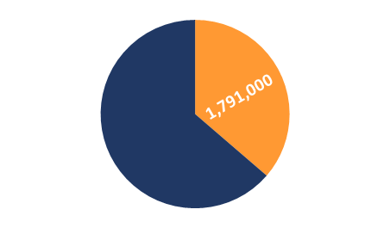
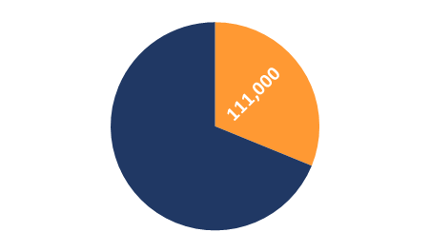
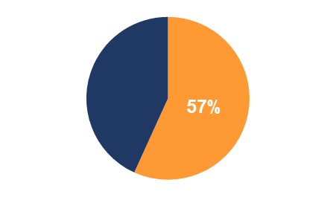
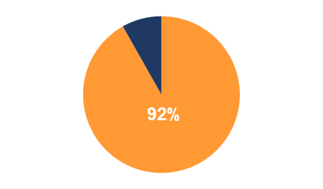
PHASE 3 WIP COUNTY SNAPSHOTS
www.dep.pa.gov
Countywide Action Plan Snapshot
Bedford County, Pennsylvania
Current Conditions
Bedford County is one of 34 counties in Pennsylvania's Chesapeake Bay Watershed that have developed Countywide Action Plans. Current loading rates are 4.93M lbs of nitrogen and 355K lbs of phosphorus annually. By 2025 Bedford County needs to reduce 1.8M lbs of nitrogen and 110K lbs of phosphorus.
Nitrogen (N)
Current Load (lbs):
4,930,000
Phosphorus (P)
Current Load (lbs):
355,000
Planning
Target (lbs)
Reduction
Goal (lbs)
Planning Target (lbs): 3,139,000
Reduction Goal (lbs): 1,791,000
Planning Target (lbs): 245,000
Reduction Goal (lbs): 110,000
Pollutant Reduction Progress
By 2025, Bedford County needs to reduce 1.8M lbs of nitrogen and 110K lbs of phosphorus. Bedford County has developed a plan to reduce 1.02M lbs of nitrogen, which is 57% of the goal and 101K lbs of phosphorus, which is 92% of the goal.
Nitrogen (N)
Reduction Goal (lbs):
1,791,000
Phosphorus (P)
Reduction Goal (lbs):
110,000
Remaining
Reduction
Nutrient
Reduction
Progress
Reduction Progress: 1,017,000 lbs
Reduction Progress: 101,000 lbs
Sector Reductions
Bedford County has identified reductions within all five sectors within their planning template: agriculture, developed, natural, septic and wastewater. Bedford County has identified practices that result in total reductions of 1.02M lbs of nitrogen and 101K lbs of phosphorus.
Sector | Nitrogen (lbs.) | Phosphorus (lbs.)
Agriculture | -905,000 | -65,000
Developed | -10,000 | -600
Natural | -90,000 | -37,000
Septic | -200 | -
Wastewater | -12,000 | -900
Total Reductions | -1,017,000 | -101,000
Data is from CAST19 and progress year 2019

Slide 2
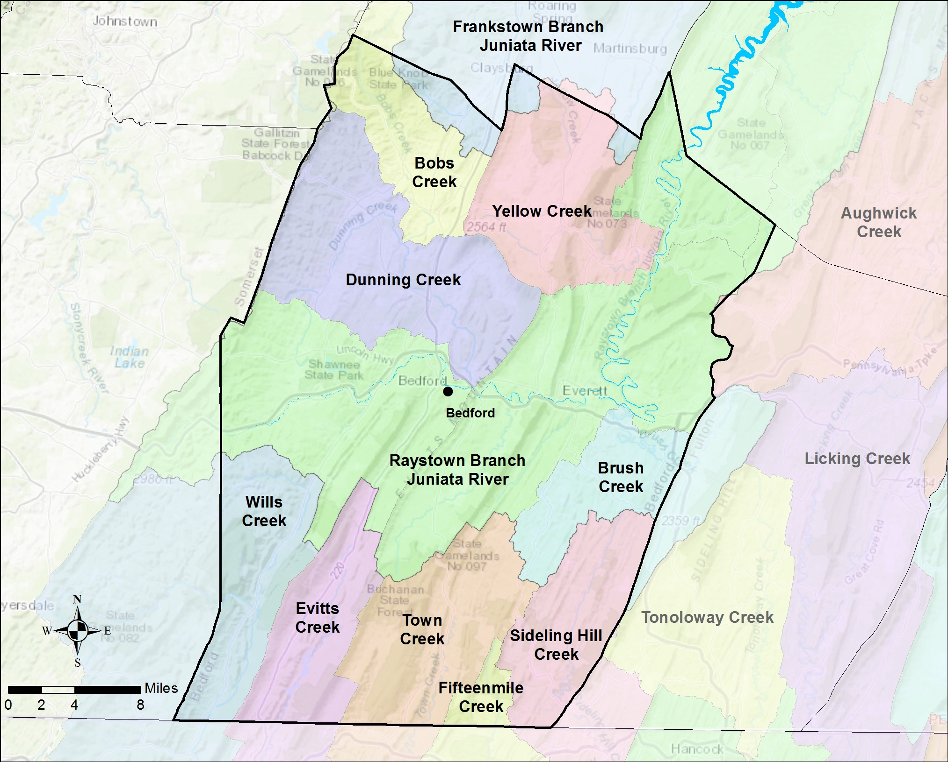
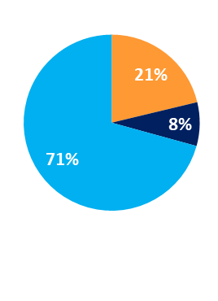
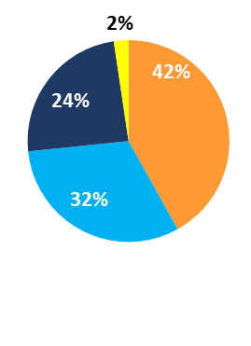
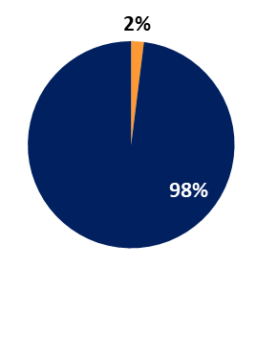
PHASE 3 WIP COUNTY SNAPSHOTS
www.dep.pa.gov
Bedford County Watershed Map
Information About the Watersheds
Bedford County contains 9 major watersheds: Bobs Creek, Yellow Creek, Dunning Creek, Raystown Branch Juniata River, Brush Creek, Wills Creek, Evitts Creek, Town Creek, and Sideling Hill Creek. Watersheds in Bedford County have elevated levels of nitrogen, phosphorus, and sediment. Of the 2,466 total stream miles in Bedford County, approximately 13% have degraded aquatic communities due to causes such as disturbance, siltation (excessive sediment), metals, nutrient pollution and others.
County Land Use:
Bedford County has a total acreage of
649,504 acres in the Bay watershed. Agricultural land represents 21% of the total land with 138,029 total acres. Developed land represents another 8% of the total land
in Bedford County. Natural land, which is made up of forests, stream, and wetlands, represents the remaining 71% of the land
in Bedford County. Cropland makes up a majority of the Agriculture sector with 57,835 acres. The developed sector is mostly Non- Municipal Separate Storm Sewer Systems (MS4s) (98%) 51,101 acres and a smaller portion of MS4s (2%) 1,032 acres.
Bedford County:
Total Acres: 649,504
Agriculture:
Total Acres: 138,029
Developed:
Total Acres: 52,133
Local Benefits:
Storm events are the number one way for nutrients and sediment to enter waterways. Increased runoff impacts: flooding, water quality, habitat, etc. Pollutants enter the waterways by two methods: overland runoff or leaching into groundwater.
Flooding affects safety, property, infrastructure, and economics.
Bedford County relies on local water sources to supply drinking water to its residents.
Just like humans, Bedford County’s livestock depend on clean water.
Learn more and Get Involved
To learn more about the Countywide Action Plans, visit DEPs Countywide Action Plans website: dep.pa.gov/cap

