Slide 1
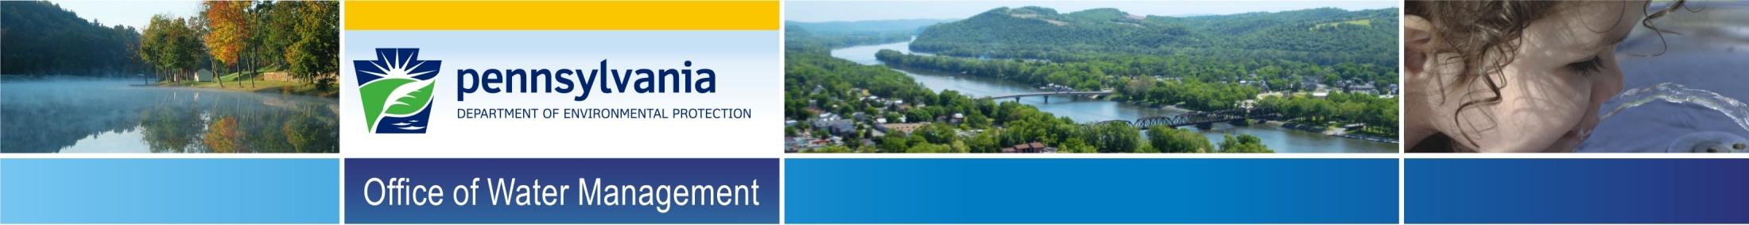
Module 14: Conventional Filtration
Drinking Water Plant Operator Certification Training
Notes:
Power point presentation for module 14, subclass 1 study material.

Slide 2

Welcome!
Please silence cell phones.
Notes:
Introductions and housekeeping (restrooms, phones, lunch).

Slide 3
Unit 1 – Conventional Water Treatment Overview
Unit 2 – Mixing, Coagulation, and Flocculation
Unit 3 – Sedimentation/Clarification
Unit 4 – Filtration
Unit 5 – Operation of Conventional Filtration Facilities
Notes:
Course overview

Slide 4
Unit 1 – Conventional Water Treatment Overview
Learning Objectives
Understand the purpose for Conventional Water Treatment and relevant regulations
Use vocabulary appropriate to conventional filtration of water in discussing the process.
Follow the Typical Process Flow Diagram and identify the four major conventional filtration processes.
Notes:
Turn to page 1-2 to begin.

Slide 5
Purpose for Conventional Water Treatment
The primary purpose for Conventional Water Treatment is to comply with the Environmental Protection Agency (EPA) and Pennsylvania Department of Environmental Protection (Pa. DEP) regulations requiring filtration as a mandatory "treatment technique" for all surface water supplies.
Conventional Filtration also assists with production of safe drinking water.
Notes:
Beginning on 1-2, discuss turbidity and relevant regulations. Page 1-5 discusses safe drinking water production.

Slide 6
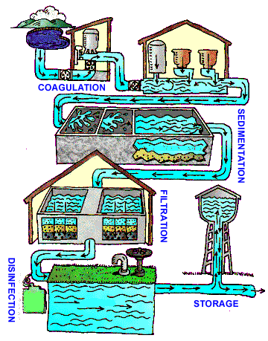
Terms and Definitions
Source: EPA
Notes:
Briefly review the terms and definitions on page 1-5 and 1-6.
Picture source: http://water.epa.gov/learn/kids/drinkingwater/watertreatmentplant_index.cfm

Slide 7
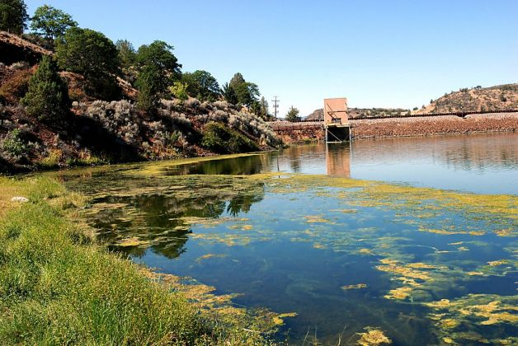
Source Water
Notes:
Beginning on page 1-8, source water is introduced
Surface water supplies can be divided into river, lake and reservoir supplies.
Note the picture on slide 8 is a reservoir supply which is experiencing an algae bloom.
Discuss that it may be possible to eliminate or control water quality programs in domestic water supply lakes and reservoirs through a water quality management program. For example, copper sulfate pentahydrate (CuSO₄ .5 H₂O) can be used for controlling algal growths in domestic water supply lakes and reservoirs.

Slide 8
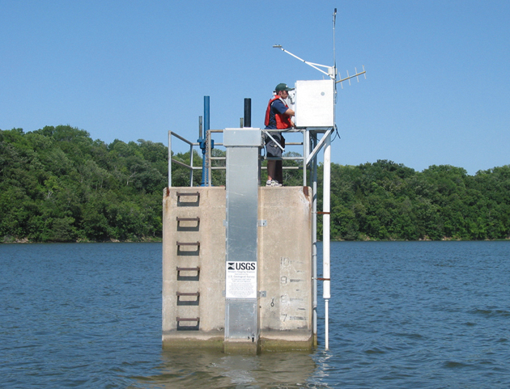
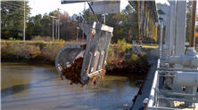
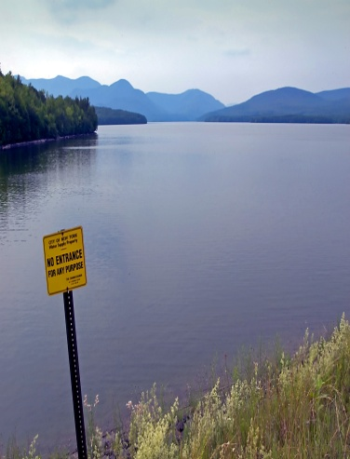
Intake Structures
Notes:
Intake structures found on page 1-8

Slide 9
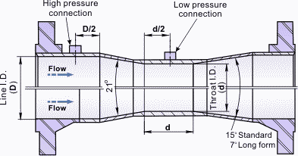
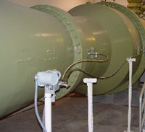
Flow Measurement
Venturi meter consists of a tube whose diameter gradually decreases to a throat and then gradually expands to the diameter of the intake pipe.
Notes:
Page 1-9 discusses common flow meter technologies used to measure potable water flow in large pipes: Venturi and magnetic flow measurement systems.
Review questions are on slides 10-14. Give students time to complete, then

Slide 10
Unit 1 Exercise
    Combined filter effluent turbidity must be below:
      0.3 NTU in at least 95% of the turbidity measurements taken and 1.0 NTU at all times
      1.0 NTU in at least 95% of the turbidity measurements taken and 1.5 NTU at all times
      0.3 NTU in at least 95% of the turbidity measurements taken and 0.5 NTU at all times
      0.5 NTU in at least 95% of the turbidity measurements taken and 1.0 NTU at all times

Slide 11
Unit 1 Exercise
    Typical sources of turbidity in raw water sources include:
      Humic acids and other organic compounds resulting from decay of plants, leaves
      High iron concentrations which give waters a rust-red coloration
      Heavy rains flushing into a water reservoir
      All of the above

Slide 12
Unit 1 Exercise
    National Secondary Drinking Water Regulations:
      Are focused on treatment goals that are below the regulatory Primary Maximum Contaminant Levels for those contaminants that present health risks based on acute or chronic exposure
      Are guidelines regulating contaminants that may cause cosmetic effects (such as skin or tooth discoloration) or aesthetic effects (such as taste, odor, or color) in drinking water
      Both A and B
      None of the above

Slide 13
Unit 1 Exercise
    4. Venturi and magnetic flow measurement systems are used to:
  Regulate the rate at which water flows into the water treatment plant
  Measure the rate at which water flows into the water treatment plant
  Monitor the chemical which flow into the water treatment plant
  All of the above

Slide 14
Unit 1 Exercise
Vocabulary Review
  Across Down
    3. Coagulation 1. Turbidity
    6. Flocculation 2. Conventional
    7. Sedimentation Filtration
    8. Floc 4. Clarification
    10. Colloids 5. Disinfection
    9. Sludge

Slide 15
Key Points
Turn to page 1-13 to summarize the unit key points.
Notes:
Instructor Note: Refer to page 1-13 for Unit 1 key points

Slide 16
Unit 2 – Mixing, Coagulation, and Flocculation
Learning Objectives
List the major chemicals used in the coagulation process and explain their importance to the process.
Explain the importance of flocculation to conventional filtration.
List two types of mechanical flocculators in common use.
Notes:
Page 2-1 starts unit 2

Slide 17
Mixing
Notes:
Page 2-2: Point out that the coagulant should be added just in front of the mixer (mechanical or static). Also discuss that watching floc formation at this point is important, floc that is too large may be caused by chemical addition at the wrong point.

Slide 18
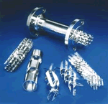
Hydraulic Mixing
Notes:
Note that this is often called Static Mixing.

Slide 19
Propeller – type Mixer

Slide 20
Coagulant Chemicals
There are a variety of primary coagulants which can be used in a water treatment plant:
Primary Coagulants
Metallic salts
Aluminum Sulfate (Alum)
Ferric Sulfate
Ferric Chloride
Synthetic inorganic polymers
Polyaluminum Chloride
Notes:
Page 2-5, discuss effective pH of each primary coagulant, noting that a pH over 9.0 could result in increased dissolved aluminum when using aluminum sulfate.

Slide 21
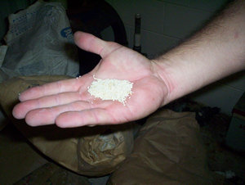
Coagulant Aids
Coagulant aids are added to the water during the coagulation process to:
  Improve coagulation
  Build a stronger, more settleable floc
  Overcome slow floc formation in cold water
  Reduce the amount of coagulant required

Slide 22
Choosing Coagulant Chemicals
Based on raw water conditions including:
  pH
  Alkalinity
  Water Temperature
  Turbidity
Notes:
Page 2-7, discuss how:
The optimum pH depends on the specific coagulant.
Low alkalinity causes poor coagulation. Therefore it may be necessary to add lime, soda ash or caustic soda to add/replace alkalinity and pH during the coagulation process.
Low water temperatures slow chemical reactions. Polymers, Bentonite Clay and coagulant aids can be added to assist floc formation in cold water.
Difficult to form floc with low turbidity water, may need to add weighting agents.

Slide 23
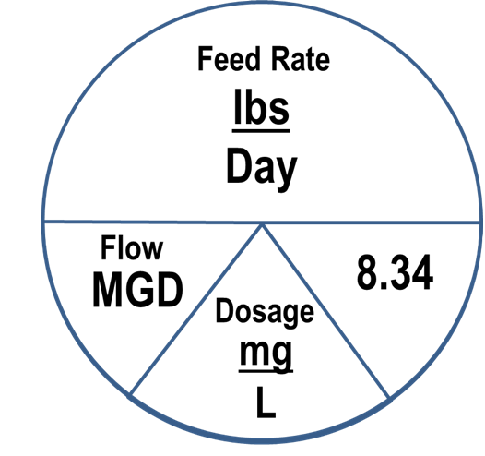
Example 2.1 – Dosage Calculation
Calculate the dosage (mg/L), if 1500 pounds of dry Alum are required to treat 15 - MGD of water.
Dose = (lbs/day)
Flow x 8.34
mg = 1500 lb/day
L (15 x 8.34)
= 12 mg/l
1500
15
Notes:
Work will appear on click. Second click, the Davidson’s Pie Chart will appear.
Completed by using the Davidson Pie Chart or rearranging the “pounds formula”.
Lbs = Flow x Dose x 8.34
Day
Dose = (lbs/day)
Flow x 8.34

Slide 24
Example 2.2 – Dosage Calculation
A system treated 875,000 gallons of water using 100 pounds of lime. Calculate the lime dosage in mg/L.
First must convert volume from gallons to million gallons = 875,000 = .875
1,000,000
mg = 100 lb/day
L (0.875 x 8.34)
13.7 mg/l
100
.875
Notes:
Work will appear on click. Second click, the Davidson’s Pie Chart will appear.
Completed by using the Davidson Pie Chart or rearranging the “pounds formula”
Lbs = Flow x Dose x 8.34
Day
Had to convert volume from gallons to million gallons
Dose = (lbs/day)
Flow x 8.34

Slide 25

Hazard Communication Safety Data Sheets
The Hazard Communication Standard requires chemical manufacturers, distributors, or importers to provide Safety Data Sheets communicate the hazards of hazardous chemical products.
Notes:
Discuss how the Safety Data Sheet (SDS) provides information with regard to how corrosive and reactive caustic soda is and makes it very evident that if caustic comes in contact with skin, burns will result. Therefore wearing personal protective equipment like gloves, goggles and respirators are important with all chemicals used in water treatment.
Discuss how the SDS provides information like the density of chemicals which is necessary for accurate determination of chemical dosages.

Slide 26

Chemical Containment
Notes:
Discuss how a concrete barrier around chemical storage or a portable container as demonstrated in figure 2.8 are examples of secondary containment.
Discuss how a spill response procedure in an ERP can ensure employees are prepared and know what actions must be taken and what material will be needed during a chemical spill.

Slide 27
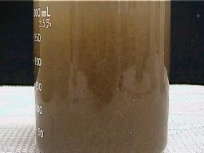
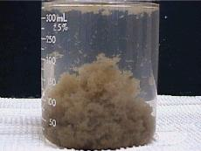
Floc Formation
The goal of flocculation is to promote growth of flocs to a size that can be removed by sedimentation and filtration.
Notes:
This visual shows how collisions of the microfloc particles cause them to bond and produce larger, visible flocs.

Slide 28
Calculating Theoretical Detention Time
Theoretical Detention Time Formula:
Detention Time (time) = Volume of Tank (gallons)
Influent Flow
Units of time should match

Slide 29
Example 2.3 – Flocculation Detention Time Calculation
The flow to a flocculation basin that has a volume of 36,670 gallons is 1930 gpm. What is the detention time in the tank, in minutes?
Detention Time (time) = Volume of Tank (gallons)
Influent Flow
= 36,670 gallons
1930 gpm
= 19 minutes
Notes:
Work appears on click

Slide 30
Example 2.4 – Flocculation Detention Time Calculation
A flocculation basin receives a flow of 2,830,000 gpd. System prints indicate the basin holds 60,915 gallons. Assuming the flow is steady and continuous, what is the flocculation basin detention time in minutes?
Need the units to match (flow given in gpd, question wants answer in minutes).
So convert 2,830,000 gpd to gpm = 2,830,000 gpd ÷1440 = 1965 gpm
Determine the detention time:
Detention Time (time) = Volume of Tank (gallons)
Influent Flow
= 60,915 gallons
1965 gpm
= 31 minutes
Notes:
First step appears on first click.
Second step appears on second click.

Slide 31
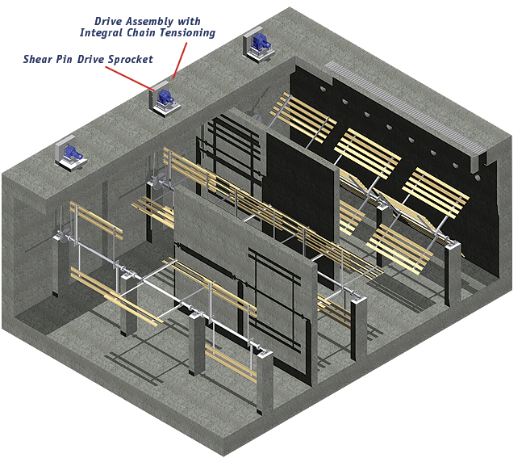
Stirring
Notes:
Discuss how stirring can be problematic:
Insufficient stirring or stirring too slowly can prevent particles from clumping enough and will result in ineffective collisions and poor floc formation.
Excessive stirring or stirring too fast, may tear apart flocculated particles after they have clumped together. Once flocs have been torn apart, it is difficult to reform to their optimum strength and size.
Slow stirring can cause floc particles to settle out prematurely.

Slide 32
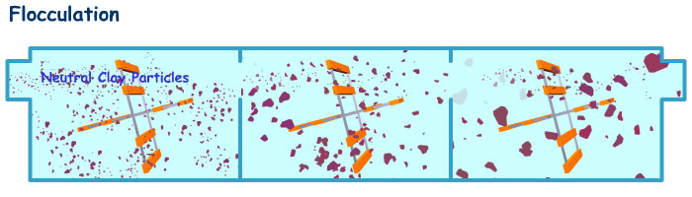
Multiple Stage Flocculation
The floc is getting larger and larger as it passes from stage to stage.
The mixing intensity is generally reduced as flow passes through the compartments.
Notes:
Discuss how the floc is getting larger and large as it passes from stage to stage.
Discuss how the paddle speeds could be adjusted; each step the particles get bigger and the paddles move slower (but not so slow that the floc particles settle out prematurely). This helps prevent breaking larger floc particles after they have formed.

Slide 33
Unit 2 Exercise
List the primary coagulants (3 metallic salts and 1 synthetic inorganic polymer) used in the coagulation process.
Aluminum Sulfate Ferric Sulfate
Ferric Chloride Polyaluminum Chloride
In the space provided, explain the importance of coagulant aids—synthetic organic polymers.
Coagulant Aids strengthen and add density to the flocs.
Notes:
Instructor Note: Turn to Unit 2 exercise on page 2-16 and 2-17. Answers are on slides 33-38.

Slide 34
Unit 2 Exercise
List three types of chemicals that can be used to add or replace alkalinity or pH.
Lime, soda ash, caustic soda.
True 9. True 14. True 19. False
False 10. True 15. True 20. False
True 11. True 16. True 21. True
False 12. True 17. True 22. False
False 13. True 18. False

Slide 35
Unit 2 Exercise
A system treats 845,000 gallons of water using 25 pounds of calcium hydroxide (slaked lime) every day. What is the dose?
  1.42 mg/L
  3.55 mg/L
  7.11 mg/L
  9.23 mg/L

Slide 36
Unit 2 Exercise
A system uses 225 lbs of dry polymer as coagulant aid each day to treat a plant flow set at 3,260,000 gpd. What is the dose?
  576.33 mg/L
  103.27 mg/L
  8.33 mg/L
  4.21 mg/L

Slide 37
Unit 2 Exercise
If the plant flow is set at 350,000 gallons and the system uses 12 pounds of anhydrous ferric chloride, what is the dose?
  4.11 mg/L
  411 mg/L
  2.86 mg/L
  286 mg/L

Slide 38
Unit 2 Exercise
The flow to a flocculation basin is 399,000 gpd. The basin holds 11,550 gallons. What is the detention time in the tank, in minutes?
  33 minutes
  35 minutes
  37 minutes
  39 minutes

Slide 39
Unit 2 Key Points
Turn to pages 2-18 and 2-19 to summarize the unit key points.

Slide 40
Unit 3 – Sedimentation/Clarification
After this unit, you’ll be able to:
List five operating parameters important to sedimentation.
Identify the four zones of a sedimentation basin.
Given the formula and required data, calculate each of the following: detention time, surface loading rate, mean flow velocity, and weir loading rate.
Explain why tube or plate settlers increase settling efficiency.
Identify five characteristics upon which the sedimentation process is dependent.
Notes:
Turn to page 3-2.

Slide 41
After coagulation and flocculation comes sedimentation.
Seven basic factors:
Particle Size
Gravitational Settling
Particle Shape
Relationship of Downward Movement of Particle to Forward Flow Velocity
Water Temperature
Electrical Charge on Particles
Environmental Conditions

Slide 42
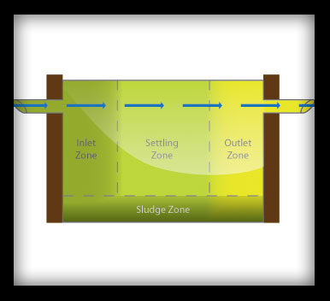
Short Circuiting
Notes:
Discuss how short circuiting in the sedimentation may occur; the water is not evenly distributed across the width of the basin and floc does not have enough time to settle.
Discuss the 4 zones of the sedimentation basin.

Slide 43
Example 3.1 – Sedimentation Detention Time Calculation
A water treatment plant treats a flow of 1.5 mgd. It has 2 sedimentation basins, each 20 feet wide by 60 feet long, with an effective water depth of 12 feet. Calculate the Theoretical Sedimentation Detention Time (in hours) with both basins in service.
1. Determine the volume of both basins:
Volume = Length x Width x Depth
60 feet x 20 feet x 12 feet = 14,400 ft³ for 1st basin x 2 = 28,800 ft³ for both basins
28,800 ft³ x 7.48 (gallons conversion) = 215, 424 gallons
2. Determine the detention time:
Detention Time = Volume of Tank (gallons)
Influent Flow *
= 215,424 gallons
1,500,000 gpd (note: 1.5 mgd = 1,500,000 gpd)
= 0.144 day
3. Convert day to hours: hours = 0.144 day x 24 hour = 3.45 hours
day
Notes:
Step 1 = first click
Step 2 = second click
Step 3 = third click

Slide 44
Example 3.2 – Surface Overflow Rate Calculation
A water treatment plant treats a flow of 1.5 mgd. It has 2 sedimentation basins, each 20 feet wide by 60 feet long, with an effective water depth of 12 feet. Calculate the Surface Overflow Rate in gallons per minute per square foot of surface area (gpm/ft²) for the treatment plant with both basins in service.
1. Convert the mgd to gpm:
gpm = 1.5 mgd x 1,000,000 = 1042 gpm
1440
2. Determine the area of both basins:
Area = Length x Width = 60 feet x 20 feet = 1200 ft²
x 2
2400 ft²
3. Plug into Surface Loading Rate Equation:
Surface Loading Rate (flow/ft²) – Flow Rate = 1042 gpm
Surface Area, ft² 2400 ft²
= 0.43 gpm/ft²
Notes:
Step 1 = first click
Step 2 = second click
Step 3 = third click

Slide 45
Example 3.2 – Mean Flow Velocity Calculation
A water treatment plant treats a flow of 1.5 mgd. It has 2 sedimentation basins, each 20 feet wide by 60 feet long, with an effective water depth of 12 feet. Calculate the Mean Flow Velocity in feet per minute for one of the sedimentation basins, assuming both basins are in service and there is equal flow distribution to each basin.
1. Convert the mgd to gpm:
gpm = 1.5 mgd x 1,000,000 = 1042 gpm (both basins)
1440
One basin 1042 gpm = 521 gpm
2
2. Cross Sectional Area = Width x Depth - 20 feet x 12 feet = 240 ft²
3. Plug into Mean Flow Velocity Formula:
Mean Flow Velocity =
flow = 521 gpm = 0.29 ft/min
Cross Sectional Area, ft² x 7.48 gal/ft³ 240 ft² x 7.48 gal/ft³
=
Notes:
Step 1 = first click
Step 2 = second click
Step 3 = third click

Slide 46
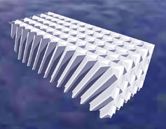
Tube or Plate Settlers
Notes:
Discuss how tube or plate settlers are high rate sedimentation equipment developed to increase settling efficiency. A specific example would include lamellar plates.

Slide 47
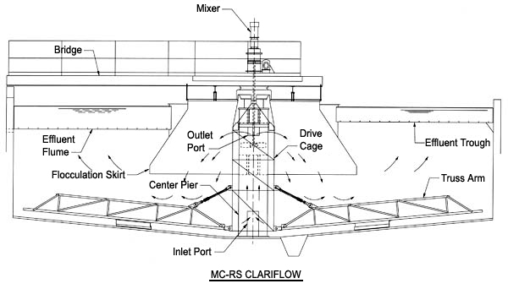
Specialized Processes

Slide 48
Example 3.3 – Weir Loading Rate Calculation
A rectangular sedimentation basin has a total of 95 feet of weir. What is the weir loading rate in gpm/ft when the flow is 763 gpm?
Weir Loading Rate = Flow, gpm
Weir Length
= 763, gpm
95 ft
= 8.0 gpm/ft
Notes:
Work comes up on a click.
Slides 49-55 are answers to unit exercises. Give students time and then review.

Slide 49
Unit 3 Exercise
1. Identify the four zones of a sedimentation basin.
c – Inlet zone
g – Outlet zone
p – Sludge zone
q – Settling zone
2. List four operating parameters important to sedimentation.
d – Detention time
o – Surface loading rate
r – Mean flow velocity
s – Weir loading rate

Slide 50
Unit 3 Exercise
3. List the settling characteristics upon which the sedimentation process is dependent.
a – Water temperature
d – Gravitational settling
k – Electrical charge of particle
b – Particle size
f – Particle shape
l – Environmental conditions
h – Relationship of downward movement of particle to forward flow velocity

Slide 51
Unit 3 Exercise
4. The largest portion of the horizontal flow sedimentation basin is the settling zone.
5. If the motor is normally running and the sludge collector is not moving, the most likely cause of a clarifier sludge collector problem would be that a shear pin is broken.
6. A sludge collector device should move very slowly.
7. Increase flow to the treatment plant will affect the settling tank in that the detention time will decrease and the overflow rate will increase.

Slide 52
Unit 3 Exercise
A series of thin parallel plates installed at 45-degree angle for shallow depth sedimentation are known as lamellar plates.
Two methods of improving settling efficiency in a sedimentation basin are using tilted plates or tube settlers.
If the weir overflow rate for a clarifier is too high, floc carry over will be observed.
Improper coagulant dosage and/or improper pH, could cause floc carry over.
When increasing the flow rate, the weir overflow rate for the clarifier will be increased.

Slide 53
Unit 3 Exercise
13. A sedimentation basin is 65 feet long, 20 feet wide and has water to a depth of 12 feet. If the flow to the basin is 1297 gpm, what is the detention time in hours?
First Step:
1. Determine the volume of the basin:
Volume = Length x Width x Depth
65 feet x 20 feet x 12 feet
15,600 ft³ for the first basin
x 7.48 gallons conversion factor
116,688 gallons
Notes:
This is a three step problem. Step 2 is on slide 54 and step 3 is on slide 55.

Slide 54
Unit 3 Exercise
Second Step:
Determine the detention time:
Detention Time (time) =
Volume of Tank (gallons)
Influent Flow
= 116,688 gallons
1297 gpm
= 90 minutes

Slide 55
Unit 3 Exercise
Third Step:
Convert min to hours:
hours = 90 min x hour = 1 hour 30 minutes
60 min

Slide 56
Unit 3 Key Points
Turn to page 3-16 to summarize the unit key points.

Slide 57
Unit 4 – Filtration
After this unit, you’ll be able to:
Define filtration as it relates to water treatment.
Identify the four performance considerations of Filtration.
Given the formula and required data, calculate each of the following: filtration rate and backwash rate.
Explain the importance of good record keeping.

Slide 58
Filtration
Notes:
Instructor Note: Advance to next slide.

Slide 59
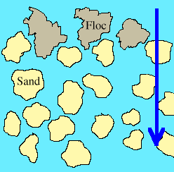
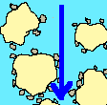
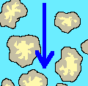
Removal Processes
Straining Adsorption Absorption

Slide 60
Rate of Flow Controller
Filter control systems regulate flow rates by maintaining adequate head above the media surface.
Constant Rate
Declining Rate

Slide 61
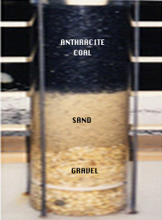
Filter Media
The filter media is the part of the filter which actually removes the particles from the water being treated.
Applying the layer of anthracite provides a higher
filtration rate and a longer filter run time than sand alone.

Slide 62
Media Classification
Effective Size
Uniformity Coefficient
Specific Gravity
Hardness

Slide 63
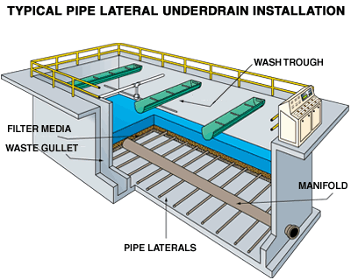
Filter Underdrains

Slide 64
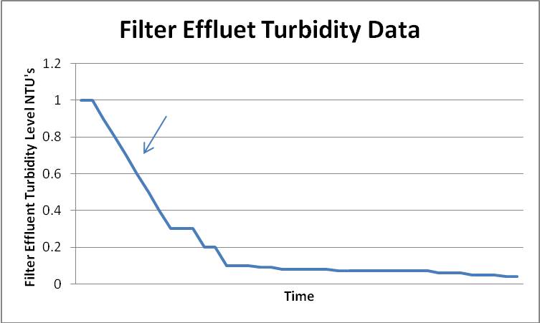
Filter Ripening
Filter Ripening Period
Notes:
Discuss that ripening can be thought of as a process in which floc particles that are passing through the clean bed are captured and released and recaptured by the filter media.
Options to Reduce Filter Ripening Time:
Delayed start-up or filter resting (allow the filter to rest before start-up).
Slow start-up where a freshly washed filter is started at a slower filter rate and eventually brought up to full rate.
Filter aid addition where a chemical like an anionic polymer or a coagulant is added to the influent of the filter. (The addition of the anionic polymer can increase head loss on filters.)
Filter to waste (one of the most common techniques of eliminating the turbidity spike directly after a filter backwash is to filter to waste during the filter ripening period).
Pay careful attention to backwash so that beds are not overly cleaned.

Slide 65
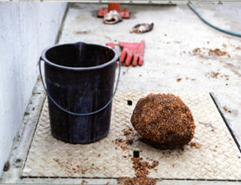
Filter Problems
Mud balls: A small agglomerate of floc and filter media which form on the surface of filters which can grow in size during a filter cycle.
  Air Binding: Caused by the release of dissolved gases from the water in the filter or under drain or if the water in the filter bed is drawn down below the filter surface.
Notes:
Discuss how mud balls result in shortened filter run times and loss in filter capacity since water will not pass through the mud balls and must flow around them.
Discuss how air binding can also be caused by allowing the filter to run too long and that the air prevents water from uniformly passing through the filter.

Slide 66
Example 4.1 – Filter Capacity Calculation
What is the filter capacity of a system if the sand bed has a surface area of 700 sq ft and the filters are rated to have a capacity of 3 gpm/sq ft (in gpm)?
Filter Capacity = Filtration Rate x Surface Area
= 3 gpm x 700 sq ft
sq ft
= 2,100 gpm
Notes:
Work appears on click.

Slide 67
Example 4.2 – Filter Capacity Calculation
The surface of a filter is 15 feet long and 10 feet wide. What is the rated total capacity for a rate of 5 gpm/sq ft?
Step 1 – Determine the surface area.
Area = Length x Width
= 15 ft x 10 ft
= 150 sq ft
Step 2 – Determine the filter capacity.
Filter Capacity = Filtration Rate x Surface Area
= 5 gpm x 150 sq ft
sq ft
= 750 gpm
Notes:
Step 1 appears on first click.
Step 2 appears on second click.

Slide 68
Example 4.3 – Filtration Rate Calculation
A rapid sand filter has a surface area of 150 sq ft. If the flow through the filter is 312 gpm, what is the filter loading rate in gpm/sq ft?
Filtration ₌ Flow Rate, gpm
Rate Filter Area, sq ft
₌ 312 gpm
150 sq ft
= 2.08 gpm
sq ft
Notes:
Work appears on click.

Slide 69
Example 4.4 – Filtration Rate Calculation
Determine the filter loading rate of a filter 35 feet in diameter treating a flow of 3000 gpm.
Step 1 – Determine the surface area.
Area = 0.785 x D²
= 0.785 x (35 ft)²
= 961.63 sq ft
Step 2 – Determine the filter loading rate.
Filtration ₌ Flow Rate, gpm
Rate Filter Area, sq ft
= 3000 gpm
961.63 sq ft
= 3.12 gpm/sq ft
Notes:
Step 1 appears on first click.
Step 2 appears on second click.

Slide 70
Backwashing
When to Backwash
Gallons filtered or when a specified time period has passed indicates the need to backwash.
Head loss on the filter may be used to indicate the need to backwash.
An increase in the cleanliness or cloudiness (turbidity) of the water coming out of the filter.
Notes:
Discuss in a bit more detail how head loss can be used to indicate the need for backwash: as the filter gets clogged, more negative pressure is created. The more clogged the filter, the more resistant to the flow as it passes through the filter media. The more resistance, the greater the head loss which can be measured on a differential pressure gauge.

Slide 71
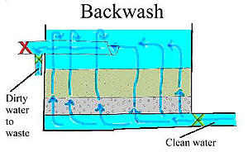
Backwash Process
Notes:
Discuss how the influent valve is closed and a waste line is opened. A backwash pump or tower forces treated (finished) water from the system back up through the filter bed. The dirty backwash water is collected by the wash troughs and can be recycled to the beginning of the plant or can be allowed to settle in a tank, pond, or basin.
Discuss how the backwash rate is the flow rate at which the filter is backwashed and is usually expressed in gallons per minute per square foot of filter surface area, or the backwash pumping rate in gallons per minute. Too high of a flow rate can result in excessive loss of filter media.

Slide 72
Example 4.5 – Backwash Rate Calculation
A filter 26 feet wide by 30 feet long needs a backwash rate of 18 gallons per minute per square foot. Determine the required backwash pumping rate in gpm.
Step 1 – Determine the surface area.
Area = Length x Width
= 30 ft x 26 ft
= 780 sq ft
Step 2 – Determine the Backwash Pumping Rate, gpm
= FilterArea, sq ft x Backwash rate, gpm/sq ft
= 780 sq ft x 18 gpm/sq ft
= 14,040 gpm
Notes:
Step 1 appears on first click.
Step 2 appears on second click.

Slide 73
Example 4.6 – Backwash Rate Calculation
A fitler is 40 ft long and 20 ft wide. If the desired backwash rate is 20 gpm/sq ft, what backwash pumping rate (gpm) will be required?
Step 1 – Determine the surface area.
Area = Length x Width
= 40 ft x 20 ft
= 800 sq ft
Step 2 – Determine the Backwash Pumping Rate, gpm =Filter Area, sq ft x Backwash rate, gpm/sq ft
= 800 sq ft x 20 gpm/sq ft
= 16,000 gpm
Notes:
Step 1 appears on first click.
Step 2 appears on second click.
Slides 74 to 89 are the answers to unit 4 exercises. Give students time and then review.

Slide 74
Unit 4 Exercises
Filter Media - The materials used to filter out impurities.
Filter Underdrains - Where filtered water is collected during normal operation.
Filter Operating Parameters - Filter production and efficiency
Backwashing - The process of reversing the flow of water back through the filter media to remove trapped material.

Slide 75
Unit 4 Exercises
List two ways filters can become air bound.
Allowing the filter to run too long
Release of dissolved gases from water in the filter
Water is drawn down below the filter surface
6. How can a system achieve longer filter run times?
By applying a layer of anthracite to the filter

Slide 76
Unit 4 Exercises
The removal of particulates by trapping in the open space between the grains of the media:
  Straining
  Adsorption
  Biological Action
  Absorption

Slide 77
Unit 4 Exercises
The measurement used to define the uniformity of filter media:
  Specific Gravity
  Hardness
  Uniformity Coefficient
  All of the above

Slide 78
Unit 4 Exercises
One of the most common techniques of eliminating the turbidity spike directly after a filter backwash is to filter to waste during the:
  End of a timed backwash
  Filter ripening period
  Middle of a timed backwash
  None of the above

Slide 79
Unit 4 Exercises
Ways to reduce filter ripening time:
  Delayed start-up
  Filter aid addition like an anionic polymer or coagulant
  Filter to waste
  All of the above

Slide 80
Unit 4 Exercises
A problem in a filter that can prevent water from uniformly passing through a filter:
  Well formed floc
  Mudballs
  Air binding
  Both b and c

Slide 81
Unit 4 Exercises
A method used to indicate when a filter needs backwashed:
  Time
  Head loss
  Increase in effluent turbidity (breakthrough)
  All of the above

Slide 82
Unit 4 Exercises
Backwash rates set too high:
  This is not a problem
  Can cause loss of filter media
  Will not adequately expand the filter bed
  All of the above

Slide 83
Unit 4 Exercises
A backwash normally uses _____________ of treated water produced (finished water).
  1-2%
  2-5%
  6-8%
  8-10%

Slide 84
Unit 4 Exercises
A filter 35 feet wide by 20 feet long needs a backwash rate of 20 gallons per minute per square foot. Determine the required backwash pumping rate in gpm.
  12,000 gpm
  13,000 gpm
  14,000 gpm
  15,000 gpm

Slide 85
Unit 4 Exercises
What is the filter capacity (in gpm) of a system with a sand bed 40 feet in diameter when the filters are rated to have a capacity of 2.5 gpm/sq ft?
  78.5 gpm
  250 gpm
  1,500 gpm
  3,140 gpm

Slide 86
Unit 4 Exercises
A system has filters that measure 25 feet long and 15 feet wide. What is the rated total capacity at a rate of 2 gpm/sq ft?
  250 gpm
  500 gpm
  750 gpm
  1,000 gpm

Slide 87
Unit 4 Exercises
Determine the filter loading rate of a filter 20 feet in diameter treating a flow of 1500 gpm.
  4.8 gpm/sq ft
  9.8 gpm/sq ft
  15.1 gpm/sq ft
  95.2 gpm/sq ft

Slide 88
Unit 4 Exercises
A filter 25 feet long and 35 feet wide treats a total of 1400 gpm. What is the filter loading rate?
  1.6 gpm/sq ft
  3.2 gpm/sq ft
  3.4 gpm/sq ft
  9.8 gpm/sq ft

Slide 89
Unit 4 Exercises
A filter has a diameter of 35 feet. If the desired backwash rate is 25 gpm/sq ft, what backwash pumping rate (gpm) will be required?
  687 gpm
  1,508 gpm
  12,761 gpm
  24,041 gpm

Slide 90
Unit 4 Key Points
Turn to pages 4-24 and 4-25 to summarize the unit key points.

Slide 91
Unit 5 – Operation of Conventional Filtration Facilities
After this unit, you’ll be able to:
Identify the five components of Normal Operations.
Explain the importance of “jar testing” and describe how the test is performed.

Slide 92
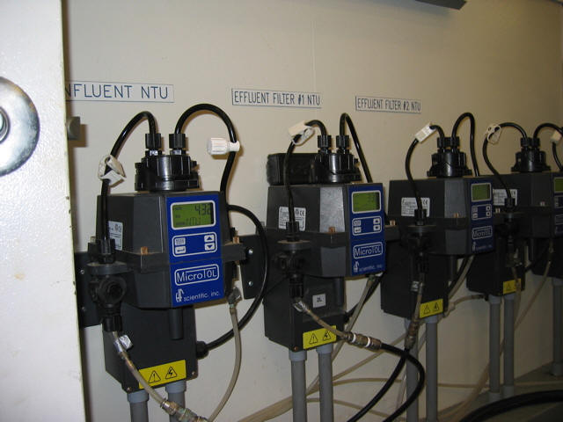
Monitoring Methods
Monitoring process performance is an ongoing, regular activity of plant operators.
Early detection of a pre-treatment failure is extremely important to effective filtration performance.

Slide 93
Monitor Filtration Process
Filter influent turbidity or, settled water turbidity.
Filter effluent turbidity or filtered water turbidity.
Headloss - measures solids accumulation in the filter bed. It is the resistance to flow as it passes through a filter.

Slide 94
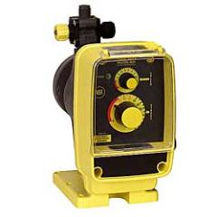
Process Support Equipment
Plant operators must operate and maintain support equipment in accordance with manufacturer’s recommendations:
Filter control valves
Backwash and surface wash pumps
Chemical feed pumps
Air scour blowers
Flow meters and level/pressure gauges
Water quality monitoring equipment (turbidimeters)
Process monitoring equipment (head loss and filter level)
Sludge drying: Sludge drying beds and sludge filter presses
Notes:
Discuss chemical feed pump maintenance:
Chemical feed pumps like positive displacement diaphragm pumps need calibrated and monitored on a regular basis.
Any leak throughout the system will cause a reduction in the amount of chemical solution pumped which could effect floc formation or settling.
For example, if the pump looks to be operating, but the chemical feed is less than expected, suspect a ruptured diaphragm.

Slide 95
Changes in Source Water Quality
Increases or decreases in source water:
  turbidity
  Alkalinity
  pH
  temperature
Can greatly affect floc formation.
Notes:
Slides 96 to 98 are unit 5 review questions. Give students time and then review together.

Slide 96
Unit 5 Exercises
Write the 5 components of Normal operations of conventional filtration on the lines below.
1.Process Performance Monitoring
2.Process Controls and Equipment
3.Process Support Equipment
4.Housekeeping
5.Laboratory Testing
Notes:
Give students time to complete the exercises then review using slides.

Slide 97
Unit 5 Exercises
Circle all of the following which are indicators of abnormal operating conditions.
9. Increased filtered water turbidity
12. Media cracks and shrinkage
13. Mud balls
14. Rapid filter headloss increase
15. Short filter runs

Slide 98
C. True/False
17. T
18. F
19. T
20. T
21. T
22. T
24. T
25. F
26. F

Slide 99
Unit 5 Key Points
Turn to page 5-20 to summarize the unit key points.

Slide 100
Review
Slides 101 to 155 are module review questions.
All questions are multiple choice and there is only one correct answer.
Notes:
Instructor: The correct answer will change from black font to red font on “click”.

Slide 101
Review Question
Typical sources of turbidity in raw water sources include:
  Heavy rains
  High iron concentrations
  Waste discharges
  All of the above

Slide 102
Review Question
To remove turbidity from water, systems rely heavily on:
  Coagulation and sedimentation
  Sedimentation and filtration
  Mixing and flocculation
  Filtration and chlorination

Slide 103
Review Question
Combined filter effluent turbidity must be below ______ NTU in at least 95% of the turbidity measurements taken and combined filter effluent turbidity must be below ______ NTU at all times.
  0.5 NTU, 1.0 NTU
  0.8 NTU, 3 NTU
  0.3 NTU, 1.0 NTU
  0.5 NTU, 0.3 NTU

Slide 104
Review Question
Turbidity in drinking water can be a problem because:
  It is not a problem
  Can provide food and shelter for pathogens
  Can promote re-growth of pathogens in the distribution system
  Both b and c

Slide 105
Review Question
Stage I Disinfectants and Disinfection Byproduct Rule sets maximum disinfectant residual concentrations for chlorine, chloramines, and chlorine dioxide at:
  2.0 mg/L, 2.5 mg/L, and 0.8 mg/L respectively
  4.0 mg/L, 4.0 mg/L, and 1.0 mg/L respectively
  4.0 mg/L, 4.0 mg/L, and 0.8 mg/L respectively
  2.0 mg/L, 2.5 mg/L, and 1.0 mg/L respectively

Slide 106
Review Question
Interim Enhanced Surface Water Treatment Rule:
  Regulating contaminants that may cause cosmetic effects or aesthetic effects in drinking water.
  Requires disinfection of all water supplies.
  Strengthened filter effluent turbidity requirements.
  All of the above

Slide 107
Review Question
To control algal growths in domestic water supply lakes and reservoirs, a system can add:
  CuSO₄ .5 H₂O
  CaPO₄ .5 H₂O
  C₂H₄O₂
  NaOCl
Notes:
CuSO₄ .5 H₂O = copper sulfate

Slide 108
Review Question
By using a Venturi rate of flow meter, a system:
  Is able to adjust chemical feed rates
  Is able to calculate detention times
  Is able to monitor the amount of water being treated
  All of the above

Slide 109
Review Question
River, lake and reservoir supplies:
  Should never be used as a source for drinking water
  Are subject to seasonal changes in water quality
  Are unsafe for domestic use unless properly treated including filtration and disinfection
  Both b and c

Slide 110
Review Question
Employees must be trained on ___________ procedures before performing maintenance:
  Lock-out/tag-out
  The Surface Water Treatment Rule
  Filter backwash
  All of the above

Slide 111
Review Question
A _____________is a chamber that contains mechanical stirrers, which is designed to assure fast, thorough, mixing of lime and alum for the purpose of creating floc.
  Exothermic mixer
  Flash mixer
  Bed stirrer
  Rotator

Slide 112
Review Question
Alum addition should be done:
  After the static mixer
  With the static mixer
  Prior to the static mixer
  In the flocculation basic

Slide 113
Review Question
Which of the following is a primary coagulant:
  Aluminum Sulfate
  Bentonite Clay
  Activated Silica
  Organohalogens

Slide 114
Review Question
A waters alkalinity must be considered when using Alum and Ferric since every 1 mg/L will consume ____ mg/L or _____ mg/L alkalinity (as CaCO₃) for coagulation (respectively).
  0.05, 0.75
  0.5, 0.92
  0.25, 0.65
  0.75, 0.75

Slide 115
Review Question
The flash mix, or rapid mix process, occurs just _______ coagulation chemicals are added to the raw water.
  before
  after

Slide 116
Review Question
Raw water conditions to consider when choosing a coagulant chemical include:
  pH and Alkalinity
  Turbidity
  Water Temperature
  All of the above

Slide 117
Review Question
Optimal effective pH range of Aluminum Sulfate:
  4.5-6.5
  5.5 – 7.5
  5.0 – 8.5
  over 9.0

Slide 118
Review Question
Chemicals used to add density to slow-settling floc and to strengthen floc formation:
  Coagulant aids
  Flocculants
  Oxidizers
  None of the above

Slide 119
Review Question
Systems with low turbidity water may need to add __________ to form floc.
  Baffles
  Weighting Agents
  Organic Matter
  Aeration

Slide 120
Review Question
______________ coagulants in general consume considerably less alkalinity than alum.
  Polyphosphate (state not a coagulant, sequestering agent or corrosion control chemical)
  Polyhalogenated
  Polyethylene
  Polyaluminium

Slide 121
Review Question
Low alkalinity causes poor coagulation. The addition of _________ can increase alkalinity and help coagulation.
  Lime
  Caustic Soda
  Soda Ash
  All of the above

Slide 122
Review Question
Calculate the dosage (mg/L), if 150 pounds of dry Alum are required to treat 1.5 - MGD of water.
  12
  120
  415
  834
Notes:
On the first click, the Davidson’s Pie Chart will come up as a hint on how to solve the problem. On the second click, the answer will appear.

Slide 123
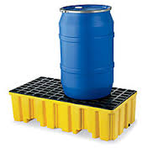
Review Question
A second barrier or an outer wall of a double enclosure which will contain any leak or spill from a storage container is an example of:
  Primary Restriction
  Secondary Enforcement
  Secondary Containment
  Primary Containment
Notes:
First click answer changes color, second click a picture of secondary containment appears.

Slide 124
Review Question
Required information for accurate determination of chemical dosages:
  Chemical Feed
  Plant Flow
  Chemical Density
  All of the Above

Slide 125
Review Question
A system treated 1,750,000 gallons of water using 250 pounds of lime. Calculate the lime dosage in mg/L.
  12 mg/l
  17 mg/l
  1700 mg/l
  1200 mg/l
Notes:
On the first click, the Davidson’s Pie Chart will come up as a hint on how to solve the problem. On the second click, the answer will appear.

Slide 126
Review Question
Safety Data Safety Sheets (previously MSDS) provide information on:
  Chemical Handling and Storage
  Chemical Composition/information on ingredients
  A and B
  None of the Above

Slide 127
Review Question
Equipment worn to minimize exposure to serious workplace injuries and illnesses:
  PPE
  FFA
  NIOSH
  All of the above

Slide 128
Review Question
50% NaOH solution:
  is corrosive to the skin
  may cause a severe burn
  may be damaging to the eyes
  All of the above

Slide 129
Review Question
Collisions of microfloc particles:
  Cause a sheering effect where particles break apart
  Cause particles to bond and produce larger, visible flocs
  Produce unstable particles that will not settle out
  Should be treated with additional coagulant

Slide 130
Review Question
Large particles that settle out in the flocculation basis:
  Indication that system is producing well-formed/good size floc
  Indication that system is functioning as designed
  Indicates floc reached optimum size and strength before making it to the sedimentation process
  Both A and B

Slide 131
Review Question
An Emergency Response Plan:
  Is not necessary in a water filtration plant
  Is a list of guidelines used to permit the release of chemicals
  Can ensure employees are prepared and know what actions must be taken and what materials will be needed during a chemical spill
  All of the above

Slide 132
Review Question
Slow stirring is a key aspect of the flocculation process, however stirring too slowly:
  Is not a problem and can only help the process
  can prevent particles from clumping enough and will result in ineffective collisions and poor floc formation
  can cause ineffective collisions that produce perfectly formed floc
  may tear apart flocculated particles after they have clumped together

Slide 133
Review Question
Flocculation paddle speeds can be adjusted and with each step the particles get bigger, therefore the paddle speed should:
  Stay the same
  Move faster
  Move slower
  Never adjust the paddle speed

Slide 134
Review Question
Floc formation is controlled by:
  The effectiveness of coagulation
  The effectiveness of collisions in promoting attachment between particles
  The rate at which collisions occur
  All of the above

Slide 135
Review Question
Tapered-energy mixing:
  Flocculation using one large compartment where the mixing intensity is increased as the flow passes
  Flocculation using baffled, smaller compartments where the mixing intensity is reduced as flow passes
  Sedimentation using one large compartment where the mixing intensity is increase as the flow passes
  Sedimentation using one large compartment where the mixing intensity is increase as the flow passes

Slide 136
Review Question
Short-circuiting occurs when:
  Water bypasses the normal flow path through the sedimentation basin and reaches the inlet of the flocculation basin in less than the normal detention time.
  Water bypasses the normal flow path through the flocculation basin and reaches the inlet of the sedimentation basin in less than the normal detention time.
  Water flows through the entire sedimentation basin and reaches the inlet of the flocculation basin in the theoretical detention time.
  Water flows through the entire flocculation basin and reaches the inlet of the sedimentation basin in the theoretical detention time.

Slide 137
Review Question
A system has a sedimentation basin that has a volume of 1,250,000 gallons. The plant flow is currently set at 4 MGD. What is the theoretical detention time?
  0.013 hours
  0.3125 hours
  2 hours 15 minutes
  7 hours 30 minutes
Notes:
Detention Time = Vol/Flow so 1,250,000/4000000 = 0.3125 day
Convert day to hours and minutes = 0.3125 x 24 = 7.5 or 7 hours 30 minutes

Slide 138
Review Question
High rate sedimentation equipment developed to increase settling efficiency would include:
  Techtonic Plates
  Lamella Plates
  Nazca Plates
  All of the above

Slide 139
Review Question
Particles carried through and out of the basin can be referred to as:
  Sedimentation Discharge
  Flocculation Cross Over
  Floc Carry Over
  Rechargeable Floc

Slide 140
Review Question
The rate at which settled water passes over the basin effluent weirs or orifices:
  Weir Loading Rate
  Upflow Clarifier Rate
  Contact Flow Rate
  Velocity Rate

Slide 141
Review Question
Used to prevent sudden flow increases or surges throughout the filter bed:
  Filter control system
  Multistage Clarifier
  Surge Resistant Filter
  All of the above

Slide 142
Review Question
A higher filtration rate and a longer filter run time can be achieved by applying:
  A layer of polyphosphate to filter media
  A coating of silica to filter media
  A layer of anthracite filter media
  Both a and b

Slide 143
Review Question
Typical filter media characteristics include:
  Effective Size
  Uniformity Coefficient
  Specific Gravity
  All of the Above

Slide 144
Review Question
One of the most common techniques of eliminating the turbidity spike directly after a filter backwash is to:
  Spray filter with fresh water before returning to service.
  Filter to waste during the filter ripening period.
  Apply a coating of orthophosphate sequestering agent to filter media.
  Press filter media

Slide 145
Review Question
Reduce filter ripening time by:
  Allow the filter to rest before start-up
  Slow start-up where a freshly washed filter is started at a slower filter rate and eventually brought up to full rate.
  Filter aid addition where a chemical like an anionic polymer or a coagulant is added to the influent of the filter.
  All of the above

Slide 146
Review Question
Added subsequent to or simultaneously with a primary coagulant, prior to flocculation, or prior to filtration (as a filter aid):
  Biomes
  Anthracite
  Polymer
  Antiseptic

Slide 147
Review Question
Adding polymer or coagulant to backwash water can:
  Reduce ripening time of filters
  Agitate filters
  Produce mud balls in filters
  Help in clear well settling time

Slide 148
Review Question
________________monitoring of filtered water is done to indicate that pathogenic organisms such as Giardia and Cryptosporidium are being removed during the filtration process.
  Phosphate
  Turbidity
  Algae
  Fragment

Slide 149
Review Question
What is a small agglomerate of floc and filter media which forms on the surface of filters and can grow in size during a filter cycle?
  Conglomerates
  Particulates
  Media Ball
  Mud Ball

Slide 150
Review Question
Air binding can be caused by:
  the release of dissolved gases from the water in the filter or under drain
  the water in the filter bed is drawn down below the filter surface
  allowing the filter to run too long
  all of the above

Slide 151
Review Question
What is the filter capacity of a system if the sand bed has a surface area of 1,200 sq ft and the filters are rated to have a capacity of 4 gpm/sq ft (in gpm)?
  4,800 gpm
  2,400 gpm
  1,200 gpm
  300 gpm
Notes:
Filter Capacity = Area X Capacity = 1200 x 4 = 4,800 gpm

Slide 152
Review Question
What is the filter loading rate in gpm/sq ft of a filter 35 feet long by 20 feet wide treating a flow of 2,800 gpm?
  0.25
  1
  2
  4
Notes:
Filter Loading Rate = flow/area = 2,800/(35x20) = 4

Slide 153
Review Question
Method used to determine when to backwash a filter:
  Gallons filtered or when a specified time period has passed
  Head loss on the filter
  An increase in the cleanliness or cloudiness (turbidity) of the water coming out of the filter
  All of the above

Slide 154
Review Question
How does water temperature affect settling rates?
  Colder Water = Faster Settling
  Colder water = Slower Settling
  Warm water = Slower Settling
  No affect

Slide 155
Review Question
When evaluating jar test results, evaluate results using:
  A visual analysis
  A turbidity analysis
  Only B
  Both A and B

Slide 156
Questions?
Evaluations
Thank you for your time.

