Slide 1

Module 8: Distribution Systems
Drinking Water Plant Operator Certification Training

Slide 2
Topical Outline
Unit 1 – Introduction to Operator Certification
Unit 2 – Distribution Networks
Unit 3 – Distribution Storage
Unit 4 – Water Quality and Monitoring

Slide 3
Unit 1 – Intro to Operator Certification
Learning Objectives
Introduce distribution operator certification regulations.
Discuss operator certification continuing education requirements.
Discuss intended results of certification regulations.
Identify the use of process control decisions and standard operating procedures.

Slide 4
Operator Certification Act
Water and Wastewater Operator Certification Program Regulations
  Establishes standards for operator certification, recertification, certification renewal and security training;
  Certification Board has the authority to give certification approval.

Slide 5
Unit 1 Wrap-Up
Key Points on Page 1-4
Exercise on Page 1-5

Slide 6
Unit 2 – Distribution Networks
Learning Objectives
  Identify the key components of a distribution network and describe the primary purpose or function of each component.
  Define the relationship among pressure, head, and hydraulic grade line.
  Outline the relationship between distribution system customers’ demands and their effects on distribution system performance.

Slide 7
Distribution System Layout

Slide 8
Typical Customer Service Connection
Service lines are used to convey water from the distribution network to individual system customers.
A corporation stop or shut-off valve is typically located at the connection of the service line and distribution pipe.

Slide 9
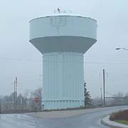
Storage Facilities
Help offset fluctuations in system demands
Help minimize fluctuations in system pressure
Elevated tanks are used to provide pressure in distribution systems
Provide reserve volumes of water to help meet fire flow needs
Provide an emergency source of supply for the system

Slide 10
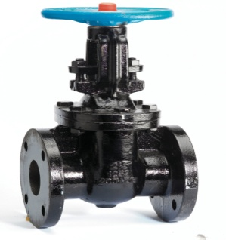
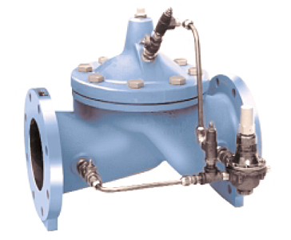
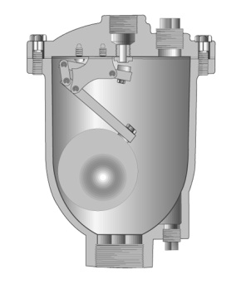
Valves
Isolation Valves
The most commonly used isolation valve is the gate valve.
Control Valves
Altitude valves are types of flow control valves that control flow in and out of storage facilities based on water level.
Air Release Valves
Used to eliminate air from a distribution network or to allow air into a distribution network.

Slide 11
Typical Isolation Valve Locations

Slide 12
Valve Operation
# of turns = (Diameter of the valve (in inches) x 3) + 3
Valve Size | Number of Turns
4 inch | 14½
8 inch | 27
12 inch | 38½
16inch | 53

Slide 13
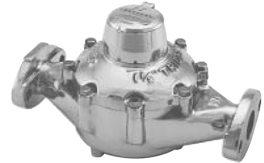
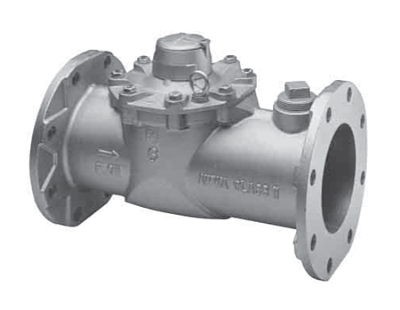
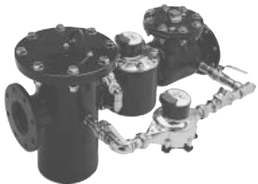
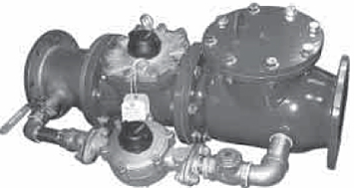
Types of Meters
Displacement
Velocity
Compound
Electronic
Proportional

Slide 14
Types of Fire Hydrants
Dry-barrel hydrants
Include a shut-off valve at the base to prevent damage from freezing.
Wet-barrel hydrants
Have a shut-off valve at the outlet and can only be used in areas where freezing is not a concern.

Slide 15
Fire Hydrant Coding
Color | GPM | Rating
Blue | 1500 or more | Very Good Flows
Green | 1000-1499 | Good for residential
Orange | 500-999 | Marginally adequate
Red | Below 500 | Inadequate
Primarily, fire fighters need to know how much water is available from the closest hydrant so that they may select the appropriate size hose lines for the size and complexity of the fire, but not select lines which would exceed the capacity of the hydrant and thus be ineffective. This information is known as "available flow."

Slide 16
Backflow Prevention
To prevent potential contaminants from being introduced to the distribution network by the reverse flow of water from a source of questionable water quality.
Physical air gap
Vacuum Breaker
Double check valve assembly
Reduced pressure zone device

Slide 17
Hydraulic Grade Line

Slide 18
What would be the pressure at the bottom of each tank?
125 ft

Slide 19
Example 2.2 – Pressure Head Calculation
How many feet of water would be in a tank if the pressure gauge at the base of the tank read 15 psi?
ft = 2.31 ft x 15 psi
1 psi
= (2.31) (15)
= 35 Feet

Slide 20
Example 2.3 – Pressure Head Calculation
What would the pressure head in psi be on a fire hydrant if a pressure gauge on that fire hydrant read 258 feet?
psi = 1 psi x 258 ft = 111.7 psi
2.31 ft

Slide 21
Example 2.4 – Pressure Head Calculation
What is the pressure (in psi) at a point 12 feet below the surface?
psi = 1 psi x 12 ft = 5.2 psi
2.31 ft

Slide 22
Hydraulic Grade Line

Slide 23
Energy Loss

Slide 24
Friction Losses
Turbulence
Water Main Flow
The degree of pipe roughness is called the C-Factor.

Slide 25
Customer Types
Residential
Commercial
Industrial
Other commonly used customer category types include institutional (schools, hospitals, etc.), bulk (service to another water utility), and municipal (municipal buildings and facilities).

Slide 26
Diurnal Demand Curve

Slide 27
Pressures and Flows
Normal pressures range from:
    a minimum of approximately 35 psi
    maximum of approximately 100 psi.
The minimum pressure allowed in a distribution system is 20 psi. When pressures drop below 20 psi, a system could experience backflow conditions

Slide 28
Routine Maintenance of Distribution Networks
Pump Maintenance
Valve Maintenance
Meter Testing and Maintenance
Fire Hydrant Maintenance
Inspection and Monitoring

Slide 29
Pipeline Maintenance Program
Leak Detection
Main Break Repair and Replacement
Water Main Replacement

Slide 30
Unit 2 – Wrap-Up
Key Points on Page 2-33
Unit 2 Exercise on 2-34

Slide 31
Unit 3 – Distribution Storage
Learning Objectives
  List the three primary functions and identify the four types of distribution storage facilities.
  Calculate the volume of water in a storage facility and define the components of distribution system storage volume allocation.

Slide 32
Purpose of Distribution Storage
Equalize Demands and Pressures
Minimize Fluctuations In System Pressure
Fire Protection
Emergency Supply

Slide 33
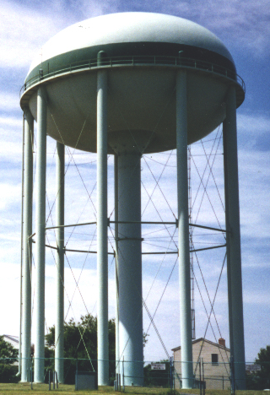
Types of Storage Facilities
Clear well
Elevated
Ground Level
Stand Pipe
Hydropneumatic

Slide 34
Storage Volume and Water Level
V = Length x Width x Height
V = .785 x Diameter² x Height
Don’t forget, answers will be in cubic feet. If you need gallons, you need to multiply by 7.48 to convert.

Slide 35
Example 3.1 – Volume Calculation
A rectangular ground level storage facility is 100 feet long by 50 feet wide. The water level in the tank (measured from the bottom of the tank) is 10 feet. What is the volume (in gallons) of water in the tank?
V = (l) x (w) x (h), where h is the height of water in the tank
V = 100 ft x 50 ft x 10 ft
V = 50,000 cubic feet
There are 7.48 gallons in a cubic foot. Thus,
V = 50,000 cubic feet x 7.48 gallons/cubic foot
V = 374,000 gallons

Slide 36
Example 3.2 – Volume Calculation
An elevated tank has a diameter of 50 feet. The water level in the tank is 20 feet. What is the volume of water in the tank?
V = (0.785) x (Dia)² x H
V = (0.785) x (50)² x 20
V = 0.785 x 2500 x 20 = 39,250 cubic feet
V = 39,250 ft ³ x 7.48 = 293,590 gallons

Slide 37
Example 3.3 – Volume Calculation
How many gallons of water are in a 400 foot section of main that has an 8 inch diameter?
First step:
Convert 8 inch to feet
Feet – 8 in = 0.67 feet
12 in
Second step:
Plug into volume formula
Vol = (0.785) x (diameter)² x (length)
= (0.785) x (0.67 feet)² x 400 feet
= 141 ft³
Third step:
Convert ft³ to gallons
Gallons = 141 ft³ x 7.48 = 1,055 gallons

Slide 38
Example 3.4 – Volume Calculation
The diameter of a tank is 60 feet. Without refilling of the tank, in one day, the water depth dropped from 25 feet to 21 feet, how many gallons of water were used that day?
Height = 25 ft – 21 ft = 4 ft
V = (0.785) x (diameter)² x (height)
V = (0.785) x (60 ft)² x (4 ft) = 11,304 ft³
Convert ft³ to gallons
Gallons = 11,304 ft³ x 7.48 = 84,554 gallons

Slide 39
Useable Storage
The useable storage is the total volume of water in a storage facility that can provide minimum required pressures to the highest elevation customers who are served by the facility.
Equalization Storage
Fire Storage
Emergency Storage

Slide 40
Purpose of Maintenance
Storage facilities require routine maintenance, including routine inspections, to ensure proper operation and identify replacement and repair needs.
Painting
Corrosion Control
Water Quality

Slide 41
Unit 3 – Wrap Up
Key Points Page 3-11
Exercise on Page 3-12

Slide 42
Unit 4 – Water Quality and Monitoring
Learning Objectives
  Identify the three types of distribution system water quality issues.
  Describe the purpose of disinfection and chlorine residual in the distribution system.

Slide 43
Purpose of Disinfection
The use of chlorination is quoted to have a “tremendous boon in the safeguarding of public health all over the world and is probably the most important and efficient sanitary measure of protection ever introduced”.

Slide 44
Disinfection Chemicals
Pure chlorine (Cl₂) is a poisonous, acidic gas that is heavier than air. When injected into water, it forms the following reaction:
Cl₂ + H₂O → HOCl + HCl
Chlorine Water
Hypochlorous
Acid
Hydrochloric
Acid

Slide 45
Three Types of Chlorine
Gas Chlorine
Calcium Hypochlorite
Sodium Hypochlorite

Slide 46
Breakpoint Chlorination
Breakpoint

Slide 47
Example 4.1 – Dosage Calculation
The chlorine residual is 0.7 mg/l, and the demand is 0.5 mg/l. What is the dose?
Dose = demand + residual = 0.7 + 0.5 = 1.2 mg/l

Slide 48
Example 4.2 – Dosage Calculation
The chlorine dose is 2.1 mg/l, and the demand is 0.9 mg/l. What is the residual?
Rearrange =
Chlorine Residual = Chlorine Dosage – Chlorine Demand
So, 2.1 - 0.9 = 1.2 mg/l

Slide 49
Disinfection of New Mains and Storage Facilities
Contamination Prevention
Flushing
Disinfection
Post-Disinfection

Slide 50
Example 4.3 – Dosage Calculation
A system has replaced 200 feet of 8 inch water main. They are going to use 50 mg/l of chlorine for 24 hours to disinfect the line. How many pounds of 65% calcium hypochlorite are required?
Feet – 8 in = 0.67 feet
12 in
Vol = (0.785) x (diameter)² x (length)
= (0.785) x (0.67 feet)² x 200 feet
= 70 ft³
Gallons = 141 ft³ x 7.48 = 527 gallons
527 gal = 0.0005MGD
1,000,000 gal
0.2 = 0.3 pounds
0.65

Slide 51
Example 4.4 – Dosage Calculation
A system has repaired the storage facility. They need to disinfect it before putting it back in service. They are going to use 25 mg/l of chlorine. How many pounds of 65% calcium hypochlorite are required if the storage facility has a 50 foot diameter and is 75 feet tall?
Vol = (0.785) x (diameter)² x (length)
= (0.785) x (50 feet)² x 75 feet
= 147,188 ft³
Gallons = 147,188 ft³ x 7.48 = 1,100,963 gallons
1,100,963 gal = = 1.1 MGD
1,000,000 gal
Pounds/day = flow(MG) dose(mg/l)(8.34)
= (1.1)(25)(8.34)
= 229 pounds
229 = 353 pounds
0.65

Slide 52
Regulatory Monitoring and Sampling Requirements
Total Coliform Rule (TCR)
Surface Water Treatment Rule (SWTR)
Disinfection/Disinfection By-products Rule (DBPR)
Lead and Copper Rule

Slide 53
Operations Monitoring
Water Age
Storage
Pressure
Other Purposes

Slide 54
Other Monitoring
Customer Monitoring
Secondary Standards

Slide 55
Distribution Flushing
A regular distribution flushing program can help reduce the need for reactive maintenance in a distribution system by removing biofilm and other bacteriological growth, sediment, and corrosion products and help to prevent tuberculation.

Slide 56
Cross Connection Control
In order to prevent contamination from backflow, every system should have a cross-connection control program.

Slide 57
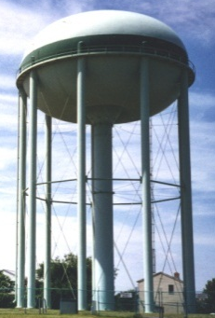
Benefits of Looping

Slide 58
Unit 4 – Wrap-Up
Key Points page 4-21
Exercise on Page 4-22

Slide 59
Random, example multiple choice questions.

Slide 60
1. How should air and/or vacuum relief valves be installed?
  Below ground level.
  On all of the high locations within the system.
  At the highest location within the system.
  In low drainage areas.

Slide 61
2. When manganese issues are present in a distribution system, they are most commonly found in what area?
  Areas serving hospitals
  High Flow Areas
  Dead Ends
  Around Fire Hydrants

Slide 62
3. What type of valve is usually installed on a storage reservoir to prevent overflows?
  Regulating valve
  Altitude Valve
  Limiting Valve
  Globe Valve

Slide 63
4. What does it mean if the C value of a pipe is high?
  the smoother the interior of the pipe is
  the easier corrosion will adhere to the inside of the pipe
  the pipe is stronger
  the more resistant to corrosion the pipe is

Slide 64
5. One of the purposes of storage tanks is to:
  lower the chlorine residual in the distribution system
  achieve a lower water temperature
  supply water during peak demand periods
  remove carbon dioxide

Slide 65
6. What are check valves used for in a water distribution system?
  to stop the water flow in both directions
  to stop the water flow in one direction
  to regulate the flow through the distribution system
  to regulate the pressure throughout the system

Slide 66
7. Minimum trench depth which require trench wall shoring:
  2 feet
  3 feet
  4 feet
  5 feet

Slide 67
8. Where would a thrust block be used:
  At the reservoir
  Fire hydrants
  Storage reservoir
  Chemical Feed System

Slide 68
9. What type of water meter is used in household applications?
  Velocity
  Displacement
  Compound
  Venture

Slide 69
10. When installing water mains, where should the corporation stop be placed into the main?
  12:00 O’Clock
  6:00 O’Clock
  9:00 O’Clock
  2:00 O’Clock

Slide 70
11. Why must a safe, minimum allowable chlorine residual be maintained in a distribution system?
  Public Health
  Pipe Maintenance
  Annoy Public
  None of the above

Slide 71
12. What is the volume (in gallons) of water that is in a tank that is 125 feet long and 69 feet wide, and has a depth of 17 feet?
  164,625 gallons
  146,625 gallons
  1,069,755 gallons
  554,976 gallons

Slide 72
13. The minimum water pressure, at ground level, at all points in the distribution system, under all flow conditions, must be:
  50 psi
  40 psi
  30 psi
  20 psi

Slide 73
14. Before excavating to install or repair a water main you should always:
  Notify all other utilities to mark any lines they may have in the area.
  Service your digging equipment.
  Arrange your tools on the truck.
  Take auxiliary pumps to pump the water out of the ditch.

Slide 74
15. During a routine pressure test of a fire hydrant the gage reads 66 psi. What was the pressure head in feet?
  29 feet
  152 feet
  494 feet
  56 feet

Slide 75
16. Valves in a distribution system should be exercised at least:
  Quarterly
  Monthly
  Annually
  Semi-Annually

Slide 76
17. At a minimum, how often should fire hydrants be operated and maintained?
  Quarterly
  Monthly
  Annually
  Bi-Annually

Slide 77
18. If a routine sample is found to contain total coliform, which of the following actions must be taken?
  run the HPC of ONPG test
  run the SPC or HPC test
  run EMB of ONPG test
  run the fecal coliform or E. Coli test

Slide 78
19. What is the number of total coliform samples collected each month in a distribution system based on?
  the type of water source used
  the type of water treatment used
  the amount of water purchased from other water supplies
  the population served

Slide 79
20. Before entering a confined space, the atmosphere must be prepared and monitored by:
  Continuous air monitoring equipment provided and operational
  Oxygen level maintained over 19.5% but less than 21%
  Providing continuous ventilation
  All of the above

Slide 80
21. Spacing between ladders or other means of egress in a trench must be such that a worker will not have to travel more than:
  25 feet laterally to the nearest means of egress
  36 feet laterally to the nearest means of egress
  15 feet laterally to the nearest means of egress
  Do not need ladders in a trench

Slide 81
22. A valve which is activated by water pressure from a reservoir to close automatically when the reservoir is full is an:
  Pressure Reducing Valve
  Pressure Relief Valve
  Air and Vacuum Valve
  Altitude Valve

Slide 82
23. If a storage tank is 75 feet long, 35 feet wide, and 14 feet deep how many gallons of water would it take to overflow the tank?
  274,891 gallons
  36,750 gallons
  139,098 gallons
  491,310 gallons

Slide 83
24. Which of the following storage tanks would be used to increase system pressure?
Elevated
Ground Level
Stand pipe
All of the above

Slide 84
25. OSHA shoring requirements depend on which one of the following:
  All trenches must be shored
  There are no trench shoring regulations
  The depth of the trench
  The length of the trench

Slide 85
26. Proper fire hydrant installation includes:
Installation on firm footing
Securely blocked or restrained to prevent movement
Course gravel or crushed rock to facilitate quick removal of water from hydrant barrel
All of the above

Slide 86
27. Once certified, a distribution system operator is required to meet continuing education requirements to maintain their certification which requires:
4 hours of continuing education in the first 3 year cycle and 8 hours of continuing education in each subsequent 3 year cycle.
8 hours of continuing education in the first 3 year cycle and 15 hours of continuing education in each subsequent 3 year cycle.
15 hours of continuing education in the first 3 year cycle and 30 hours of continuing education in each subsequent 3 year cycle.
8 hours of continuing education in the first 3 year cycle and 15 hours of continuing education in each subsequent 3 year cycle

Slide 87
28. When trying to achieve optimal water quality, what should be considered?
  System looping
  System flushing
  System pressure
  All of the above

Slide 88
29. In order to provide an adequate level of protection against the development of tastes and odors in a distribution system, it is important that the system be:
  Properly flushed
  Routinely sampled for taste and odor
  Taste and odor is not the distribution system’s concern
  Both A and B

Slide 89
30. You need to disinfect a 300 foot section of 36 inch water main to a dosage of 25 mg/L. You are using 12.5% sodium hypochlorite. How many pounds of chlorine do you need?
  52 lbs
  26 lbs
  8.8 lbs
  3.3 lbs

Slide 90
31. When connecting bell and spigot pipes, the way to determine if the pipe is fully connected is to do what?
  Ensure that the end of the bell matches up with the line on the spigot end.
  Hit the bell with a hammer to see if it moves.
  Jump up and down to see if it moves.
  Pressurize the line and look for water leaks.

Slide 91
32. A process that gradually constricts flow and causes water discoloration due to corrosion can be referred to as:
  Tuberculation
  Plasticitis
  Iron Infestation
  Transduced

Slide 92
33. Maintaining positive pressure (system pressure) to make distribution repairs in a water system is the best way to minimize:
  Chance of a violation
  Chance of contamination
  Never make a repair under system pressure
  All of the above

Slide 93
34. What is the pressure (in psi) at a point 22 feet below the surface?
  51 psi
  35 psi
  9.5 psi
  4.7 psi

Slide 94
35. Which of the following should not be performed on a fire hydrant?
  Painting
  Throttling the flow
  Standing behind the hydrant while opening it
  Lubrication

Slide 95
36. When filling in an excavation pit, the fill must be compacted after every________inches of lift?
  12”
  24”
  36”
  6”

Slide 96
37. What does the term diurnal mean?
  Yearly
  Monthly
  Weekly
  Daily

Slide 97
38. The amount of power that must be applied to the pump shaft to operate the pump?
Brake Horsepower
Motor Horsepower
Water Horsepower
Wire to Water Efficiency

Slide 98
39. Fire flow needs typically range from:
A minimum of 200 gallons per minute (gpm) for low density residential areas to 1,500 gpm or more for areas with large or high occupancy facilities.
A minimum of 300 gallons per minute (gpm) for low density residential areas to 2,500 gpm or more for areas with large or high occupancy facilities.
A minimum of 500 gallons per minute (gpm) for low density residential areas to 3,500 gpm or more for areas with large or high occupancy facilities.
A minimum of 700 gallons per minute (gpm) for low density residential areas to 5,500 gpm or more for areas with large or high occupancy facilities.

Slide 99
40. Dead ends on water mains may:
  Have a build-up of iron and manganese sediment
  Have taste and odor issues
  Have low chlorine levels
  All of the above

Slide 100
41. A cross-connection control program:
  Prevents backflow
  Educates the public
  Is not necessary
  Both A and B

Slide 101
42. The first reaction to finding a free chlorine residual at 0.00 mg/L at a sample location is to:
  Tell the homeowner not to drink the water
  Not tell anyone.
  Check your sample collection and analysis protocol
  Assume it is a fluke and record what you normally get at that location.

Slide 102
43. Under the Operator Certification Act an operator is required to notify the owner if what occurs?
  Customer Complaint
  Violation
  Main Break
  Power Outage

Slide 103
44. Any decision that changes or maintains water quality or water quantity of a water system or wastewater system in a manner that may affect the public health or the environment:
Operational Protocol
Process Control Decision
Standard Operating Procedure
Operator Mandate

Slide 104
45. The height to which a column of water will rise if you placed a vertical riser pipe on a pipe under pressure:
Hydraulic Gradient Line
Normal System Pressure
Pressure Head
None of the above

Slide 105
46. How many gallons of water are in a 200 foot section of ¾” main?
95,123 gallons
880 gallons
661 gallons
88 gallons

Slide 106
47. The difference in the amount of water produced and the amount of water metered for billing purposes:
Unaccounted for water
Consumption water
System Demand
None of the above

Slide 107
48. The total volume of water in a storage facility that can provide minimum required pressures to the highest elevation customers who are served by the facility.
Equalized Storage
Usable Storage
Available Storage
Fire Storage

Slide 108
49. Tier I Violation:
Check Sample positive for total coliform
Check sample positive for fecal coliform
Both A and B
None of the above

Slide 109
50. Form of chlorine with about 65% available chlorine:
Gaseous Chlorine
Sodium Hypochlorite
Calcium Hypochlorite
All of the above

