Slide 1

General Exam Training (DEP Modules)
Drinking Water Plant Operator Certification Training

Slide 2

General Overview
This general overview is to help operators prepare for the Part 1 General Water Treatment Examination.
Excerpts have been compiled from various modules to assist learning.

Slide 3
Modules Included
  Module 1 – Public Water System Responsibilities
  Module 2 – Ground Water Sources
  Module 4 – Water Quality and Characteristics
  Module 29 – General Chemistry
  Module 5 – Disinfection and Chlorination
  Module 10 – General Maintenance
  Module 8 – Distribution Systems
  Module 30 - Safety

Slide 4
Unit 1 Objectives
Describe the responsibilities of the water supply facility and the treatment plant operator.
List the 5 drinking water treatment objectives.
Describe three important historical achievements in water treatment that link contaminated water to disease.

Slide 5
Examples of Contaminants
Contaminant Type Natural/Man Made
Iron Chemical Natural
Cryptosporidium Biological Natural
Clay particles Suspended Natural
MTBE Chemical Man made
Nitrates Chemical Usually man made
Legionella (a virus) Biological Natural
Fluoride Chemical Natural

Slide 6
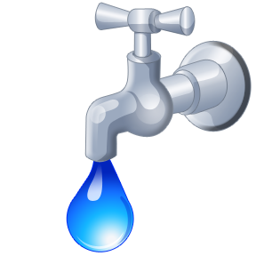
Job of the public water supplier
The job of the public water supplier is to provide a clean, safe, and reliable supply of water at a reasonable cost.

Slide 7
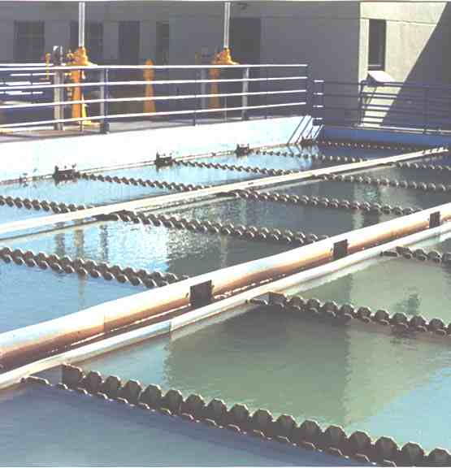
Job of the water treatment operator
The water treatment plant operator is ultimately responsible for the quality and safety of the treated water leaving the water treatment plant

Slide 8
Operator must:
Be aware of the raw water quality
Understand the treatment process
Monitor the quality of the water at various stages of the treatment process.
Monitor the quality of the treated water leaving the plant
Ensure water treatment plant facilities are maintained in a safe and operable condition.
Ensure reliable production and delivery of water to the distribution system.

Slide 9
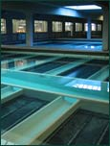
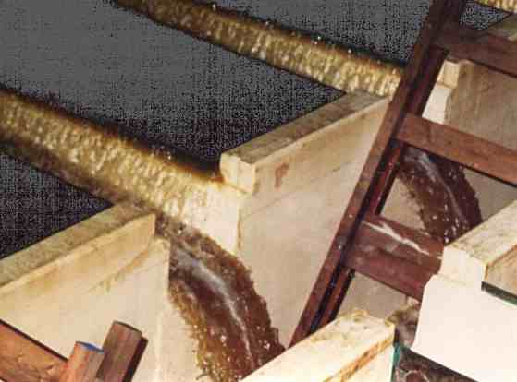
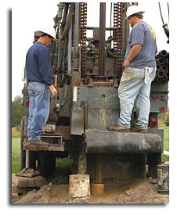
Water Treatment Objectives
Remove turbidity (suspended) material.
Reduce concentrations of chemical contaminants to permissible levels
Remove or inactivate pathogenic protozoans, bacteria, and viruses.
Produce water that is clear, with no objectionable colors, odors or taste.
Produce water that is chemically stable, and is not corrosive to metal piping and fixtures

Slide 10
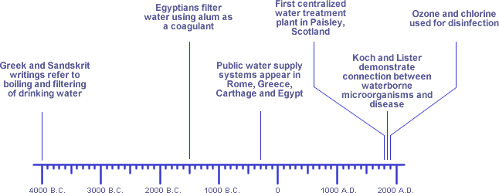
Figure 1.1: Timeline of Significant Developments

Slide 11
Unit 1 Key Points
  See page 1-6, Module 1

Slide 12
Unit 2 – Public Water Supplies System Classifications
Learning Objectives
  Describe the three different classifications of water systems and an example of each.

Slide 13
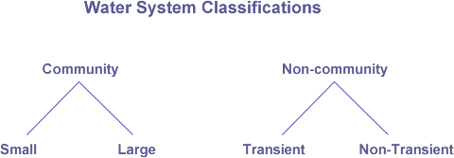
“A system for the provision to the public of water for human consumption through pipes or other constructed conveyances, if such system has at least fifteen service connections or regularly serves an average of at least twenty-five individuals daily at least 60 days out of the year”.
Public Water System

Slide 14
Community versus Non-Community
A hospital has its own private well and water treatment system.
  ANS: NTNCWS because it employs 25 of the same people at least 6 months out of the year.
A farmer has a good spring on his property and provides drinking water to 16 of his neighbors, free of charge.
  ANS:CWS because it has 16 service connections.
A real estate developer drills a well and provides the water to 17 homes in the development.
  ANS: CWS because it has 17 service connections.
A restaurant with its own well supply has an apartment above that’s connected to the restaurant’s plumbing system.
  Ans: TNCWS because the restaurant serves a transient population.
A campground has sites with camper trailers set up permanently.
  Ans: TNCWS because the people are probably not staying year round or even 6 months of the year.

Slide 15
Unit 2 Key Points
See Page 2-6 in the workbook

Slide 16
Unit 3 – Federal and State Regulations
Learning Objectives
  State the roles of federal and state agencies regarding drinking water.
  Identify key regulations that directly affect the water treatment plant operator.
  Explain the requirements for becoming and maintaining operator certification
  Identify the maximum contaminant levels, and monitoring and reporting requirements for regulated contaminants.

Slide 17
Who makes the rules and enforces them?
United States Environmental Protection Agency
Department of Environmental Protection
Pennsylvania has two River Basin Commissions:
  Susquehanna River Basin Commission (SRBC)
  Delaware River Basin Commission (DRBC)

Slide 18
Operator Certification Act
The purpose of the operator certification regs is to protect public health, safety and the environment.
State Board of Certification of Water and Wastewater Systems Operators and the Pa. DEP sets the training, experience and examination standards for operator certification.

Slide 19
Definitions
An appropriately certified operator is an operator who holds a certificate of the same or higher class with all the subclasses of the system at which they work or want to work.
A process control decision is any decision that changes or maintains water quantity or water quality of a water or wastewater system in a manner that may affect public health or the environment.

Slide 20
SOPs
Uncertified and not appropriately certified operators can make process control decisions ONLY WHEN:
Under the direction of an appropriately certified operator
Using SOPs that were developed by an appropriately certified operator.
  An appropriately certified operator must be available at all times during system operations.

Slide 21
Certification Requirements
Education Requirement
Examination Requirements
Criminal History Check
Experience Requirement
Final official approval by the Board and awarded a certificate of a class and subclass(es) commensurate with your experience. Final approval will be granted after a thorough review of the applicant’s information.

Slide 22
Table 3.1: Experience Requirements
 | MINIMUM OPERATING EXPERIENCE TO BECOME CERTIFIED
CLASS | High School Diploma or GED | DEP Approved Certificate Program in Water or Wastewater | DEP Approved Associates Degree Program in Water or Wastewater | Associates Degree in Env’l or Physical Sciences or Engineering | BS/BA Degree in Biology, Chemistry, Env’l or Physical Sciences, or Sanitary or Env’l Engineering
A | 4 Years | 2 Years | 1 Year | 3.5 Years | 2 Years
B | 3 Years | 1 Year | 6 Months | 2.5 Years | 1 Year
C | 2 Years | 6 Months | 6 Months | 1.5 Years | 6 Months
D | 1 Year | 6 Months | 6 Months | 6 Months | 6 Months
E | 1 Year | 6 Months | 6 Months | 6 Months | 6 Months
Dc | 6 Months | 0 | 0 | 6 Months | 0

Slide 23

Operator Experience
Operation of mechanical equipment,
Maintenance of mechanical equipment,
Collection of samples,
Analysis of chemical and biological samples,
Performing calculations related to process control,
Preparing or standardizing chemical and biological solutions,
Compiling and completing monitoring data, determining appropriate process control measures

Slide 24

2-Part Examination
          Part I: General Exam
          Part II: Treatment technology specific

Slide 25
Water system classes and subclasses
If you have treatment other than disinfection you cannot be classified as a Dc.
An operator must be certified in both the class and subclasses of the treatment plant they are operating.

Slide 26
Table 3.2: Continuing Education
Operator Certification Class | Minimum Number of Samples Required per Month
A | 30
B | 30
C | 30
D | 15
E | 15
Dc | 9
Dn | 6

Slide 27
Certified Operator Responsibility
The board may revoke, suspend or modify a certificate if it is found an operator has been:
  Negligent
  Committed fraud
  Falsified an application
  Falsified operating records
  Failed to use reasonable care
  Failed to use reasonable judgment

Slide 28
Certified Operators must:
Meet all the requirements for recertification.
Report to the system owner any know violation or system condition that may be or are causing violations of any department regulation or permit condition.
Providing for the suitable O&M of a water system utilizing available resources to comply with all laws.
Making or implementing process control decisions, or directing actions related to process control decisions for specific water systems.

Slide 29
Owners must:
Employ, identify and report to the department the names of available operators required by DEP.
Require, supervise and direct certified operators to take such action so that the water system is in compliance with all laws.
Providing a copy of permit conditions to the certified operator in responsible charge.

Slide 30
Vocabulary
Safe Drinking Water Act establishes maximum contaminant levels (MCL’s) for various contaminants that may be found in drinking water. These standards are divided into:
  Primary Standards
  Secondary Standards

Slide 31
Other Relevant Federal Regulations
Surface Water Treatment Rule
Groundwater Rule
Interim Enhanced Surface Water Treatment Rule
Long Term 1/2 Enhanced Surface Water Treatment Rule
Filter Backwash Recycling Rule
Stage 1 Disinfectants and Disinfection Byproduct Rule
Stage 2 Disinfectants and Disinfection Byproduct Rule

Slide 32

More Regulations
Groundwater Rule
Total Coliform Rule
Arsenic Rule

Slide 33
Last Regulation
Lead and Copper Rule

Slide 34

PA Water Supply Manual
Seven Sections:
Summary of Key Requirements
Community System Design Standards
Non- Community System Design Standards
Bottled Water, Bulk Water Hauling, Water Vending Machines, and Retail Water Facilities
Operations and Maintenance
Emergency Response
Cross-Connection Control/Backflow Prevention

Slide 35
Microbiological
Monitored monthly (# based on population)
Samples collected in distribution system
Acute violations (Table 3.3)
 | Total Coliform | Fecal or E. coli
Routine Sample | + | +
Associated Check Sample | +
 | Total Coliform | Fecal or E. coli
Routine Sample | +
Associated Check Sample | + | +

Slide 36
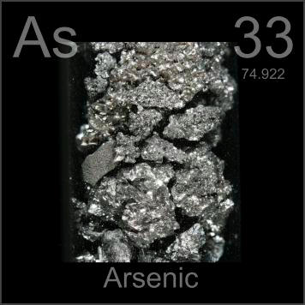
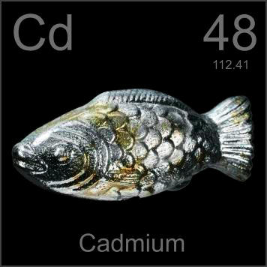
Inorganic Chemicals
One annual sample (surface water sources) or one sample every three years (groundwater sources) is required
Samples are taken from each point water enters the distribution system.

Slide 37
Organics: VOCs and SOCs
One annual sample is required
Samples are taken from each point water enters the distribution system.

Slide 38
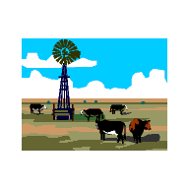
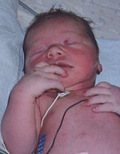
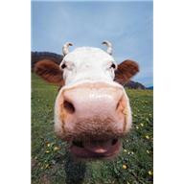
Nitrate/Nitrite
One annual sample is required,
  Or quarterly samples for at least 4 consecutive quarters if initial sample is over 50% of the MCL.
Samples are taken from each point water enters the distribution system.

Slide 39
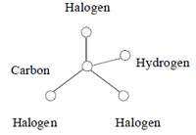
Disinfection Byproducts
Sampling requirements for TTHM’s and HAA5 vary according to source type and population served.
Sample are taken from the locations within the distribution system that are likely to cause high levels of TTHMs and HAA5s.
A system has exceeded the MCL if the locational running annual average of any site exceeds the MCL.

Slide 40
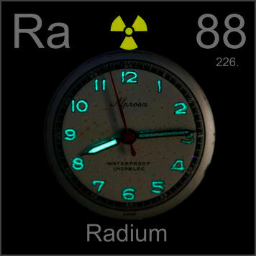
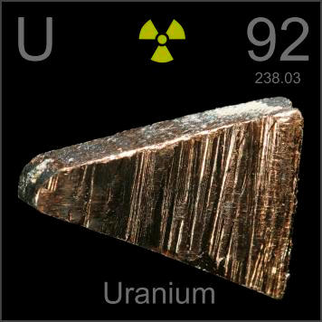
Radionuclides
Level is based on an annual composite of four consecutive quarterly samples (for surface water systems) or one sample every four years (for groundwater systems).
Samples are taken from the distribution system.

Slide 41
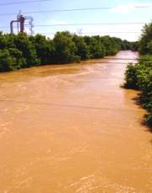
Turbidity (filtration)
Effluent turbidity of individual filters must be monitored continuously. The turbidity of the combined effluent flow from all filters must be sampled at least every 4 hours.
Important: What qualifies as MCL exceedances listed in workbook on 3-21

Slide 42
Disinfectant Residual
Disinfectant residual must be monitored continuously except for groundwater systems serving 3,300 or fewer people.
  <3,300 take a daily grab sample
Surface water systems have specific minimum residual levels
  Other systems must have detectable levels of residual in distribution

Slide 43
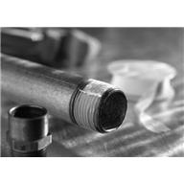
Lead and Copper
A system has exceeded the MCL if the 90th percentile value of the samples exceeds the action levels for lead or copper.
  The action levels for lead and copper are 0.015 mg/L and 1.3 mg/L

Slide 44
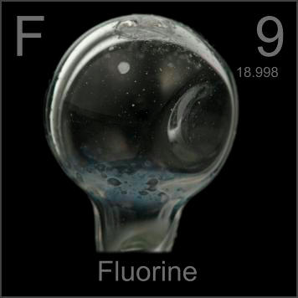
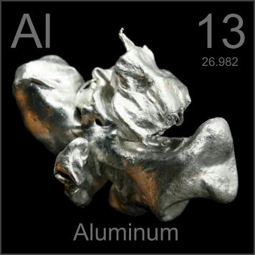
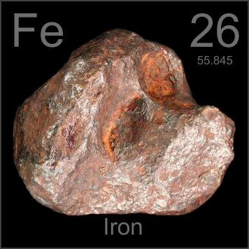
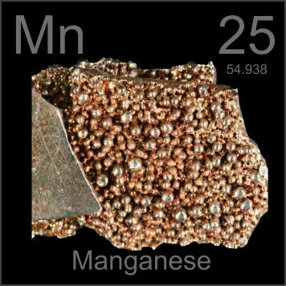
Secondary Contaminants
The secondary contaminants most commonly monitored by the water treatment plant operator include color, corrosivity, aluminum, chlorides, iron, manganese, odor, pH, and total dissolved solids.

Slide 45
Public Notification
1-hour reporting for:
  All Tier 1 violations and situations
  Most Tier 2 violations or situations
  Any sample that requires a check sample
Tier 1 and Tier 2 definitions

Slide 46
Public Notification – Cont’d
Tier 1 Violations (3-23 and 3-24)
  Common Tier 1: Violation of MCL total coliforms when fecal or E. Coli are present

Slide 47
Public Notification – Cont’d
Tier 2 Violations (3-24 and 3-25)
  Please note that secondary contaminants are a Tier 2
  Also note: total coliform without E. coli/Fecal is Tier 2.

Slide 48
Public Notification – Cont’d
Table 3.4: Public Notification Delivery Deadlines
Tier | Deadlines for Notice | Deadlines to Contact DEP*
1 | 24 hours | 1 Hour
2 | 30 days | 1 Hour for MCL, MRDL,TT Violations
3 | 1 year | Not required

Slide 49
Unit 3 (Regulations) Wrap-Up
Exercise: Page 3-27 in the workbook
Key Points: Page 3-29 in the workbook

Slide 50
Unit 4: System Management Responsibilities
Learning Objectives
Identify the major system management responsibility topics and provide links to templates.
Identify additional drinking water resources.

Slide 51
Tables
This unit includes tables that summarize selected system management responsibilities
  Total coliform sampling siting plan
  Lead and copper rule sample siting plan
  Stage 2 Disinfectant Byproduct Rule Monitoring Plan
  Monthly Operation Reports
  Complaint Record
  Operation / Maintenance Plan
  Emergency Response Plan
  Distribution System Map
  Cross Connection Control Plan
  Sanitary Survey
  Record Retention

Slide 52
Unit 4 Key Points
Use the numerous tables in this unit to review your system management responsibilities under chapter 109
Use the templates for the various plans if you have not yet created these plans
Table 12: Additional Resources provides you with links to many important DEP web pages
Systems that serve more than 3,300 people must conduct a vulnerability assessment to address terrorist threats

Slide 53
Groundwater Sources of Supply and Protection
Volume II, Module 1
Unit 1 – Introduction to Groundwater
Unit 2 - Aquifers

Slide 54
Sources of Groundwater for Drinking
Water obtained from dug, drilled, bored, jetted or driven wells
Water obtained from Infiltration Galleries and Radial Collectors
Water obtained from springs

Slide 55
GUDI
Groundwater Under the Direct Influence of water that has been classified as a surface water source.
Requires treatment as surface water.

Slide 56
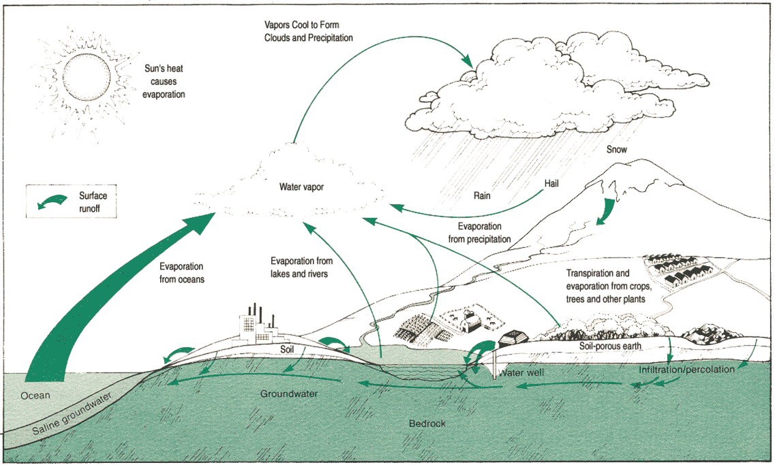
Hydrologic Cycle

Slide 57
Unit 1 (Intro to GW) Wrap-Up
Exercise on Page 1-11 of Volume II workbook
Key Points on Page 1-12 of Volume II workbook

Slide 58
Module 2, Unit 2 - Aquifers
Objectives
List four types of groundwater aquifers found in Pennsylvania
Identify on a map, the location of Pennsylvania’s principal groundwater aquifers.
Describe the geology of each of the four aquifers.
List three common types of groundwater sources found in Pennsylvania.

Slide 59
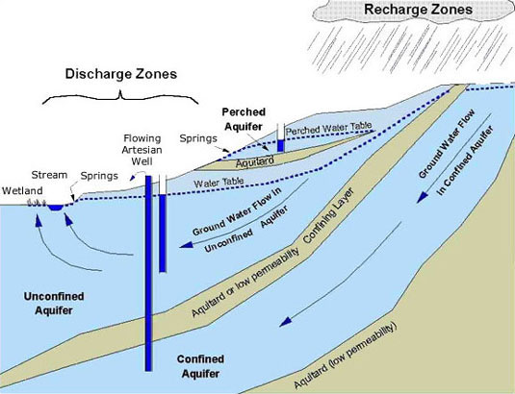
Aquifer
A water-bearing stratum of rock, sand or gravel

Slide 60
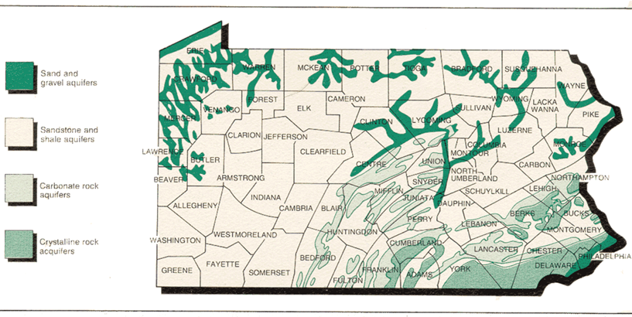
Types of Aquifers
Pages 2-2 to 2-8 in workbook

Slide 61
Types of Groundwater Sources
Types of wells
Springs
Infiltration Galleries

Slide 62
Unit 2 (Aquifers) Wrap-Up
Exercise: Page 2-12
Key points: Page 2-14

Slide 63
(Mod 4) Water Quality and Characteristics
Unit 3: Water Quality Classifications
Physical Characteristics
I. Microorganisms
II. Inorganic Constituents
III. Organic Compounds
IV. Radionuclides
V. Disinfectants and Disinfection Byproducts

Slide 64
Regulated Waterborne Micros
Microorganism/Indicator | Regulation | Goal
Cryptosporidium | TT | Zero
Giardia lamblia | TT | Zero
E. coli | TT | Zero
Fecal coliforms | TT | Zero
Legionella | TT | Zero
Viruses (enteric) | TT | Zero
Heterotrophic plate count (HPC) | TT | NA
Total coliforms | Max 5% of monthly readings positive | Zero
Turbidity | PS: < 0.3 NTU – 95% of readings; 1.0 NTU max | NA
TT = Treatment Technique | NA = Not Applicable

Slide 65
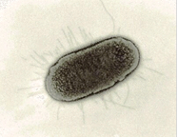
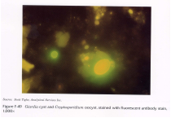
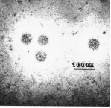
Categories of Micros
Bacteria
Protozoa
Viruses

Slide 66
Microbial Indicators
Microbial indicators used in place of testing for pathogens.
Ideal microbial indicators should have the following characteristics listed on 3-13 (Volume II)

Slide 67
Inorganic Chemical and Treatment Terminology
Page 3-19 and 3-20
Page 3-23, Bring your attention to:
  Hardness, Total: The presence of divalent metallic cations in water due to dissolution of minerals (primarily salts of calcium and magnesium) in geologic formations by natural waters.

Slide 68
Acute vs Chronic
“Usually, acute means sudden onset of a disease or injury whereas chronic diseases develop slowly and gradually. Acute condition happens when you cut yourself with a knife or catch a cold whereas chronic medical condition is when you suffer from pain and disease over an extended period of time.”
The health effects listed on table 3-10 are primarily chronic.

Slide 69
Nitrates
Infants below the age of six months who drink water containing nitrate and/or nitrite in excess of the MCL could become seriously ill (Blue Baby Syndrome)
  Symptoms include shortness of breath and blue-baby syndrome.
Acute Health Effect

Slide 70
Exercise - Inorganics
Exercise on Page 3-18

Slide 71
Organic Compounds
Man-made (Synthetic)
Natural Organic Matter (NOM)
Organics Exercise on 3-34

Slide 72
Rads and DBPs
Types of Rads (pg 3-35)
Disinfectants (Table 3-17):
Parameter | MRDL | MRDLG | BAT
Chlorine – mg/L as Cl₂ | 4 | 4.0 | DC
Chloramines – mg/L as Cl₂ | 4 | 4.0 | DC
Chlorine dioxide – mg/L as ClO₂ | 0.8 | 0.8 | DC

Slide 73
Answers for Volume II Exercises
Water Table
By water dissolving portions of the carbonate rock
E. Coli, Cryptosporidium, Giardia lamblia, Fecal Coliform, Legionella, Viruses, Heterotrophic Plate Count, total coliforms, turbidity
True
Present in large numbers, Present in pathogenic microorganisms, High ratio of indicators, stable, absent in uncontaminated water, easily detectable
True
True
4 mg/L
0.005 mg/L
False

Slide 74
Key Points for Unit 3 – Water Quality Classifications
See page 3-41

Slide 75
(Mod 29) Chemistry Concepts
Learning Objectives
List three states of matter and explain the difference among them.
List and define four physical properties of matter.
Explain the difference between elements, compounds and mixtures.
List the primary difference between a physical and a chemical change of matter.

Slide 76
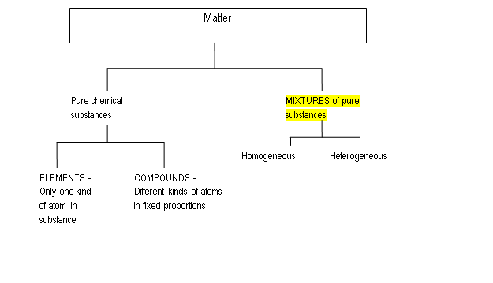
Classification of Matter

Slide 77
General Chemistry Definitions
Density is the mass of a substance per unit of volume of the substance.
Specific gravity is the density of a substance compared to the weight of the same volume of water.

Slide 78
Calculate the weight of a gallon of 50% NaOH (sodium hydroxide or caustic soda), given that a 50% solution of caustic soda has a specific gravity of 1.53.
Example 1
Weight, lbs/gal = (Specific gravity of substance) x (weight of a gallon of water)
Weight, lbs/gal = (1.53) x (8.34 lbs/gal)
Weight = A 50% solution of NaOH weighs 12.8 lbs/gal

Slide 79
What would be the weight of a 55 gallon drum of the coagulant Sternpac if the specific gravity of the product is 1.27?
Example 2
Weight, lbs/gal = (Specific gravity) x (wt of a gal of water)
Weight, lbs/gal = (1.27) x (8.34 lbs/gal) = 10.6 lbs/gal
Weight = ONE gallon of Sternpac weighs 10.6 lbs/gal
So, 55 gallons = 10.6 lbs x 55 gallons = 583 pounds
gallons

Slide 80
Calculate the number of gallons of 2,000 pounds of 12% NaOCl (sodium hypochlorite), given its specific gravity of 1.12.
Example 3
Weight, lbs/gal = (specific gravity of substance) x (weight of a gallon of water)
Weight, lbs/gal = (1.12) x (8.34 lbs/gal)
Weight = A 12% solution of NaOCl weighs 9.3 lbs/gal
Calculate the numbers of gallons of 2,000 lbs. of 12% NaOCl
(total weight lbs) ÷ (weight lbs/gallon) = gallons of 12% NaOCl
(2,000 lbs) ÷ (9.3 lbs/gal) = 215 gallons of 12% NaOCl

Slide 81
Class Exercises
The specific gravity of Aqua Mag is 1.4. How much (lbs) does a one gallon weigh?
One gallon = 8.34 x 1.2 = 12. lbs
How much does a 30 gallon drum of 60% fluorosilic acid weigh (lbs) if it has a specific gravity of 1.46?
30 gal drum = 8.34 x 1.46 x 30 = 365 pounds
Your plant has a 10,000 gallon tank of Aluminum Chloride. The specific gravity of Aluminum Chloride is 1.2. How much (in pounds) does the tank of Aluminum Chloride weigh when the tank is full?
10,000 gal = 8.34 x 1.46 x 10,000 =100,000 pounds

Slide 82
Converting temperatures C/F
Formulas area given on the formula sheet!
0.555 (°F - 32) =°C
(1.8 x °C) + 32 =°F

Slide 83
Convert: 10 °C = ? °F
Problem Set Up and Calculation:
Step 1: Select correct conversion formula which is
°F = (1.8 x °C) + 32
Step 2: Insert known value of 10 °C into formula
Step 3: Multiply within the parentheses (1.8 X 10) = 18
Step 4: Add 18 + 32 = 50

Slide 84
Module 29 Wrap Up
Exercise on Page 4-9
Key Points on Page 4-10

Slide 85
(Vol. III) Module 5: Disinfection
Learning Objectives
Explain the general purpose and regulatory requirements of the disinfection process.
List bacteria, viruses and intestinal parasites that contaminate drinking water.
List factors that influence disinfection and explain how they influence it.
List five types of chemical disinfectants and explain the advantages and disadvantages of each.
Explain how irradiation is used as a disinfection process.
List drinking water regulations and explain the reason for each regulation

Slide 86
Disinfection
For the most part, we will be focusing on the factors influencing disinfection.

Slide 87
Minimum Treatment Disinfection
For groundwater wells, disinfection using chlorine or one of its compounds, followed by 20 minutes of detention time, is required.
For surface water: Various forms of treatment required

Slide 88
Factors which influence disinfection
Chemistry
(pH, temp.)
Organisms
(# and type)
Byproducts
Disinfection Efficiency
Time
Disinfection
Demand -
Turbidity
Process
Control

Slide 89
Organisms
The numbers and types of organisms could determine the type of disinfectant needed and the amount or dosage of that product.
We use an indicator organism to determine the bacterial quality of the water.
Coliform bacteria make good indicator organisms because:
  They are always present when pathogens are present.
  The testing method for detection is easy and reliable.
  When they are absent, we can assume that pathogens are also absent.

Slide 90
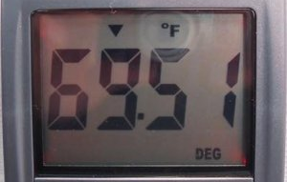
Disinfection: Temperature
Disinfection of water with free chlorine will be more efficient at temperatures greater than 60ºF than at temperatures less than 60ºF.
Important to monitor chlorine residual throughout the disinfection process.

Slide 91
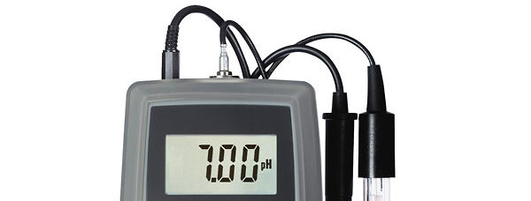
Disinfection: pH
Disinfection of water with free chlorine will be more efficient at values lower than 7.0 than at values greater than 7.0.
Lower pH, better disinfection

Slide 92
Why Are We Here?
What are disinfection byproducts?
What are disinfection byproducts:
Natural Organic Matter
Chlorine
Chloramines
TTHM
HAA5
+
=
Precursors
Added disinfectant
DBPs
Trihalomethanes (4)
Haloacetic Acids (5)
Notes:
NOM – we are talking about dissolved organics: Humic and fulvic acid, tannic acid (from biodegredation of dead organic matter)
Bromide as a precursor with ozone can also cause a DBP (Bromate)
Chlorine dioxide can also cause a DBP: Chlorite
DBPs that are primarily concerned about are TTHM (4 species) and HAA5 (5 species)

Slide 93
Disinfection Demand
Anything in the source water that will react with the disinfectant and make it unavailable for disinfection.
  Includes turbidity, inorganics and organic material.

Slide 94
Process Control
Controlling the key parameters to ensure proper water quality.
  Chemical feed rates and application points
  Mixing time
  Detention time
  Chemical feed of a disinfectant must be continuous and adequate.

Slide 95
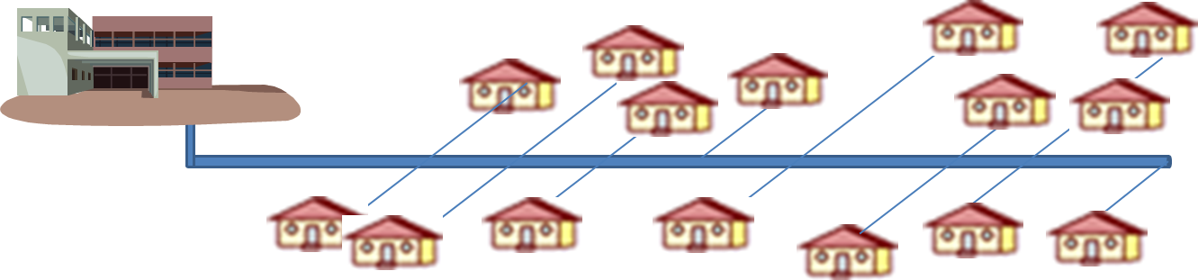
Disinfection: Contact Time
Amount of time (in minutes) necessary for the chlorine to perform its disinfection function before the water is delivered to the first customer.

Slide 96
Chemical Disinfection
Gas chlorine
Hypochlorite
Chlorine Dioxide
Chloramines
Ozone
What is the major disadvantage of using gas chlorine?
It requires special training to assure safe handling of the chemical and related equipment.

Slide 97
Surface Water Treatment Rule
Page 1-18 in Workbook
This rule required all surface waters or ground waters under the influence of surface waters to provide filtration and/or disinfection of the source to meet:
  3-log removal or inactivation of Giardia Lamblia cysts and,
  4-log removal or inactivation of enteric viruses.

Slide 98
Disinfection Wrap Up
Exercise on 1-21
Key Points on 1-24

Slide 99
(Mod 10 ) General Maintenance
Unit 1 Learning Objectives
Define maintenance
Discuss the roles of maintenance
Discuss safety practices of maintenance

Slide 100
Definition of Maintenance
Ensures that all equipment and systems are:
  Operated at an expected level of reliability
  Within a specified budget and
  Within the life cycle of the equipment.

Slide 101
Role of Maintenance
Some elements of system have a 25 to 30 year life cycle before needing maintenance
Most elements will need regular service directly after start-up.
The role of maintenance is to identify and remedy potential problems before they impact plant operation.

Slide 102
5 General Goals of a Maintenance Program
Safety and environmental protection (our focus)
Fixed asset management
Maintenance of design intent
Efficiency of operations
System reliability

Slide 103
Safety and Environmental Protection
Water treatment plants have a direct impact on public health.
Plant operators constantly monitor process parameters to ensure the quality of the water.
Maintenance must be done to ensure all equipment is functioning properly so all processes can be monitored – helps during operation to ensure water quality while protecting public health.

Slide 104
Follow all safety programs!
All required safety procedures must be followed at a water system.
  For example, drinking water system must have specially designed areas for chemical storage which allows containment in case of fire and explosion.

Slide 105
Common Ways to Minimize Hazards
Use lockout-tagout procedures! Remember, the person performing the maintenance is responsible for following lock out/tag out protocol.
Before disconnecting power leads, mark the configuration. Note: by hooking the leads in the reverse, you can change the direction of how a pump will run (a counter clockwise pump will run clockwise).
Follow confined space procedures.
Perform good housekeeping procedures.

Slide 106
Typical Maintenance Procedures
Objectives
Discuss pump performance issues
Discuss shaft adjustment
Discuss mechanical seals
Discuss lubrication of equipment

Slide 107
Pump Performance Issues
Maintenance on a pump is important to keep the pump running at its optimum performance level.
Troubleshooting Example: Pump is running but not discharging, troubleshooting could indicate:
  The pump has lost its prime
  Worn impeller
  Valve on the discharge side is closed

Slide 108
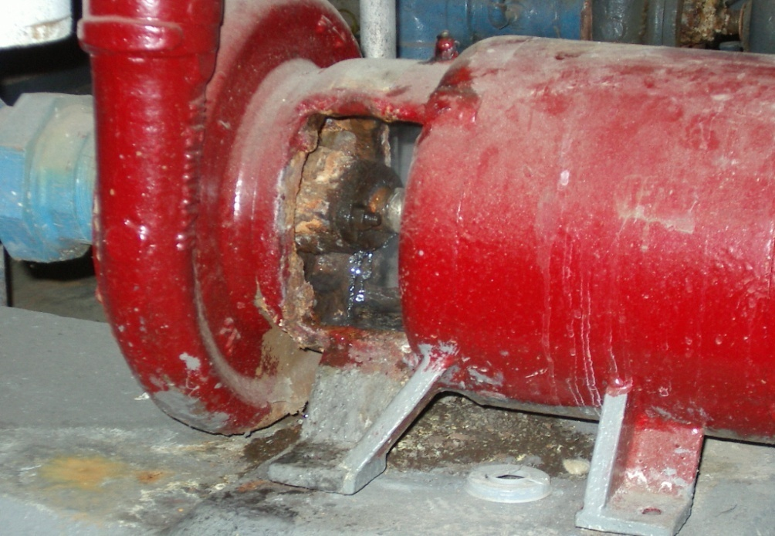
Shaft Seals
Shaft seals will be standard packing or mechanical.
Leaking Gland

Slide 109
Lubrication
Lubrication protects equipment.
Special Note
Oil lubricated bearings typically utilize a sight glass or bowl.
  Note: the manufacturer might recommend that you check your electrical amperage before and after greasing bearings. If an increase in electrical amperage is detected, the drag on the bearings has increased due to over-greasing the bearings.

Slide 110
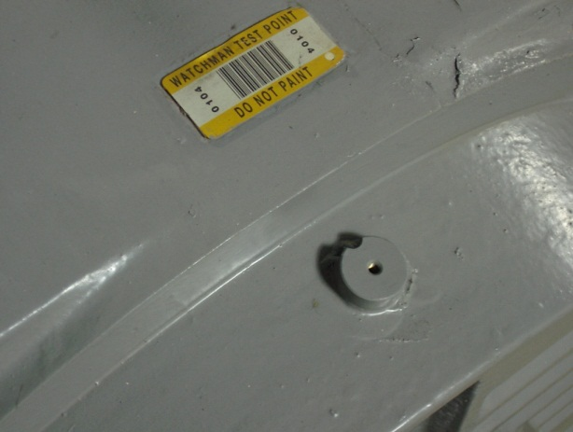
Condition Assessment
Vibration analysis
Vibration caused by:
  Worn bearings, worn housings, loose bolts, and misalignment.
  Misalignment can occur within a pump or between a motor and a pump which causes excessive vibration.
Vibration Analysis Point

Slide 111
Module 10 Wrap Up
Exercise on Page 4-8 (Mod 10)
Key Points on Page 4-9 (Mod 10)

Slide 112
Module 8: Distribution
We will cover:
Distribution components
Hydraulics
Routine Maintenance and Repairs

Slide 113
Distribution Networks
Purpose
Components

Slide 114
Pipes
Transmission Systems
Service Connections

Slide 115
Storage Facilities
Provide sufficient amount of water to equalize the daily demands on the water supply system.
Elevated Tanks
Stand Pipes
Reservoir or ground level storage tanks
Pressure Tanks

Slide 116
Valves
Valves used to stop flow, regulate flow, drain lines or isolate a section of line.
Valves can be operated manually or by motorized controls that may be operated through a remote.

Slide 117
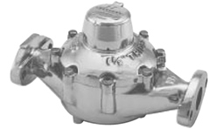
Meters
Meters measure, display, and record the amount of water that passes through a distribution system component.
Types of Meters
Displacement Meters
Velocity Meters
Compound Meters
Electric Meters
Proportional Meters

Slide 118
Backflow Prevention
Purpose of Backflow Prevention
Prevent potential contaminants from being introduced to the distribution by the reverse flow of water
Types of Backflow Prevention Devices
  A physical air gap
  A reduced pressure device
  A double-check valve assembly

Slide 119
Pressure and Head
Pressure - the force per unit of area. Pressure is commonly expressed in units of pounds per square inch (psi).
Pressure, psi = Pressure Head, ft / 2.31, or
Pressure, psi x 2.31 = Pressure Head, ft
125 ft

Slide 120
What would the pressure head in feet be on a fire hydrant if a pressure gauge on that fire hydrant read 155 psi?
Example 1
ft = 2.31 ft x 155 psi
1 psi
= (2.31) (155)
= 358.05 Feet

Slide 121
What would the pressure head in psi be on a fire hydrant if a pressure gauge on that fire hydrant read 258 feet?
Example 2
psi = 1 psi x 258 ft = 258 = 111.7 psi
2.31 ft 2.31

Slide 122
Customers and Demands
Unaccounted-for Water— is the difference between the amount of water produced and the amount of water metered for billing purposes.
Unaccounted for water (the difference between net water produced and total water metered) should not exceed 15%.

Slide 123
ABC water treated 96,000,000 gallons of water during December of 2012. Records indicate that ABC billed 88,673,249 gallons for December of 2012. What is their percent of water loss?
Example 1
96,000,000 gallons - 88,673,249 gallons = 7,326,751 gals
7,326,751 gallons x 100 = 7.6 % or 8%
96,000,000 gallons Unaccounted

Slide 124
The master meter for a system shows a monthly total of 700,000 gallons. 600,000 gallons were used for billing. Another 30,000 gallons was used for flushing. On top of that, 15,000 gallons were used in a fire episode and an estimated 20,000 gallons were lost to a main break that was repaired that same day. What is the total unaccounted for water loss percentage for the month?
Example 2
600,000 + 30,000 + 15,000 + 20,000 = 665,000 gallons accounted for.
700,000 Master Meter Reading - 665,000 Accounted for Through System = 35,000 Unaccounted for
35,000 Unaccounted For = 0.05 x 100 = 5% Unaccounted For
700,000 Master Meter

Slide 125
Customer Types
Residential
Commercial
Industrial
Other

Slide 126
Routine Maintenance and Repairs
Pipeline Maintenance and Repairs
Leak Detection
Main Break Repair and Replacement
Cleaning and Lining

Slide 127
Wrap-Up
Distribution Exercise: Page 1-16 (Mod 8)
Key points: Page 1-17 (Mod 8)

Slide 128
Module 30: Safety/Hazards
Mechanical Hazards
Electrical Hazards
Noise
Slip, Trip and Fall Hazards
Excavations
Confined Space

Slide 129
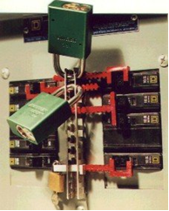
Lockout/Tagout Program
Purpose: Ensure that all personnel follow standardized shutdown and startup procedures to prevent accidental equipment start up, energization or release of stored energy
NOTE: The person performing the maintenance on an electrical device is responsible for the lock out/tagout procedure.

Slide 130
Electrical Hazard Control
Electrical hazards can be controlled by:
Insulation
Guarding
Grounding
Electrical Protective Devices
Safe Work Practices
Deenergizing Electrical Equipment (Lockout/Tagout)
Tools
Overhead/Underground Power Lines
Protective Equipment
Good Judgment

Slide 131
Noise
Treatment plant operation and maintenance activities expose workers to a variety of intermittent or continuous high noise sources.
Monitoring should be performed.
Hearing conservation program.
Noise reduction program.
Calculation on 3-12

Slide 132
Walking/Working Surfaces
Walking and working surfaces in treatment plants are inherent sources of slip, trip and fall hazards.
Ladders: must be maintained in good condition.
Good housekeeping: maintenance of clean dry floors and walkways is important.
Footwear: good with adequate tread.

Slide 133
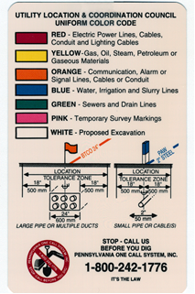
Excavation
Remember: Call Before You Dig (PA OneCall)

Slide 134
Permit-Required Confined Space
One or more of the following hazardous characteristics:
contains or has the potential to contain a hazardous atmosphere
contains a material that has the potential to engulf an entrant such as water;
Has an internal configuration such that an entrant could be trapped or asphyxiated by inwardly converging walls or by a floor that slopes downward and tapers to a smaller cross section such as a hopper or bin;
contains any other recognized serious safety or health hazard.

Slide 135
Classes of Fire
Class A Includes ordinary combustibles such as wood, paper and textiles.
Class B Includes flammable or combustible liquids such as gasoline, oils, paints and greases.
Class C Are electric fires from wiring and electrical equipment or class A or B fires adjacent to electrical equipment.
Class D Includes combustible metals such as aluminum, magnesium and titanium.

Slide 136
Additional Chemical Storage Tips
Chemical storage requirements are listed on MSDS sheets. In general:
Store acids and bases separately.
Store oxidizers and reducers separately.
No smoking, drinking or eating when working with chemicals.
Store carbon in a clean, dry place
Store chlorine in secure areas with leak detection equipment.
Handle cylinders and containers carefully,
First aid kits, safety showers and eyewash stations should be available and easy to access.

Slide 137
Safety Wrap Up
Key points on Page 3-35 (Module 30)

Slide 138
The End
That is the end of the material in the manuals.
However:
We now have 50 practice questions.
We will cover all of the questions that we can cover.

Slide 139
1. Uncertified and not appropriately certified operators can only make process control decisions when:
  They can never make process control decisions
  Under direction of an appropriately certified operator
  Using (SOP) developed by a certified operator
  Both B and C

Slide 140
2. Which of the following most accurately describes a decision which maintains or changes the quality or quantity of water in a system that may affect the public health or the environment:
  Chemical Feed Modulation
  Process Control Decision
  Rate of Flow change
  None of the above

Slide 141
3. Less dense fluids float on more dense fluids when they do not mix. The mass density of a material varies with temperature. The temperature where water is most dense:
  32 Celsius
  32 Fahrenheit
  39 Celsius
  39 Fahrenheit

Slide 142
4. The certification board may revoke, suspend or modify a certificate if it is found an operator has:
  Been negligent
  Committed fraud
  Falsified an application or operating records
  All of the above

Slide 143
5. Your plant has a 10,000 gallon tank of Aluminum Chloride. The specific gravity of Aluminum Chloride is 1.2. How much (in pounds) does the tank of Aluminum Chloride weigh when the tank is full?
  10 pounds
  8,333 pounds
  12,000 pounds
  100,000 pounds

Slide 144
6. This rule required all surface waters or ground waters under the influence of surface waters to provide filtration and/or disinfection of the source to meet 3 log removal or inactivation of Giardia Lambia cysts and 4 log removal or inactivation of enteric viruses:
  Surface Water Treatment Rule
  Ground Water Rule
  Filtration Rule
  Total Coliform Rule

Slide 145
7. Which of the following is an example of an acute violation?
  A positive sample for total coliforms when E. Coli are present
  Violation of any maximum contaminant level
  Failure to comply with a required treatment technique
  Failure to comply with a variance schedule

Slide 146
8. Which of the following violations pose immediate health effects and therefore require a public notice issued within 24 hours:
  Tier 1 violation
  Tier 2 violation
  Tier 3 violation
  All of the above

Slide 147
9. To address terrorist threats, systems that serve more than 3,300 people must conduct:
  Terrorist Susceptibility Analysis
  Vulnerability Assessment
  Security Threat Study
  All of the above

Slide 148
10. What is 80○F in ○C?
  12
  26
  48
  112

Slide 149
11. Groundwater Under the Direct Influence of Surface Water (GUDI) sources are classified as:
  Ground Water
  Drinking Water
  Surface Water
  Not potable

Slide 150
12. The hydrologic cycle is:
  Physical changes that water undergoes continuously
  Continuous – no starting or ending point
  The exchange of water between the earth and the atmosphere through evaporation and precipitation
  All of the above

Slide 151
13. Fluorosilic Acid (60%) has a specific gravity of 1.46. How much would 1 gallon weigh (in pounds)?
  5.7
  12.2
  27.9
  59.7

Slide 152
14. The term “aquifer” relates to which one of the following?
  Surface Water
  Lake
  Groundwater
  Stream

Slide 153
15. Water samples are analyzed for the coliform group of bacteria because these bacteria:
  Are pathogenic
  Cause Typhoid
  Indicate that water is safe
  Indicate the possible presence of disease-causing organisms

Slide 154
16. Running tap water 30 seconds or more before using the water may reduce:
  Chlorine level in water
  pH level in water
  Lead level in water
  None of the above

Slide 155
17. Which of the following elements cause hardness in water:
  Sodium and Potassium
  Calcium and Magnesium
  Fluoride and Oxygen
  Nitrogen and Sulfur

Slide 156
18. Which of the following contaminants is a secondary contaminant?
  Total Coliforms
  Iron
  Copper
  Lead

Slide 157
19. Which of the following contaminants is chronic?
  Cadmium
  Copper
  Uranium
  All of the above

Slide 158
20. You plant has a 5,000 gallon bulk tank for 50% NaOH (specific gravity of 1.53). How much (in pounds) does the tank weigh after each fill?
  63,800 pounds
  35,000 pounds
  12,760 pounds
  12.76 pounds

Slide 159
21. Which of the following is a Tier 2 MCL violation:
  Iron
  Nitrate
  Manganese
  Both a and c

Slide 160
22. Detention time is achieved by using:
  Baffled Tanks
  Hydraulic Lift
  Suction Lift
  Blending

Slide 161
23. Which of the following is an “indicator” test that may be performed to determine if other drinking water pathogens may be present?
  Fecal Coliform
  E. Coli
  Total Coliform
  None of the above

Slide 162
24. Of the four chemicals listed below, which is the most hazardous?
  Orthophosphate
  Chlorine
  Bicarbonate Soda
  Fluoride

Slide 163
25. This rule required all surface waters or ground waters under the influence of surface waters to provide filtration and/or disinfection:
  Surface Water Treatment Rule
  Stage 2 Disinfectant and Disinfection Byproducts Rule
  Total Coliform Rule
  None of the above

Slide 164
26. Following safety procedures and keeping a maintenance program at a treatment facility can:
  Protect Public Health
  Ensure the Public Receives a Quality Product
  Allow containment of chemicals in case of fire and explosion
  All of the above

Slide 165
27. Who initiates a lock out/tag out procedure?
  The DEP
  Your engineering firm
  Person who performs lock out/tag out
  OSHA

Slide 166
28. The reversal of the 2 power leads in a 3-phase pump will cause the pump to:
  rpm increases
  motor burns up
  reverse rotation
  rpm decreases

Slide 167
29. Issues that can cause poor pump performance:
  Worn Impellers
  Worn Bearings
  Both A and B
  None of the above

Slide 168
30. A manufacture recommends checking electrical amperage of a pump because:
  If an increase in electrical amperage is detected after greasing the bearings, the drag on the bearings has increased due to over greasing
  Of operator safety concerns
  It is important to determine the electrical demand of the pump
  None of the above

Slide 169
31. Excessive pump vibration can be caused by:
  Worn bearings and housing
  Loose bolts
  Misalignment
  All of the above

Slide 170
32. Which type of water storage tower is primarily used to maintain system pressure:
  Stand Pipe
  Elevated Tank
  Reservoir
  None of the above

Slide 171
33. Which type of meter is commonly used as customer service meters:
  Displacement Meter
  Velocity Meter
  Compound Meter
  Electric Meter

Slide 172
34. The maximum space between fire hydrants in a distribution network:
  50 feet
  100 feet
  250 feet
  500 feet

Slide 173
35. What is the pressure in pounds per square inch at the bottom of a standpipe filled to a height of 47 feet?
  10.0
  15.0
  20.3
  108.5

Slide 174
36. If the water level in a elevated tank is 100 feet above the ground surface, the pressure at a tap on a line on the ground below the tank will be about:
  15.0 pounds per square inch
  32.5 pounds per square inch
  43.3 pounds per square inch
  75 pounds per square inch

Slide 175
37. If a water tank has 55 feet of water in it, what is the pressure at the bottom of the tank?
  12 psi
  24 psi
  75 psi
  127 psi

Slide 176
38. The difference between the net water produced and the total water metered:
  Unaccounted For Water
  Water Procured
  Positively Produced
  Consumptive Demand

Slide 177
42. The majority of sampling inaccuracy is the result of:
  Confluent growth
  Laboratory maintenance
  Poor sampling techniques
  None of the above

Slide 178
39. The master meter for a system shows a monthly total of 800,000 gallons. Total meter readings for the month are 575,000 gallons. Another 45,000 gallons was used for flushing. On top of that, 35,000 gallons were used in a fire episode and an estimated 30,000 gallons were lost to a main break that was repaired the same day it was found. What is the percent unaccounted water?
  1.4 %
  14%
  28%
  85%

Slide 179
40. Prior to excavating a main break, notification must be given to:
  Identify and locate any underground utilities through a PA One Call (811)
  To the PA DEP that water contamination will occur
  To area residence due to breaking noise ordinance
  To OSHA due to shoring hazards

Slide 180
41. Sodium thiosulfate is used to:
  Buffer chlorine solutions
  Neutralize chlorine residuals
  Detect chlorine leaks
  Sterilize sample bottles

Slide 181
43. A hearing conservation program includes:
  Monitoring
  Conservation
  Neither a or b
  Both a and b

Slide 182
44. The purpose of an electrical lock-out device is to:
  Introduce electrical current to a specific circuit
  Keep operators out of an electrical control room while maintenance is being performed
  Lock out an electrical switch box door
  Positively prevent the operation of an electrical circuit

Slide 183
45. Hypochlorite is:
  An effective disinfectant
  Safer to handle than gas chlorine
  Comes in two forms – sodium and calcium
  All of the above

Slide 184
46. The act which protects public health, safety and the environment by ensuring that certified operators have the skills, knowledge and abilities to make appropriate process control decisions during the operation of water systems and water distribution systems:
  Operator Certification Act (Act 11)
  Drinking Water Rule
  Safe Water Act
  Operation Mandate Act

Slide 185
47. Any sample that test positive for total coliforms must:
  Be analyzed for E. Coli or fecal coliforms
  Flush the system
  Analyze for manganese removal efficiency
  Locate the source

Slide 186
48. A public water system which serves at least 15 service connections used by year round residents or regularly serves at least 25 year round residents is a :
  Noncommunity Water System
  Transient Water System
  Community Water System
  Public Water Regulator

Slide 187
49. Factor which influence disinfection include:
  Water chemistry
  Process Control
  Byproducts
  All of the above

Slide 188
50. Your plant treats 36,500,000 gallons during the month of July. The total water measured into various storage tanks is 28,710,000 gallons. What percentage of treated water is unaccounted for?
  12.7
  21.3
  27.2
  78.7

