Slide 1

Chapter 109 General Update and Fees
DRAFT Proposed Regulatory Amendments
Information Sharing Webinar
December 08, 2016
10:00am to 11:00am
Tom Wolf, Governor Patrick McDonnell, Secretary

Slide 2

Webinar Logistics
Please place your phones on mute
We will field questions after the presentation using the chat feature
One hour in duration
Webinar recording and PowerPoint will be available on General Update website:
  http://tinyurl.com/109update
Notes:
We are muting phones on entry, but sometimes this doesn’t catch everyone. So, please place you phones on mute as well.
We will not be using the phone or computer audio for questions. All questions should be submitted using the chat feature in the lower right of the WebEx window. Keep in mind that many of your questions may be answered as we go through the presentation. We’ll allow time after the presentation portion for you to write in your questions and then we’ll respond. Any questions entered into the chat during the presentation will be responded to during the Q&A time.
A recording of this webinar and the PowerPoint presentation will be made available on the Draft General Update webpage at tinyurl.com/109update

Slide 3

Background and Purpose
Incorporate the remaining general update provisions that were separated from the previously proposed Revised Total Coliform Rule (RTCR) as directed by the EQB.
Establish new annual fees and amend existing permit fees.
Incorporate additional general updates that will:
  Establish the regulatory basis for issuing general permits.
  Clarify that noncommunity water systems (NCWS) require a permit or approval from DEP prior to construction or operation.
  Address concerns related to gaps in monitoring and tracking of back-up water sources and entry points.
Notes:
The purpose of the final rulemaking package is to amend the Department’s Safe Drinking Water regulations at Chapter 109 to:
Incorporate the remaining general update provisions that were separated from the proposed Revised Total Coliform Rule (RTCR) as ordered by the EQB.
***Explain what “remaining” means – these were previously proposed to Advisory Committee and EQB in April 2015.
Establish new annual fees and amend existing permit fees.
Incorporate additional general updates that will:
Establish the regulatory basis for issuing general permits.
Clarify that NCWSs require a permit or approval from DEP prior to construction or operation.
Address concerns related to gaps in monitoring and tracking of back-up water sources and entry points.
Let’s briefly review each of these parts, beginning with Part 1.

Slide 4

Previously Proposed General Updates
Clarify Source Water Assessment &
Protection Program Requirements:
  Expand Well Head Protection Program to Source Water Protection Program, clarify inclusion of Surface Sources.
  Include definitions related to SWP: Source Water Assessment, Source Water Protection Program, Surface Water Intake Protection Area and Surface Water Intake Protection Program
  Require updated source water assessment by PWS if annual system evaluation identifies changes to potential sources of contamination.
Notes:
-These revisions do NOT make PA’s historically voluntary SWP program mandatory…SWP program participation remains voluntary at this time.

Slide 5

Previously Proposed General Updates
Clarify New Source Sampling & Permitting Requirements:
  The pre-drilling plan, source water assessment, and where necessary SWIP (Surface Water Identification Protocol) testing results must be included in application for construction permit.
    This information was always required as per Public Water Supply (PWS) Design Manual & Permit Modules.
  Make the existing process and expectations more transparent and easier to understand.
  Thereby avoiding costly permitting delays for adding a new source.
Notes:
Purpose of these clarifications is to clearly convey expectations regarding the proper order of accomplishing various tasks necessary to develop a new source. Complete key steps sooner to reduce likelihood of problems.
Pre-drilling plan must be submitted/approved prior to well construction and pump test.
The overall goal is to insure:
- the best available source is developed with regard to both quantity and quality
- the level of treatment necessary for the source is accurately determined as early in the process as possible
- Texas A&M study shows that water suppliers in source water areas with chemical contaminants paid $25 more per gallon to treat drinking water than suppliers in areas with no chemical contaminants detected.

Slide 6
Previously Proposed General Updates
Require auxiliary power or an alternate provision – finished water storage and interconnections:
  Pennsylvania’s drinking water sources are susceptible to both natural and man-made disasters:
    Tropical storms, flooding, high winds, ice, snow,
    Transportation corridor spills impacting downstream users
  Therefore, water systems must have effective options to provide consistent system service during such emergencies:
    Adequate auxiliary power
    Alternate provisions: finished water storage or interconnections
Notes:
Historically:
2011 tropical storm caused flooding water line ruptures, and power outages resulting in mandatory water restrictions. As well as BWA’s at 32 PWS’s
2012, one storm caused similar problems at 85 PWSs
Recently:
Mention large chemical fire (could not use source for almost 3 months)
This is both rural and metropolitan issue
Gas line rupture in NC
81 fire in Harrisburg

Slide 7
Previously Proposed General Updates
Revise permit requirements and design standards, and add new requirements for alarm and shutdown capabilities:
  All surface water and GUDI filtration plants will need to be equipped with alarms.
  If not staffed continuously, will also need shutdown capability.
  Alarms and shutdowns will:
    Be set at a level that results in compliance with applicable MCL’s MRDL’s and Treatment Techniques.
    Include at minimum: IFE &CFE NTU, EP Cl2 residual, clearwell levels.
    Be capable of notifying the available operator on duty.
    Be tested at least quarterly.
Notes:
Some of the worst compliance cases and degraded water quality resulted from unattended operations without alarms/shutdowns…or
When the alarms/shutdowns were NOT working properly (not tested).
Important to note that impacted water systems will have 12 months from date of final regulation to comply
Department may also require alarms and/or shutdowns for any PWS according to a schedule set forth in permit or DEP Order

Slide 8
Previously Proposed General Updates
Revise treatment technique and turbidity performance requirements for pathogens:
  Clarify requirement for continuous monitoring of CFE
    Monitor and record no less frequently than once every 15 minutes the plant is in operation.
    Failure in monitoring or recording equipment shall be fixed within 5 working days.
  Establish specific performance requirements for CFE:
    0.30 NTU for conventional or direct filtration technologies
    1.0 NTU for slow sand and Diatomaceous Earth (DE) filtration
    0.15 NTU for membranes
Notes:
-12 months from adoption of rule to comply
-CFE continuous monitoring and recording has been historically expected, and has been occurring for many years. Necessary for operators to identify problematic trends and take actions in a timely manner.
-5 days was previously 5 or 14 days depending on system size. No longer differentiating time to fix critical compliance monitoring equipment based on population served.
-Previously .3 and 1
-Remember turbidity is the surrogate for the acute pathogens Giardia and Cryptosporidium…not chronic…acute!
-Treatment technique is used to reduce relative risk
-MCLs (and number of significant digits) should reflect method/instrument sensitivity/accuracy/precision – current instrumentation is accurate beyond two decimal places…so, very reasonable expectation to consider tenths of turbidity units when evaluating water quality and associated process control decisions/alarms
-CFE requirement previously not established in regulation for membrane (0.15 NTU is consistent with industry standards and permits)
-Membrane plants should already be operating with very similar (or even more stringent) performance levels in place. Not only protects public health, protects the expensive investment that is membrane filtration barrier.

Slide 9
Previously Proposed General Updates
Revise treatment technique and turbidity performance requirements for pathogens:
  Lower IFE “trigger levels” to be consistent with CFE performance levels.
  IFE levels which trigger initial corrective actions:
    0.30 NTU for conventional or direct
    0.15 NTU for membranes
    1.0 NTU for slow sand or DE
  Require continuous IFE monitoring/reporting for all filtration types.
Notes:
-12 months from adoption of rule to comply
-The IFE trigger level lowering is necessary for many reasons, simplify so consistent with CFE is one benefit…
-However, primary benefit and purpose is to is improve public health protection by requiring INVESTIGATIVE actions sooner:
-Existing IFE trigger levels are too high to initiate investigation soon enough to avoid significant degradation in water quality.
-This is only a trigger level for follow-up investigation…not a violation if water suppliers conduct adequate follow-up in a timely manner.
-Membrane plants should already be operating with very similar (or even more stringent) performance levels in place. Not only protects public health, protects the expensive investment that is membrane filtration barrier.
-IFE problems have been documented with all filter types; therefore, monitoring individual filters regardless of type, is necessary to identify a problem and take corrective actions BEFORE CFE and public health is negatively impacted.

Slide 10
Background and Purpose
Incorporate the remaining general update provisions that were separated from the proposed Revised Total Coliform Rule (RTCR) as ordered by the EQB.
Establish new annual fees and amend existing permit fees.
Incorporate additional general updates that will:
  Establish the regulatory basis for issuing general permits.
  Clarify that NCWSs require a permit or approval from DEP prior to construction or operation.
  Address concerns related to gaps in monitoring and tracking of back-up water sources and entry points.
Notes:
Let’s review Part 2 of the package:
Incorporate the remaining general update provisions that were separated from the proposed Revised Total Coliform Rule (RTCR) as ordered by the EQB
Establish new annual fees and amend existing permit fees
Incorporate additional general updates that will:
Establish the regulatory basis for issuing general permits
Clarify that NCWSs require a permit or approval from DEP prior to construction or operation
Address concerns related to gaps in monitoring and tracking of back-up water sources and entry points

Slide 11
Fees
DEP is seeking to fill the funding gap to ensure sufficient program capacity to protect public health, comply with existing environmental laws and regulations, and maintain primacy.
Fees are intended to cover ~ 50% of state costs or $7.5 M. The remaining funds ($7.7 M) will continue to come from the General Fund.
Fees will cover technical services; operations; program management, development and administration; and other state costs.
Notes:
Some of you may remember a previous initiative in 2010 to move forward with a proposed rulemaking package for fees. That package was later withdrawn. However, it formed the basis and structure for this package. Let’s review some key points about the fees:
DEP is seeking to fill the funding gap to ensure sufficient program capacity to protect public health, comply with existing environmental laws and regulations, and maintain primacy.
Fees are intended to fill the funding gap and cover ~ 50% of state costs = $7.5 M. The remaining funds ($7.7 M) will continue to come from the General Fund.
Fees will cover technical services; operations; program management, development and administration; and other state costs.
The fees include new annual fees and amended permit fees. Let’s look at program costs.

Slide 12
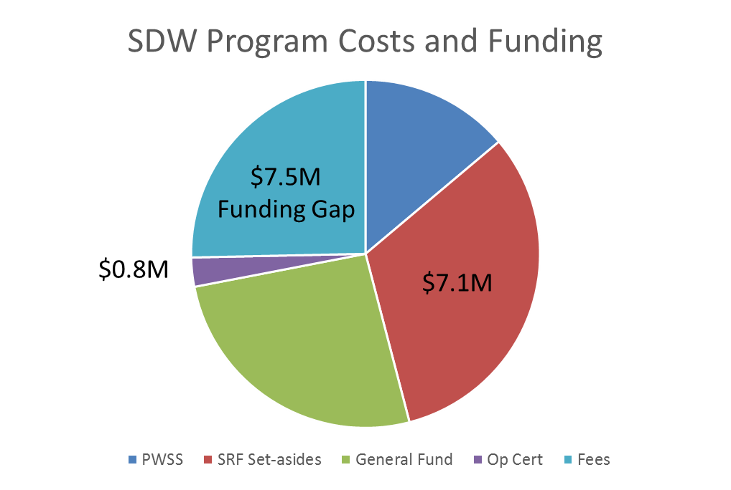
SDW Program Costs and Funding
$4.1M
$7.7M
Notes:
Total SDW Program Costs and Funding:
Total Costs = Federal ($11.2M) + State ($16M) = $27.2M
Federal funds ($11.2M):
PWSS ($4.1M) – 75/25 split; personnel costs (~ 42 FTEs); lab costs; staff training; memberships
SRF Set-asides ($7.1M) – personnel costs (50 FTEs – SWAP, AWOP, CEFs, CA); capability enhancement programs (training, technical assistance, AWOP); PADWIS; assistance grants/contracts (PfSW, SWPTAP, PES, WHP) (Notes: ~$5M is used for program operating expenses, the remainder goes towards assistance programs; **Actually spending $9.5M using banked funds)
State funds ($16M):
General Fund ($7.7M) – personnel costs (78 FTEs)
Operator Certification Sub-fund ($0.8M) – Op Cert program costs
Funding Gap ($7.5M) – new fees are intended for personnel costs (31 new +10 existing = 41 FTEs); other costs (lab, IT, supplies)

Slide 13
New Annual Fees
At least 25 states charge annual fees including DE, NJ and VA.
Annual fees apply to all PWSs.
The proposed fees are intended to bear a reasonable relationship to the actual cost of providing services.
The fees also factor in affordability and equitability.
Notes:
Regarding the proposed annual fees:
At least 25 states charge annual fees including DE, NJ and VA
Annual fees apply to all PWSs
The proposed fees are intended to bear a reasonable relationship to the actual cost of providing services
The fees also factor in affordability and equitability
Let’s look at a few examples of other state’s fees.

Slide 14
New Annual Fees
Annual Fees for Several Mid-Atlantic States
Delaware | CWSs: Based on $1.50/connection – Fees range from $330 - $32,500 NTNCWSs: $330 TNCWSs: $200
New Jersey | CWSs: Based on population and status of treatment Pop (25-999): $60 (no trt), $120 (with trt) Pop (>50,000): $1,640 (no trt), $3,280 (with trt)
Virginia | CWSs: Based on $2.05/connection, maximum fee for large systems is $160,000 NTNCWSs: $90
At least 25 states charge annual fees to augment SDW Program costs.
Notes:
Here are the annual fees for several Mid-Atlantic states.
Again, at least 25 states charge annual fees to augment SDW Program costs.

Slide 15
New Annual Fees
Annual fees range from:
  $250 - $40,000 for CWSs
  $50 - $1,000 for NCWSs
  $1,000 - $2,500 for bottled, vended, retail and bulk water systems (BVRB)
Annual fees will likely be passed on to the 10.7 million customers as a user fee.
Per person costs range from $0.35 to $10 per year.
Notes:
In addition:
Annual fees range from:
$250 - $40,000 for CWSs
$50 - $1,000 for NCWSs
$1,000 - $2,500 for BVRBs
Annual fees will likely be passed on to the 10.7 million customers as a user fee
Per person costs range from $0.35 to $10 per year
Let’s look at how the fees were derived.

Slide 16
New Annual Fees
Estimated cost of providing services and adjusted fees (for affordability):
Costs include inspections, review of sample results/plans, compliance determinations, technical assistance, etc.
Est. cost for small CWS (pop = 100)
  44.5 hrs @ $49/hr = $2,180
  Adjusted fee = $250 ($2.50 per person)
Est. cost for medium CWS (pop = 5,000)
  50.3 hrs @ $49/hr = $2,465
  Adjusted fee = $6,500 ($1.30 per person)
Est. cost for large CWS (pop = 50,000)
  80 hrs @ $49/hr = $3,920
  Adjusted fee = $25,000 ($0.50 per person)
Notes:
Estimated cost of providing services (determined using workload analysis):
Costs include inspections, review of sample results/plans, compliance determinations, technical assistance, etc.
Est. cost for small CWS (pop = 100)
44.5 hrs @ $49/hr = $2,180 ($21.80 per person)
Adjusted fee = $250 ($2.50 per person)
Est. cost for medium CWS (pop = 5,000)
50.3 hrs @ $49/hr = $2,465
Adjusted fee = $6,500 ($1.30 per person)
Est. cost for large CWS (pop = 50,000)
80 hrs @ $49/hr = $3,920
Adjusted fee = $25,000 ($0.50 per person)
Fees were adjusted for affordability (per person costs).
Let’s look at permit fees.

Slide 17
Increased Permit Fees
Permit fees have not been increased since originally adopted in 1984.
Fees were determined using a workload analysis.
Fees range from $50 - $10,000.
Notes:
Regarding permit fees:
Permit fees have not been increased since originally adopted in 1984
Fees were determined using a workload analysis
Fees range from $50 - $10,000
What has been the impact from inadequate funds (underfunded program)?

Slide 18
Impacts from Inadequate Funds
Staffing levels are down by 25% since 2009.
Number of sanitary surveys (inspections) has steadily declined from 3,177 (FY09/10) to 1,847 (FY15/16), resulting in overdue inspections for 448-703 PWSs in the last 6 years.
Number of unaddressed violations has steadily increased to 7,922 in FY10-15.
% of CWSs meeting health-based standards has declined from 97% (FY09/10) to 91% (FY15/16).
Notes:
Impacts from inadequate funds (i.e., staff/resources):
Staffing levels are down by 25% since 2009.
Number of sanitary surveys (inspections) has steadily declined from 3,177 (FY09/10) to 1,847 (FY15/16), resulting in overdue inspections for 448-703 PWSs in the last 6 years.
Mandated inspection frequency every 3 yrs. for CWSs and every 5 yrs. for NCWSs
Number of unaddressed violations has steadily increased to 7,922 in FY10-15.
Unaddressed means not RTC within 180 days or addressed via formal enforcement
% of CWSs meeting health-based standards has declined from 97% (FY09/10) to 91% (FY15/16).
And what are the consequences of inadequate funding?

Slide 19
Consequences of Inadequate Funds
The reduction in staffing levels and failure to conduct routine/timely inspections may be contributing to the overall declining trend in PWS compliance rates.
Failure to meet safe drinking water standards puts public health at risk.
Failure to meet minimum program performance measures also jeopardizes primacy. Performance issues/concerns have been well documented. Program performance is currently under review by EPA Region III.
Notes:
Consequences of inadequate funding (i.e., staff/resources):
The reduction in staffing levels and failure to conduct routine/timely inspections may be contributing to the overall declining trend in PWS compliance rates.
Failure to meet safe drinking water standards puts public health at risk.
Failure to meet minimum program performance measures also jeopardizes primacy.
PA currently has primacy for the SDW Program. EPA can/will initiate the withdrawal process if states do not maintain a program as stringent as the federal rule. Recent examples of this include: Oklahoma and California.
Performance issues/concerns have been well documented. Program performance is currently under review by EPA Region III.
Let’s review the 3rd and last part of the package.

Slide 20
Background and Purpose
Incorporate the remaining general update provisions that were separated from the proposed Revised Total Coliform Rule (RTCR) as ordered by the EQB.
Establish new annual fees and amend existing permit fees.
Incorporate additional general updates that will:
  Establish the regulatory basis for issuing general permits.
  Clarify that NCWSs require a permit or approval from DEP prior to construction or operation.
  Address concerns related to gaps in monitoring and tracking of back-up water sources and entry points.
Notes:
Part 3 includes:
Incorporate the remaining general update provisions that were separated from the proposed Revised Total Coliform Rule (RTCR) as ordered by the EQB
Establish new annual fees and amend existing permit fees
Incorporate additional general updates that will:
Establish the regulatory basis for issuing general permits
Clarify that NCWSs require a permit or approval from DEP prior to construction or operation
Address concerns related to gaps in monitoring and tracking of back-up water sources and entry points
Let’s briefly review each of these three parts.

Slide 21
Additional General Updates
Establish regulatory basis for general permits for high volume, low risk modifications to streamline permitting process.
Clarify that NCWSs must obtain a permit or approval from DEP prior to construction or operations.
Address concerns related to gaps in monitoring and tracking of back-up sources.
Notes:
Part 3 includes several additional general updates:
Establish regulatory basis for general permits for high volume, low risk modifications to streamline permitting process.
Clarify that NCWSs must obtain a permit or approval from DEP prior to construction or operations.
Address concerns related to gaps in monitoring and tracking of back-up sources.
Why is it a problem that there are gaps in monitoring and tracking of back-up sources?

Slide 22
Additional General Updates
Problem with existing gaps in monitoring and tracking of back-up sources:
  Routine compliance monitoring is not tracked for back-up/emergency sources of supply.
  Back-up sources can be used 24/7.
  There are no verifiable controls in place to ensure that proper monitoring is conducted prior to use.
  Failure to properly monitor all sources puts public health at risk.
Notes:
Problem with existing gaps in monitoring and tracking of back-up sources:
Routine compliance monitoring is not tracked for back-up/emergency sources of supply
Back-up sources can be used 24/7
There are no verifiable controls in place to ensure that proper monitoring is conducted prior to use
Failure to properly monitor all sources puts public health at risk
How do we intend to fix this gap?

Slide 23
Additional General Updates
Proposed revisions to address concerns with gaps in monitoring and tracking of back-up sources:
  Begin tracking monitoring requirements for all sources (including back-up/emergency).
  Require all sources to be used at least annually to ensure all sources are included in routine compliance monitoring. Also ensures facilities remain in good working order.
  Require submission of a comprehensive monitoring plan.
Notes:
Proposed revisions to address concerns with gaps in monitoring and tracking of back-up sources:
Begin tracking monitoring requirements for all sources (including back-up/emergency).
Require all sources to be used at least annually to ensure all sources are included in routine compliance monitoring. Also ensures facilities remain in good working order (and are available during emergencies).
Require submission of a comprehensive monitoring plan (to address part-time use, and blended vs. alternated sources).
Let’s review the tentative schedule and next steps.

Slide 24
Tentative Schedule & Next Steps
Presented pre-draft rule to TAC on 11/14/2016
Held webinar for additional stakeholders on 12/08/2016
Next steps:
  Meet with TAC on 01/05/2017 for further discussion and obtain final recommendations
  Incorporate/address TAC’s recommendations
  Present draft rule to EQB in early 2017 for approval to move forward with proposed rulemaking
Notes:
Tentative schedule and next steps:
Presented pre-draft rule to TAC on 11/14/2016
Held webinar for additional stakeholders on 12/08/2016
Next steps:
Meet with TAC on 01/05/2017 for further discussion and obtain final recommendations
Incorporate/address TAC’s recommendations
Present draft rule to EQB in early 2017 for approval to move forward with proposed rulemaking
When the proposed rulemaking is published in the PA Bulletin, a formal public comment period will be opened. Instructions will be provided regarding how to submit public comments.
We encourage all stakeholders to participate in the regulatory process.
This concludes our presentation on the pre-draft rulemaking. Now, we will move into the Q&A portion of the program.

Slide 25
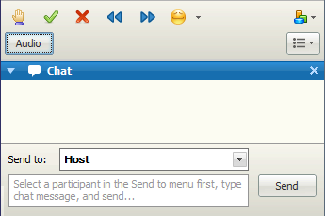
Question and Answer
Use the chat box in the lower right to submit your questions.
You will not hear a presenter for about 5 minutes to give you time to enter questions.
Notes:
This concludes our Q&A portion of the webinar.

Slide 26
For more information:
TAC’s website: http://tinyurl.com/DEPTACBoard
Draft Proposed General Update & Fees webpage: http://tinyurl.com/109update
Notes:
For more information, please refer to TAC’s website and the Draft Proposed General Update & Fees webpage.

Slide 27
Thank You
Lisa Daniels, Director
Ed Chescattie, Training & Technical Assistance
Bureau of Safe Drinking Water
Notes:
Thank you for your participation in this webinar.
We encourage your continued participation in the regulatory process.

